Slide 1
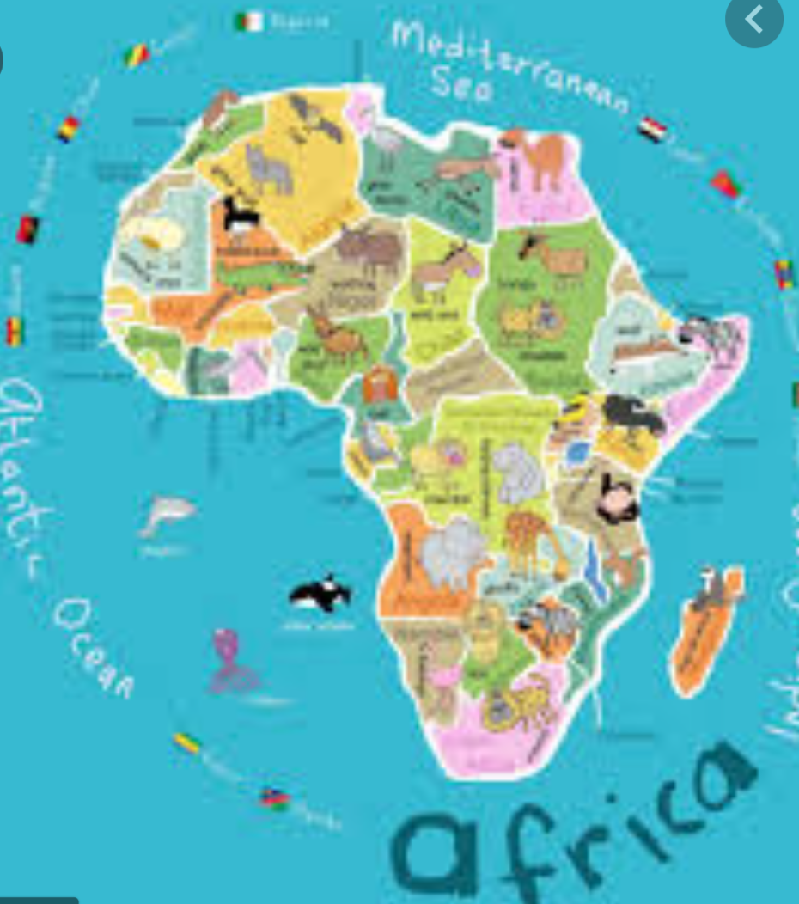
Year 2 Home Learning
Africa Project

Slide 2
Your job:
Choose an African country
Research different topics of information about your country, such as location, any geographical features (mountains/rivers) the flag, languages spoken, food, animals etc
Present your information – this could be a powerpoint, a leaflet, a poster, a holiday brochure etc
Don’t forget to let us know how you get on on Twitter
@2lwwoodlands
@2svwoodlands

Slide 3
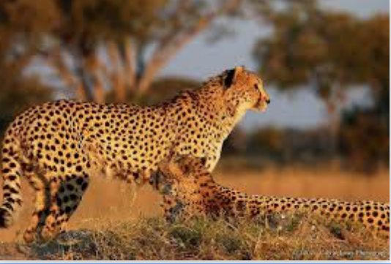
Ideas – animals
What family is this animal from?
Can you create a fact file for this animal?
Are there any interesting facts about this animal?

Slide 4
Ideas - Flag
Can you draw the flag?
What do the colours on the flag represent?
Are there any special symbols/pictures on the flag?

Slide 5
Ideas - food
What type of food is eaten in your chosen country?
Is it locally grown?
How is it prepared?
What type of food is eaten at celebrations?

