Slide 2



Diving into Mastery Guidance for Educators
Each activity sheet is split into three sections, diving, deeper and deepest, which are represented by the following icons:
These carefully designed activities take your children through a learning journey, initially ensuring they are fluent with the key concept being taught; then applying this to a range of reasoning and problem-solving activities.
These sheets might not necessarily be used in a linear way. Some children might begin at the ‘Deeper’ section and in fact, others may ‘dive straight in’ to the ‘Deepest’ section if they have already mastered the skill and are applying this to show their depth of understanding.
Diving
Deeper
Deepest

Slide 3
Aim
Draw 2D shapes and make 3D shapes using modelling materials; Recognise 3D shapes in different orientations and describe them.

Slide 4
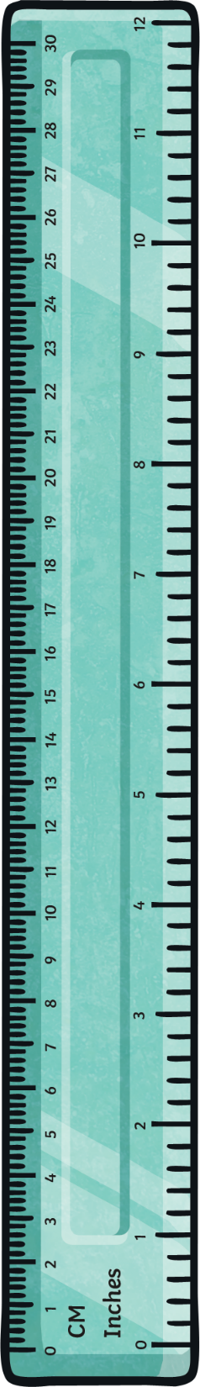


Draw Accurately
Diving
Use a ruler to draw a line which is:
7cm long
43mm long

Slide 5
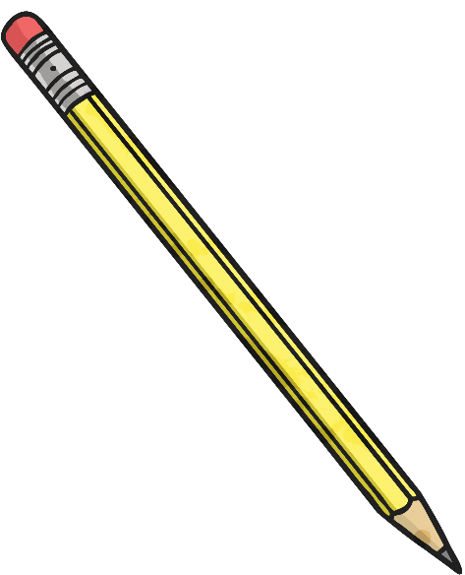
Draw Accurately
Diving
Use a ruler to accurately measure your pencil to the nearest cm.
Check your partner’s measuring to see if you agree.
Remember to line up the end of your pencil with 0cm on the ruler.

Slide 6

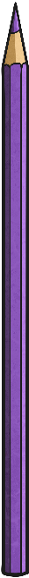

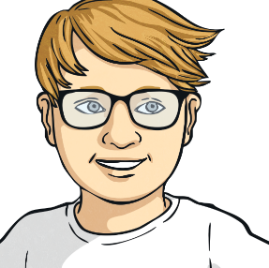
Drawing Accurately
Deeper
Aleesha and Kieran measure the same line.
What has each done wrong?
Aleesha
“The line is 22cm long.”
Kieran
“The line is 6.7cm long.”

Slide 7
Drawing Accurately
Deeper
What size lines could be rounded to 7cm as the nearest cm?
Any line between 6.5cm (65mm) and 7.4cm (74mm)

Slide 8

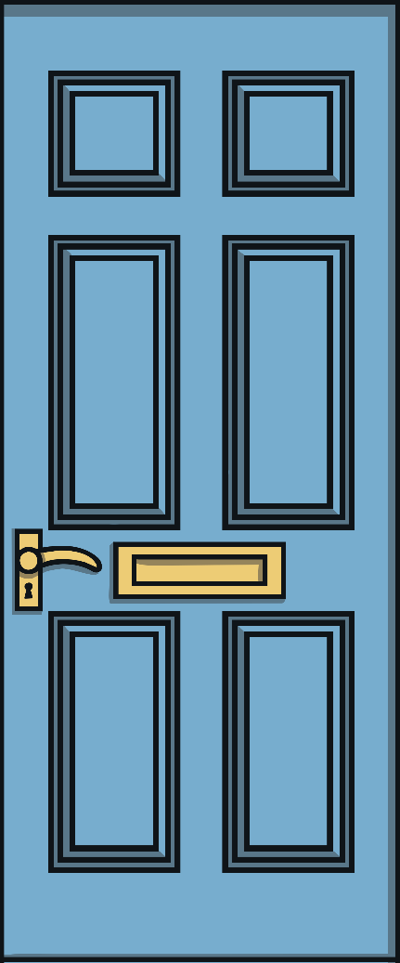
Draw Accurately
Deepest
80cm
This door is drawn using straight lines.
What do the lines equal when added together?
30cm
200cm
640cm or 6.4m
10cm

Slide 9
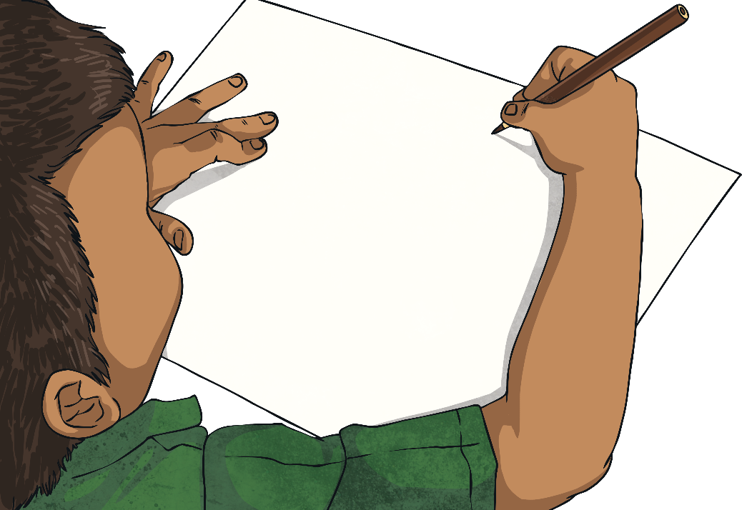
Drawing Accurately
Deeper
Draw a line longer than 7cm.
Compare it to the people around you.
Have you all drawn the same length line?
Now draw a
line between 8cm
and 10cm long.
Have you all drawn the same length line?

Slide 10
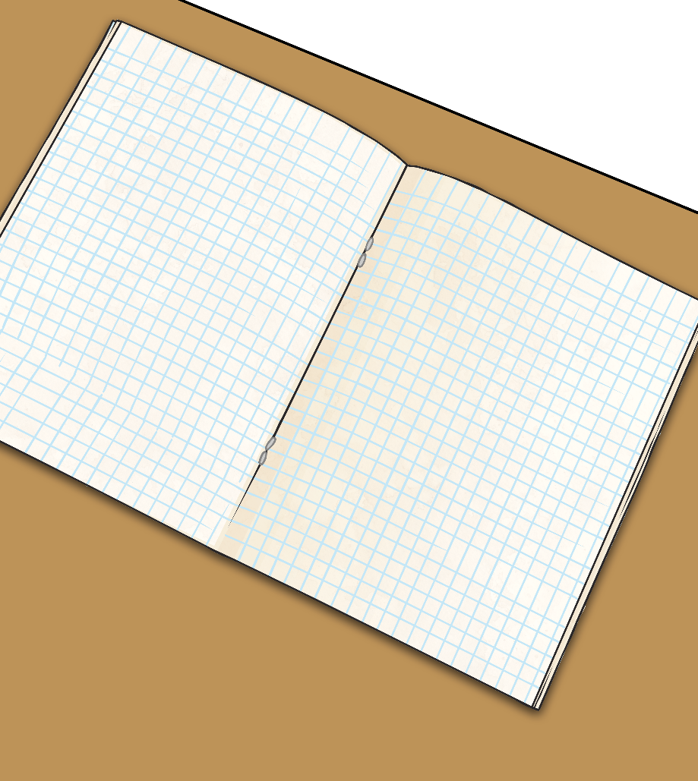
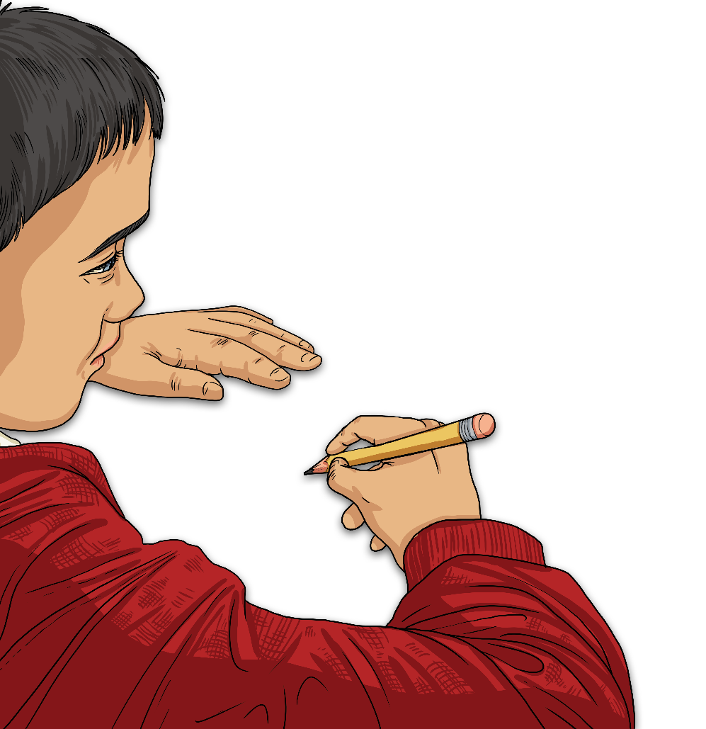
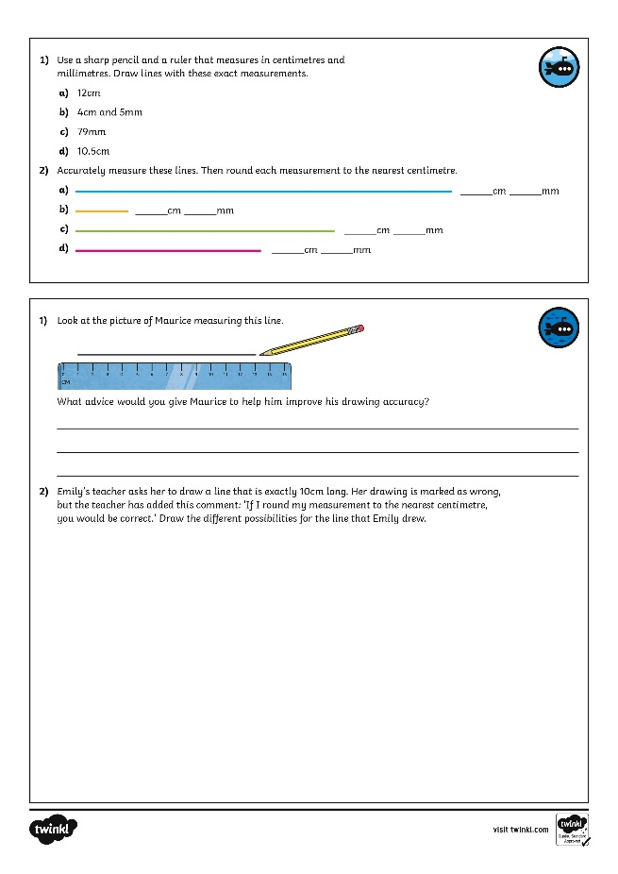
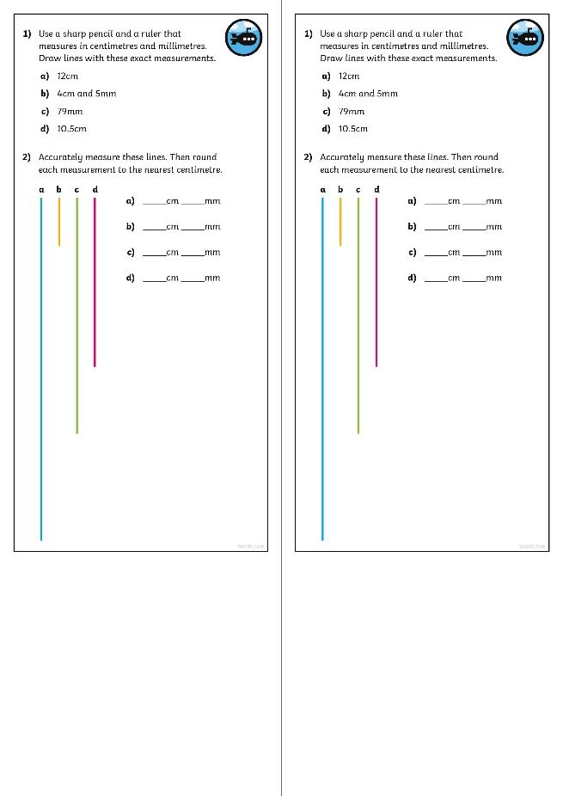
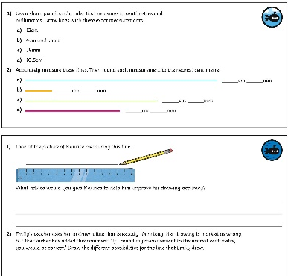
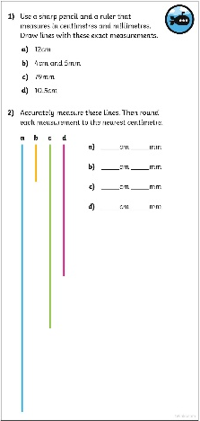
Draw Accurately
Dive in by completing your own activity!

Slide 11
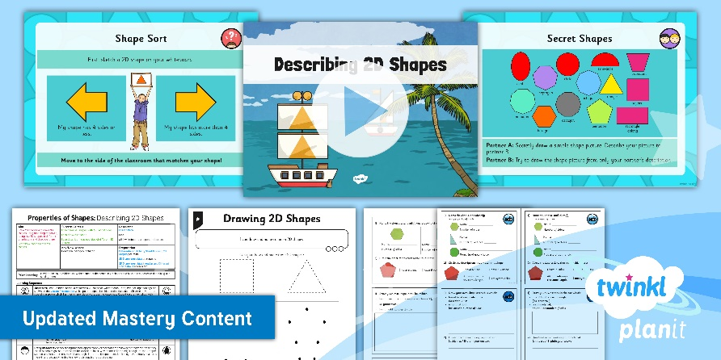
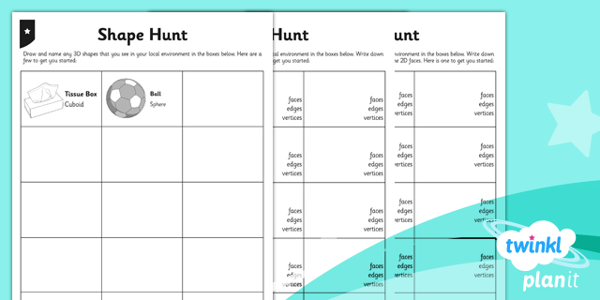

Need Planning to Complement this Resource?
National Curriculum Aim
Draw 2D shapes and make 3D shapes using modelling materials; Recognise 3D shapes in different orientations and describe them
For more planning resources to support this aim, click here.
Twinkl PlanIt is our award-winning scheme of work
with over 4000 resources.

