Slide 2



Diving into Mastery Guidance for Educators
Each activity sheet is split into three sections, diving, deeper and deepest, which are represented by the following icons:
These carefully designed activities take your children through a learning journey, initially ensuring they are fluent with the key concept being taught; then applying this to a range of reasoning and problem-solving activities.
These sheets might not necessarily be used in a linear way. Some children might begin at the ‘Deeper’ section and in fact, others may ‘dive straight in’ to the ‘Deepest’ section if they have already mastered the skill and are applying this to show their depth of understanding.
Diving
Deeper
Deepest

Slide 3
National Curriculum Objective(s)
Identify right angles, recognise that two right angles make a half-turn, three make three quarters of a turn and four a complete turn; identify whether angles are greater than or less than a right angle.

Slide 4
Compare Angles
Diving
Click on these angles to match with their descriptions.
A right angle is 90 degrees, or a quarter turn.
An angle bigger than a right angle, but not a straight line or half turn (90-179 degrees) is called an obtuse angle.
An angle smaller than a right angle (less than 90 degrees) is called an acute angle.

Slide 5
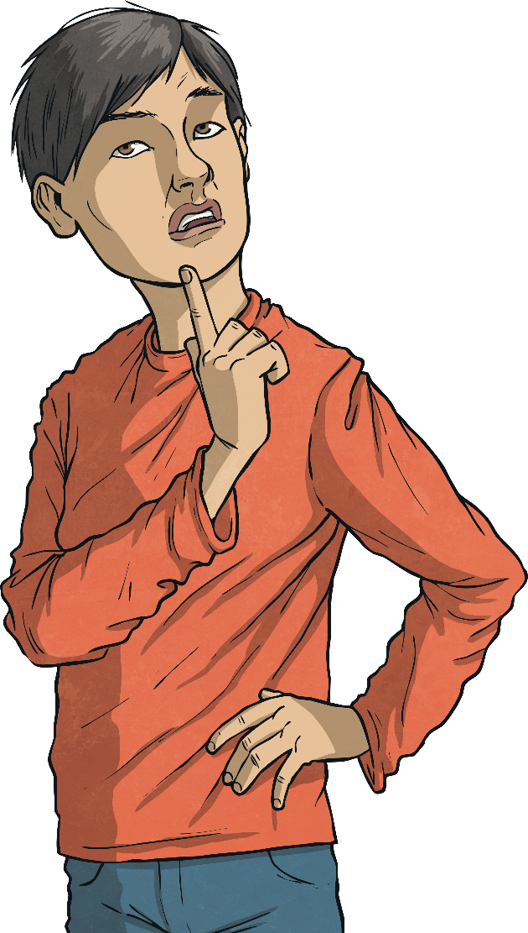
Compare Angles
Diving
Can you tell if these angles are acute, obtuse or right angles?
acute
obtuse
obtuse
right angle
acute

Slide 6

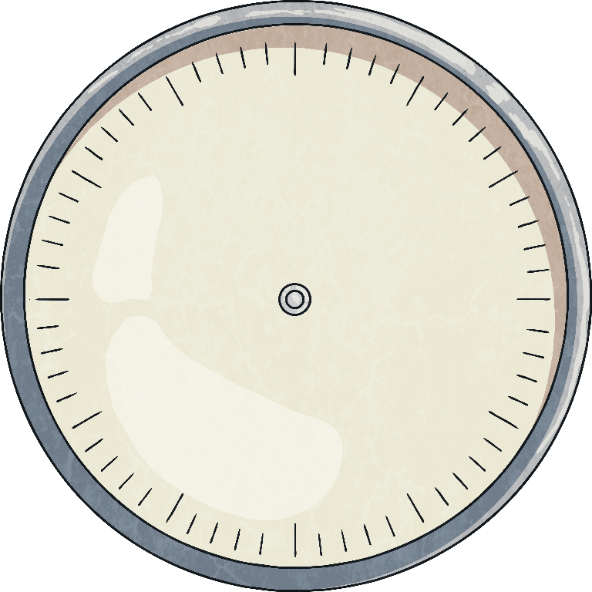
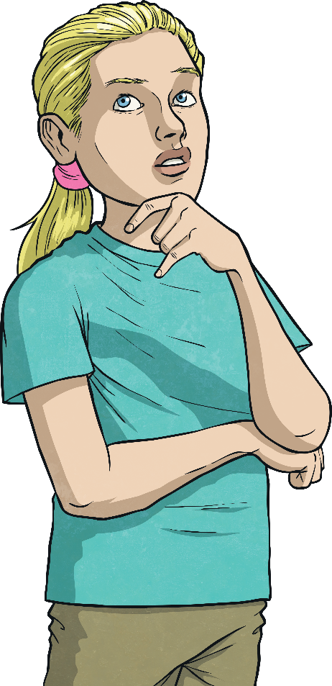
Compare Angles
Deeper
Look at this clock face.
Is the angle between the hour hand and the minute hand acute, obtuse or a right angle?

Slide 7
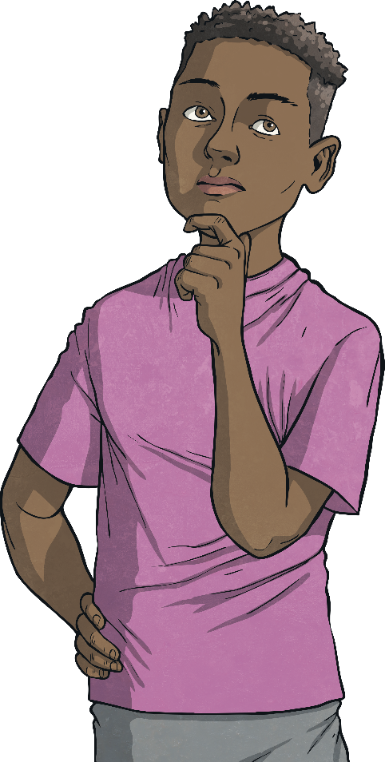
Compare Angles
Deeper
Look at this clock face.
Is the angle between the minute hand and the hour hand acute, obtuse or a right angle?

Slide 8

Compare Angles
Deeper
Look at this clock face.
Is the angle between the hour hand and the minute hand acute, obtuse or a right angle?

Slide 9
Compare Angles
Deeper
Look at these letters. Can you see any acute, obtuse or right angles where the lines meet?
A F N
obtuse and acute angles
right angles
acute angles

Slide 10

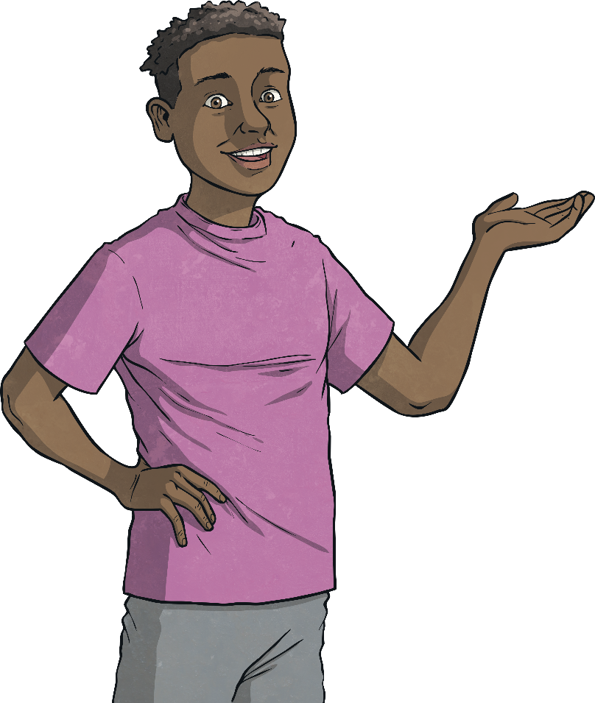
Compare Angles
Deepest
We can follow instructions about angles to draw shapes.
I’m thinking of a shape with three right angles and two obtuse angles: what could it be?

Slide 11

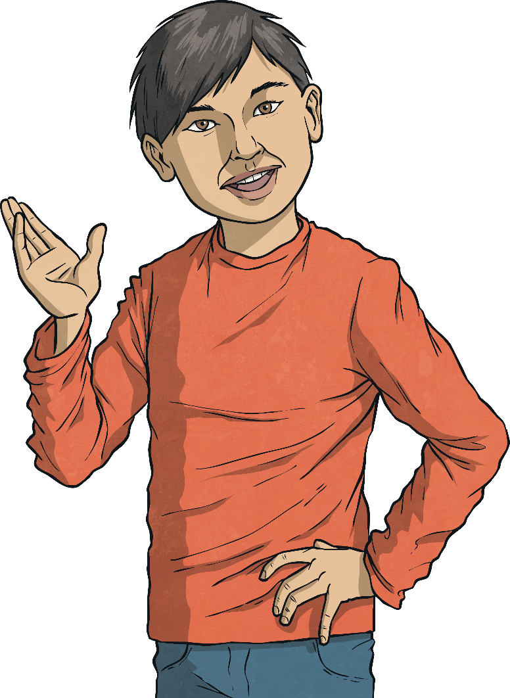
Compare Angles
Deepest
Which of these statements are correct?
This shape is a quadrilateral so it must have four right angles.
This shape has two obtuse angles.
This shape has two right angles.
This shape has two acute angles.

Slide 12
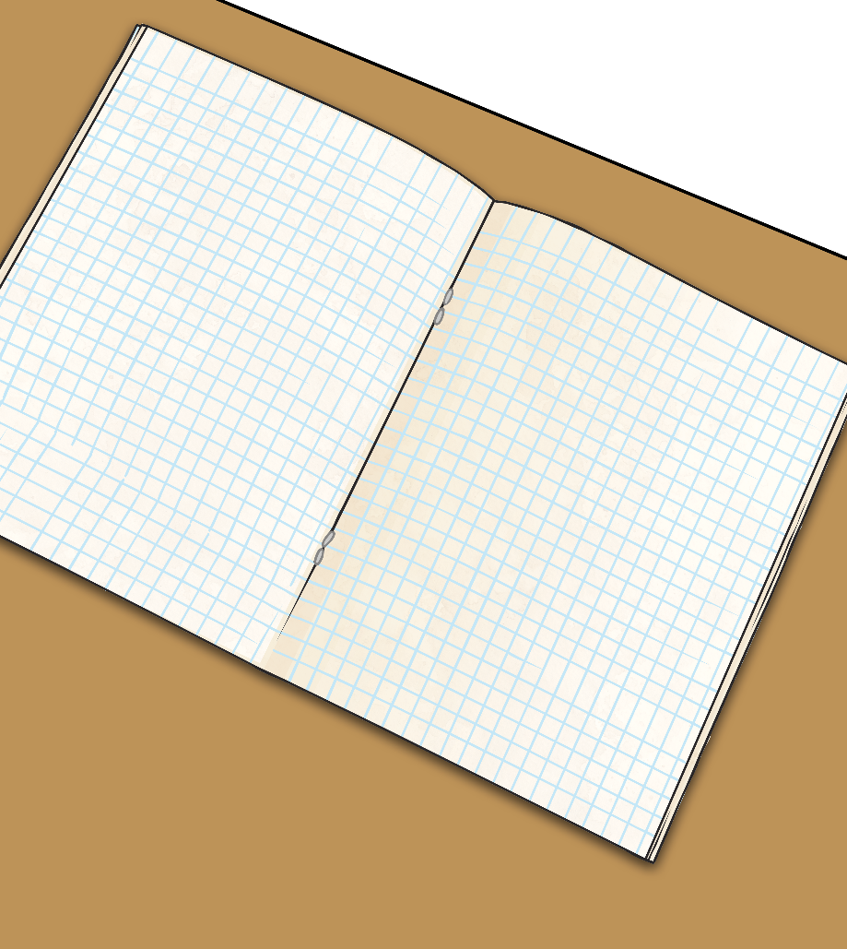
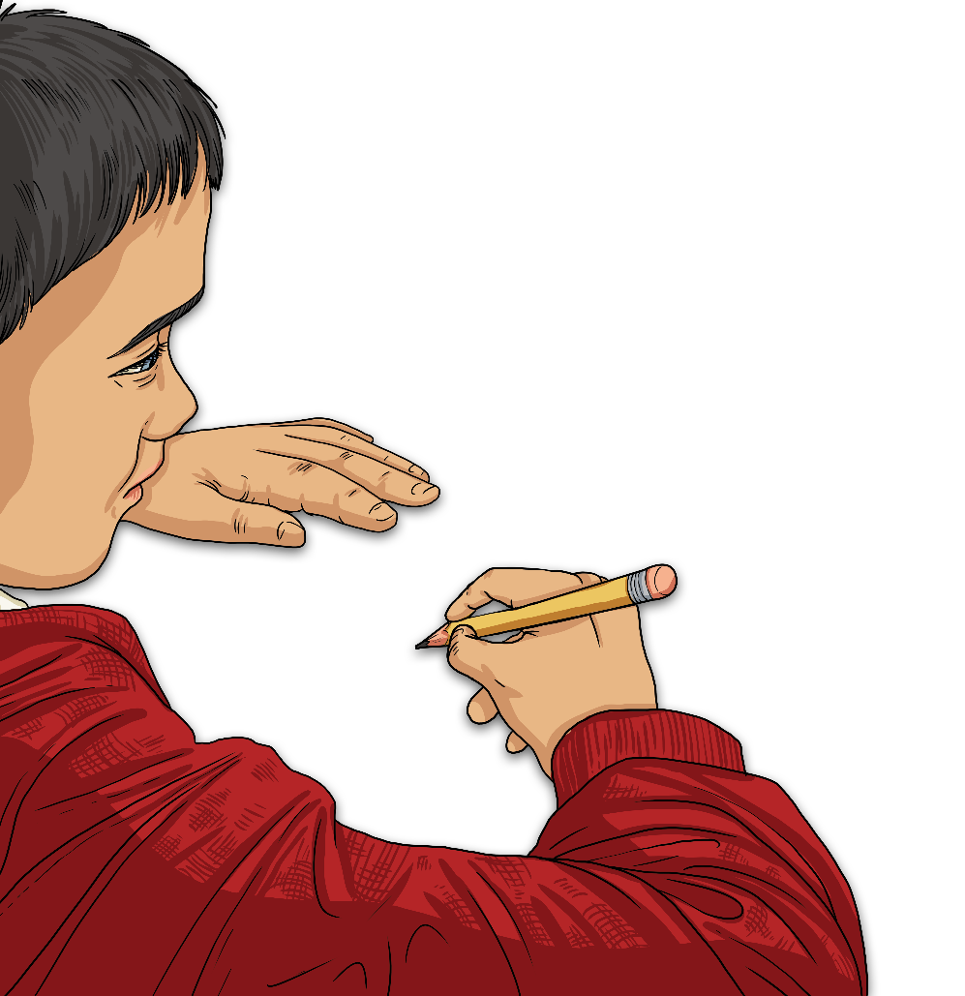
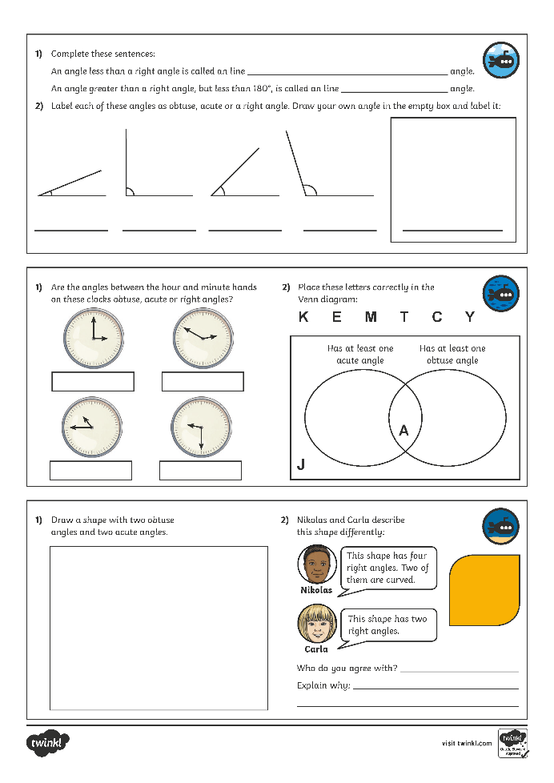
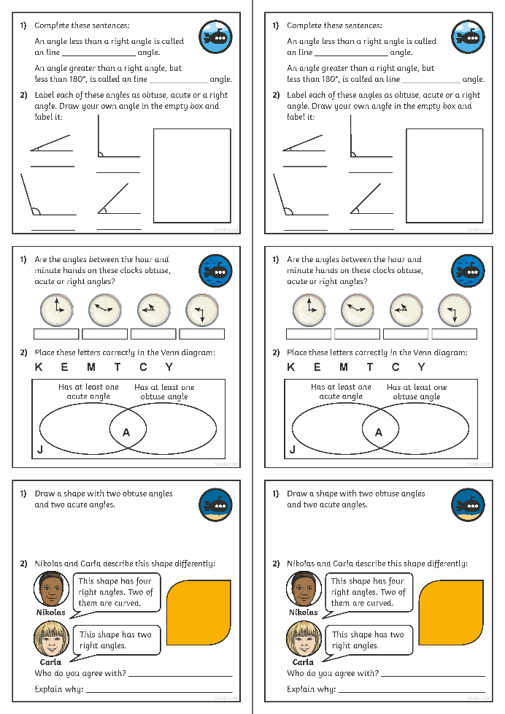
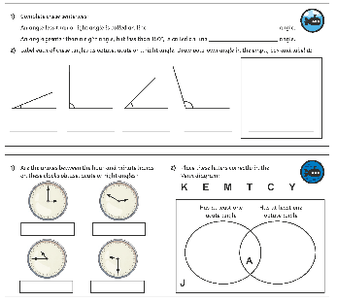
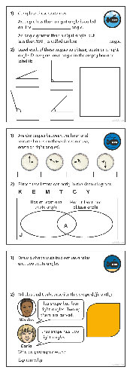
Compare Angles
Dive in by completing your own activity!

Slide 13
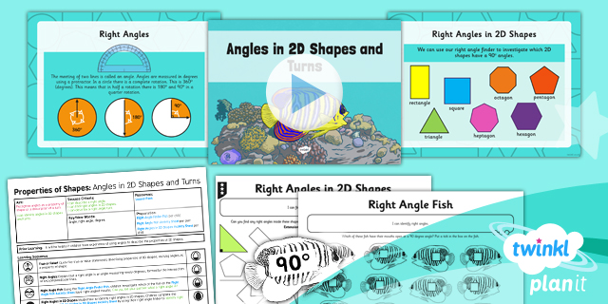
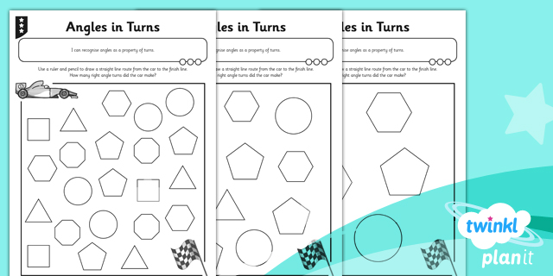

Need Planning to Complement this Resource?
National Curriculum Aim
Identify right angles, recognise that two right angles make a half-turn, three make three quarters of a turn and four a complete turn; identify whether angles are greater than or less than a right angle.
For more planning resources to support this aim, click here.
Twinkl PlanIt is our award-winning scheme of work
with over 4000 resources.

