Slide 2



Diving into Mastery Guidance for Educators
Each activity sheet is split into three sections, diving, deeper and deepest, which are represented by the following icons:
These carefully designed activities take your children through a learning journey, initially ensuring they are fluent with the key concept being taught; then applying this to a range of reasoning and problem-solving activities.
These sheets might not necessarily be used in a linear way. Some children might begin at the ‘Deeper’ section and in fact, others may ‘dive straight in’ to the ‘Deepest’ section if they have already mastered the skill and are applying this to show their depth of understanding.
Diving
Deeper
Deepest

Slide 3
National Curriculum Objective(s)
Identify right angles, recognise that two right angles make a half-turn, three make three quarters of a turn and four a complete turn; identify whether angles are greater than or less than a right angle.

Slide 4



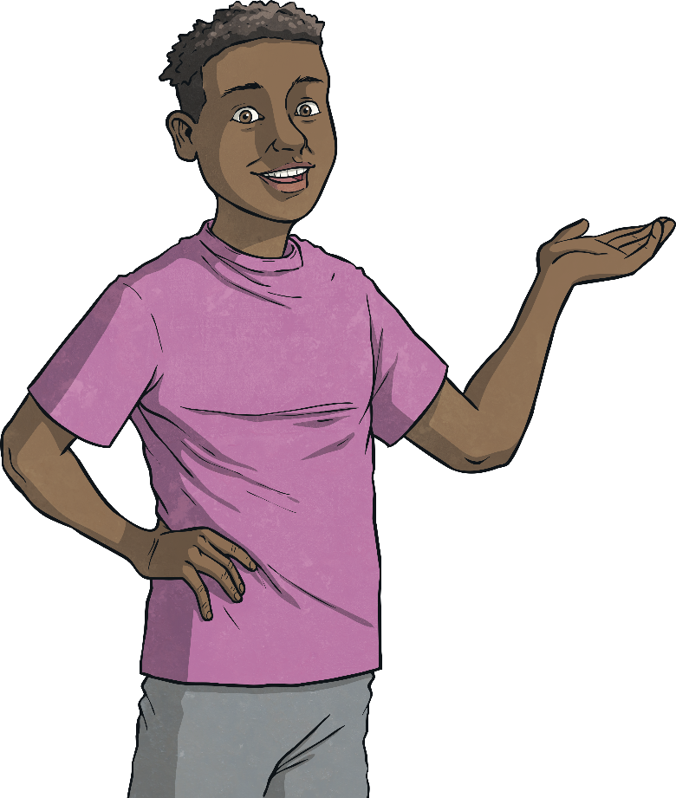
Recognise Right Angles in Shapes
Diving
Look at these shapes.
They each have a special type of angle called a right angle in one or more of their corners.

Slide 5
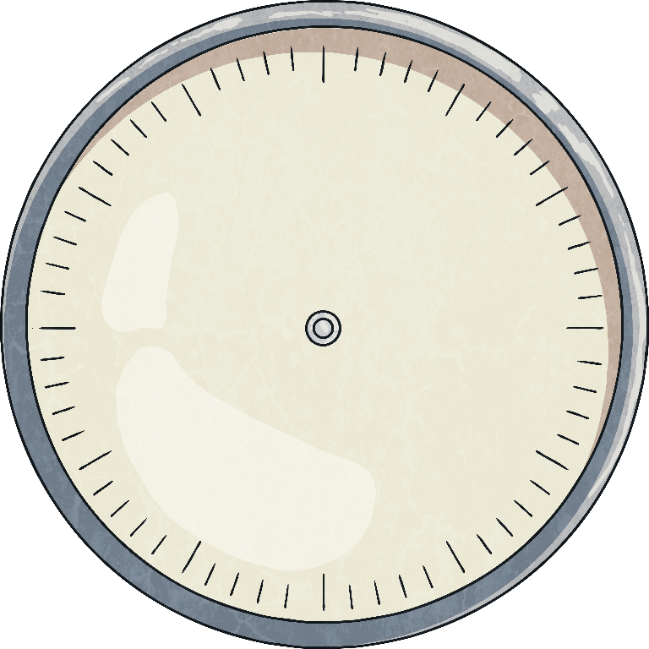
Recognise Right Angles in Shapes
Diving
We can also think of a right angle as a quarter turn.
Click to see the arrow make a quarter turn.

Slide 6
Recognise Right Angles in Shapes
Diving
Can you see any shapes here that have right angles in them?

Slide 7

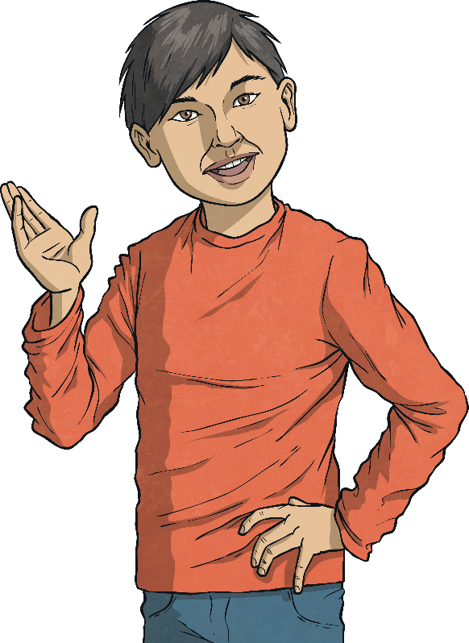
Recognise Right Angles in Shapes
Deeper
Look at these letters:
HEN
Can you see right angles where any of the lines meet?

Slide 8
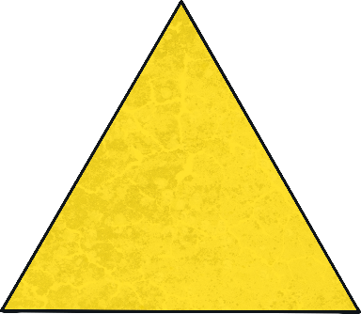
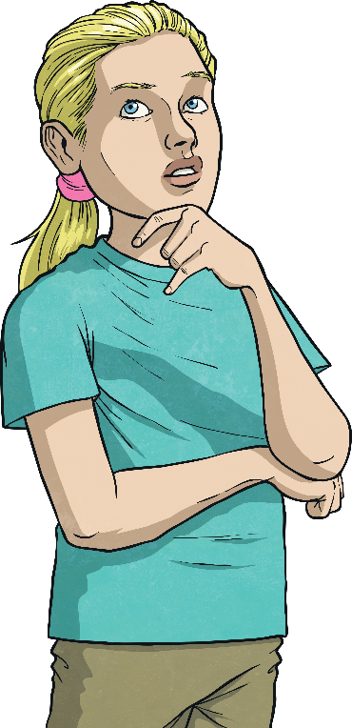
Recognise Right Angles in Shapes
Deeper
One of these shapes is different to the others:
Can you explain why?
This triangle is the only shape without a right angle.

Slide 9

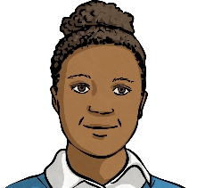
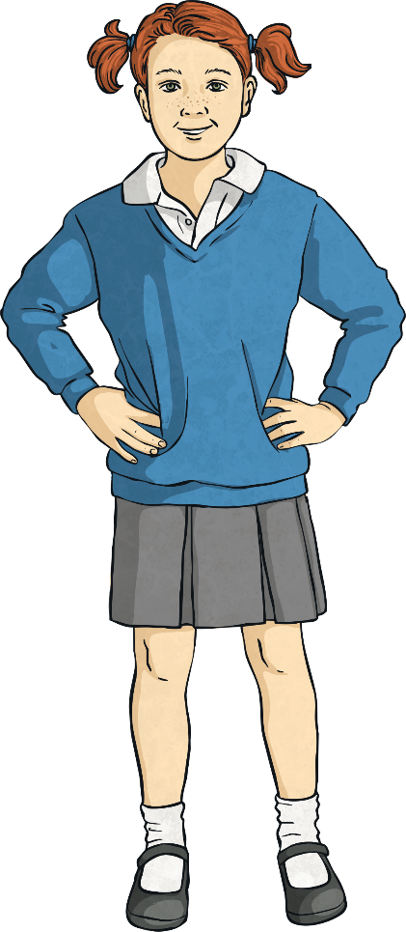
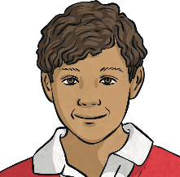
Recognise Right Angles in Shapes
Deepest
Three children have drawn a shape each.
Can you match the child to their shape from their descriptions?
My shape has half the number of right angles that Joseph’s has.
Penny
My shape has as least double the number of right angles that Joseph’s shape has.
Angelina
My shape has the same number of right angles as a square.
Joseph

Slide 10
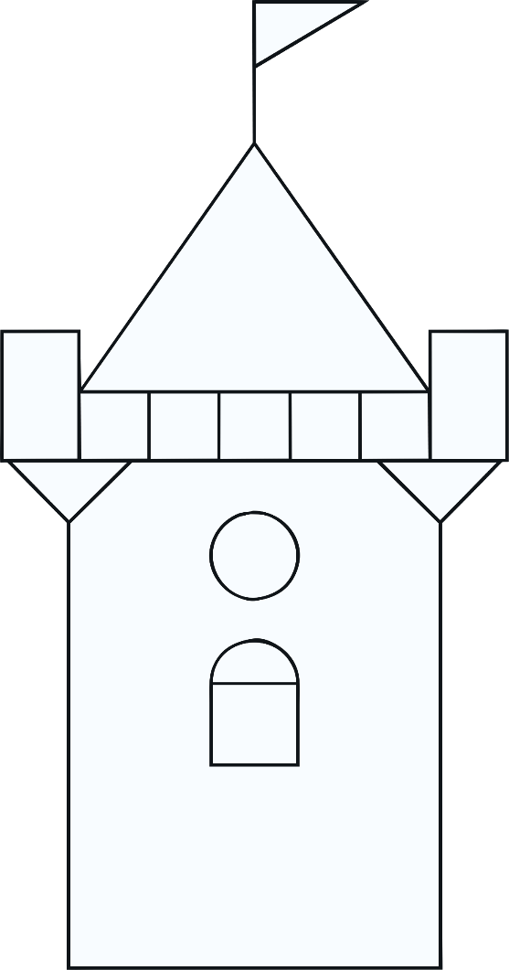
Recognise Right Angles in Shapes
Deepest
Look at this picture.
How many right angles can you spot in it?

Slide 11

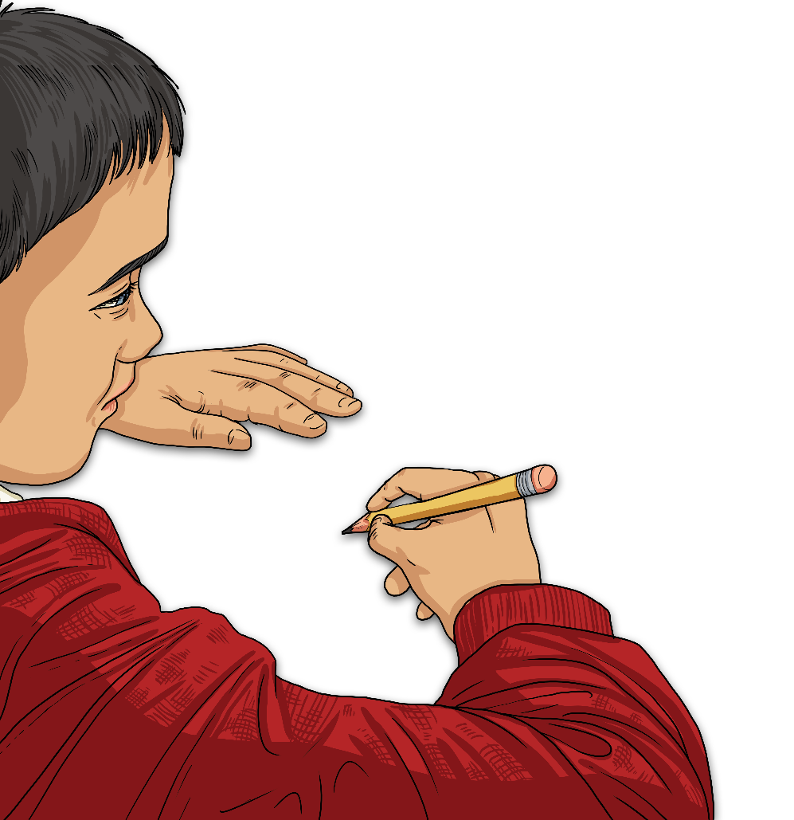
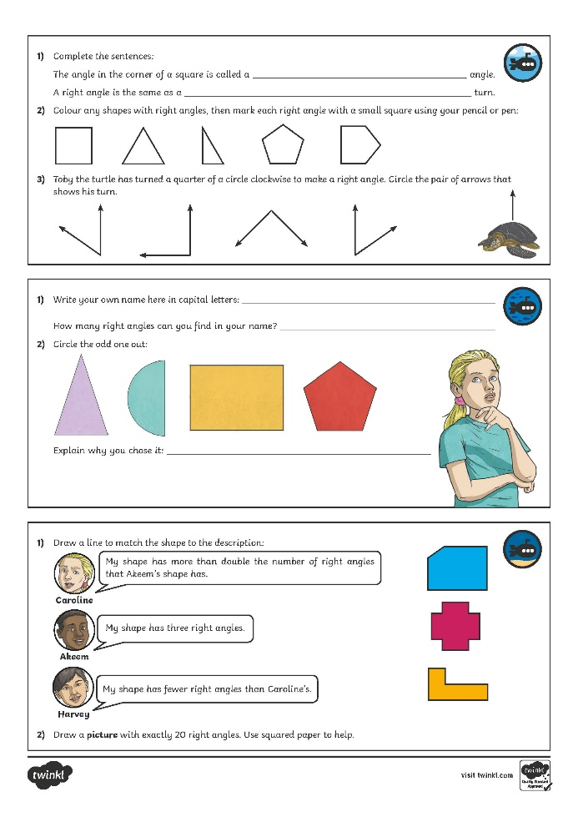
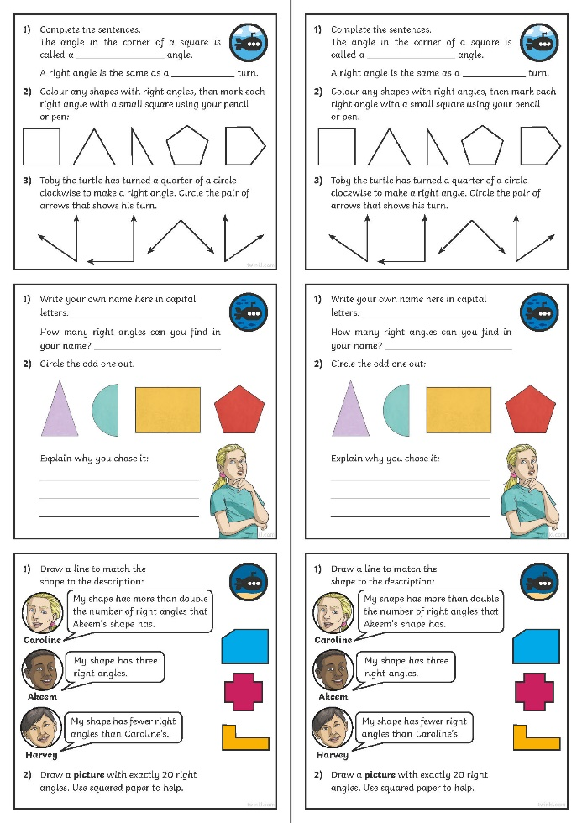
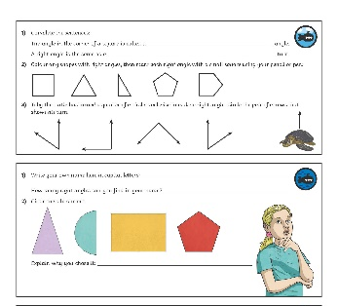
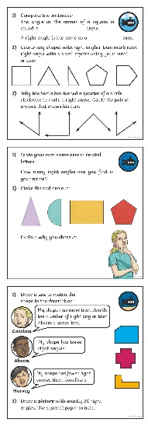
Recognise Right Angles in Shapes
Dive in by completing your own activity!

Slide 12
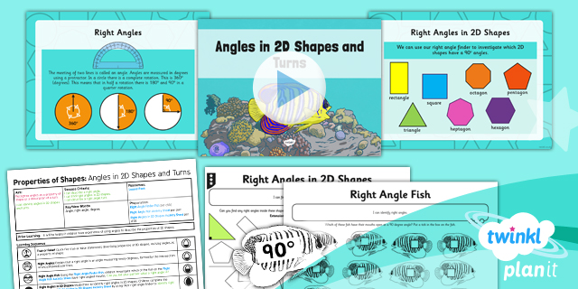
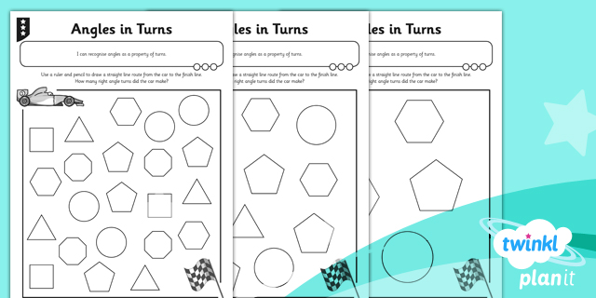

Need Planning to Complement this Resource?
National Curriculum Aim
Identify right angles, recognise that two right angles make a half-turn, three make three quarters of a turn and four a complete turn; identify whether angles are greater than or less than a right angle.
For more planning resources to support this aim, click here.
Twinkl PlanIt is our award-winning scheme of work
with over 4000 resources.

