Slide 1
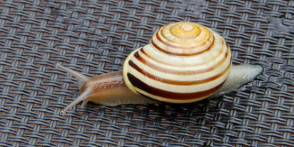
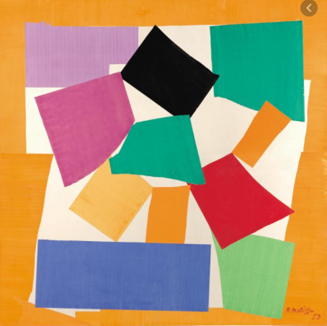
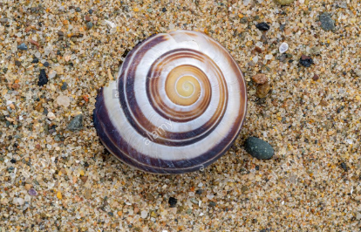
Henri Matisse
Snail art project

Slide 2
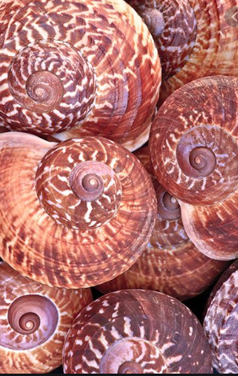
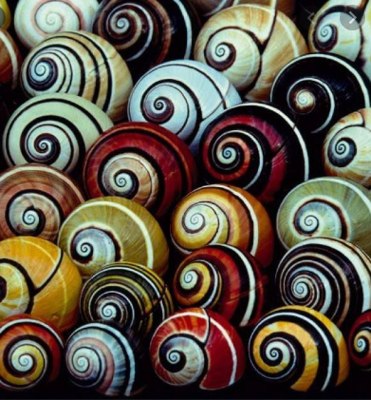
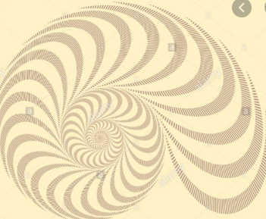
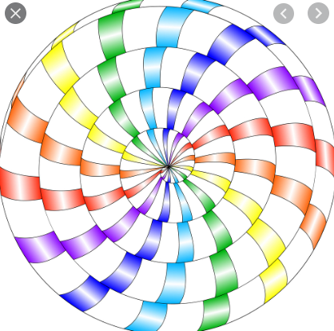
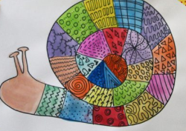
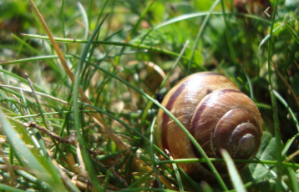
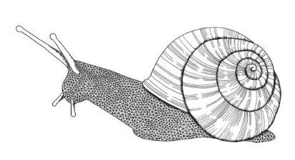

Slide 3
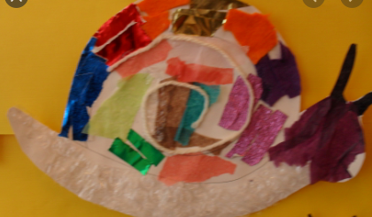
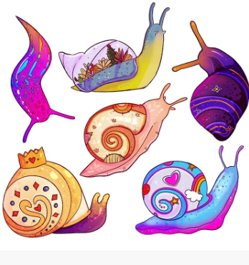
Henri Matisse is one of my favourite artists. I also love nature and finding snails. Snails have amazing spiral patterns. One of my favourite works of art from Matisse is ‘The Snail’.
Art activities:
Find out 5 or more facts about Henri Matisse. Where was he born? Why is he so famous? What is meant by abstract art? What did he like to paint?
What facts can you find out about snails?
Using the above snail images have a go at creating your own version of Matisse’s ‘The Snail’. You could use different colours to the ones he used, water colours, sharpies, paint or sketching pencils to recreate your work
Draw spiral patterns using black pens and shade using pencils
Use different materials to create your own snail collage

