Slide 1
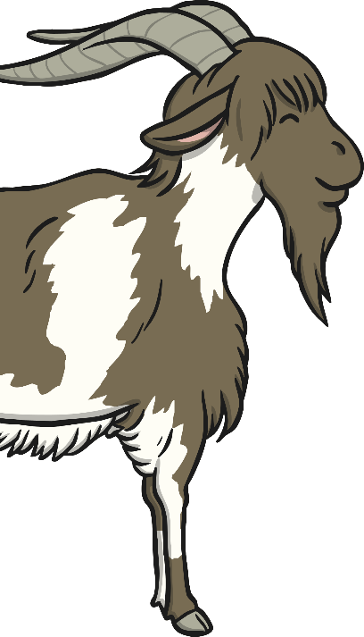
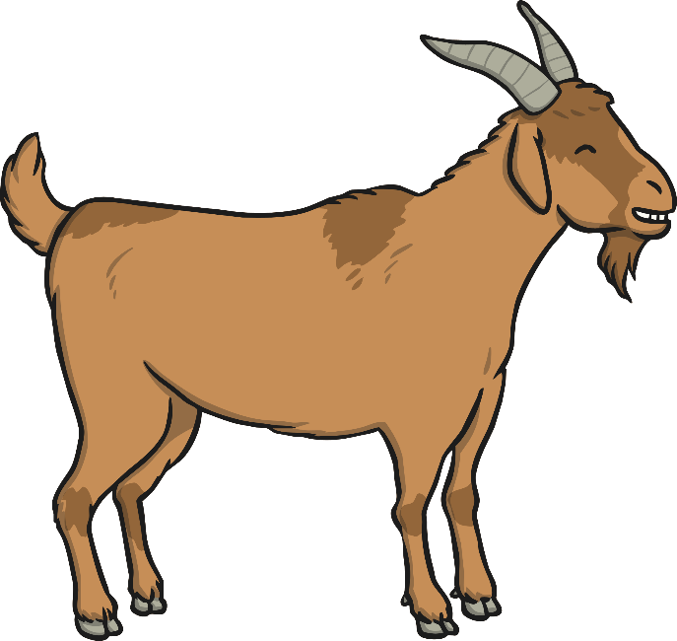
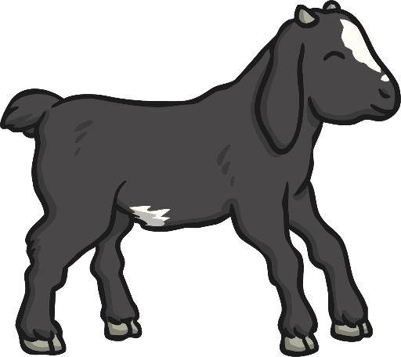
The Three Billy Goats Gruff

Slide 2
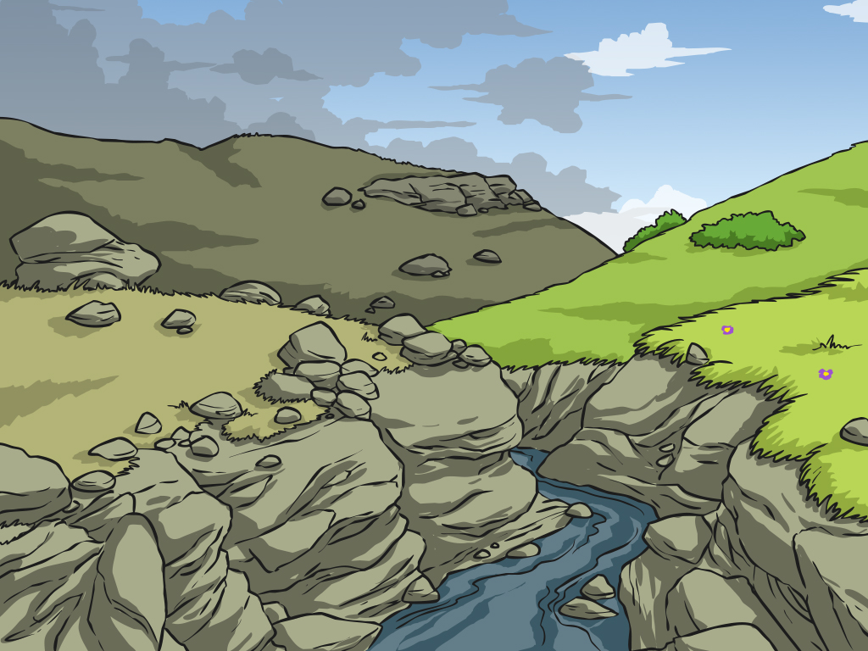



Once upon a time there were three Billy Goats Gruff. They lived in a valley in the hills.

Slide 3
One day they saw a field of sweet green grass on the other side of the valley. So they decided to go there.

Slide 4
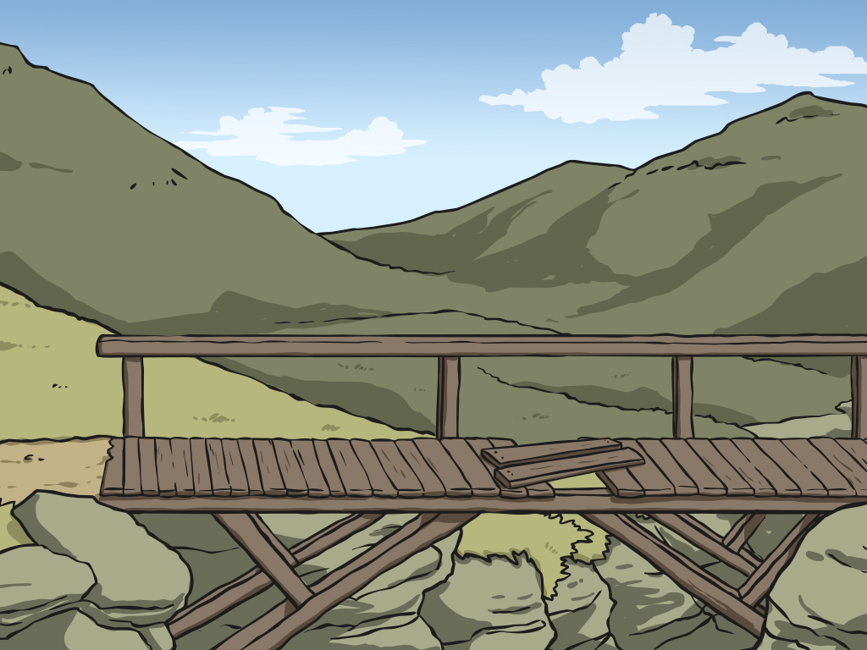


To reach the valley, the three billy goats had to cross a river.

Slide 5
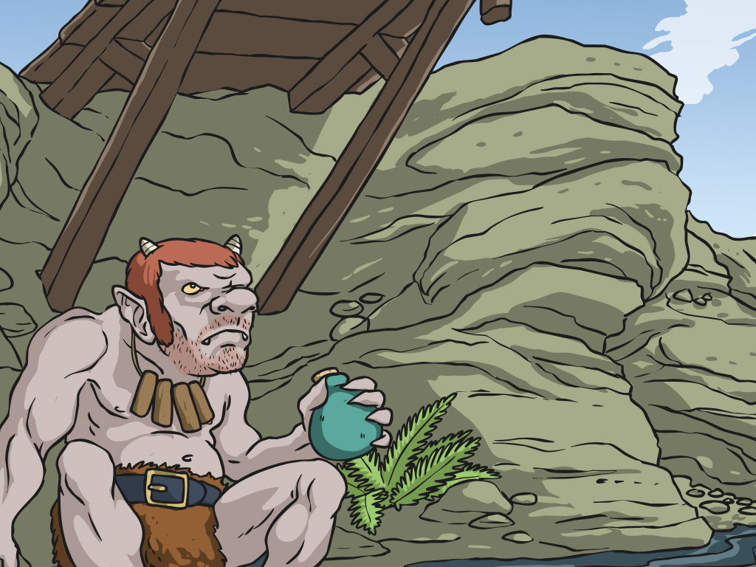
There was only one bridge across the river and underneath there lived a terrible, grumpy troll. He never let anyone cross the bridge, he always gobbled them up for breakfast.

Slide 6

The three goats made a plan. The smallest Billy Goat Gruff was the first to try and cross the bridge. Trip-trap, trip-trap went his hooves as he walked across the bridge.

Slide 7

“Who goes trip-trap over my bridge?” growled the troll from under the bridge. “It’s only me, little Billy Goat Gruff,” said the smallest goat.

Slide 8
“Then I’m coming to eat you up!” roared the troll.

Slide 9

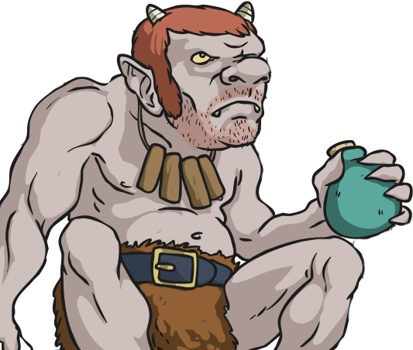
“Please don’t eat me, I’m much too little,” said the smallest Billy Goat Gruff. “My brother is coming after me and he is much bigger.”

Slide 10
“Hmm,” grunted the troll. “Then I will wait for him.”

Slide 11
Next the medium sized Billy Goat Gruff came over the bridge. Trip-trap, trip-trap went his hooves as he walked across the bridge.

Slide 12
“Who goes trip-trap over my bridge?” growled the troll from under the bridge. “It’s only me, medium sized Billy Goat Gruff,” said the goat.

Slide 13
“Then I’m coming to eat you up!” roared the troll.

Slide 14


“Please don’t eat me, I’m much too little,” said the medium sized Billy Goat Gruff. “My brother is coming after me and he is much bigger.”

Slide 15
“Hmm,” grunted the troll. “Then I will wait for him.”

Slide 16
Soon the biggest Billy Goat Gruff came over the bridge.
Trip-trap, trip-trap went his hooves.

Slide 17
“Who goes trip-trap over my bridge?” growled the troll from under the bridge. “It is I, big Billy Goat Gruff,” said the goat.

Slide 18
“Then I’m coming to eat you up!” roared the troll.

Slide 19
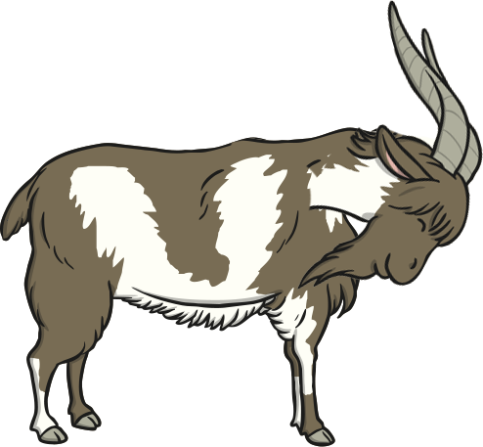
“Oh no you won’t!” The biggest goat shouted and he lowered his horns and charged at the troll. Smack! He butted him right over the edge of the bridge.

Slide 20
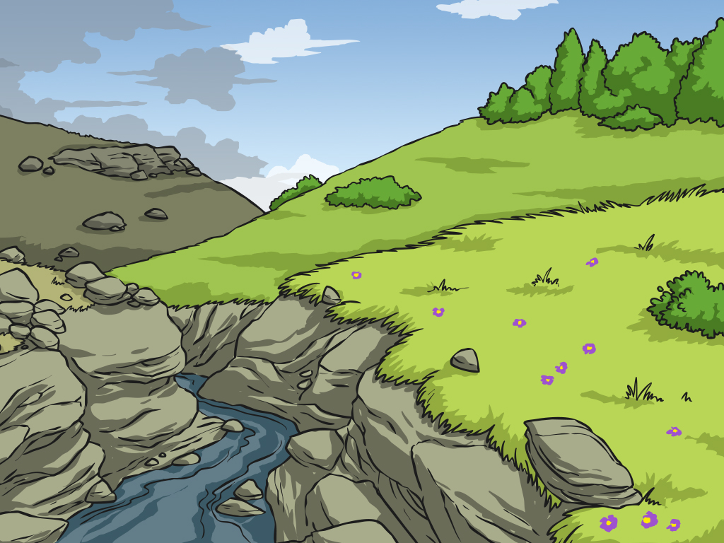

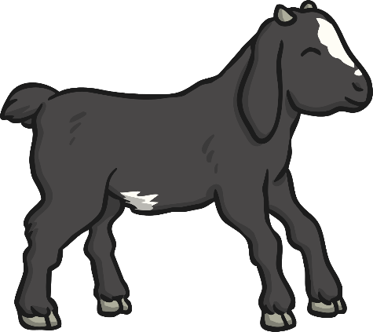
The big Billy Goat Gruff joined his brothers. They found their field of sweet green grass and ate their fill.

Slide 21
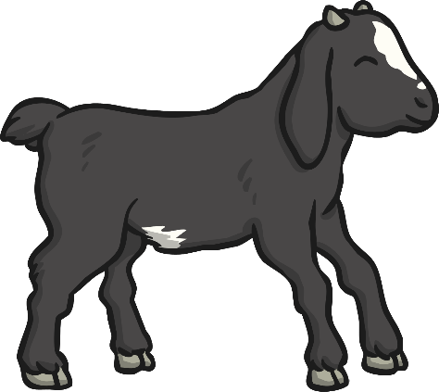
The End

