Slide 2



Diving into Mastery Guidance for Educators
Each activity sheet is split into three sections, diving, deeper and deepest, which are represented by the following icons:
These carefully designed activities take your children through a learning journey, initially ensuring they are fluent with the key concept being taught; then applying this to a range of reasoning and problem-solving activities.
These sheets might not necessarily be used in a linear way. Some children might begin at the ‘Deeper’ section and in fact, others may ‘dive straight in’ to the ‘Deepest’ section if they have already mastered the skill and are applying this to show their depth of understanding.
Diving
Deeper
Deepest

Slide 3
Aim
Add and subtract fractions with the same denominator within
one whole.

Slide 4

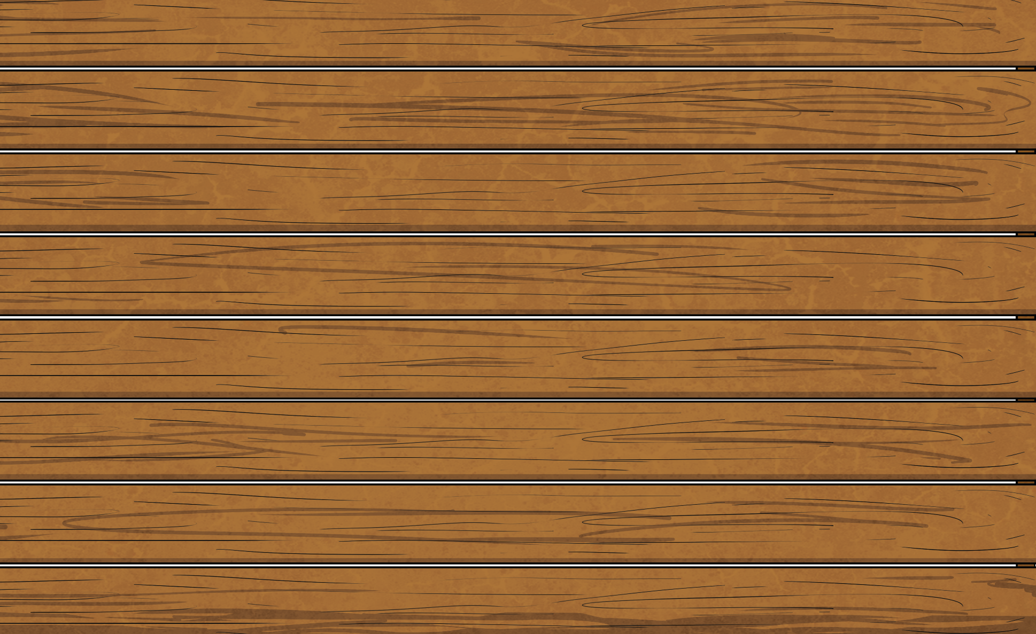


Subtract Fractions
Diving
Which number sentence does the bar model represent?
Represent the number sentence as
a bar model to help you find the answer.
6
8
4
8
−
=
6
7
3
7
3
7
6
7
6
7
2
7
2
7
4
7
4
7
6
7
4
7
2
7
−
=
−
−
=
=
−
=

Slide 5

Subtract Fractions
Diving
True or false?
Prove it using a bar model.
Represent the number sentence as
a bar model to help you find the answer.
four-fifths subtract two-fifths equals one-fifth
6
8
4
8
2
8
−
=

Slide 6
Subtract Fractions
Diving
True or false?
Prove it using a bar model.
four-fifths subtract two-fifths equals one-fifth
4
5
2
5
2
5
False.
−
=

Slide 7

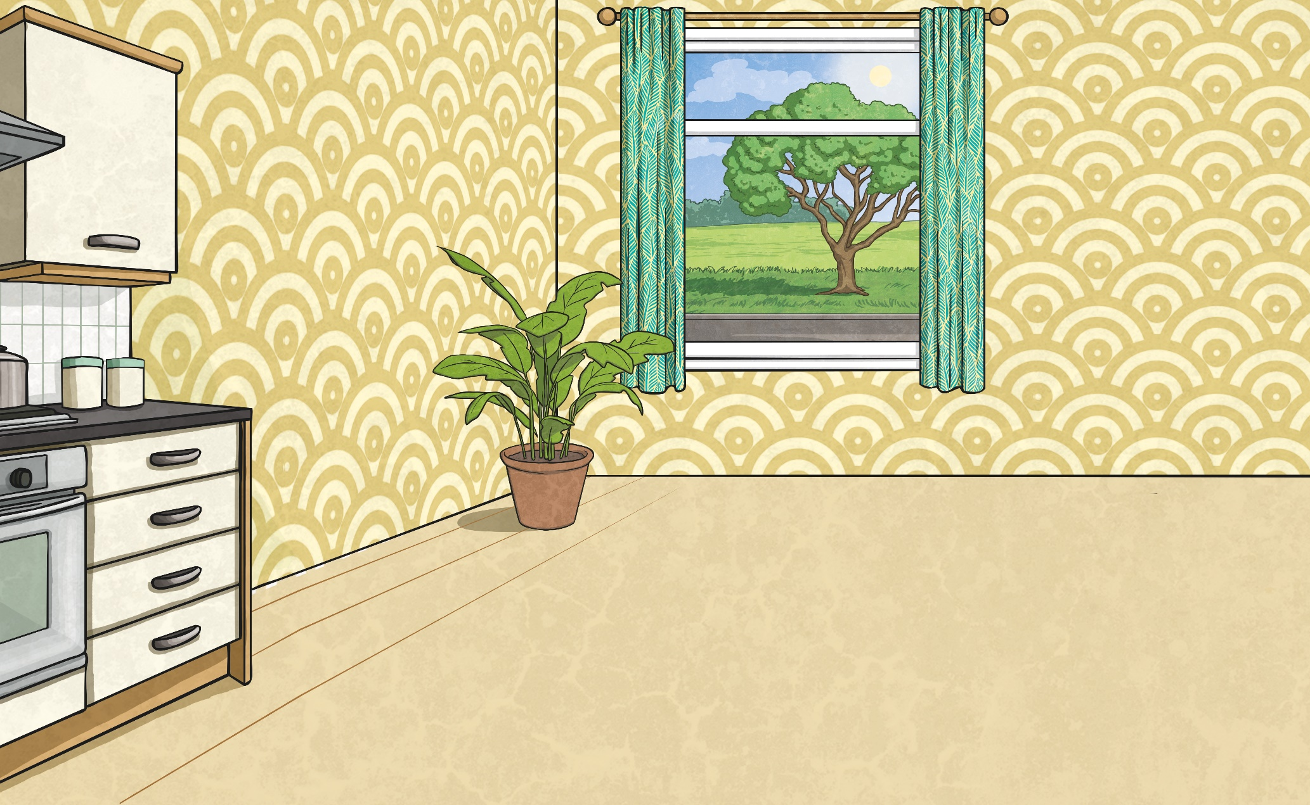


Subtract Fractions
Deeper
Work out what the missing fractions are.
3
9
8
9
3
9
2
9
−
=
+
1
6
5
6
1
6
3
6
−
=
+

Slide 8
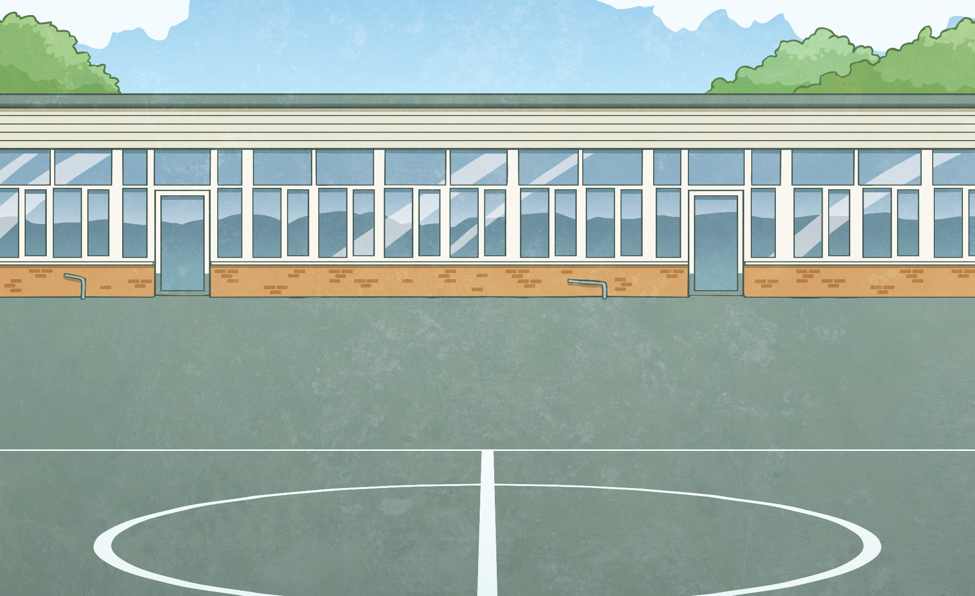

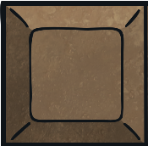
Subtract Fractions
Deeper
Annan is sharing his chocolate bar.
If I share 2 pieces
of chocolate, I will
still have left over.
Do you agree with Annan?
Explain your reasoning.
6
9
Annan is incorrect. 2 pieces
of chocolate is .
2
9
9
9
−
2
9
=
7
9

Slide 9

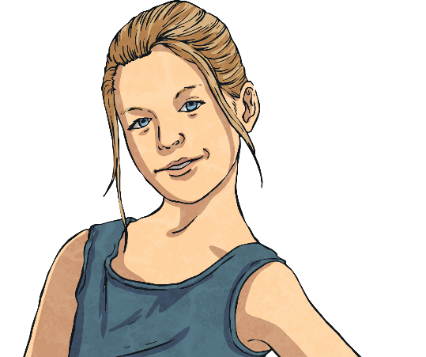
Subtract Fractions
Deeper
A shape has been part shaded.
If you were subtracting
2 fractions, you might have got:
6
6
−
4
6
=
2
6
4
6
−
2
6
=
2
6
If you were subtracting
3 fractions, you might have got:
6
6
−
2
6
−
2
6
=
2
6
5
6
−
1
6
−
2
6
=
2
6
What fractions could have been subtracted to create this shape?
Did you get anything different?

Slide 10



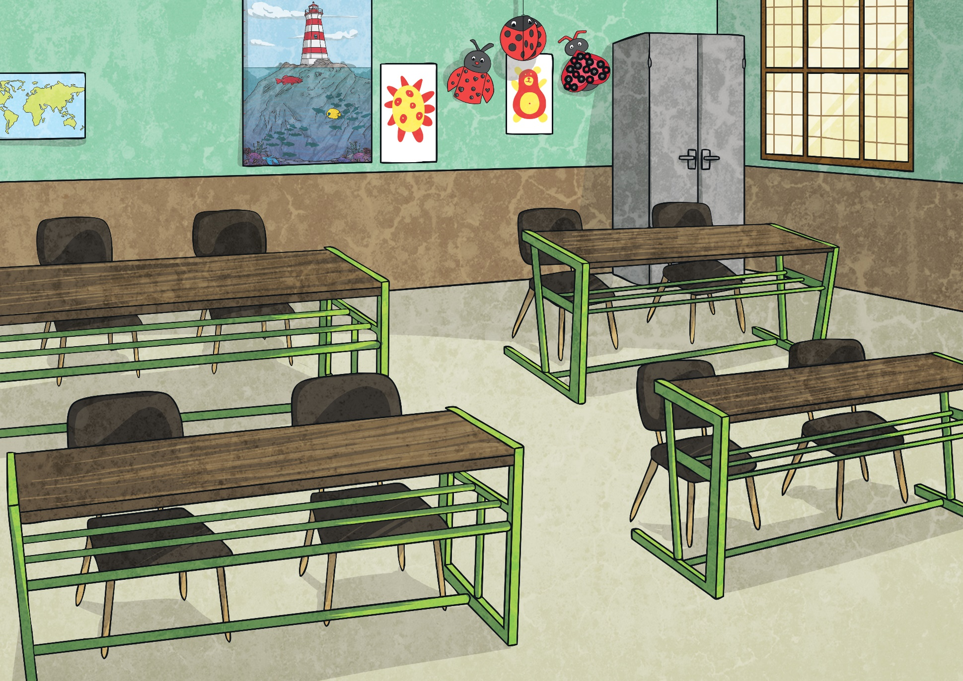

Subtract Fractions
Deepest
Work out what the missing numerators could be.
10
3
10
10
2
10
9
13
13
2
13
13
10
5
3
4
−
=
+
−
=
+
What else
could the numerators be?

Slide 11

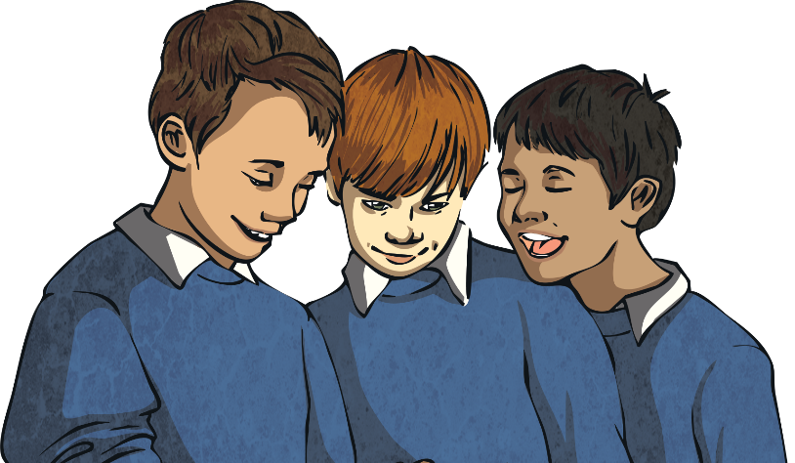
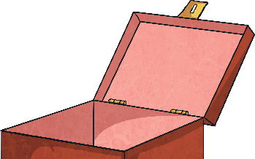
Subtract Fractions
Deepest
There were 9 cubes altogether. 3 children each took an odd number of cubes from the set with none remaining.
What fraction of cubes could each child have taken?
9
−
−
−
=
9
You could have got these answers:
9
9
1
9
1
9
7
9
9
9
3
9
3
9
3
9
9
9
5
9
3
9
1
9
−
−
−
=
0
−
−
−
=
0
−
−
−
=
0
Did you find any other answers?

Slide 12
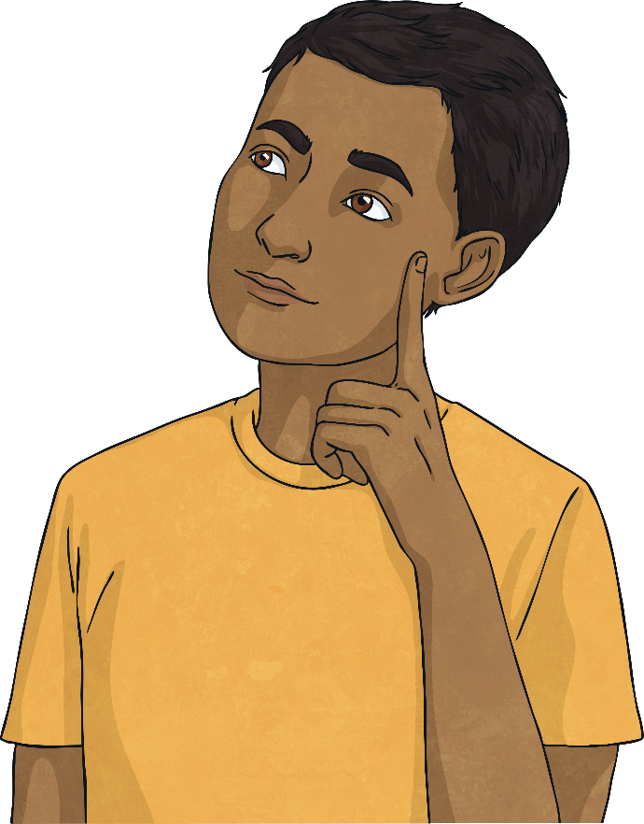
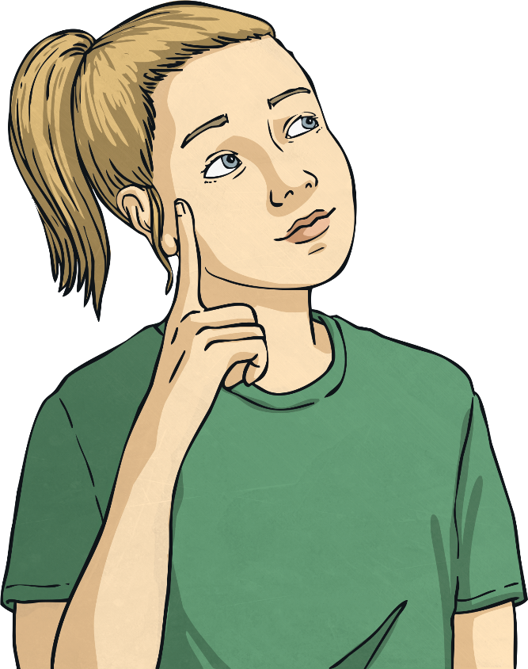
Subtract Fractions
Deepest
Using fractions, how many addition and subtraction calculations can you make from the image?
You could have got these answers:
12
12
6
12
6
12
1
12
5
12
6
12
8
12
2
12
6
12
3
12
3
12
6
12
−
=
+
=
−
=
+
=
Did you find any other answers?

Slide 13
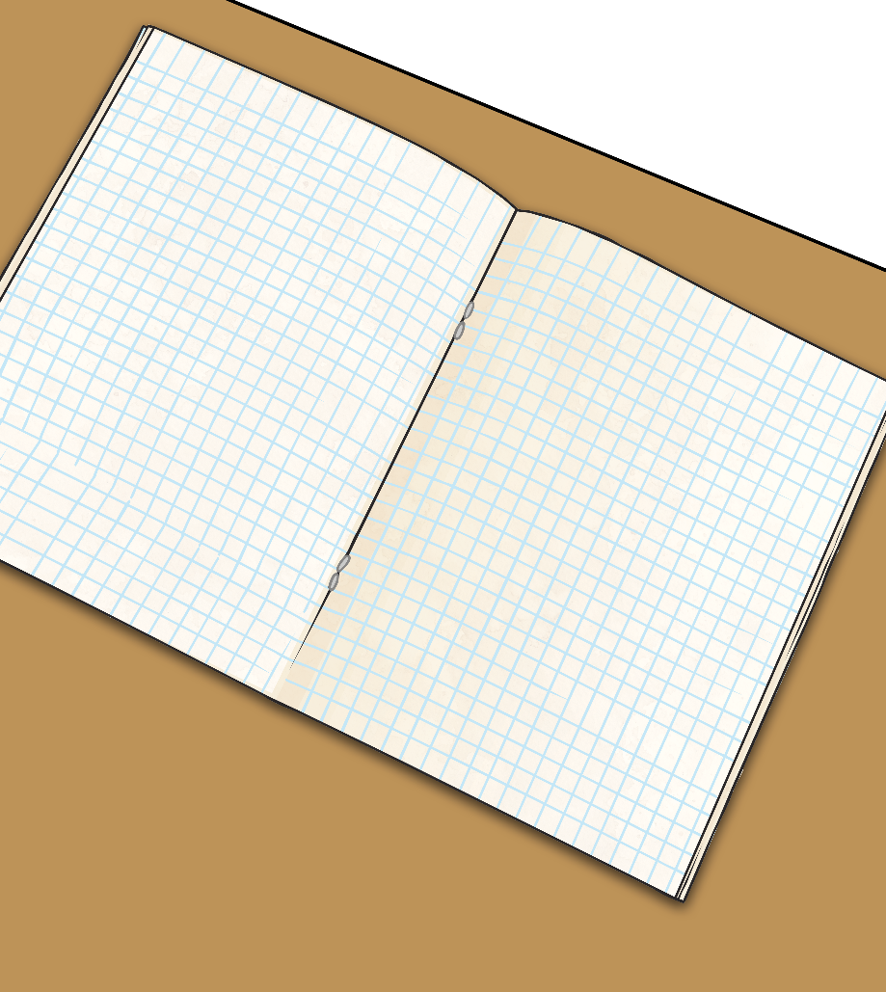
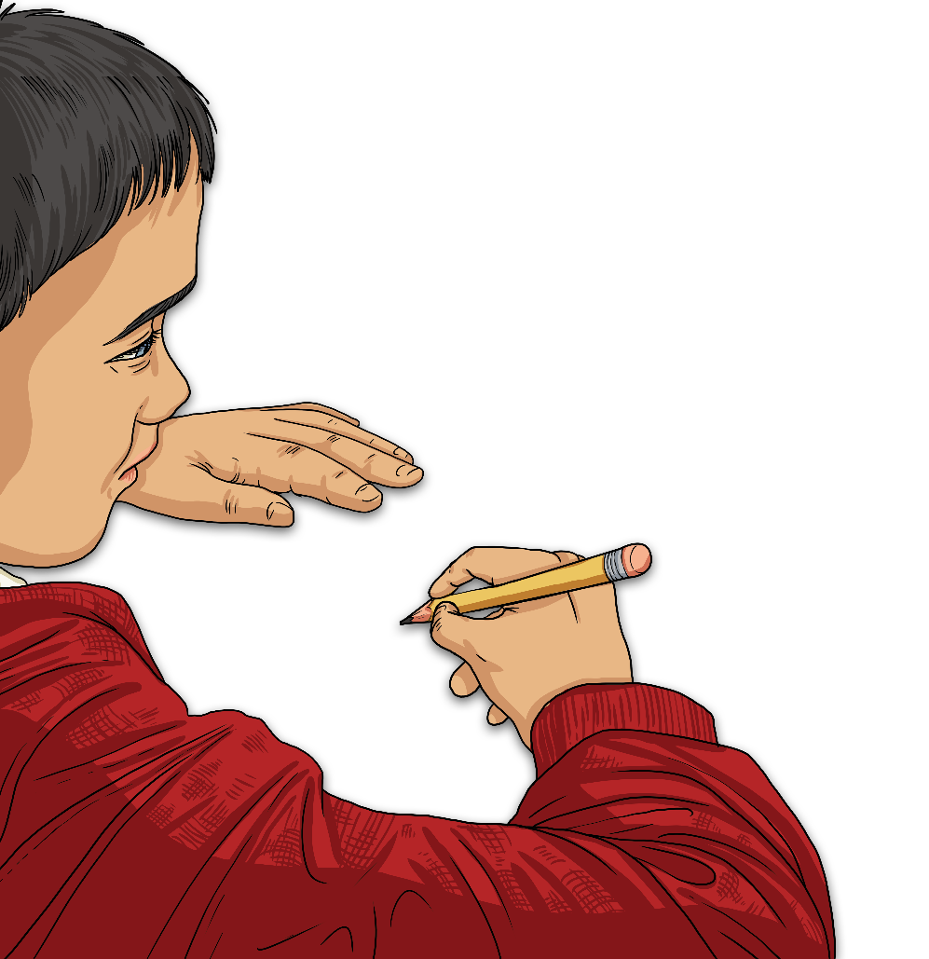
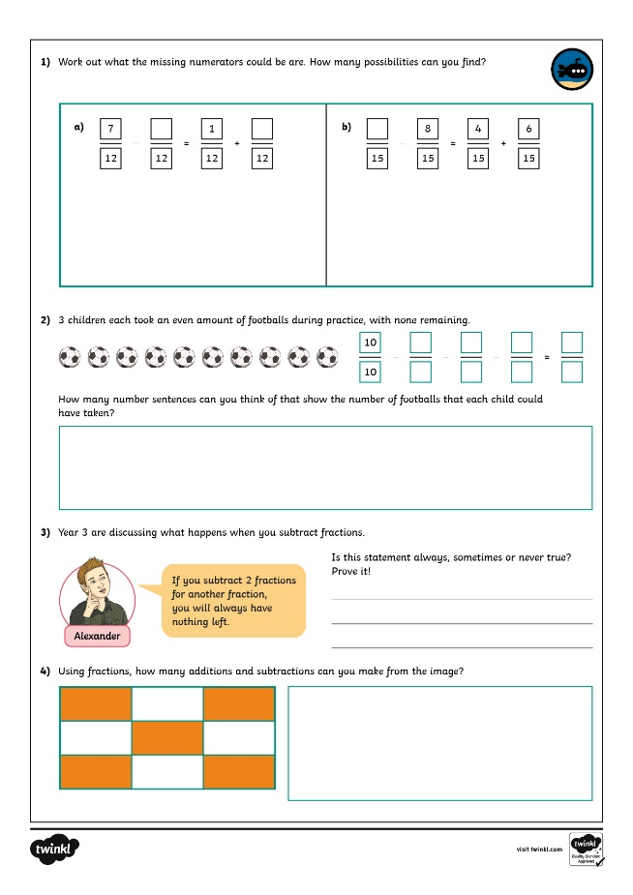
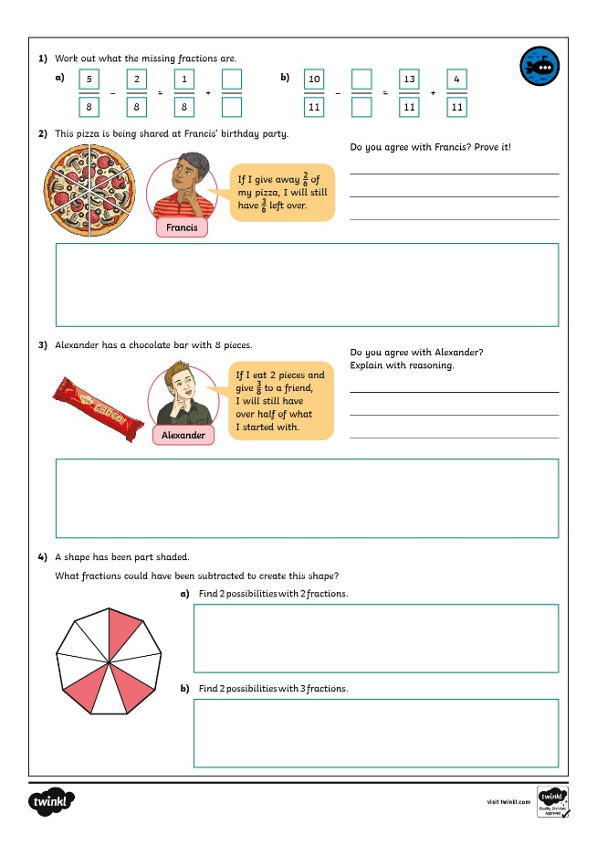
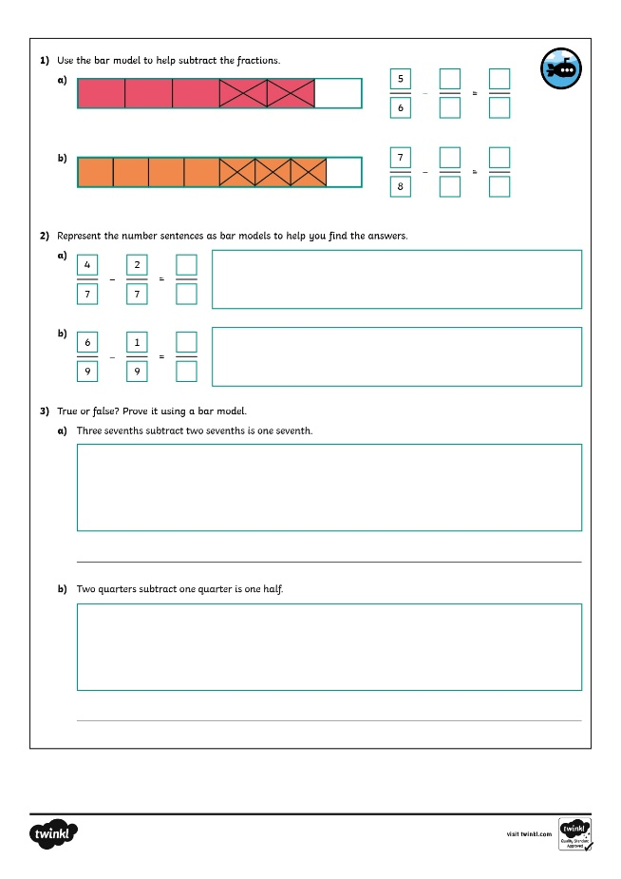
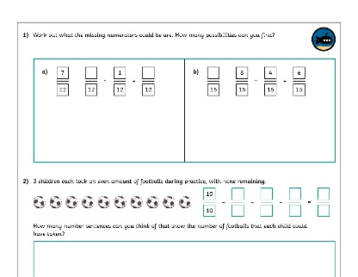
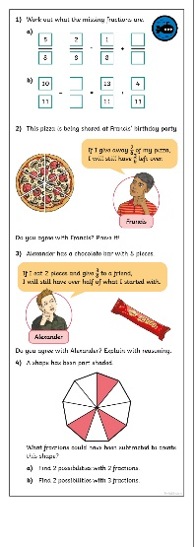
Subtract Fractions
Dive in by completing your own activity!

Slide 14
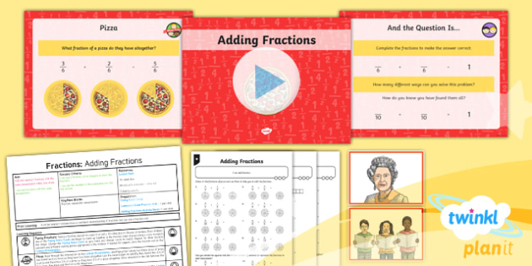
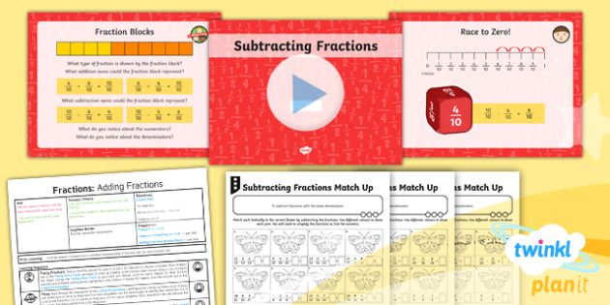

Need Planning to Complement this Resource?
National Curriculum Aim
Add and subtract fractions with the same denominator
within one whole.
For more planning resources to support this aim, click here.
Twinkl PlanIt is our award-winning scheme of work
with over 4000 resources.

