Slide 2



Diving into Mastery Guidance for Educators
Each activity sheet is split into three sections, diving, deeper and deepest, which are represented by the following icons:
These carefully designed activities take your children through a learning journey, initially ensuring they are fluent with the key concept being taught; then applying this to a range of reasoning and problem-solving activities.
These sheets might not necessarily be used in a linear way. Some children might begin at the ‘Deeper’ section and in fact, others may ‘dive straight in’ to the ‘Deepest’ section if they have already mastered the skill and are applying this to show their depth of understanding.
Diving
Deeper
Deepest

Slide 3
Aim
Add and subtract fractions with the same denominator
within one whole.

Slide 4

Add Fractions
Diving
Use the bar model to work out which two fractions have been added together.
5
7
5
7
2
7
2
7
4
7
4
7
6
7
2
7
5
7
+
+
+
=
+

Slide 5
Add Fractions
Diving
Use the bar model to work out which two fractions have been added together.
2
8
1
8
3
8
1
8
5
8
6
8
1
8
4
8
2
8
7
8
1
8
4
8
2
8
+
+
+
+
+
+
=
+
+

Slide 6
Add Fractions
Diving
Draw a bar model to show this number sentence:
26
36
5
6
+
=

Slide 7
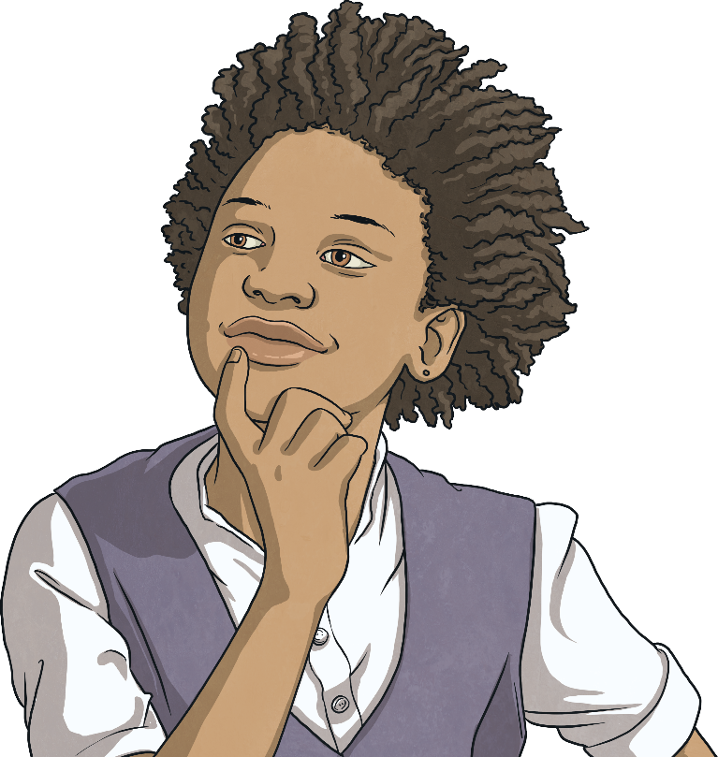
Add Fractions
Diving
Complete the part-whole model.
1
6
5
6
4
6

Slide 8

Add Fractions
Deeper
Complete the number sentence.
10
10
4
8
10
3
1
10
10
+
+
=
Did you get a different answer?

Slide 9
Add Fractions
Deeper
Find 2 ways to solve the part-whole model.
3
12
5
12
3
12
9
12
1
12
9
12
3
12
3
12
Did you get a different answer?

Slide 10
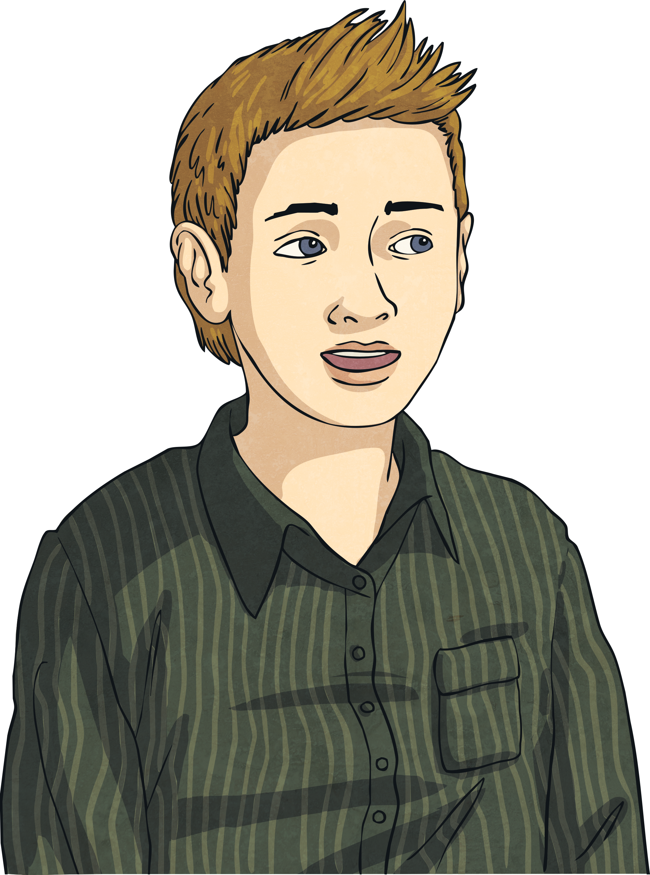
Add Fractions
Deeper
Year 3 are checking their work on fractions.
14
14
2
8
+
=
Use reasoning to explain David’s mistake.
David has added both the numerators and denominators, rather than just adding the numerators.
It should have been:
14
14
2
4
+
=

Slide 11

Add Fractions
Deeper
A shape has been part shaded.
What 2 fractions could have been added together to create this shape?
17
37
4
7
+
=
Did you get a different answer?

Slide 12

Add Fractions
Deepest
2 children are given hoops at lunchtime.
Each child is given an even number of hoops.
There are 10 hoops in total.
1
10
10
10
2
10
4
10
6
10
8
10
3
10
8
10
6
10
4
10
2
10
+
=
How many number sentences can you think of that show the number of hoops that each child was given?
2
10
+
8
10
=
10
10
4
10
+
6
10
=
10
10
6
10
+
4
10
=
10
10
8
10
+
2
10
=
10
10

Slide 13

Add Fractions
Deepest
Lucille says it is impossible for both missing numerators to be odd numbers.
Is Lucille correct? Explain with reasoning.
5
10
13
1
10
13
12
13
+
+
+
=
Lucille is incorrect. The missing numerators need to equal 6.
5
13
1
13
1
13
5
13
12
13
Both 1 and 5 are odd.
Did you get find any other examples?
+
+
+
=

Slide 14
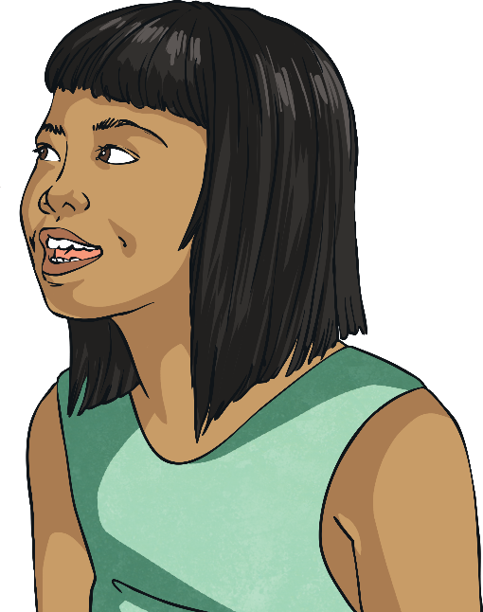
Adding Fractions
Deepest
Children have been adding together 3 fractions.
None of these representations show the correct answer.
6
15
5
15
2
15
+
+
A
13
45
C
Is Sarah correct? Explain your reasoning.
B
D
11
15
Sarah is incorrect.
B shows this.
6
15
5
15
2
15
13
15
+
+
=
What mistakes did the other children make?

Slide 15

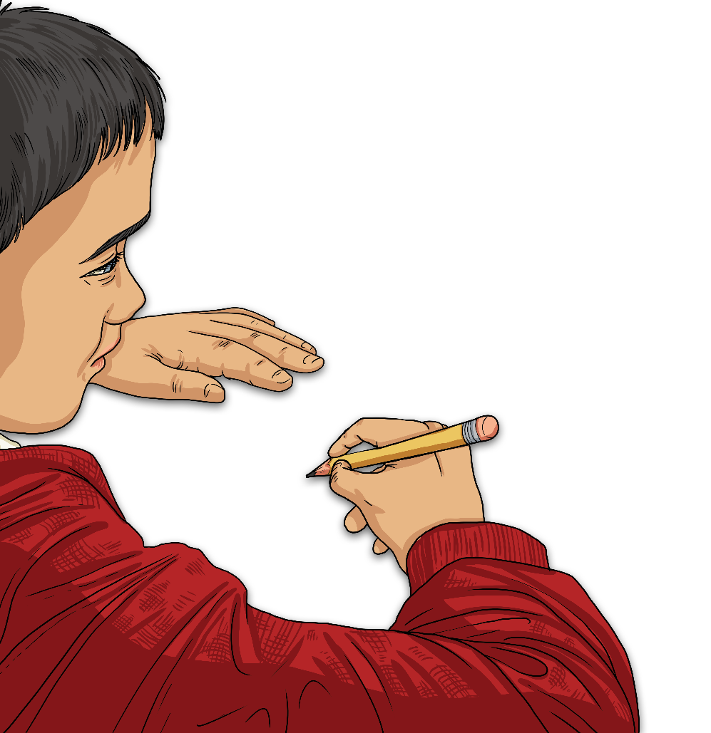
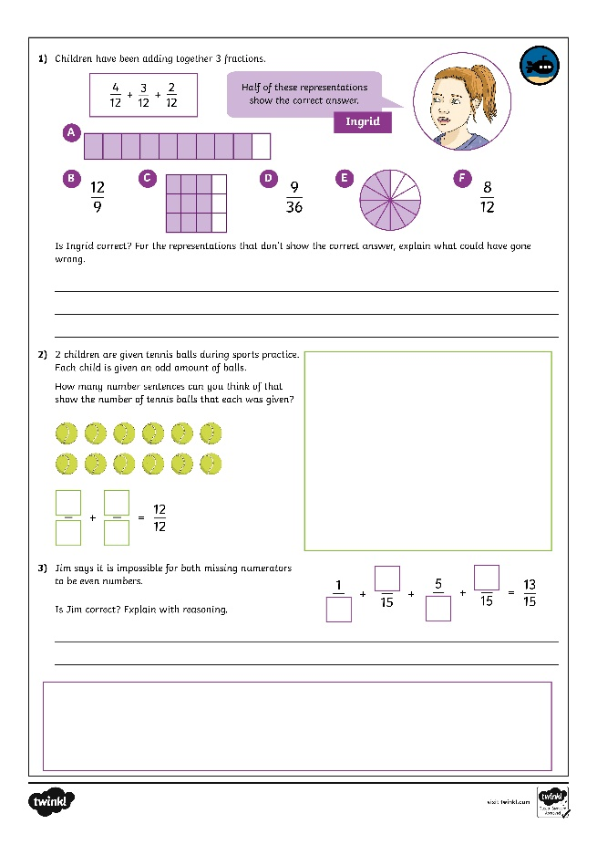
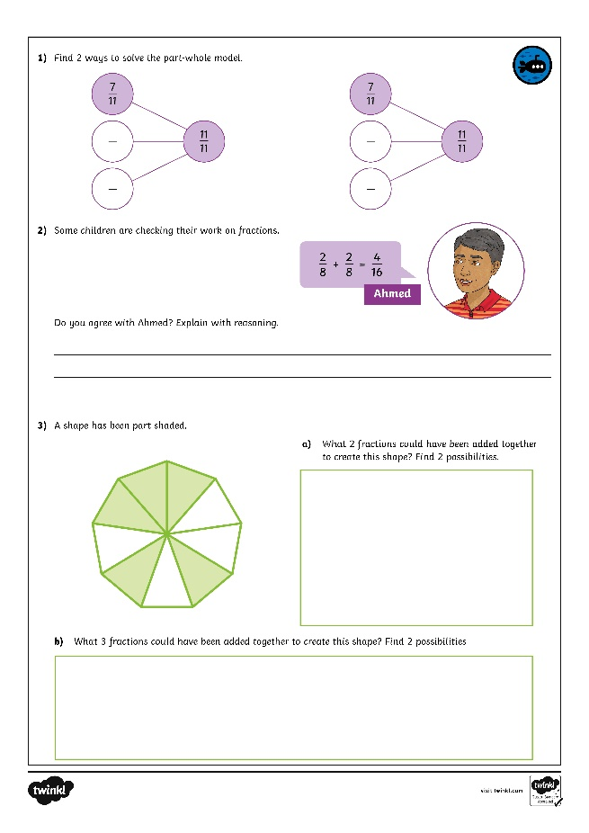
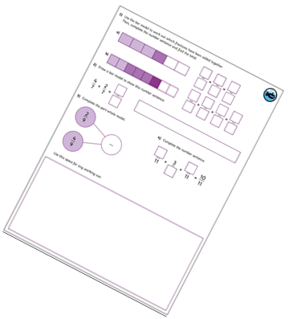
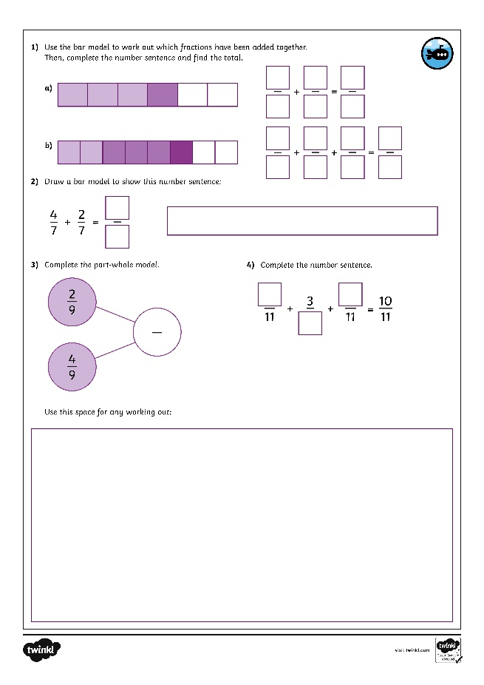
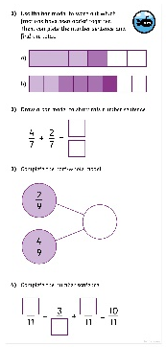
Add Fractions
Dive in by completing your own activity!

Slide 16
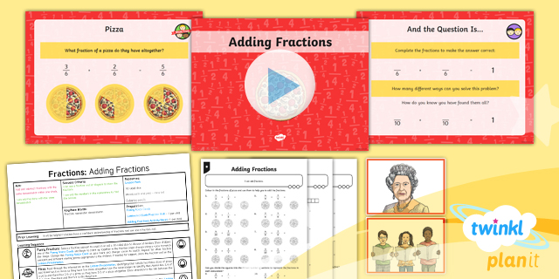
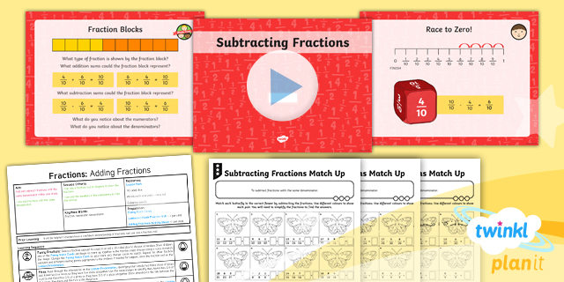

Need Planning to Complement this Resource?
National Curriculum Aim
Add and subtract fractions with the same
denominator within one whole.
For more planning resources to support this aim, click here.
Twinkl PlanIt is our award-winning scheme of work
with over 4000 resources.

