Slide 2



Diving into Mastery Guidance for Educators
Each activity sheet is split into three sections, diving, deeper and deepest, which are represented by the following icons:
These carefully designed activities take your children through a learning journey, initially ensuring they are fluent with the key concept being taught; then applying this to a range of reasoning and problem-solving activities.
These sheets might not necessarily be used in a linear way. Some children might begin at the ‘Deeper’ section and in fact, others may ‘dive straight in’ to the ‘Deepest’ section if they have already mastered the skill and are applying this to show their depth of understanding.
Diving
Deeper
Deepest

Slide 3
Aim
Compare and order unit fractions, and fractions with the
same denominators.

Slide 4

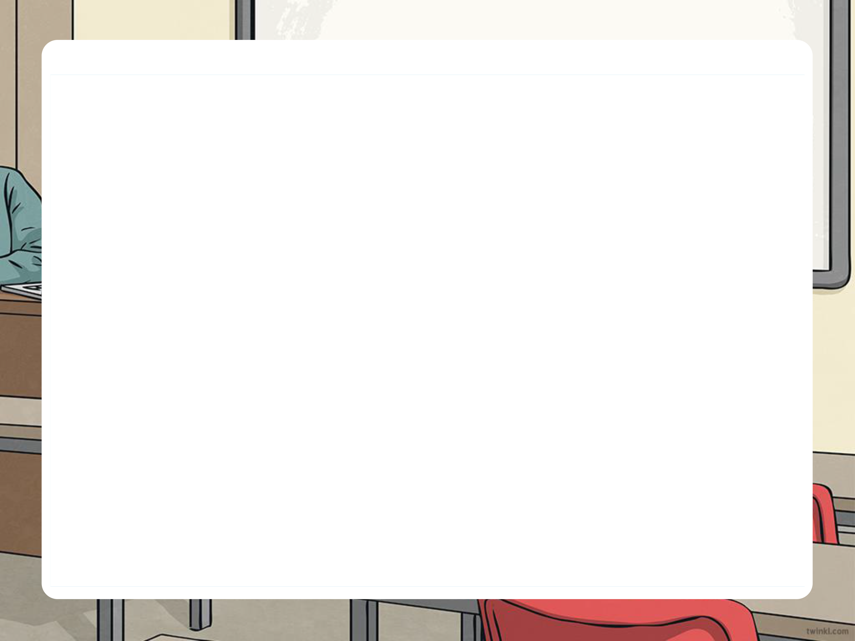




Order Fractions
Diving
Which remaining fraction is the largest of the set?
Which fraction is the largest of the set?
The remaining fraction is the smallest of the set.
Which remaining fraction is the larger?
1
5
1
3
1
7
1
9
>
>
>
The fractions have been placed in descending order: from largest to smallest.

Slide 5




Order Fractions
Diving
Which remaining fraction is the smallest of the set?
Which remaining fraction is the smaller?
The remaining fraction is the largest of the set.
Which fraction is the smallest of the set?
1
6
5
1
<
3
<
4
<
5
6
6
6
6
6
The fractions have been placed in ascending order: from smallest to largest.
3
6
4
6

Slide 6


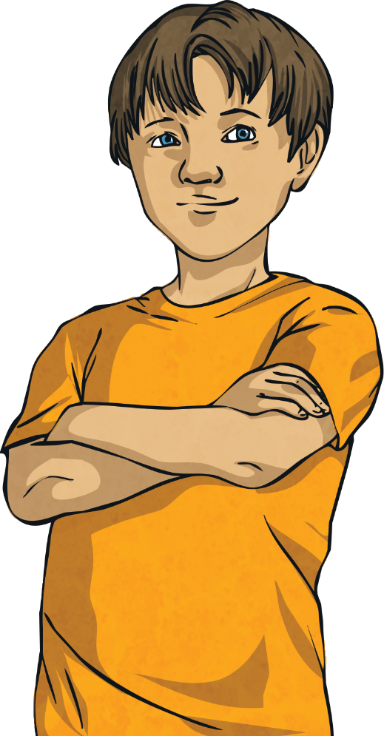
Insert White Rose Aim Here
Order Fractions
Deeper
A set of fractions is written in descending order.
The missing fraction could be .
4
5
3
6
4
2
1
6
6
6
6
Do you agree with Leo? Explain your reasoning.
Leo
Leo is correct. The missing fraction could either be or .
4
3
6
6

Slide 7

Insert White Rose Aim Here
Order Fractions
Deeper
A set of fractions is written in descending order.
The missing fraction could be .
7
8
6
5
4
9
9
9
9
9
Do you agree with Daniel? Explain your reasoning.
Daniel
Daniel is not correct. As the fractions are in descending order, only fractions less than but greater than can be used. is
the only possible fraction.
6
4
9
5
9
9

Slide 8
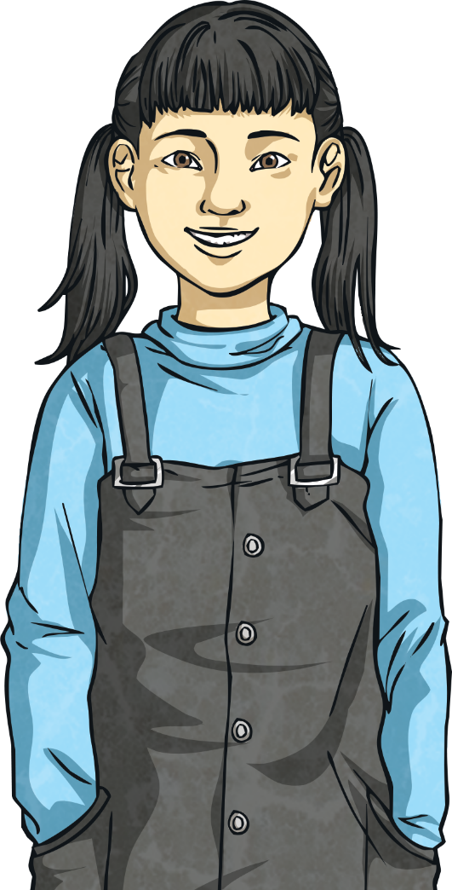
Insert White Rose Aim Here
Order Fractions
Deeper
A set of fractions is written in ascending order.
The missing fraction can only be .
2
1
2
4
6
9
3
9
9
9
9
Do you agree with Thelma? Explain your reasoning.
Thelma
2
Thelma is incorrect. Although is a possible answer, it is not the only answer. could also be used.
9
3
9

Slide 9


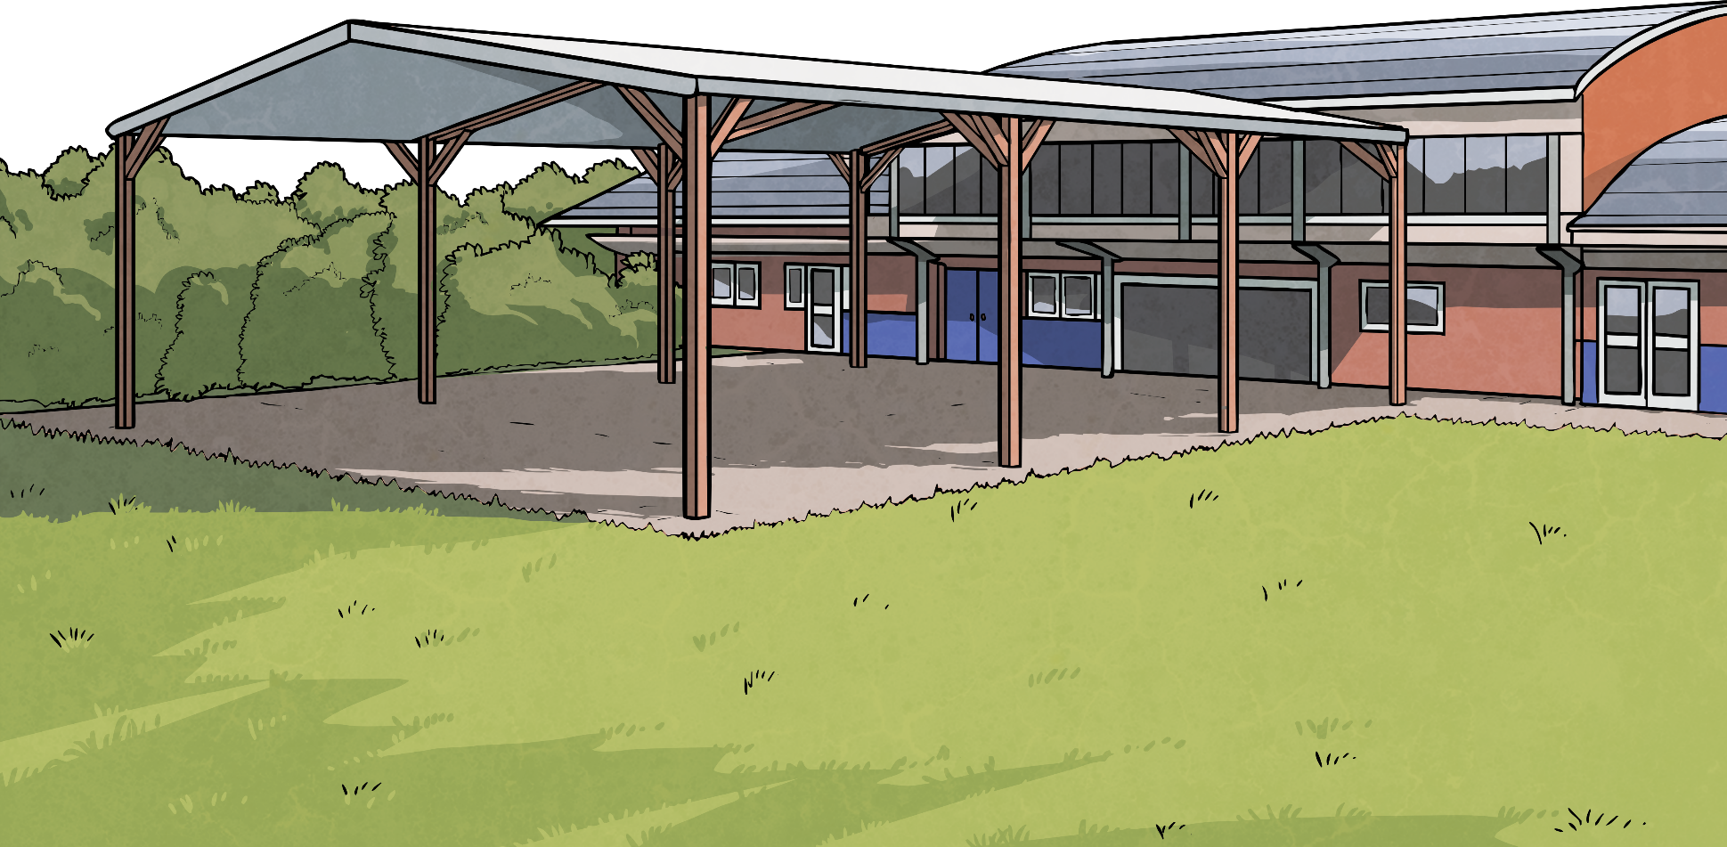

Insert White Rose Aim Here
Order Fractions
Deeper
The fractions have been placed in either ascending or descending order.
7
>
4
>
6
>
3
>
2
>
1
9
9
9
9
9
9
Which fraction is the odd one out? Explain your reasoning.
4
is the odd one out because the rest of the fractions are in descending order.
9

Slide 10

Order Fractions
Deepest
Is it possible to choose 5 fractions from the set and place them in ascending order?
Investigate, explaining your reasoning.
1
4
1
5
9
7
Yes. It is possible to choose 5 fractions and place them in ascending order.
For example:
3
1
1
9
3
9
1
2
3
4
8
,
,
,
,
9
9
9
9
9
6
2
8
9
9
9

Slide 11
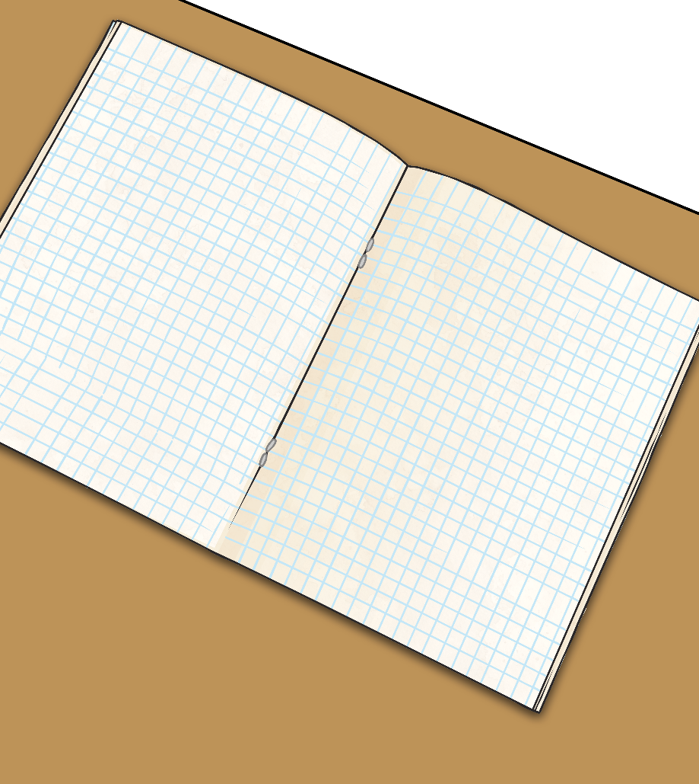

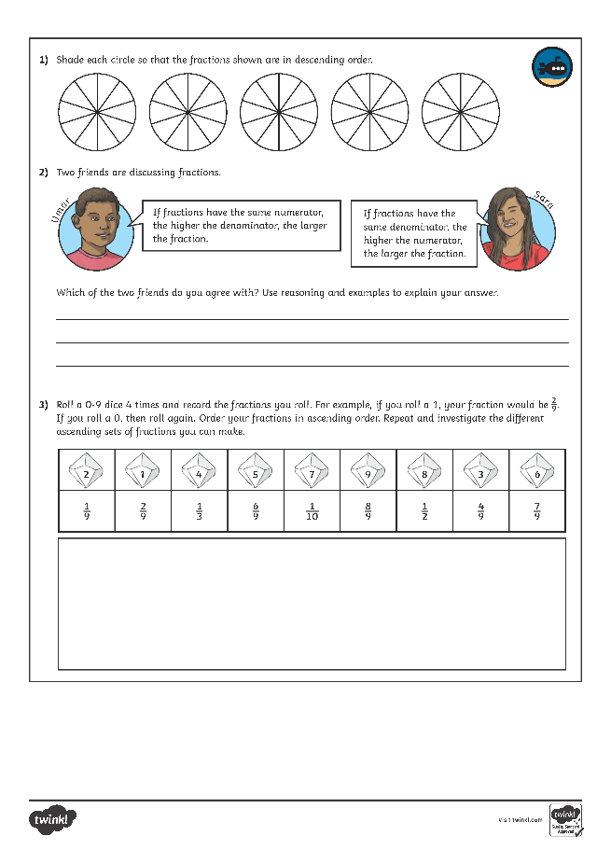
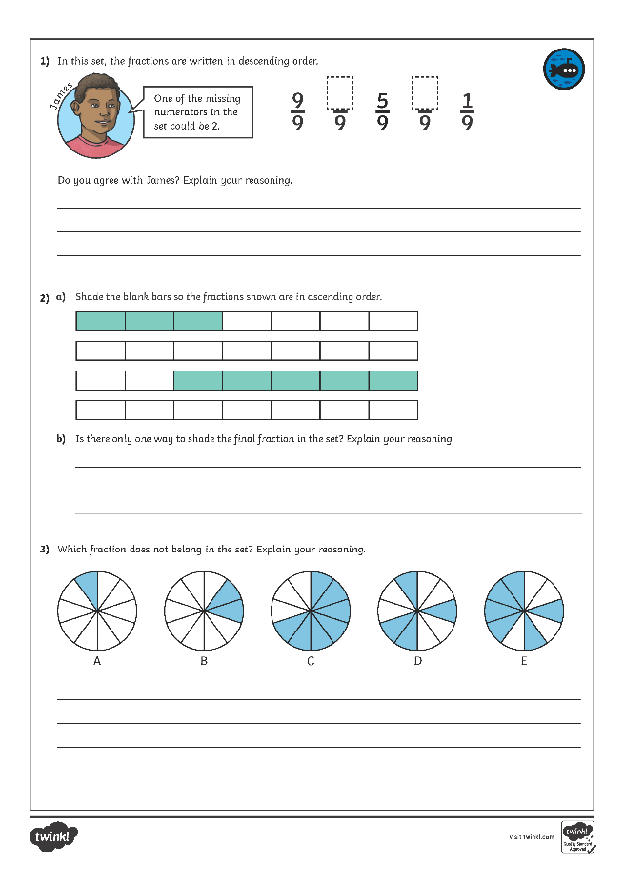
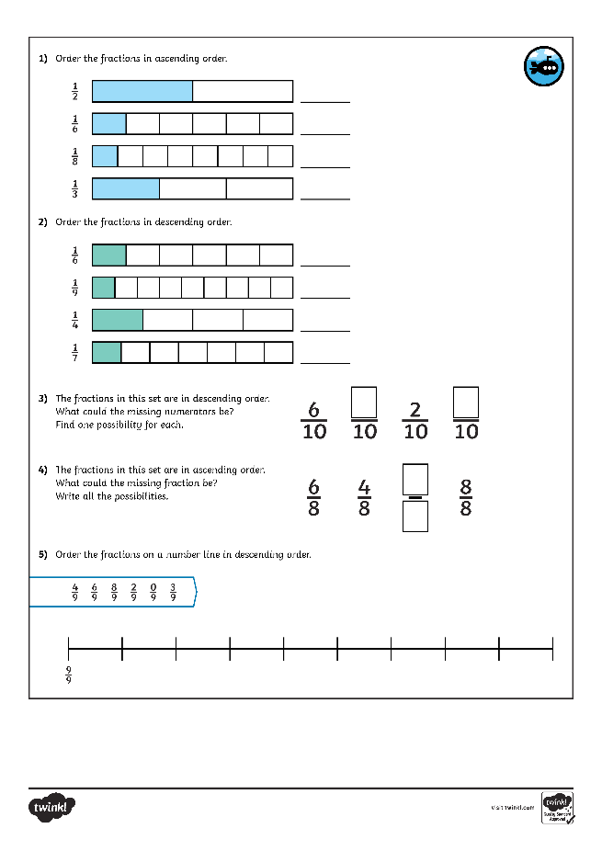
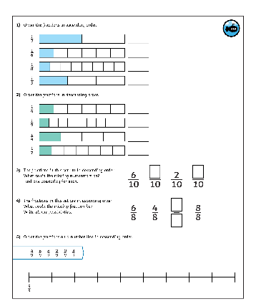
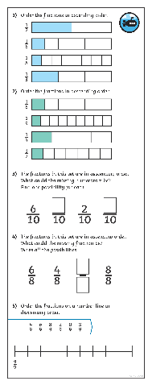
Order Fractions
Dive in by completing your own activity!

Slide 12
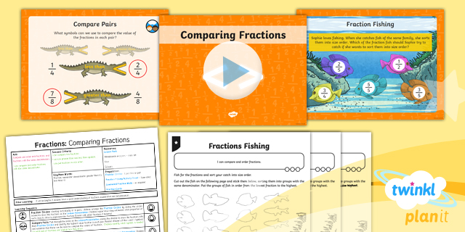
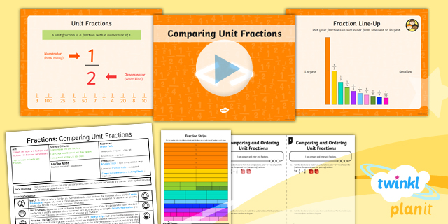

Need Planning to Complement this Resource?
National Curriculum Aim
Compare and order unit fractions, and fractions with the
same denominators.
For more planning resources to support this aim, click here.
Twinkl PlanIt is our award-winning scheme of work
with over 4000 resources.

