Slide 1
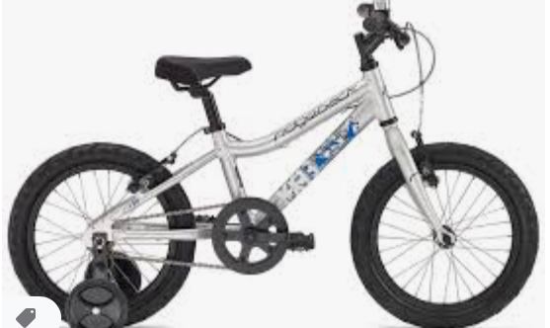
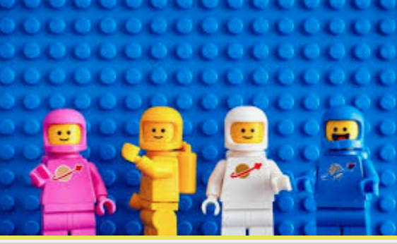
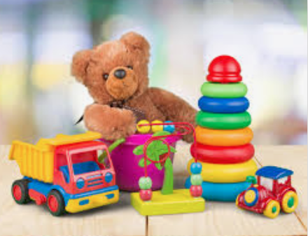
Old and New Toys Activities

Slide 2
Write a paragraph about your favourite toy
Think about:
What it does
What it looks like
Why it’s your favourite
When you got it

Slide 3
Interview an adult about their favourite toy
Is it similar to any of your toys?
Would you like to play with it? Why/not?

Slide 4
Design a toy from the future
What materials is it made from?
How does it work - does it need batteries?
What does it do?
What makes it so special?

Slide 5
Describe and compare the teddies from the photos
What’s the same about them?
What’s different?
Which do you prefer?

Slide 6
Think about how your toys and your parents’ toys may have been different
How were they different?
Which do you think you would prefer?

Slide 7
Choose 5 toys and record their materials and properties
What are they made from?
How do they feel?
Why do you think this material was chosen?

Slide 8
Research old toys and the materials they are made from
Which materials are used?
How do you think they are decorated?
Are toys made from the same materials today?

Slide 9
Record yourself talking about you favourite toy – can we guess it?
Describe what it looks like
Describe how it works
Describe how to play with it

Slide 10
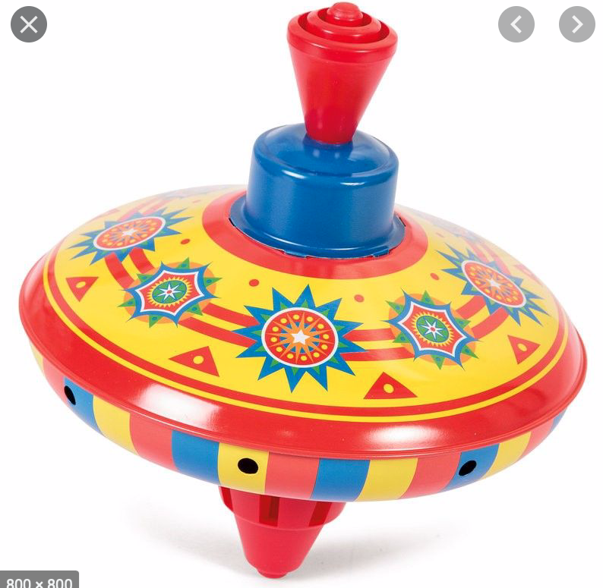
Research a spinning top
How did it work?
When was it invented?
Which materials were used?
How have they changed?

Slide 11
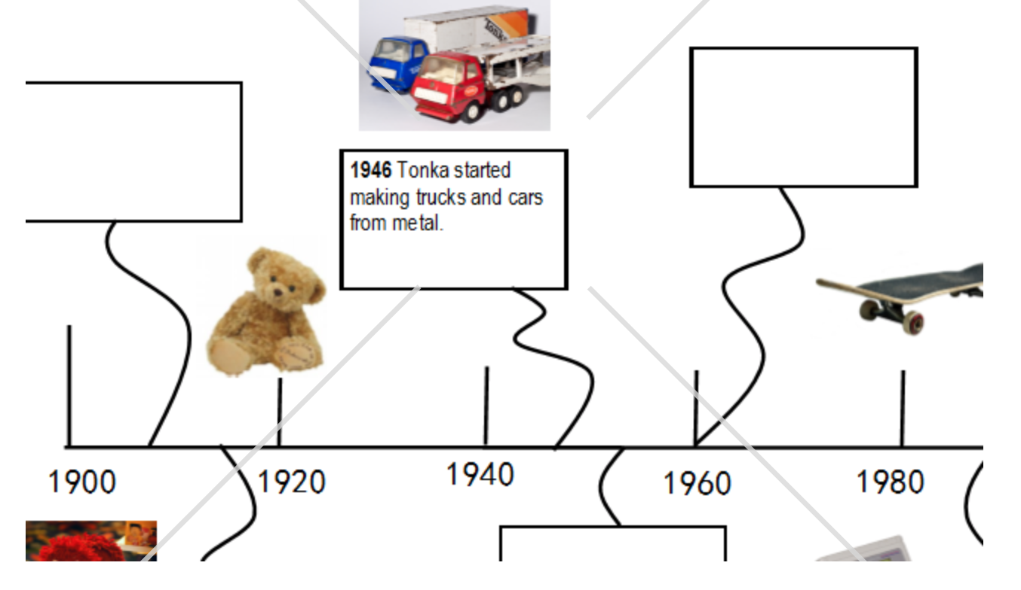
Make a timeline to show how toys have changed
Look first at how the teddies have changed
You can choose one toy (dolls, lego etc) so show a variety

Slide 12
Make a mood board to show your favourite toys
You can draw/print/cut out

Slide 13
Make a mood board of Victorian toys and compare them to toys today
Think about the toys in Major Glad and Major Dizzy ☺

