Slide 2
Mood Monsters
Are you ready to meet the Mood Monsters?
These strange round creatures often change how they look to show how they are feeling! They can change colour several times a day as their moods change.
Sometimes they are happy and a bright yellow colour, sometimes they feel sad and turn blue, sometimes they go bright purple when they get excited, sometimes they go orange if they get a surprise or bright red when they're angry or even green if they feel scared! Sometimes they feel calm and a light blue, other times they are tired and turn teal green or bright pink if they feel worried.
Let’s look at each Mood Monster. See if you can tell how each Mood Monster is feeling!

Slide 3

Happy
Mood Monster
When the monsters feel happy, they turn yellow! They are smiley and cheerful. They are friendly, kind and helpful and like to wave and cuddle their friends. They often make friends with the other monsters and help
them feel happy too.

Slide 4
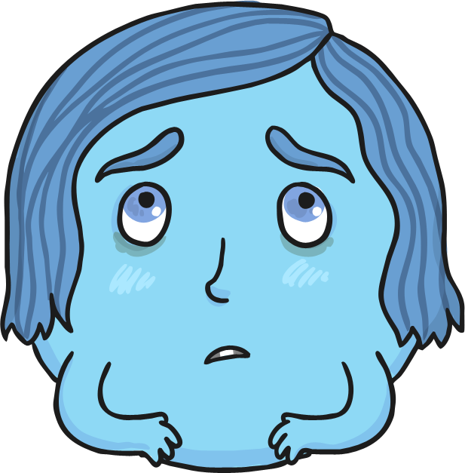
Sad
Mood Monster
When the monsters feel sad, they turn blue. They feel unhappy and sometimes cry. They often stay by themselves and are very quiet. To change how they feel, they make friends, talk to others and get help to work out how to solve their problems.

Slide 5
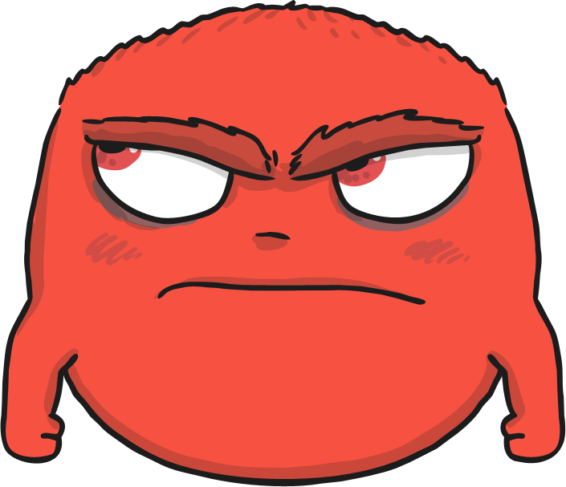
Angry
Mood Monster
When the monsters feel angry, they turn red! They feel cross and irritable. They stamp around and sometimes shout. They are often noisy and other monsters are sometimes scared of them. To change how they feel they sit quietly and calm down, talk to others and think carefully to work out ways to solve their problems.

Slide 6
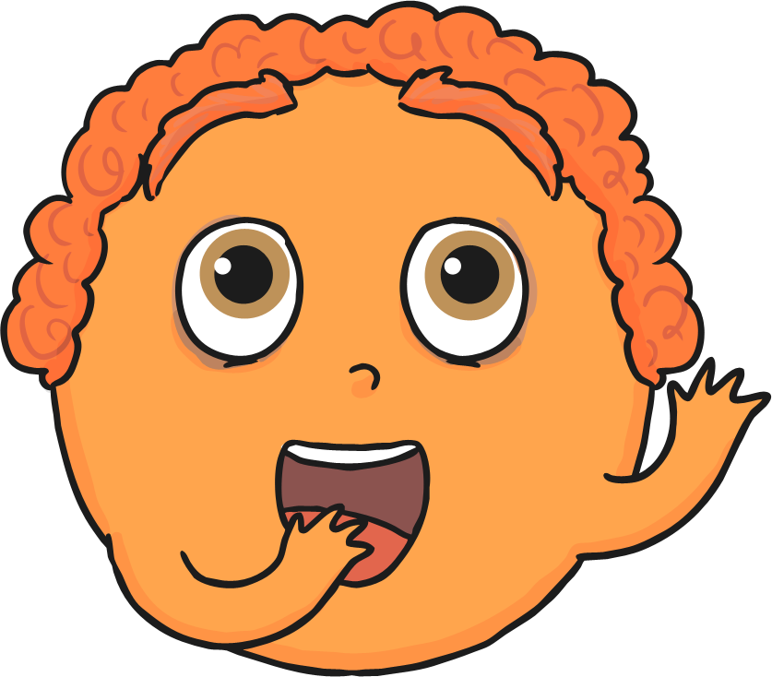
Surprised
Mood Monster
When the monsters feel surprised, they turn orange! They feel happy and a little shocked! They never know what to expect and sometimes jump in surprise! They have big eyes and a big round mouth. They have big bushy eyebrows which are often high up near their hair!

Slide 7
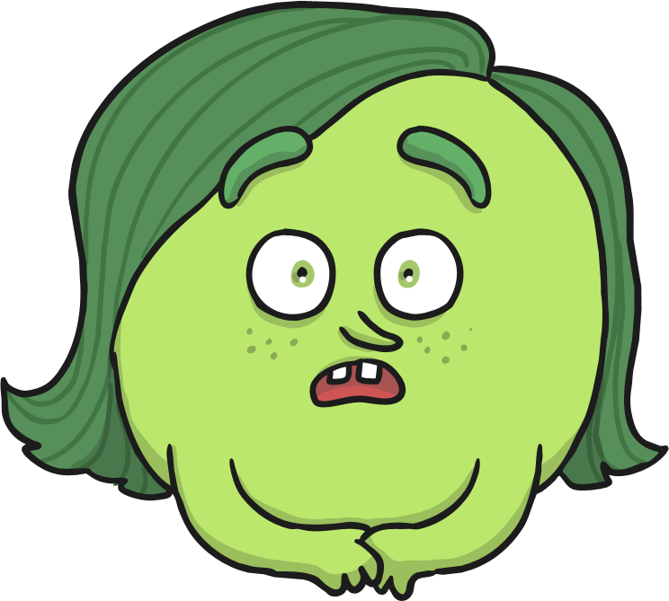
Scared
Mood Monster
When the monsters are scared, they turn green! They often scamper around quietly and tiptoe quickly from place to place. They like to hide under or behind things and can be very quiet. To change how they feel they talk to others about what frightens or worries them.

Slide 8
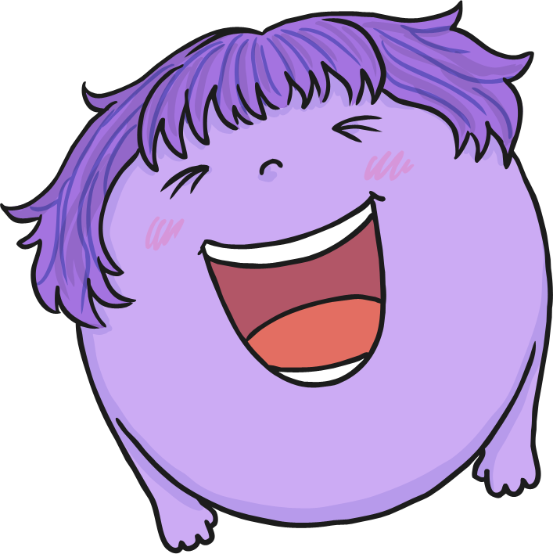
Exited
Mood Monster
When the monsters feel excited, they turn purple! They often bounce around and often jump up and down with excitement! They move very quickly and often tire themselves out. Sometimes they have to stop to rest before bouncing around again!

Slide 9
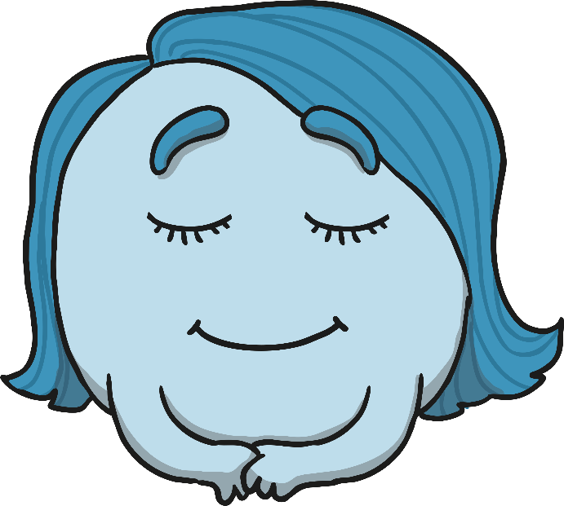
Calm
Mood Monster
When the monsters feel calm, they turn blue/grey! They are often relaxed, sitting comfortably and do not feel stressed. They have a clear mind and can make great choices when they are learning, making decisions or talking in front of others. They will often find the other monsters like to be near them and make the other monsters feel calm too.

Slide 10
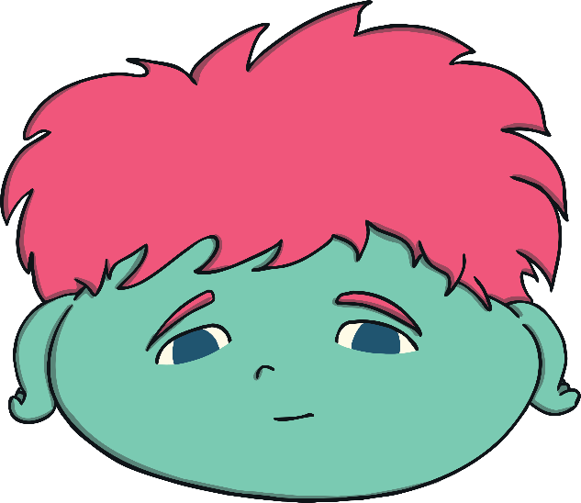
Tired
Mood Monster
When the monsters feel tired, they turn green/grey! They often look pale and yawn a lot. Look out for dark circles under their eyes as a sign of feeling tired. They can be in a bad mood or feel angry and tearful without knowing why. Treat them gently and be patient as they will feel better after a good sleep!

Slide 11
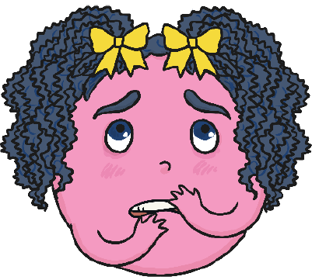
Worried
Mood Monster
When the monsters feel tired, they turn green/grey! They often look pale and yawn a lot. Look out for dark circles under their eyes as a sign of feeling tired. They can be in a bad mood or feel angry and tearful without knowing why. Treat them gently and be patient as they will feel better after a good sleep!

