Slide 1
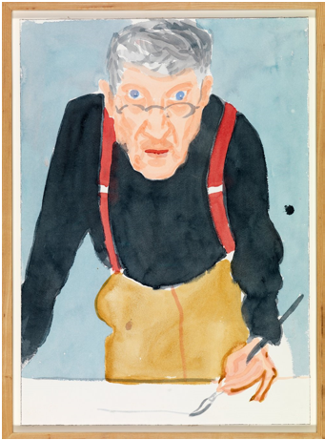
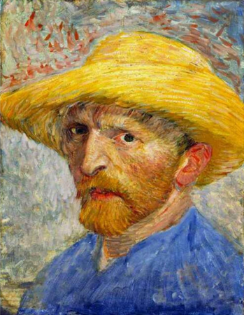
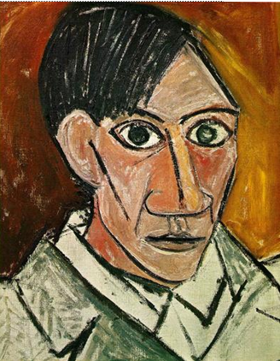
Self-portraits
Woodlands School Art Project
Vincent Van Gogh
David Hockney
Pablo Picasso

Slide 2
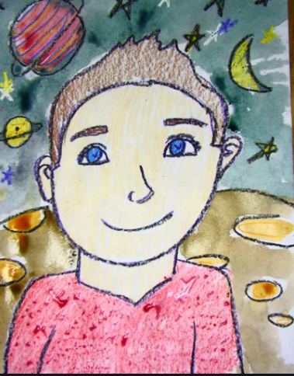
As we enter the second part of the summer term, we would like the children to take part in a whole school art project. The project is based on producing self-portraits and portraits.
Choose from the list below which activities your child -and maybe even you as parents and carers! - would like to do at home. Children can present their work in many different ways.
When we return to school we would like the children to share their portraits and the work will be then be displayed throughout the school.
We look forward to seeing the completed work when we return and also, if possible, on social media.

Slide 3
Activities linked to the art project
Have a look at the examples of portraits on the next slide
Draw or paint a self-portrait of yourself or a portrait of a member of your family
You could also produce self-portraits of yourself doing some of your favourite activities like playing football, cycling, gardening or at a place you like to visit with your family
You could use different materials or media to create your self portraits including pencils, pastels, paint, ink, charcoal or you could even create digitally enhanced portraits!
Can you find out facts about famous self-portrait artists. These include: Vincent Van Gogh, Pablo Picasso, Rembrandt, Andy Warhol, David Hockney and Henri Matisse
As part of the art project we would like you to write a diary account of your time during the ‘lock down’. You could write about things you have enjoyed doing with your family, things you have missed about school or what you are really looking forward to once we return back to school

Slide 4
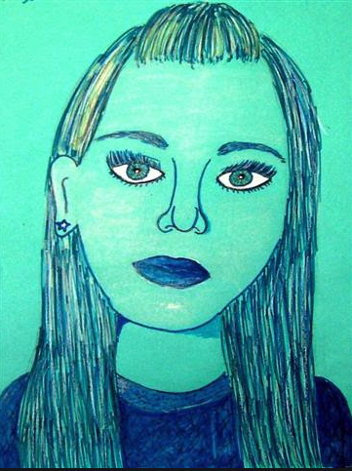
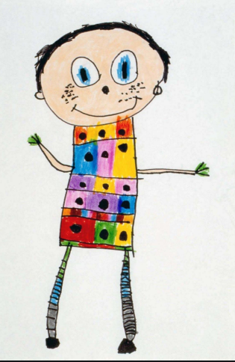
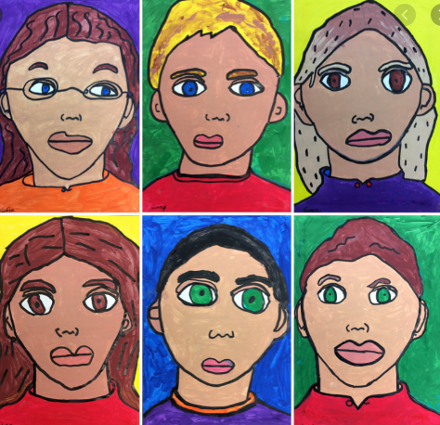
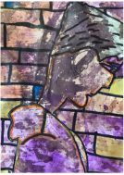
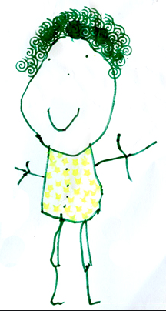
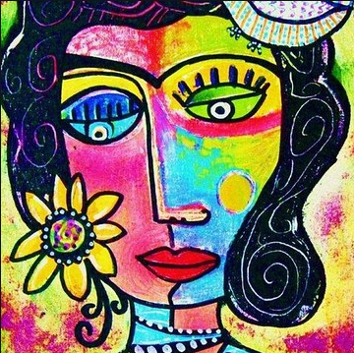
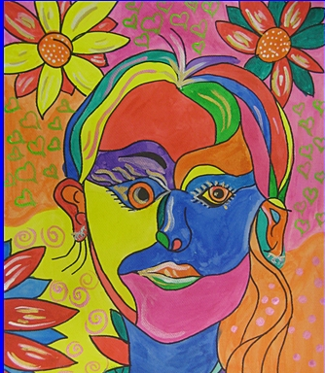
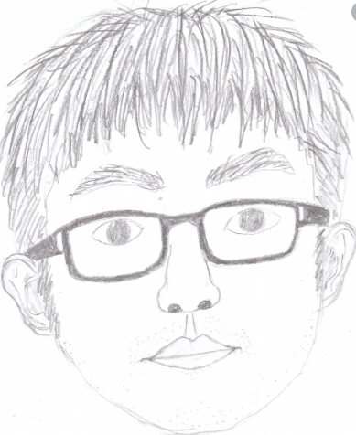
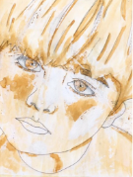
Examples of portraits and self-portraits

