Slide 2



Diving into Mastery Guidance for Educators
Each activity sheet is split into three sections, diving, deeper and deepest, which are represented by the following icons:
These carefully designed activities take your children through a learning journey, initially ensuring they are fluent with the key concept being taught; then applying this to a range of reasoning and problem-solving activities.
These sheets might not necessarily be used in a linear way. Some children might begin at the ‘Deeper’ section and in fact, others may ‘dive straight in’ to the ‘Deepest’ section if they have already mastered the skill and are applying this to show their depth of understanding.
Diving
Deeper
Deepest

Slide 3
Aim
Compare and order unit fractions, and fractions with the same denominators.

Slide 4

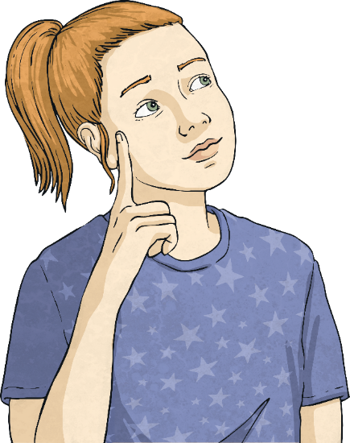
Fractions on a Number Line
Diving
The number line is divided into equal parts.
What fraction belongs in the middle of the number line?
0
1
1
4
1
5
1
2
1
1

Slide 5
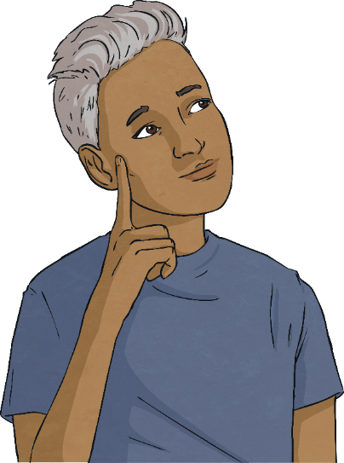
Fractions on a Number Line
Diving
The number line is divided into equal parts.
What fraction belongs here?
0
1
3
7
2
7
3
6
2
6

Slide 6

Fractions on a Number Line
Diving
The number line is divided into equal parts.
Where should 3 be placed?
3
6
a
b
c
3
4
3
6
3

Slide 7
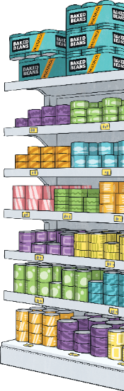
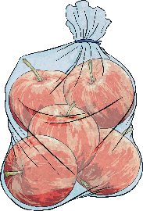
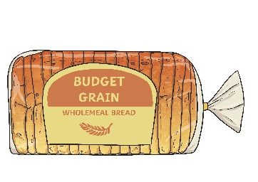

Fractions on a Number Line
Diving
1
7
Anna walked around the supermarket. She picked up some apples of the way to the till. Then, she picked up some bread of the way to the till.
5
7
Show Anna’s journey around the supermarket.
Picked up
apples.
Picked up
bread.
0
1
7
2
7
3
7
4
7
5
7
6
7
1
enters
supermarket
arrives
at till

Slide 8

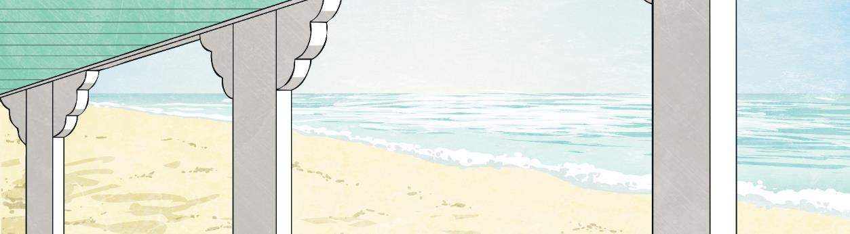

Fractions on a Number Line
Deeper
On my number line, I start at 1.
I move forwards 2 spaces, backwards 1 space and forwards
5 more spaces.
Anna
Anna lands on 2.
What number does Anna land on?
1
1
1
6
1
2
6
1
3
6
1
4
6
1
5
6
2

Slide 9
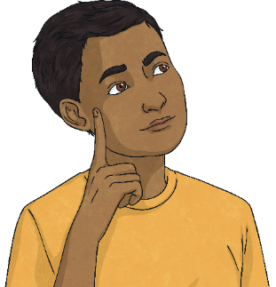
Fractions on a Number Line
Deeper
If I start at 1 and move backwards ,
I would land on zero.
1
6
No. 1 represents . Moving backwards by will put you onto .
6
6
1
6
5
6
Do you agree? Explain your reasoning.
5
6
1
1
1
6
1
2
6
1
3
6
1
4
6
1
5
6
2

Slide 10
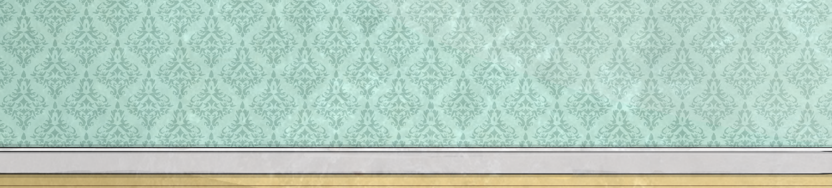
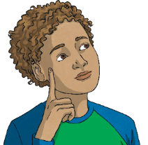
Fractions on a Number Line
Deeper
No. As you can see by the length of the number line, it takes more jumps to reach 1 (more than )
than it does it to reach 1 (more than ).
The number lines will go over 1 at the same point.
1
4
4
4
1
3
3
3
Do you agree? Explain your reasoning.
more than 1
0
1
3
2
3
3
3
1
1
3
more than 1
0
1
4
2
4
3
4
4
4
1
1
4

Slide 11



Fractions on a Number Line
Deepest
Some shapes have been removed from a number line.
Use the clues to work out where the shapes are placed on the number line.
0
1
I am 4 away from triangle.
I am at the half way point.
I am between two shapes.
I am two away from 1.

Slide 12
Fractions on a Number Line
Deepest
Only a fraction of each line can be seen. The rest is hidden. Each line stops at a whole. Which whole line is longer?
Explain your reasoning.
1
4
Line A:
1
3
Line B:

Slide 13
Fractions on a Number Line
Deepest
Only a fraction of each line is seen. The rest is hidden. Each line stops at a whole. Which whole line is longer?
Explain your reasoning.
1 whole
1
4
2
4
3
4
4
4
Line A:
1 whole
1
3
2
3
3
3
Line B:
Line A needs 3 more parts to make a whole. Line B needs an extra 2.
Therefore, Line A is longer than Line B.

Slide 14
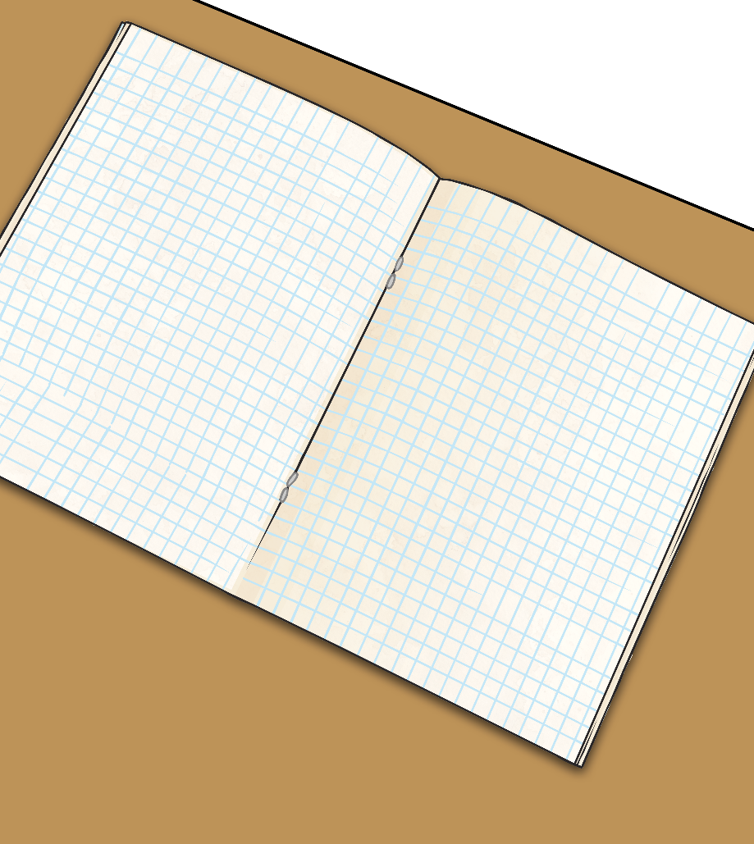

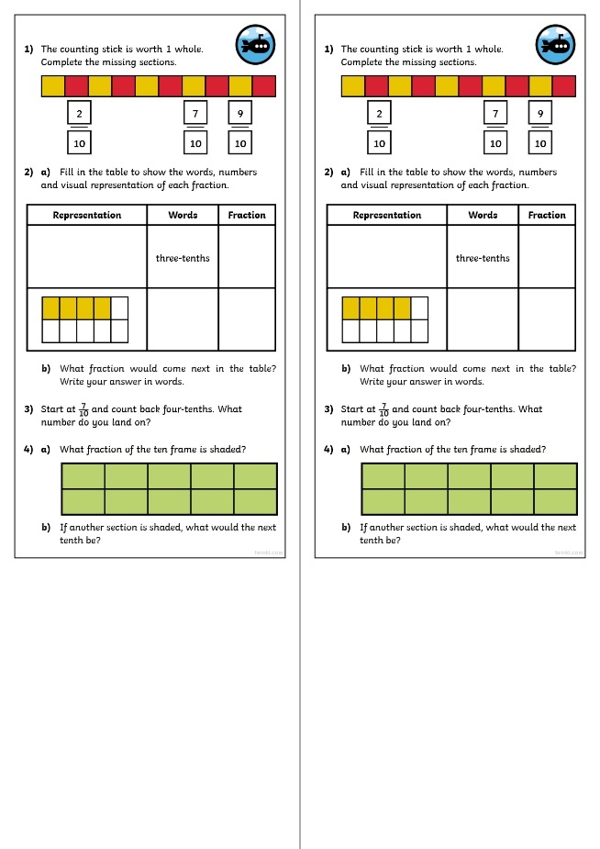
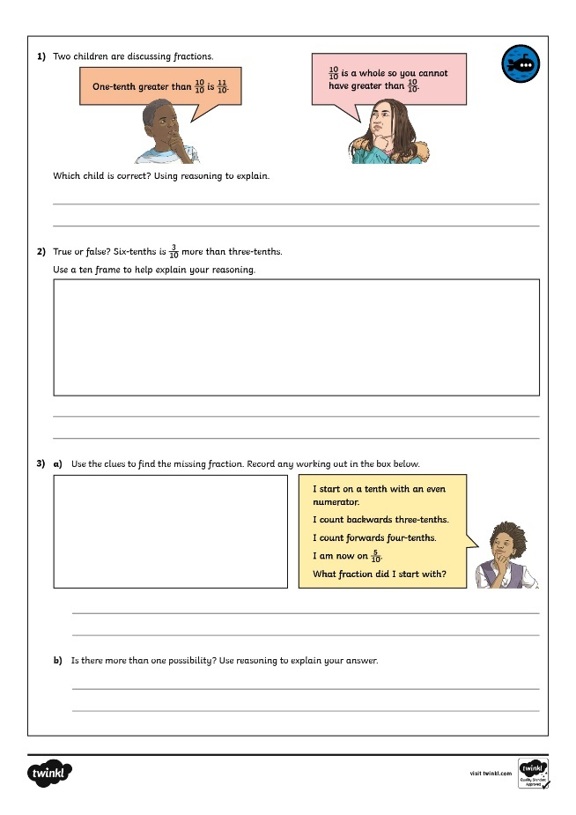
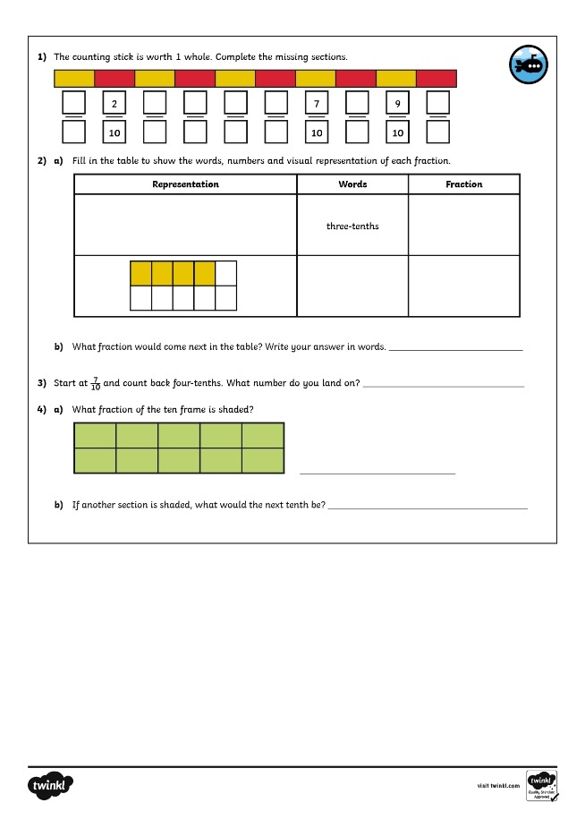
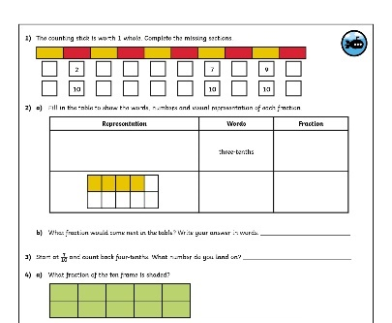
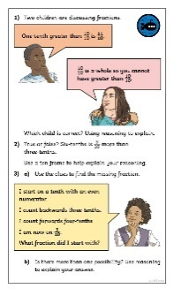
Fractions on a Number Line
Dive in by completing your own activity!

Slide 15
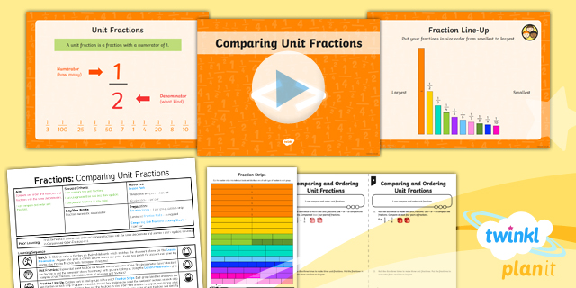
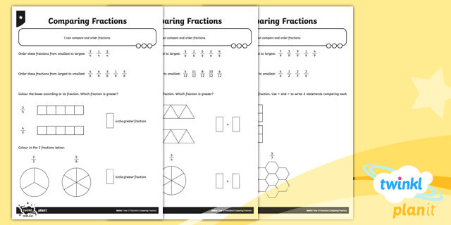

Need Planning to Complement this Resource?
National Curriculum Aim
Compare and order unit fractions and fractions with
the same denominators.
For more planning resources to support this aim, click here.
Twinkl PlanIt is our award-winning scheme of work
with over 4000 resources.

