Slide 2



Diving into Mastery Guidance for Educators
Each activity sheet is split into three sections, diving, deeper and deepest, which are represented by the following icons:
These carefully designed activities take your children through a learning journey, initially ensuring they are fluent with the key concept being taught; then applying this to a range of reasoning and problem-solving activities.
These sheets might not necessarily be used in a linear way. Some children might begin at the ‘Deeper’ section and in fact, others may ‘dive straight in’ to the ‘Deepest’ section if they have already mastered the skill and are applying this to show their depth of understanding.
Diving
Deeper
Deepest

Slide 3
Aim
Count up and down in tenths; recognise that tenths arise from dividing an object into 10 equal parts and in dividing one-digit numbers or quantities by 10.

Slide 4
Tenths as Decimals
Diving
What decimal fraction is shown?
= 0.3
0.3
0.6
0.8

Slide 5
Tenths as Decimals
Diving
What decimal fraction is shown?
0.1 | 0.1 | 0.1 | 0.1 | 0.1 | 0.1
= 0.6
0.3
0.6
0.8

Slide 6
Tenths as Decimals
Diving
What decimal fraction is shown?
0
0.1
0.2
0.3
0.4
0.5
0.6
0.7
1
0.3
0.6
0.7

Slide 7
Tenths as Decimals
Diving
Which fractions and decimals match the image?
0.1
0.1
0.1
0.1
0.1
0.1
4
10
0.6
7
10
6
10
0.5

Slide 8

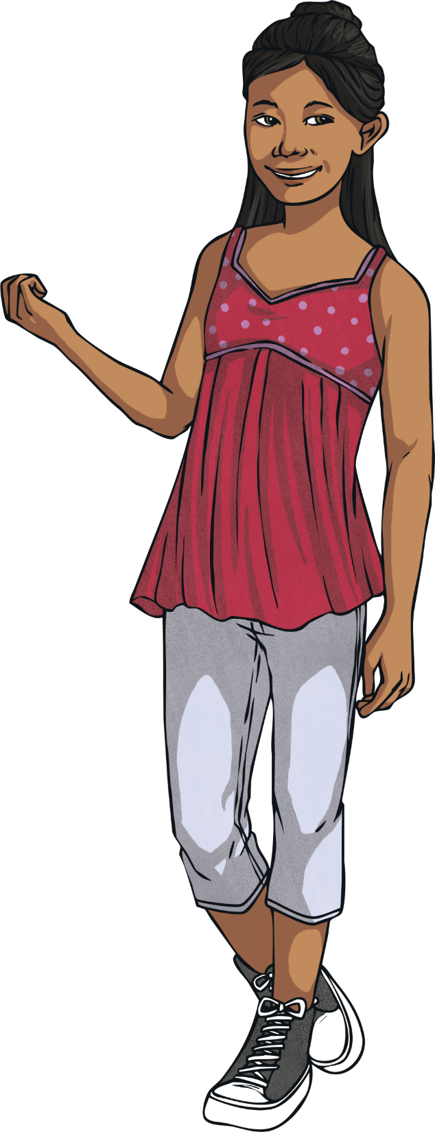
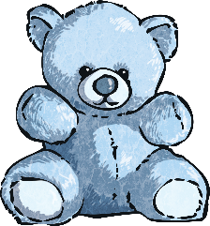
Tenths as Decimals
Deeper
True or false?
Each teddy bear represents a tenth. If I add another two teddy bears, 0.7 will be represented.
The answer is false. 0.6 or will be represented.
6
10

Slide 9
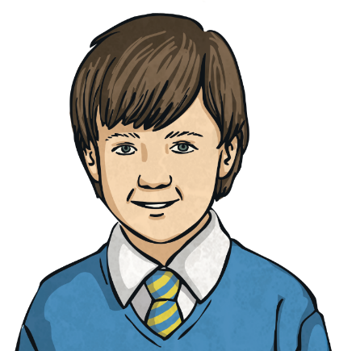
Tenths as Decimals
Deeper
True or false?
4
10
2
10
0.3
five-tenths
0.7
If I order the fractions and decimals on a number line from smallest to largest, 0.7 will be the third largest.
0
1
False. 0.7 is the largest decimal fraction when ordered.

Slide 10

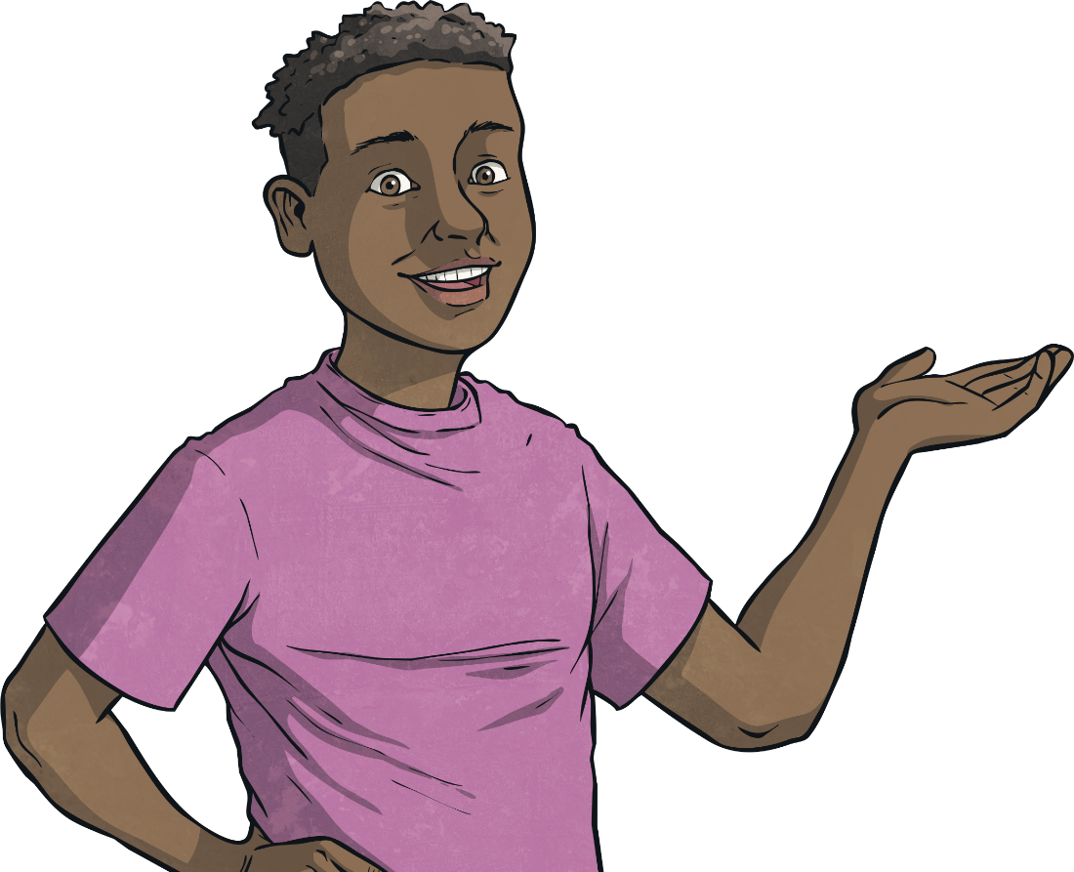
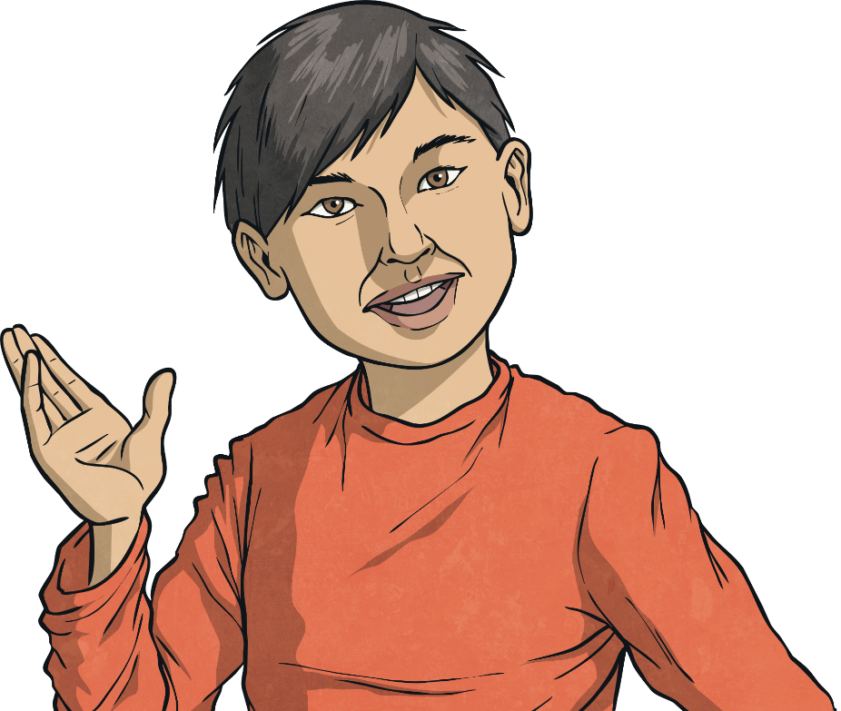
Tenths as Decimals
Deepest
Sunny and Jared are counting up and down in tenths.
Sunny starts at 1.4 and counts backwards.
Jared starts at 0.6 and counts forwards.
What decimal will they reach at the same time?
Draw then explain your answer.

Slide 11
Tenths as Decimals
Deepest
Sunny starts at 1.4 and counts backwards.
Jared starts at 0.6 and counts forwards.
0.6
0.7
0.8
0.9
1.0
1.1
1.2
1.3
1.4
The answer is 1.0. If they each take equal turns, they will reach 1.0 at the same time.

Slide 12
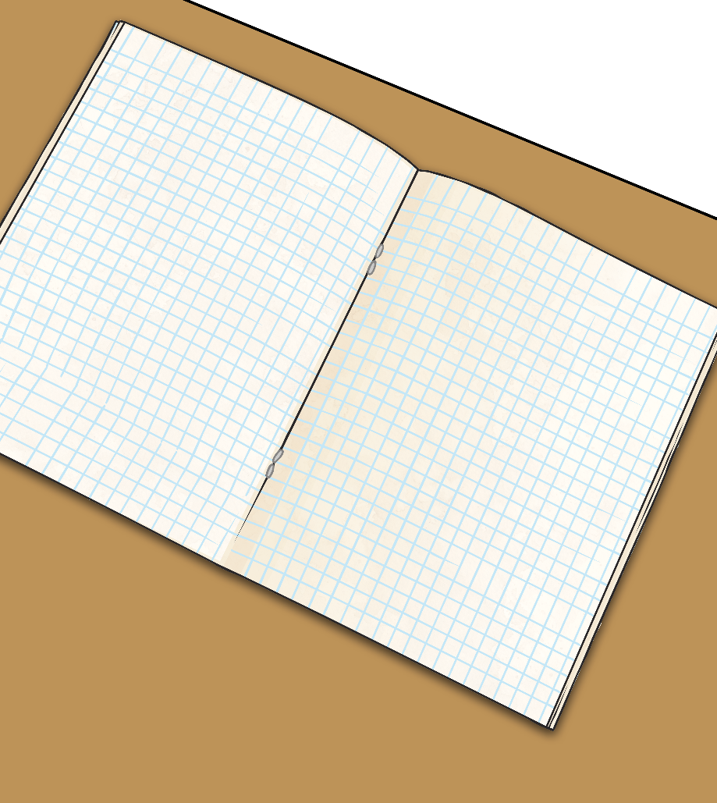
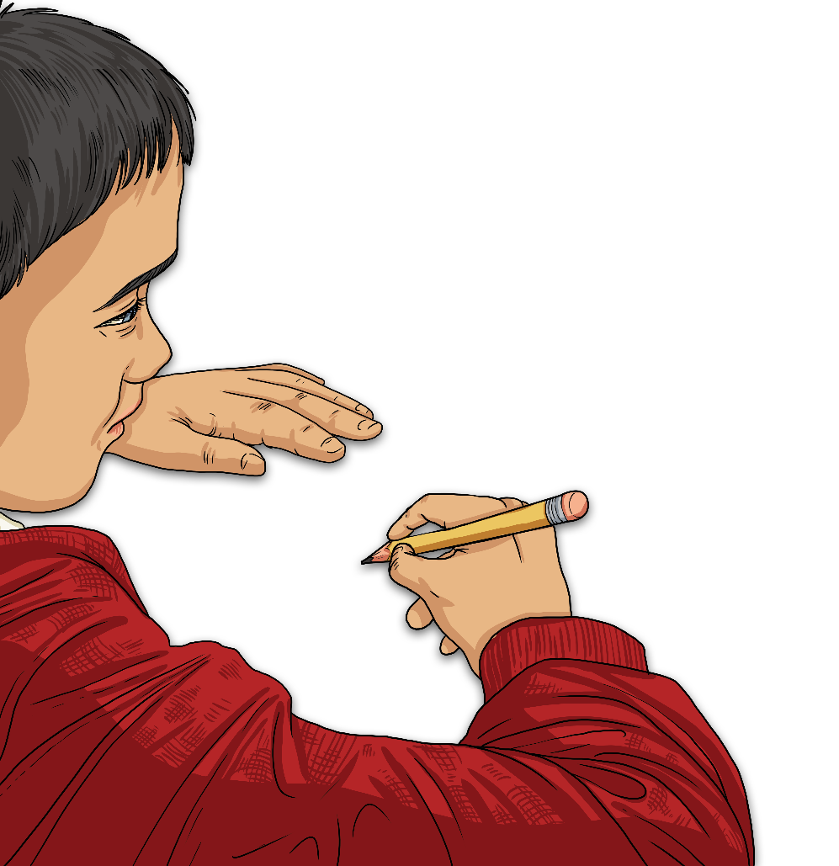
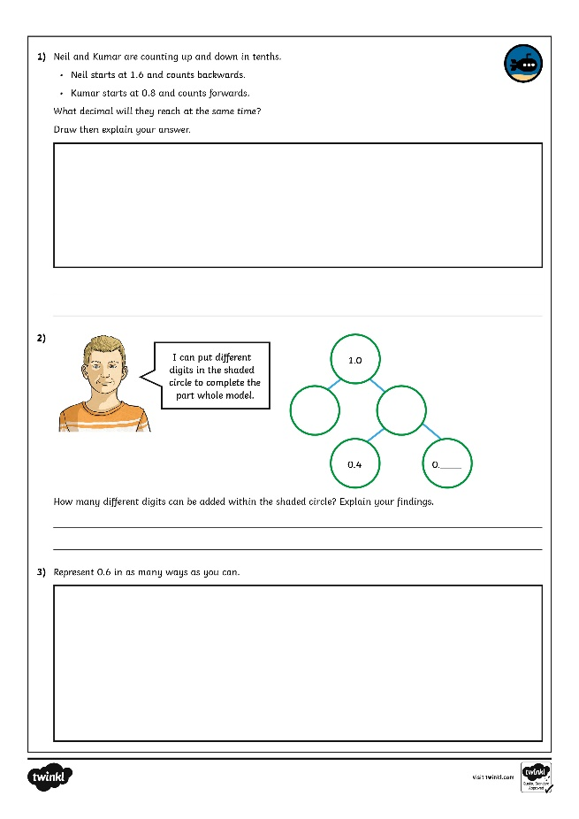
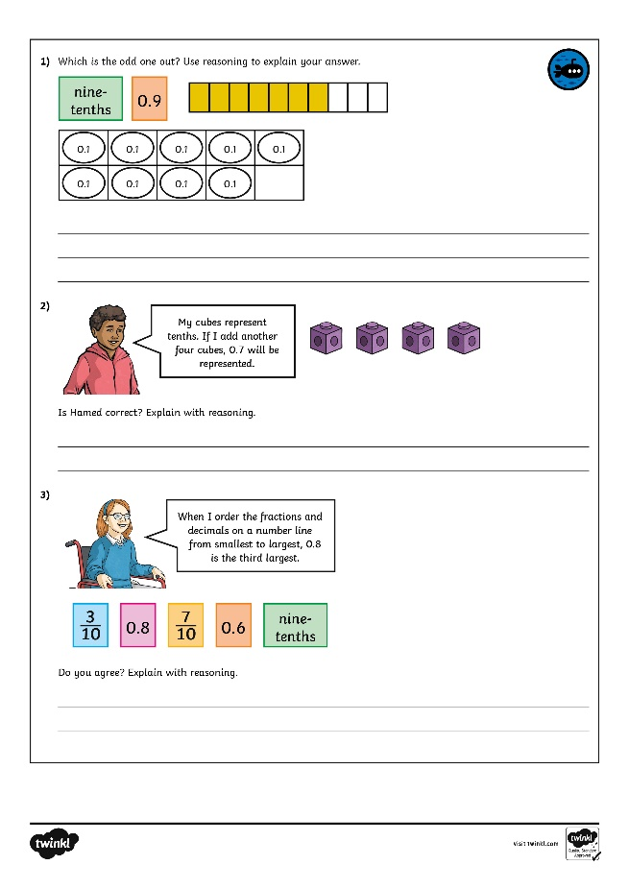
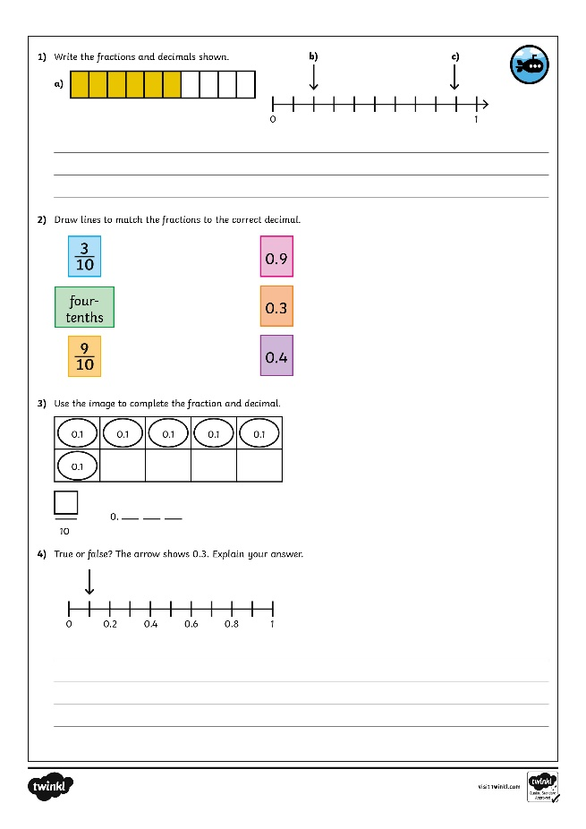
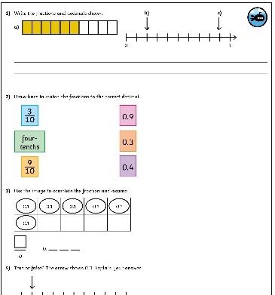
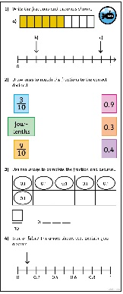
Tenths as Decimals
Dive in by completing your own activity!

Slide 13
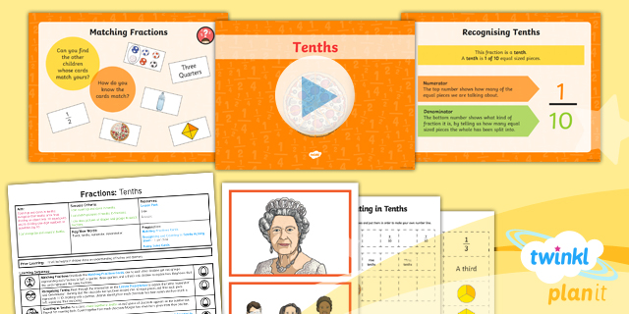
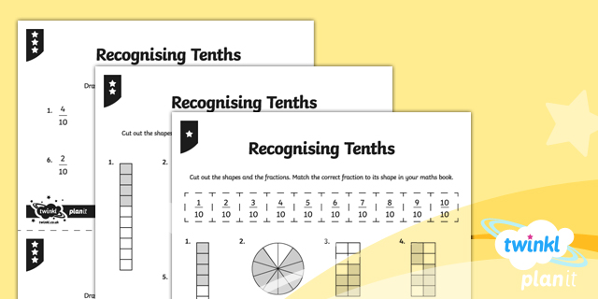

Need Planning to Complement this Resource?
National Curriculum Aim
Count up and down in tenths; recognise that tenths arise from dividing an object into10 equal parts and in dividing one-digit numbers or quantities by 10.
For more planning resources to support this aim, click here.
Twinkl PlanIt is our award-winning scheme of work
with over 4000 resources.

