Slide 2



Diving into Mastery Guidance for Educators
Each activity sheet is split into three sections, diving, deeper and deepest, which are represented by the following icons:
These carefully designed activities take your children through a learning journey, initially ensuring they are fluent with the key concept being taught; then applying this to a range of reasoning and problem-solving activities.
These sheets might not necessarily be used in a linear way. Some children might begin at the ‘Deeper’ section and in fact, others may ‘dive straight in’ to the ‘Deepest’ section if they have already mastered the skill and are applying this to show their depth of understanding.
Diving
Deeper
Deepest

Slide 3
Aim
Count up and down in tenths; recognise that tenths arise from dividing an object into 10 equal parts and in dividing one-digit numbers or quantities by 10.

Slide 4

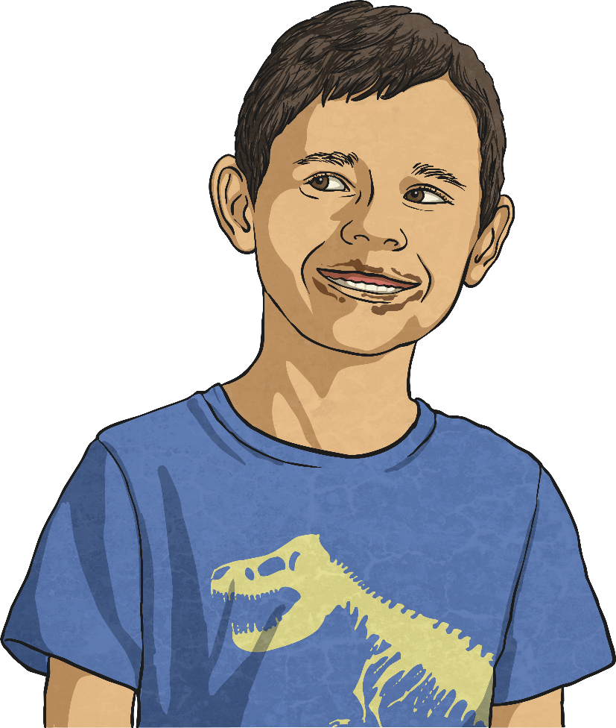
Tenths
Diving
Morgan’s chocolate is broken into pieces.
4
10
What fraction of Morgan’s chocolate is circled?

Slide 5
Tenths
Diving
Morgan’s chocolate is broken into pieces.
6
10
What fraction of Morgan’s chocolate is circled?

Slide 6
Tenths
Diving
Morgan’s chocolate is broken into pieces.
5
10
What fraction of Morgan’s chocolate is not circled?

Slide 7


Tenths
Deeper
My denominator is 10. My numerator is under 7 but over 1.
What could Morgan’s fraction be?
Explain with reasoning.
, , , or
These all have numerators greater than 1 and less than 7.
2
10
3
10
4
10
5
10
6
10

Slide 8
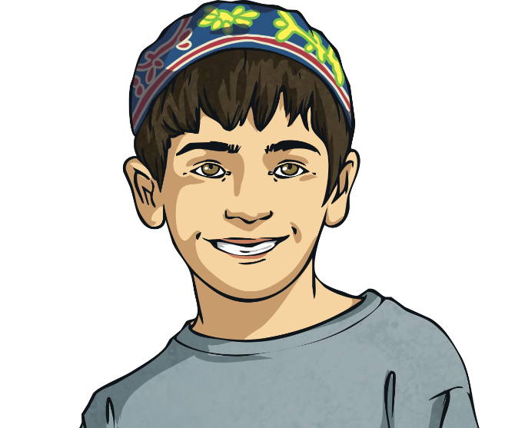
Tenths
Deeper
My numerator is half of the denominator.
2
10
5
10
7
10
6
10

Slide 9
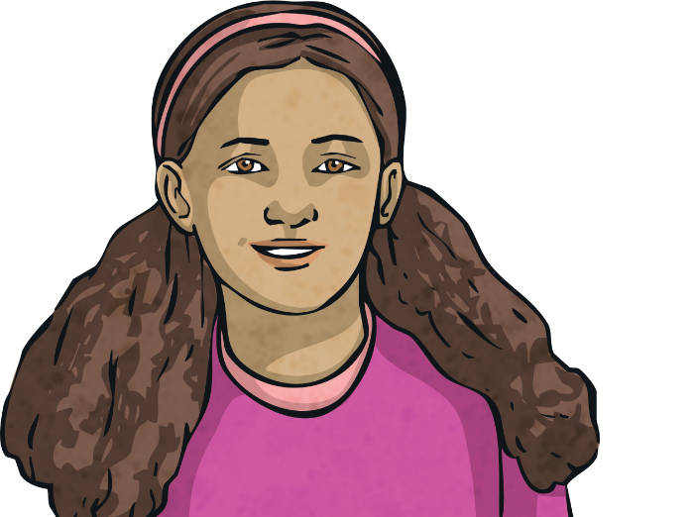
Tenths
Deeper
My fraction is made up of 3 unit fractions.
1
10
2
10
3
10
4
10

Slide 10

Tenths
Deeper
My fraction is less than a whole.
3
10
3
10
5
10
7
10
9
10

Slide 11

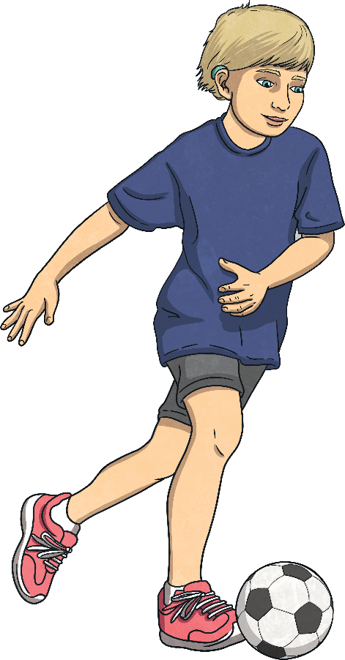
Tenths
Deepest
There are 10 outfield footballers in a team.
of the team played in defence.
3
10
of the team played in central midfield.
4
10
2
10
of the team played attacking midfield.
1
10
of the team played in the striker’s position.
After the match, Gary interviewed half of the team but
they were all players from the same two positions.
Which players might have been interviewed.
defence and attacking midfield = central midfield and striker =
5
10
5
10

Slide 12
Tenths
Deepest
Put these fractions into the part-whole model.
10
10
3
10
1
10
7
10
6
10

Slide 13
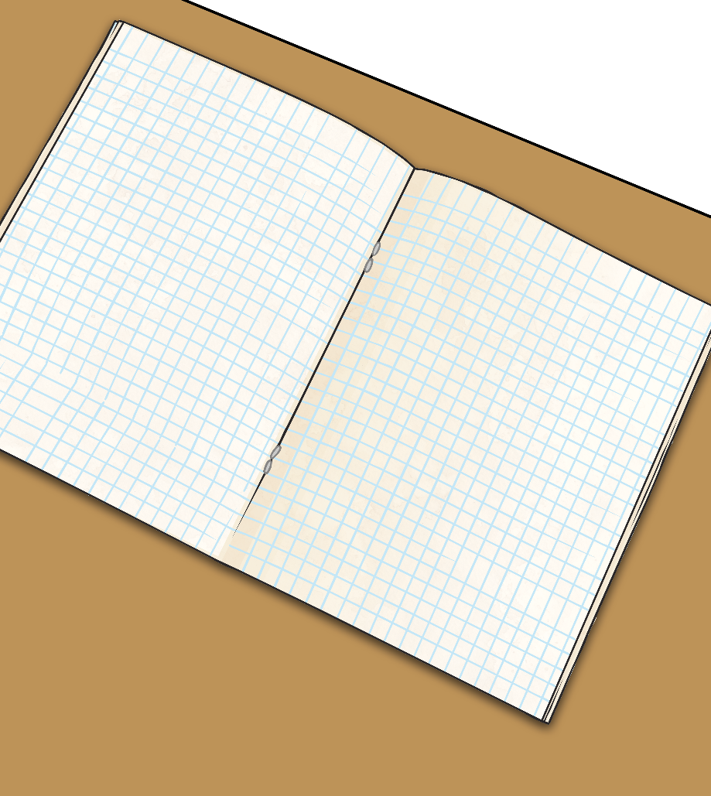
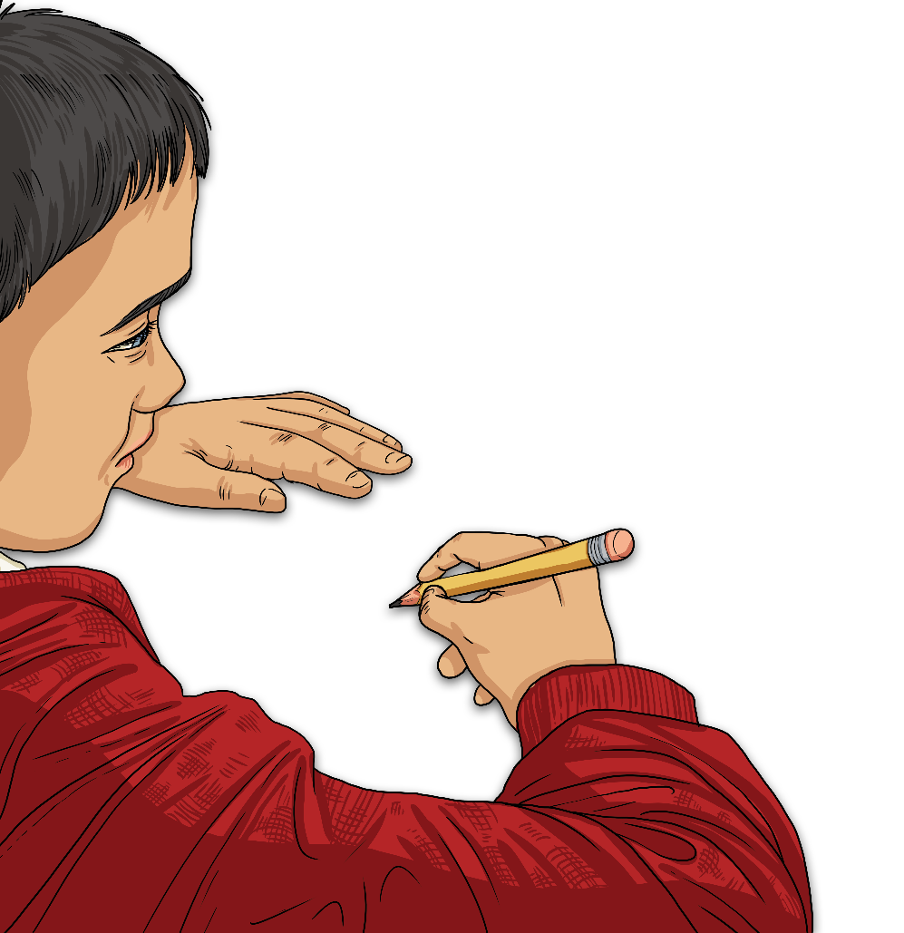
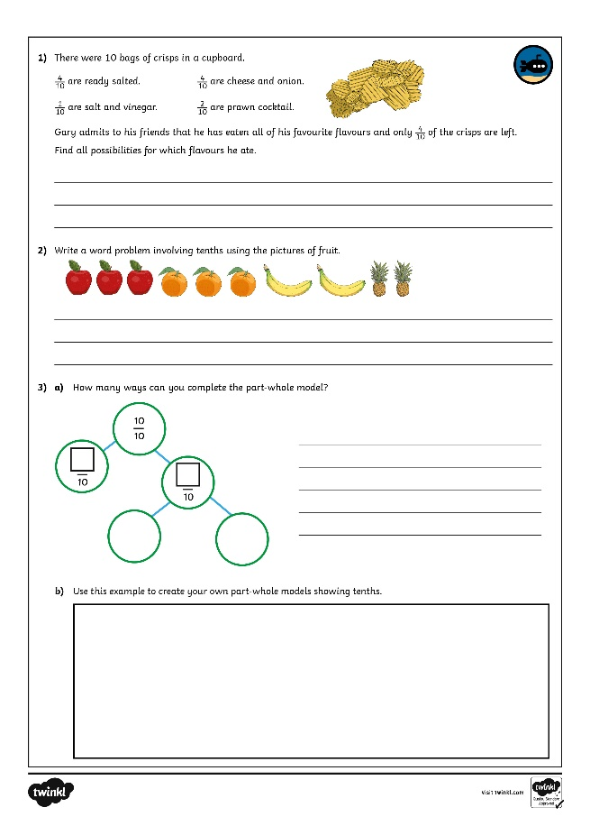
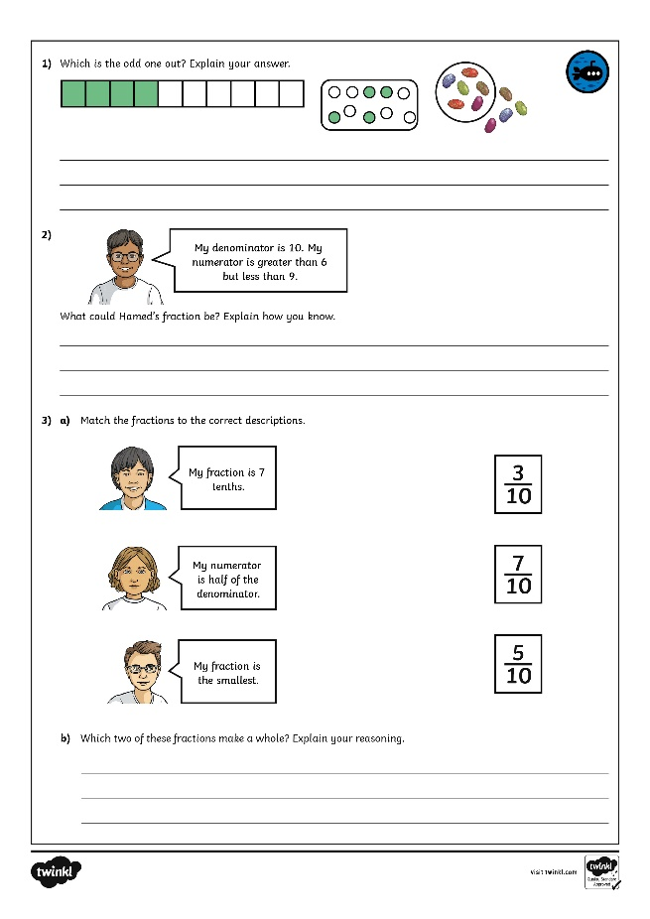
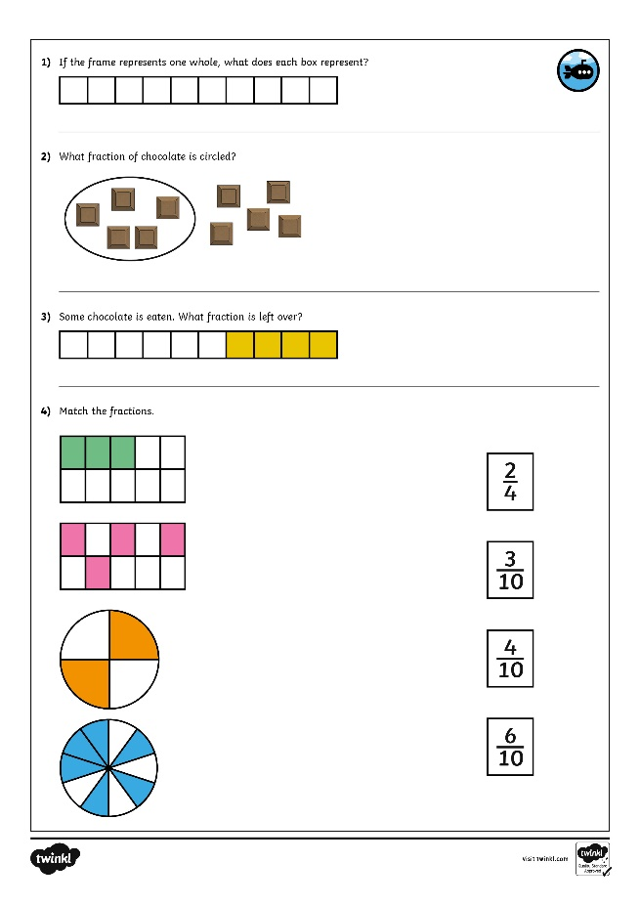

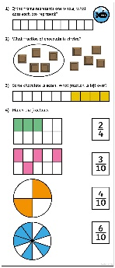
Tenths
Dive in by completing your own activity!

Slide 14
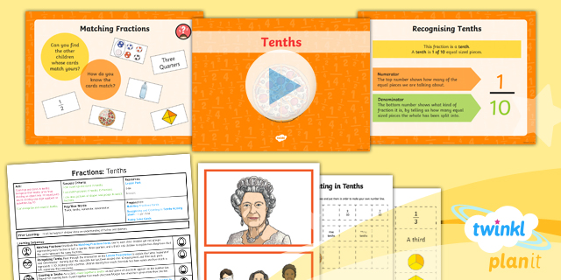
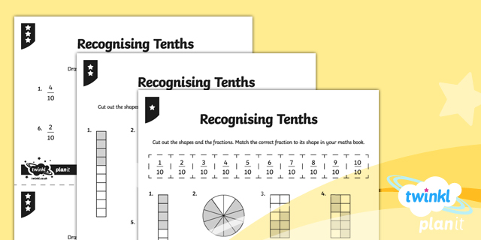

Need Planning to Complement this Resource?
National Curriculum Aim
Count up and down in tenths; recognise that tenths arise from dividing an object into 10 equal parts and in dividing one-digit numbers or quantities by 10.
For more planning resources to support this aim, click here.
Twinkl PlanIt is our award-winning scheme of work
with over 4000 resources.

