Slide 2



Diving into Mastery Guidance for Educators
Each activity sheet is split into three sections, diving, deeper and deepest, which are represented by the following icons:
These carefully designed activities take your children through a learning journey, initially ensuring they are fluent with the key concept being taught; then applying this to a range of reasoning and problem-solving activities.
These sheets might not necessarily be used in a linear way. Some children might begin at the ‘Deeper’ section and in fact, others may ‘dive straight in’ to the ‘Deepest’ section if they have already mastered the skill and are applying this to show their depth of understanding.
Diving
Deeper
Deepest

Slide 3
Aim
Recognise and use fractions as numbers: unit fractions and non-unit fractions with small denominators.

Slide 4
Making the Whole
Diving
What fraction of the counters are yellow?
3
5
2
5
5
5
1
5

Slide 5
Making the Whole
Diving
What fraction of the counters are blue?
3
5
2
5
5
5
1
5

Slide 6
Making the Whole
Diving
What fraction of the counters are blue and yellow?
3
5
2
5
5
5
1
5

Slide 7
Making the Whole
Diving
Which number sentence satisfies the bar model?
2
7
2
7
3
7
7
7
+
+
=
2
7
3
7
1
7
7
7
+
+
=
3
7
3
7
1
7
7
7
+
+
=

Slide 8

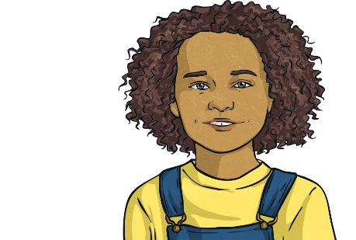
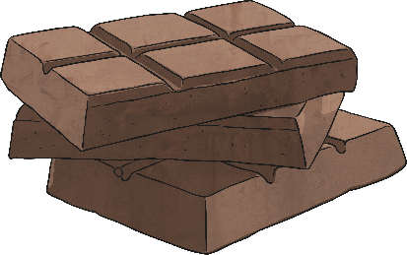
Making the Whole
Deeper
My chocolate bar is broken into 9 equal pieces. I eat 4 pieces and Alex eats 5.
Does Brianne have any chocolate left? Explain with reasoning.
4
9
+
5
9
=
9
9
9
9
All of the chocolate have been eaten. There is no chocolate left.

Slide 9
Making the Whole
Deeper
True or false?
4
4
3
3
and
Both of these fractions are equal to one whole.
Choose an appropriate method and explain with reasoning.
4
4
3
3
is equivalent to one whole
is equivalent to one whole

Slide 10

Making the Whole
Deepest
The shape is divided into four equal parts that add together to make a whole. Do you agree?
1
4
1
4
1
4
1
4
4
4
All four parts are equal and total altogether.

Slide 11
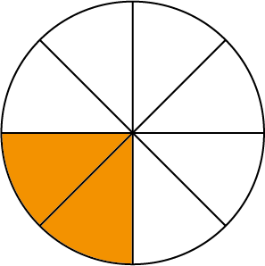
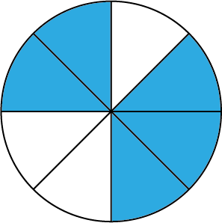
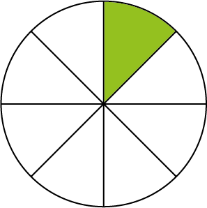
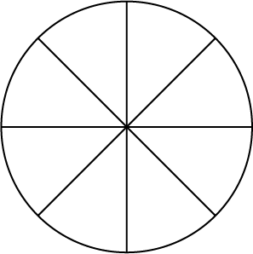
Making the Whole
Deepest
1
8
1
4
Cici ate of a pizza, Woody ate and Rustie ate the rest. How much pizza did each person eat? Draw and label your answer.
Cici ate 1 slice.
Rustie ate 5 slices.
Woody ate 2 slices.

Slide 12
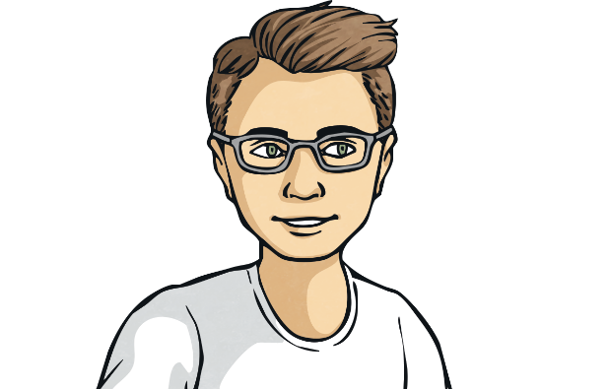
Making the Whole
Deepest
I add three non-unit fractions together to make a whole.
What three fractions could Simon be thinking of?
Explain your answer using reasoning.
You may have found many possible answers.
For example: + + =
2
9
3
9
4
9
9
9

Slide 13
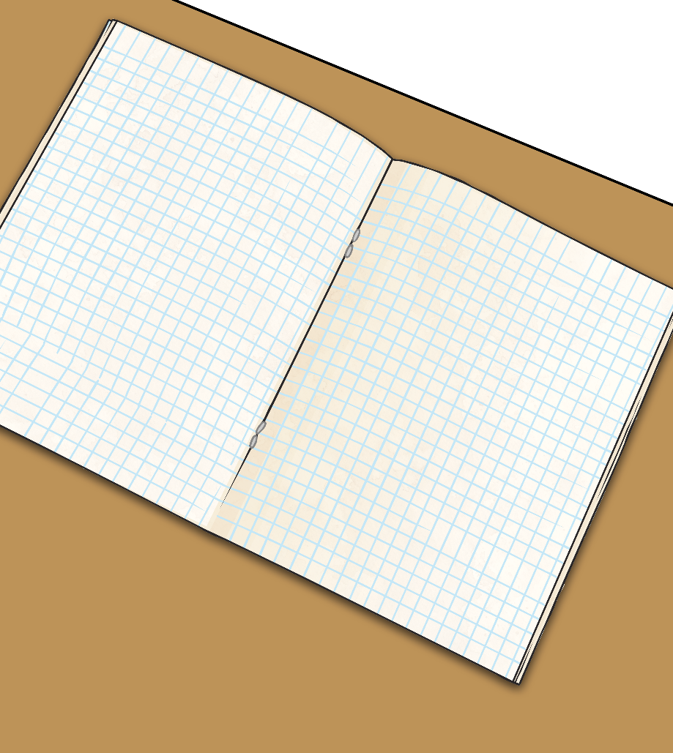
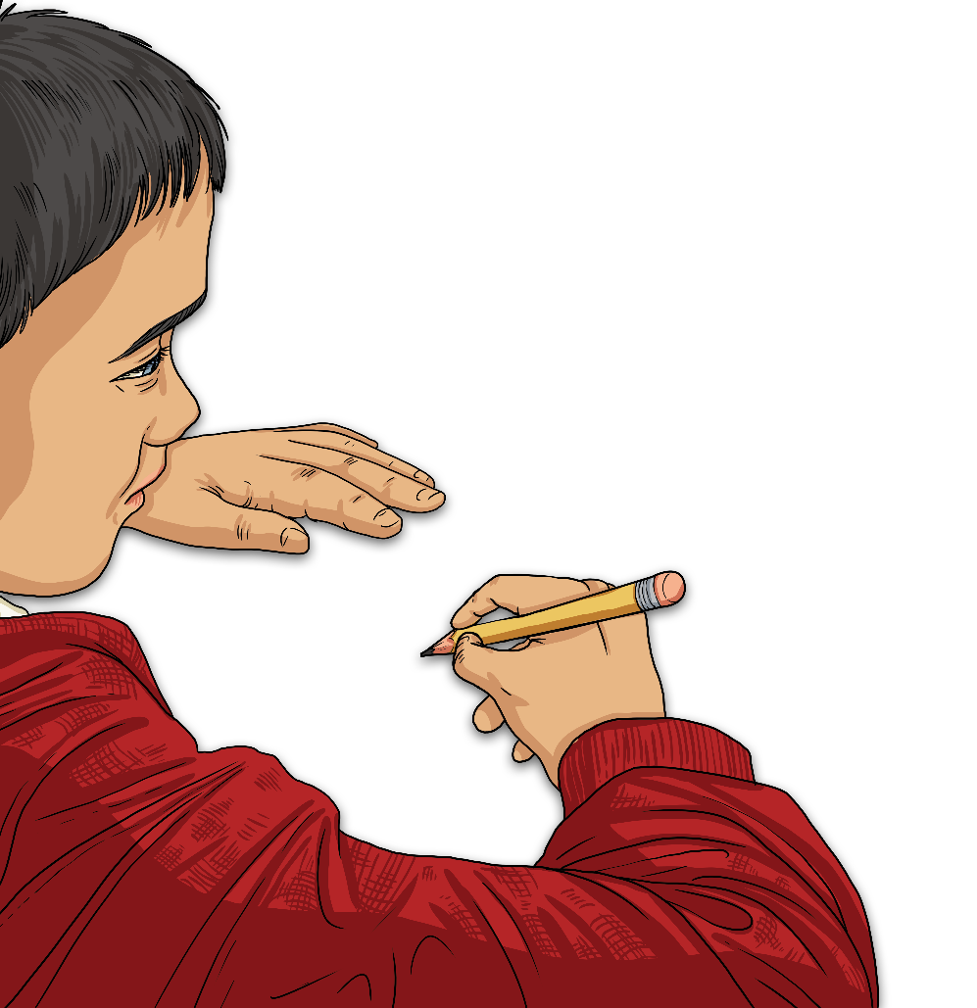
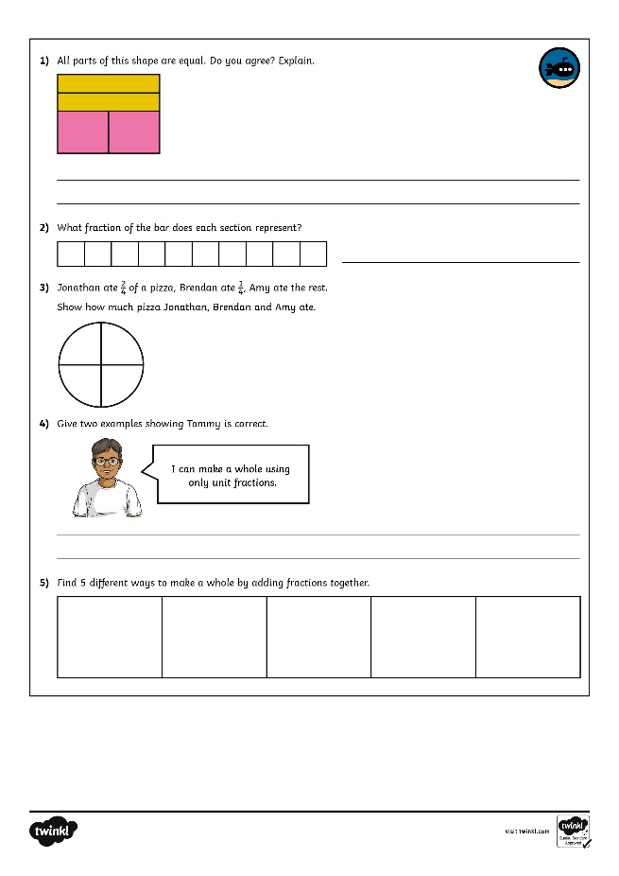
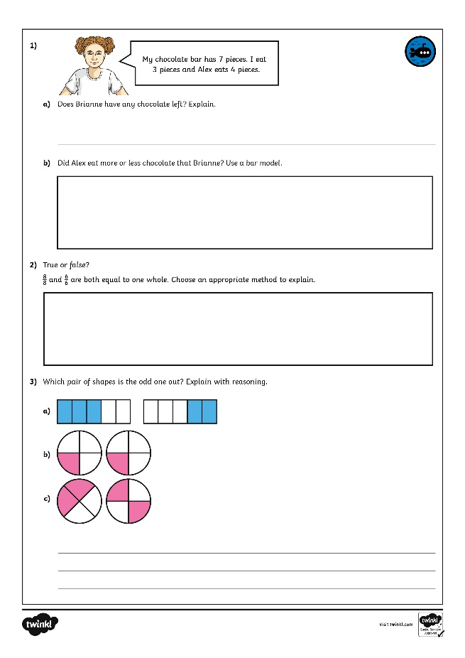
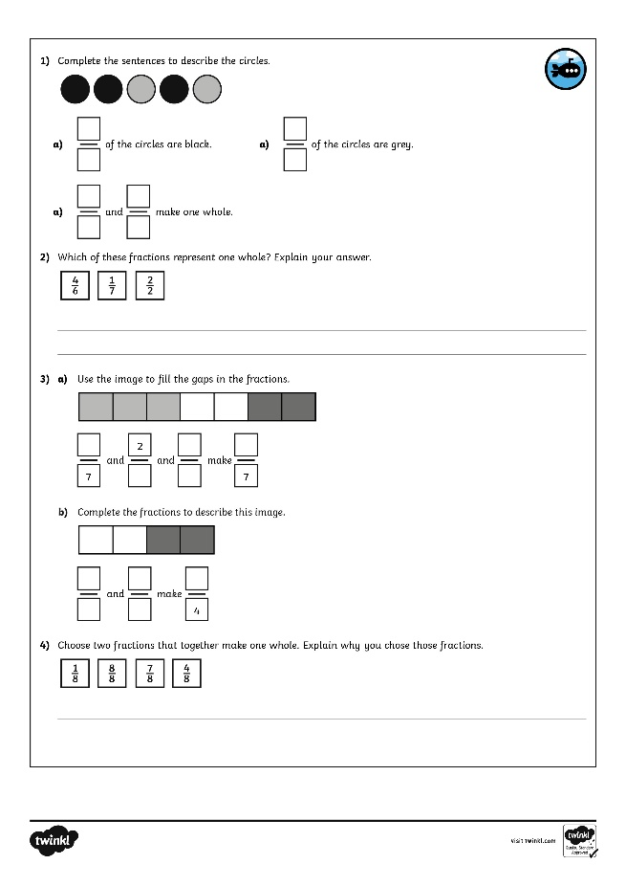
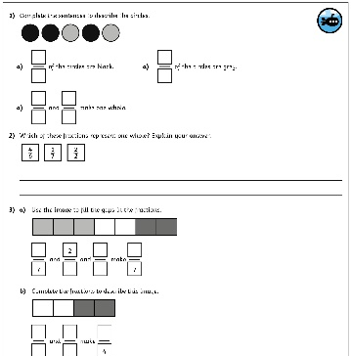
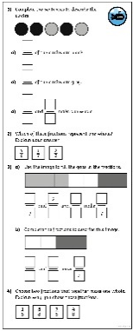
Making the Whole
Dive in by completing your own activity!

Slide 14
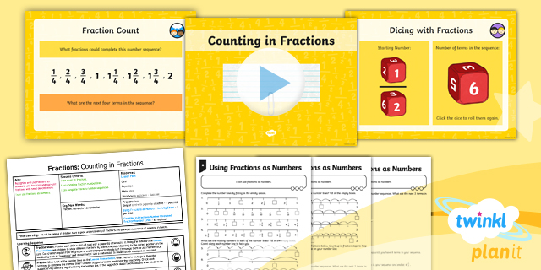
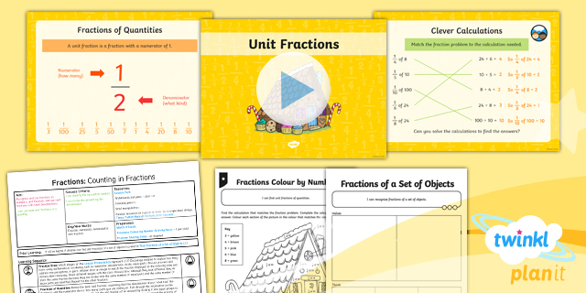

Need Planning to Complement this Resource?
National Curriculum Aim
Recognise and use fractions as numbers: unit fractions and non-unit fractions with small denominators.
For more planning resources to support this aim, click here.
Twinkl PlanIt is our award-winning scheme of work
with over 4000 resources.

