Slide 1
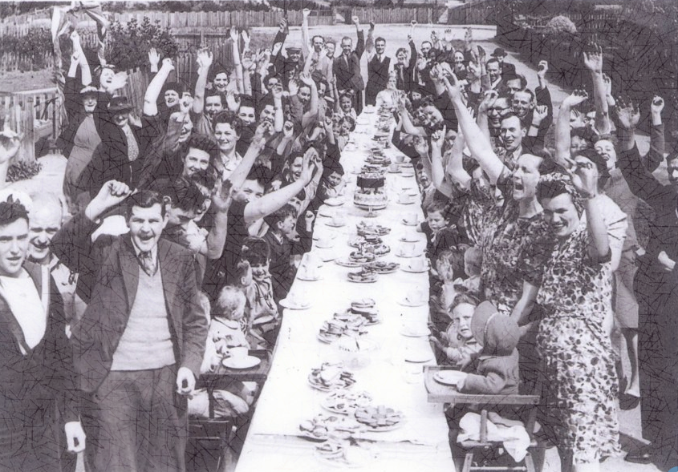
VE Day

Slide 2
TASK 1:

Slide 3
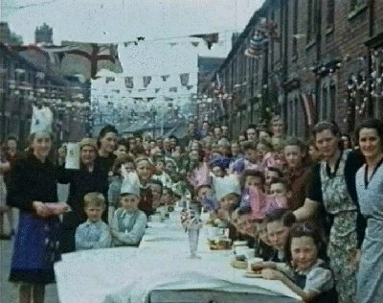
Victory in Europe (VE) Day.
Victory in Europe Day, generally known as VE Day or V-E Day, is a day celebrating the formal acceptance by the Allies of World War II of Nazi Germany's unconditional surrender of its armed forces on 8 May.

Slide 4
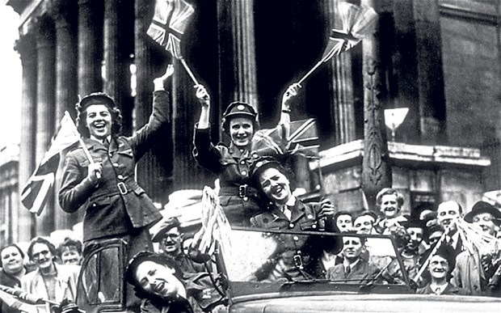
They agreed that they had lost the war and that the fighting should stop.
Millions of people had died in WWII so everyone was really happy that the fighting was over.

Slide 5
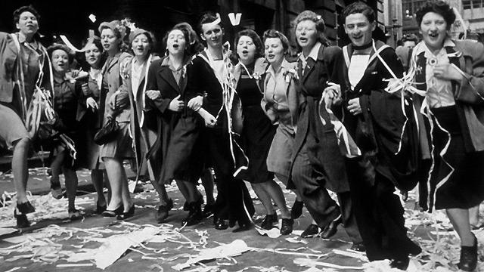
Many people found out about it because the church bells started ringing.

Slide 6
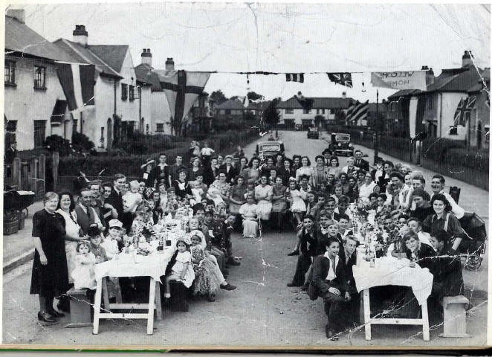
Lots of people came out onto the street dressed in red, white and blue.
They held parties in the street to celebrate with everyone that the war was over.

Slide 7
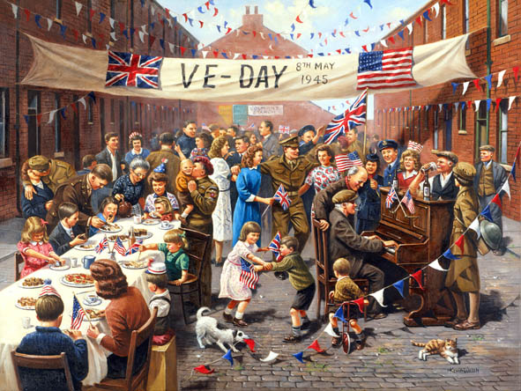
Because of rationing there wasn’t lots of food for sale so everyone coming to the party had to bring something.

Slide 8
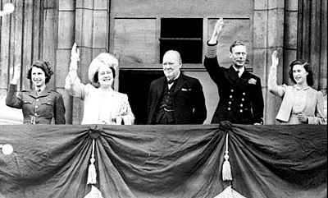
The King and Queen waved to everyone from the balcony of Buckingham palace.
Our current Queen and her sister went out and joined the party in the street! No-one knew who they were!

Slide 9
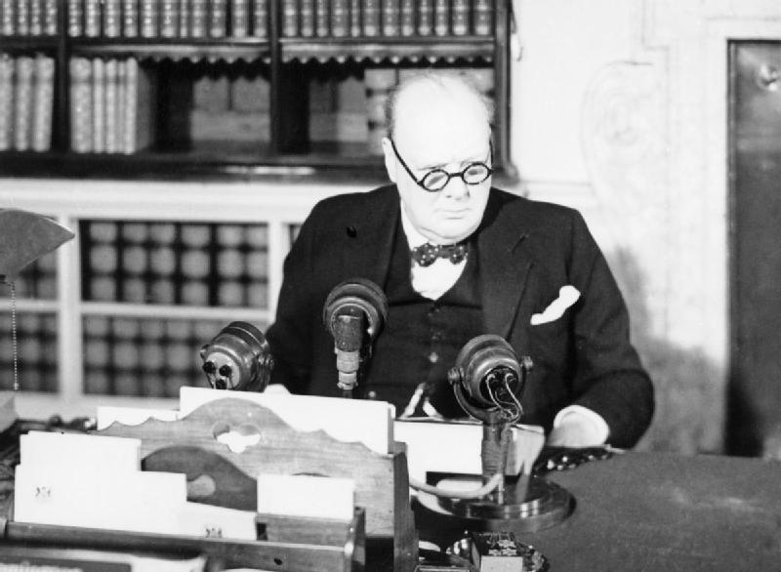
Winston Churchill went on the radio and told everyone about Germany surrendering. At the end of his speech he said
“This is your victory… Advance Britannia”.

Slide 10
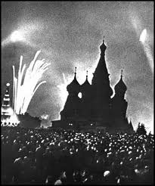
Everyone stayed up and there were bonfires and fireworks to celebrate.

Slide 11

TASK 1:
Your task is to write a ‘Postcard from the Past’
Imagine you were at the first VE day and heard the news that the war had ended.
What might you tell your family about what you heard? What you did? What you ate?
Draw a picture on the reverse showing what happened.

Slide 12
TASK 2:

Slide 13
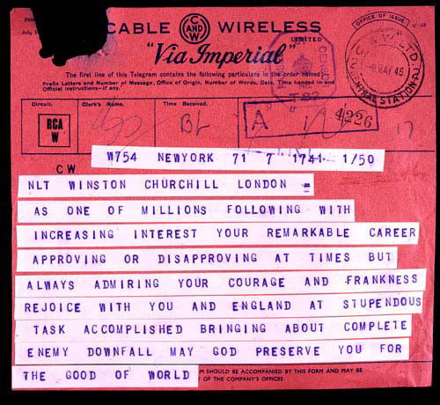
The slide shows one of the thousands of telegrams sent to Winston Churchill after Victory in Europe was announced. Explain that the impression given by the telegram is that Churchill’s job has been done. However, Churchill knew that this was far from being the case and that there were still a number of challenges Churchill and the rest of the British Government faced.

Slide 14
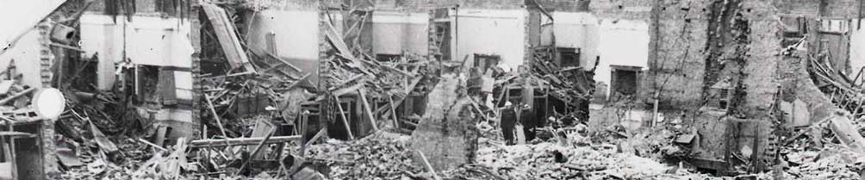
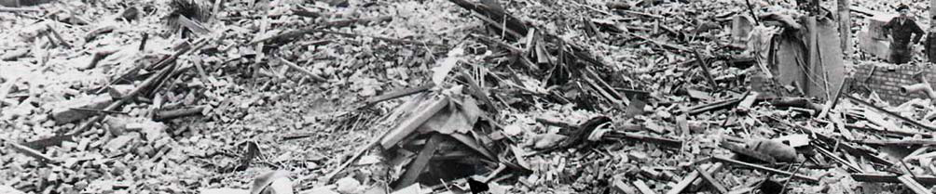
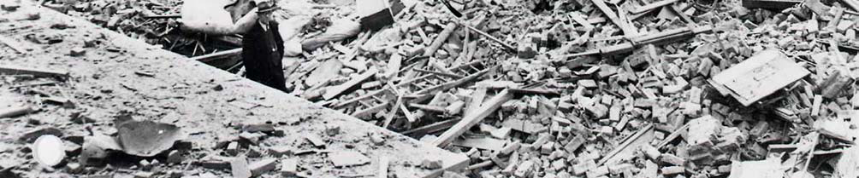
Shows bomb damage in London, 1944.

Slide 15
Traitors being rounded up in the Netherlands in 1945.

Slide 16
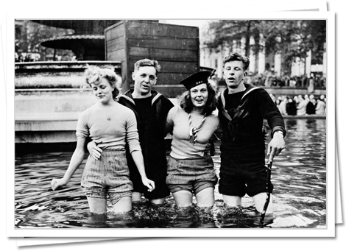
Two British soldiers and their girlfriends on VE Day.

Slide 17
Taken on May 8th 1945 (VE Day). Shows a crowd waiting in front of the Ministry of Health building in Whitehall for Churchill to make an official announcement of the end of the war from the balcony.

Slide 18
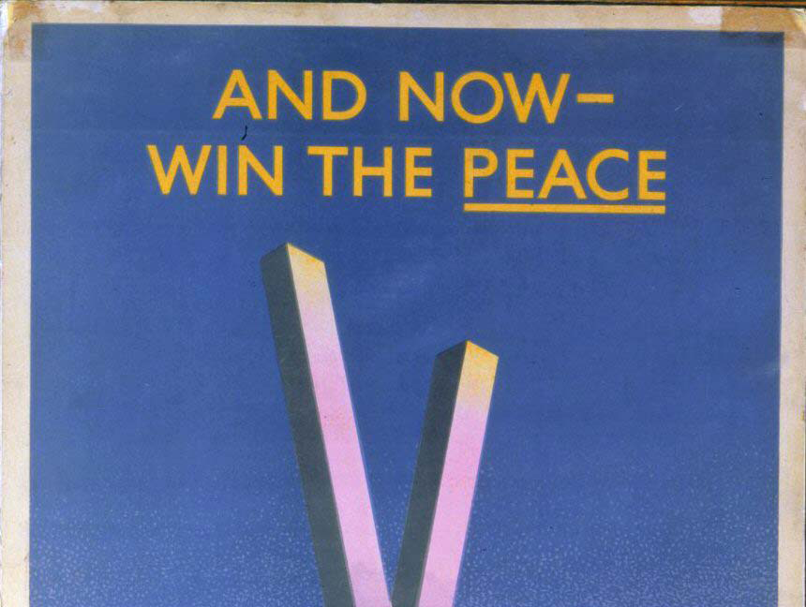
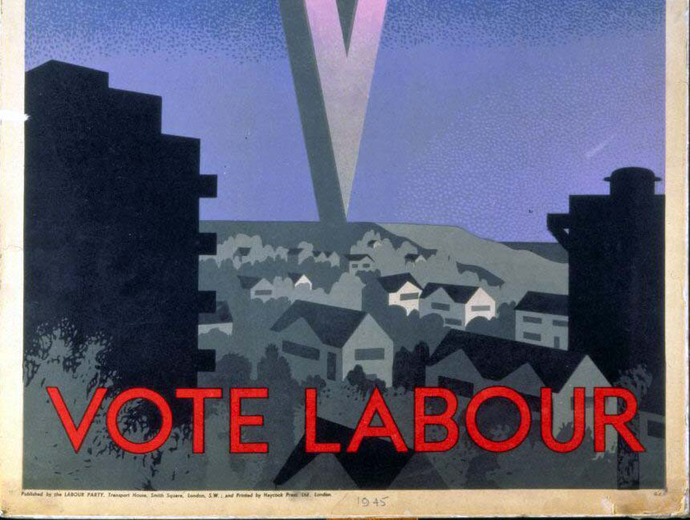
Labour election poster 1945. A General Election was held in 1945. Churchill was a member of the Conservative Party.

Slide 19
Churchill – despite winning the war – still faced many challenges:
Thousands of people were still homeless from the extensive bombing
British cities had received.
Collaborators and leading Nazis needed to be put on trial for war crimes.
Society had changed since the war began. Social ‘rules’ had become more relaxed. The Government had to take this into account.
Many people were keen for change and hoped for a new future.
Churchill had to persuade the public that he was not just a good war-time Prime Minister, but he could be a good peace-time PM also.

Slide 20
On top of this, Churchill also faced other challenges like:
The Allies were still at war with Japan.
Rationing was still needed. Would the British public continue to
accept it now the war was over?
Millions of people had been killed. How would that change society?
Evacuated children needed to be returned to their parents. Not
all of the parents were still alive, some were missing and some just
did not want their children back. What should be done with those
children?

Slide 21
TASK 2:
Your task is to write a telegram reply from Churchill.
For example ….
Dear Sir,
Thank you for your telegram of May 9th 1945. I am grateful for your kind words. However, I should stress there is much still to do. To begin with …
We also face many challenges here in Britain and in Europe. For example …

