Slide 1
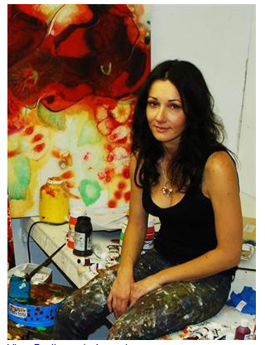
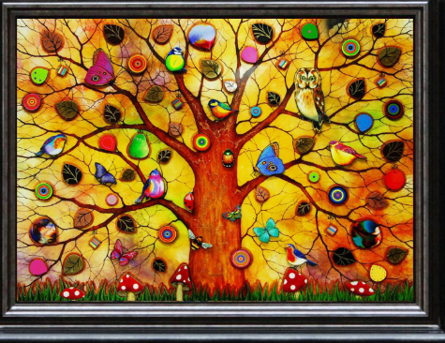
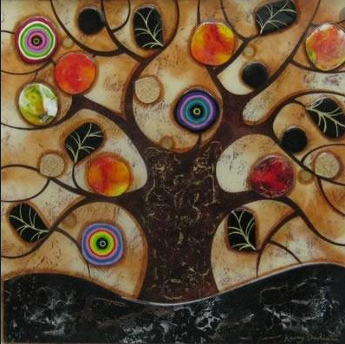
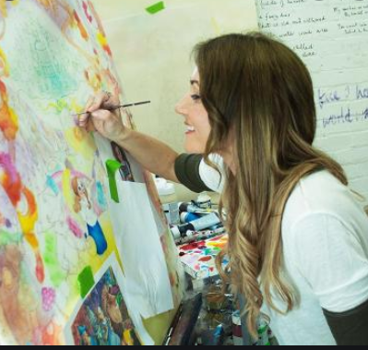
Kerry Darlington
art project

Slide 2
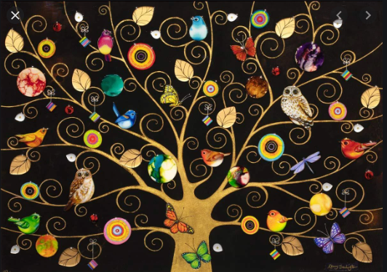
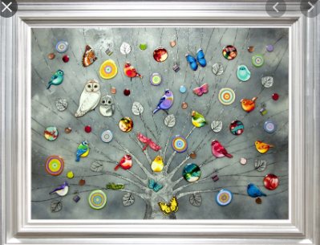
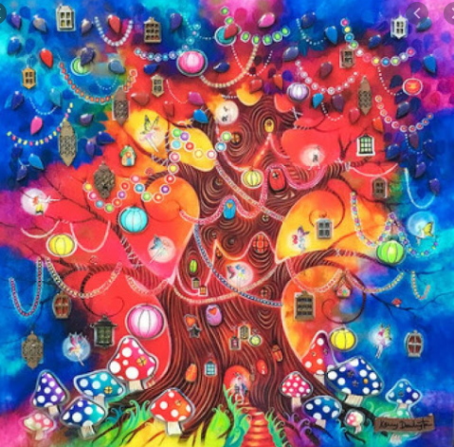
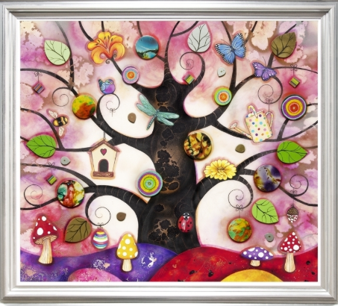

Slide 3
Kerry Darlington is a local artist. I love her work and it links brilliantly with ‘The Tin Forest’ Literacy work.
Kerry Darlington was born in 1974 in Rhyl, North Wales. She was inspired by magical fairy tale picture books and stories during her childhood. Some of her paintings are sold in a Chester art gallery.
Can you find out some more facts about Kerry Darlington?
What kind of painting materials does she like to use?
Choose one of her paintings and have a go at creating your own version. You could use different colours to the ones she used, water colours, sharpies, paint or sketching pencils to recreate your work
Draw different trees, animals, insects and blend colours
Investigate patterns and use hatching and cross hatching techniques
Draw your own forest to replace the tin forest in the story

Slide 4
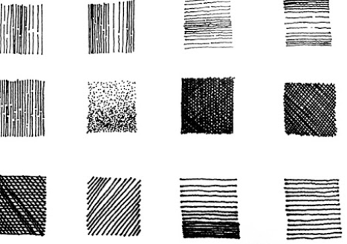
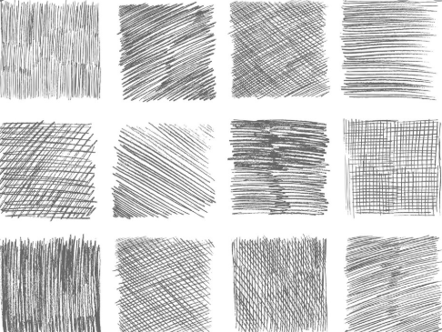
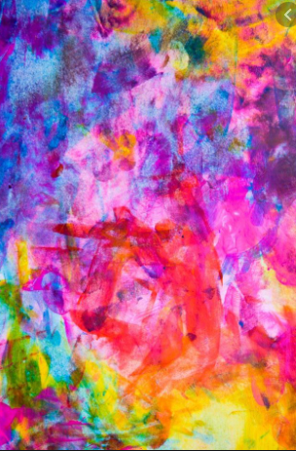
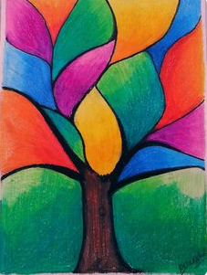
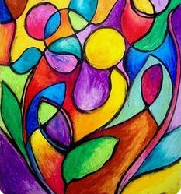
Blending, hatching and cross hatching examples

