Slide 1
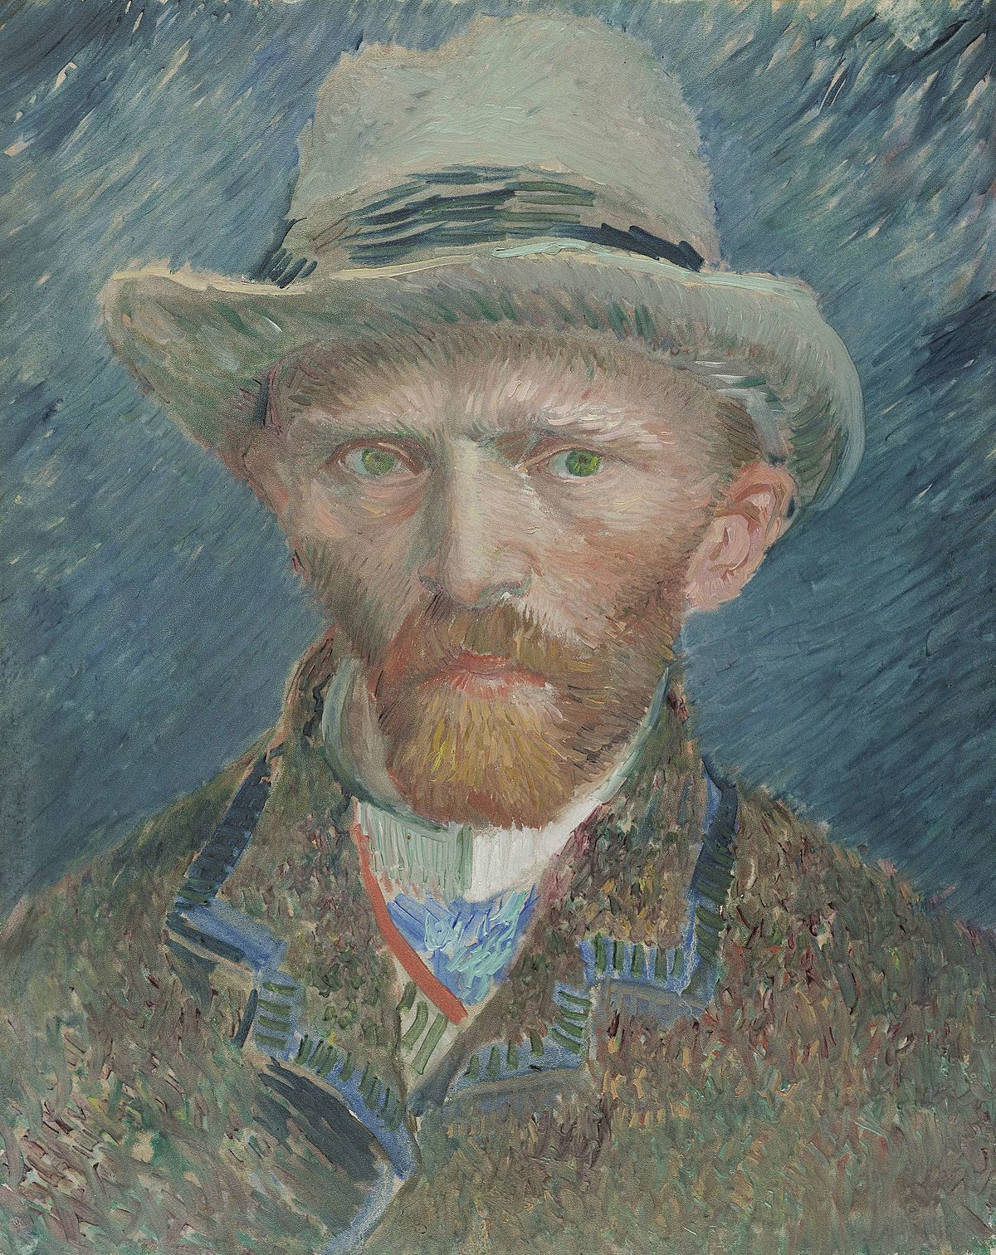
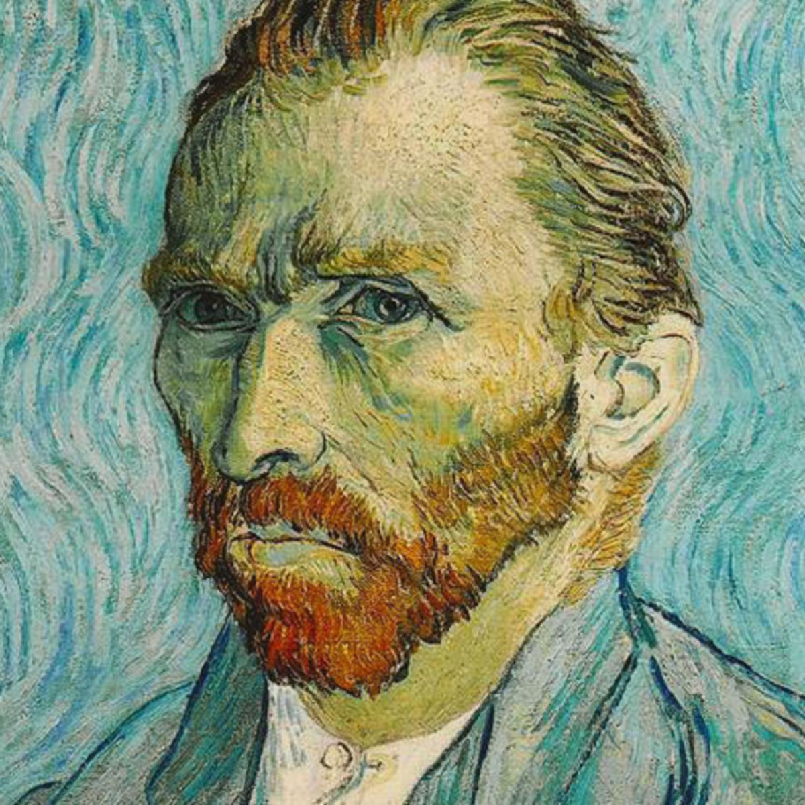
Vincent Van Gogh
Art project

Slide 2
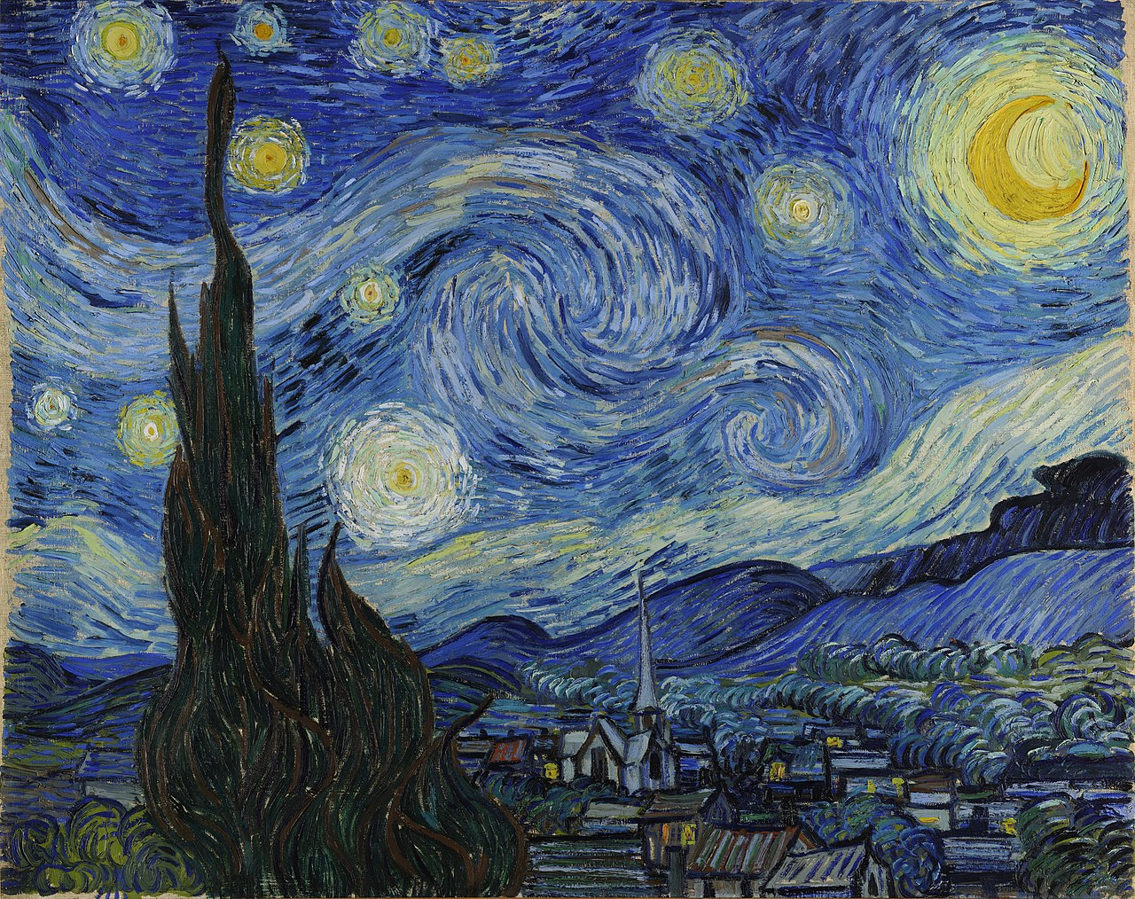
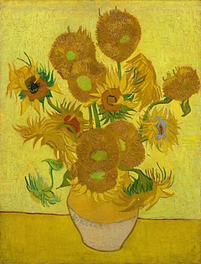
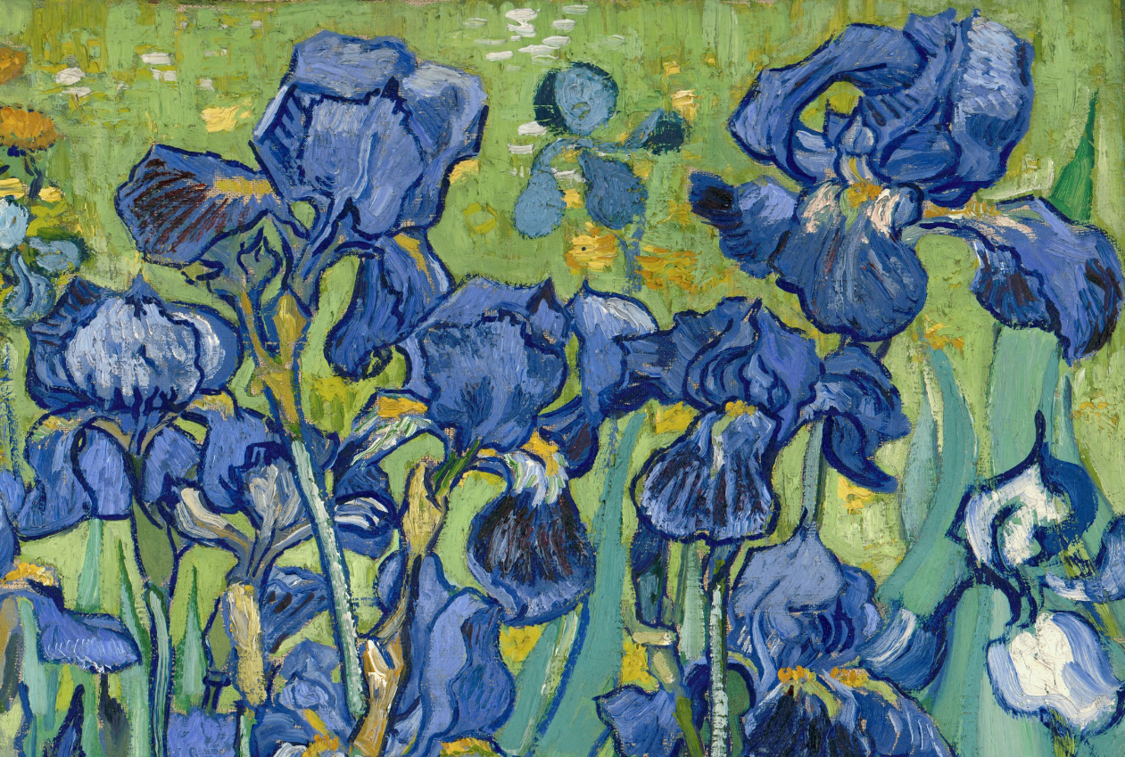
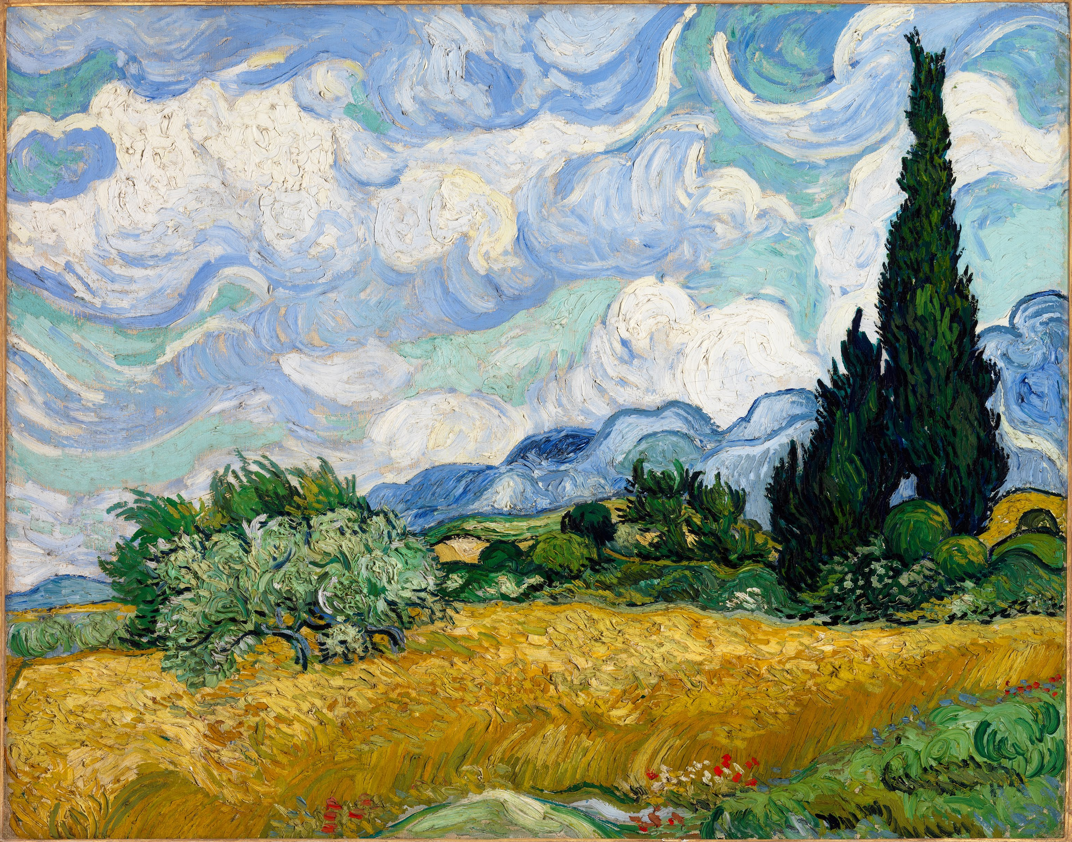

Slide 3
Vincent Van Gogh is one of my favourite artists and I love all his work
Art activities:
Find out 5 or more facts about Vincent Van Gogh. Where was he born? Why is he so famous? Where did he live as an adult and what did he like to paint?
He is famous for his ‘Sunflowers’ paintings. What facts can you find out about this series of paintings?
The ‘Starry Night’ is another famous painting by Vincent. What other famous paintings did he create?
Choose one of his paintings and have a go at creating your own version. You could use different colours to the ones he used, water colours, sharpies, paint or sketching pencils to recreate your work
Draw flowers using black pens and shade using pencils
Investigate colour mixing by using, for example, yellow paint and adding white. Try mixing blue and white . You could blend colours using oil pastels

Slide 4
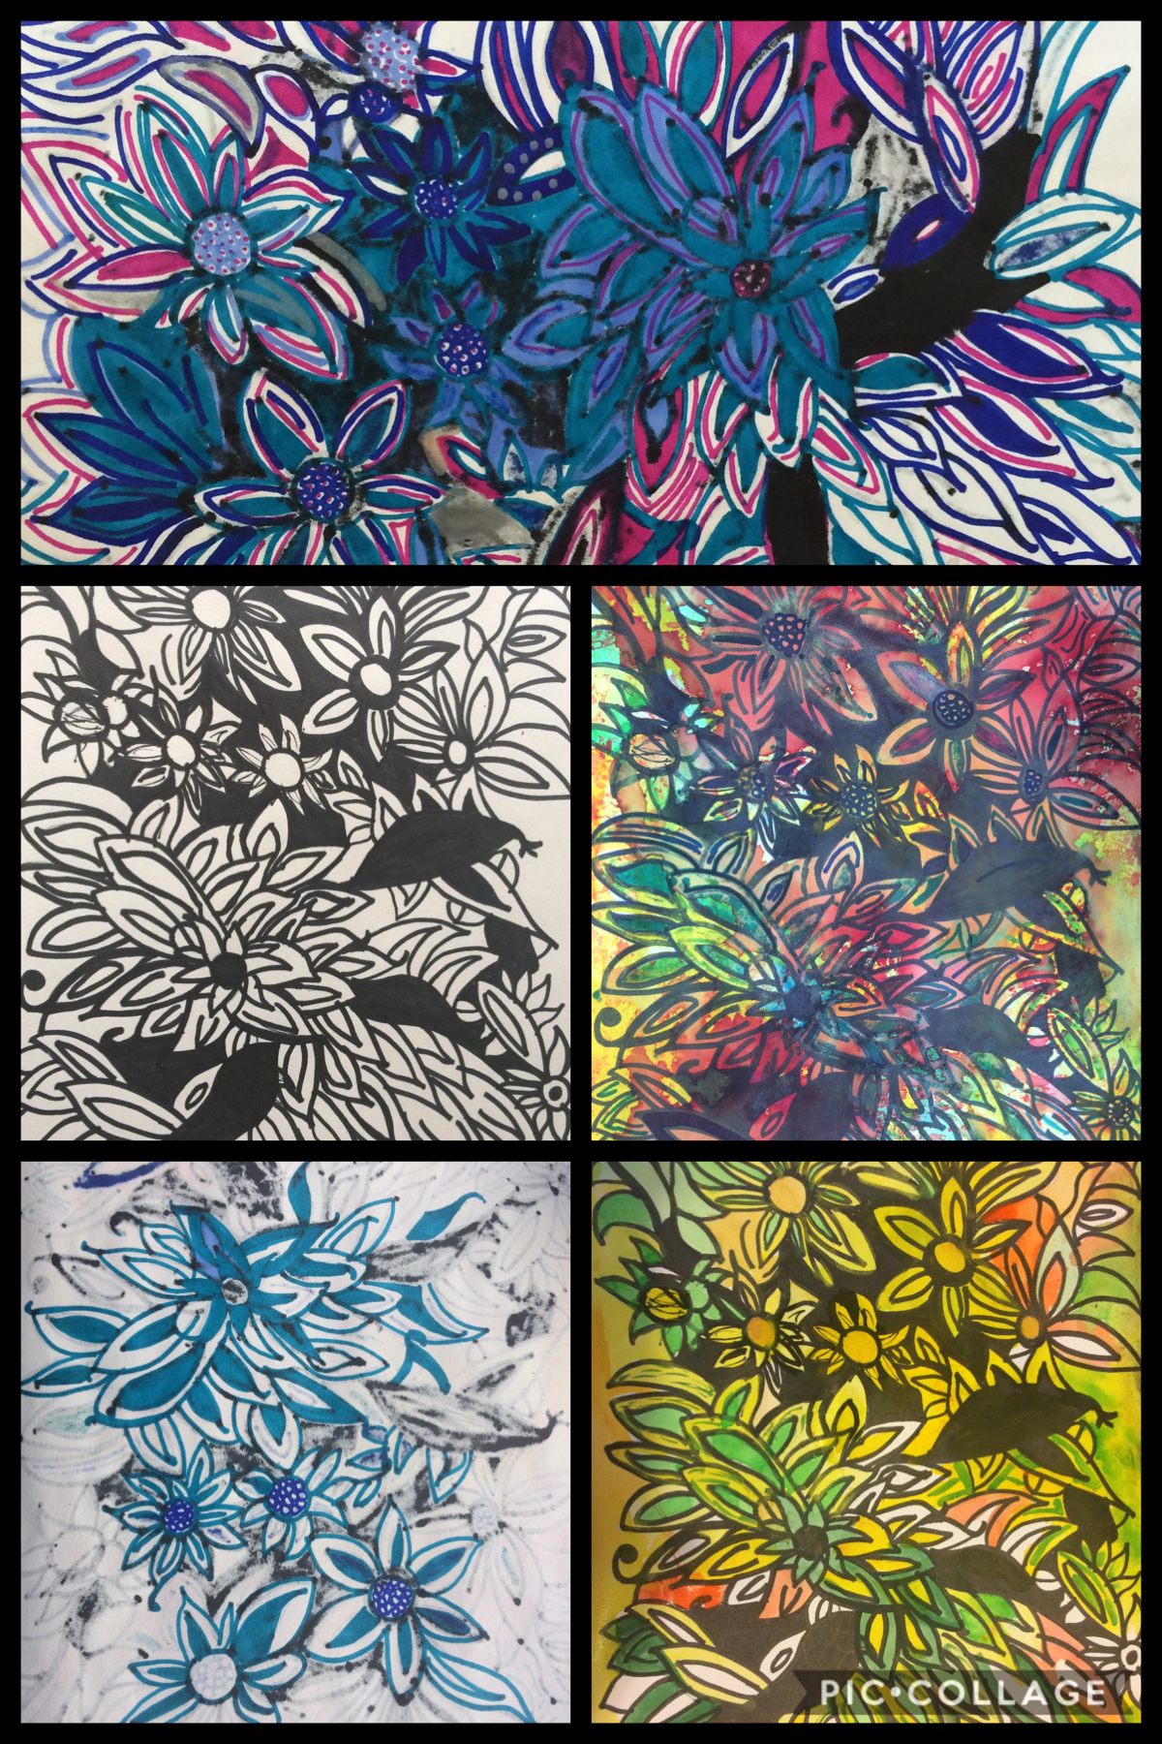
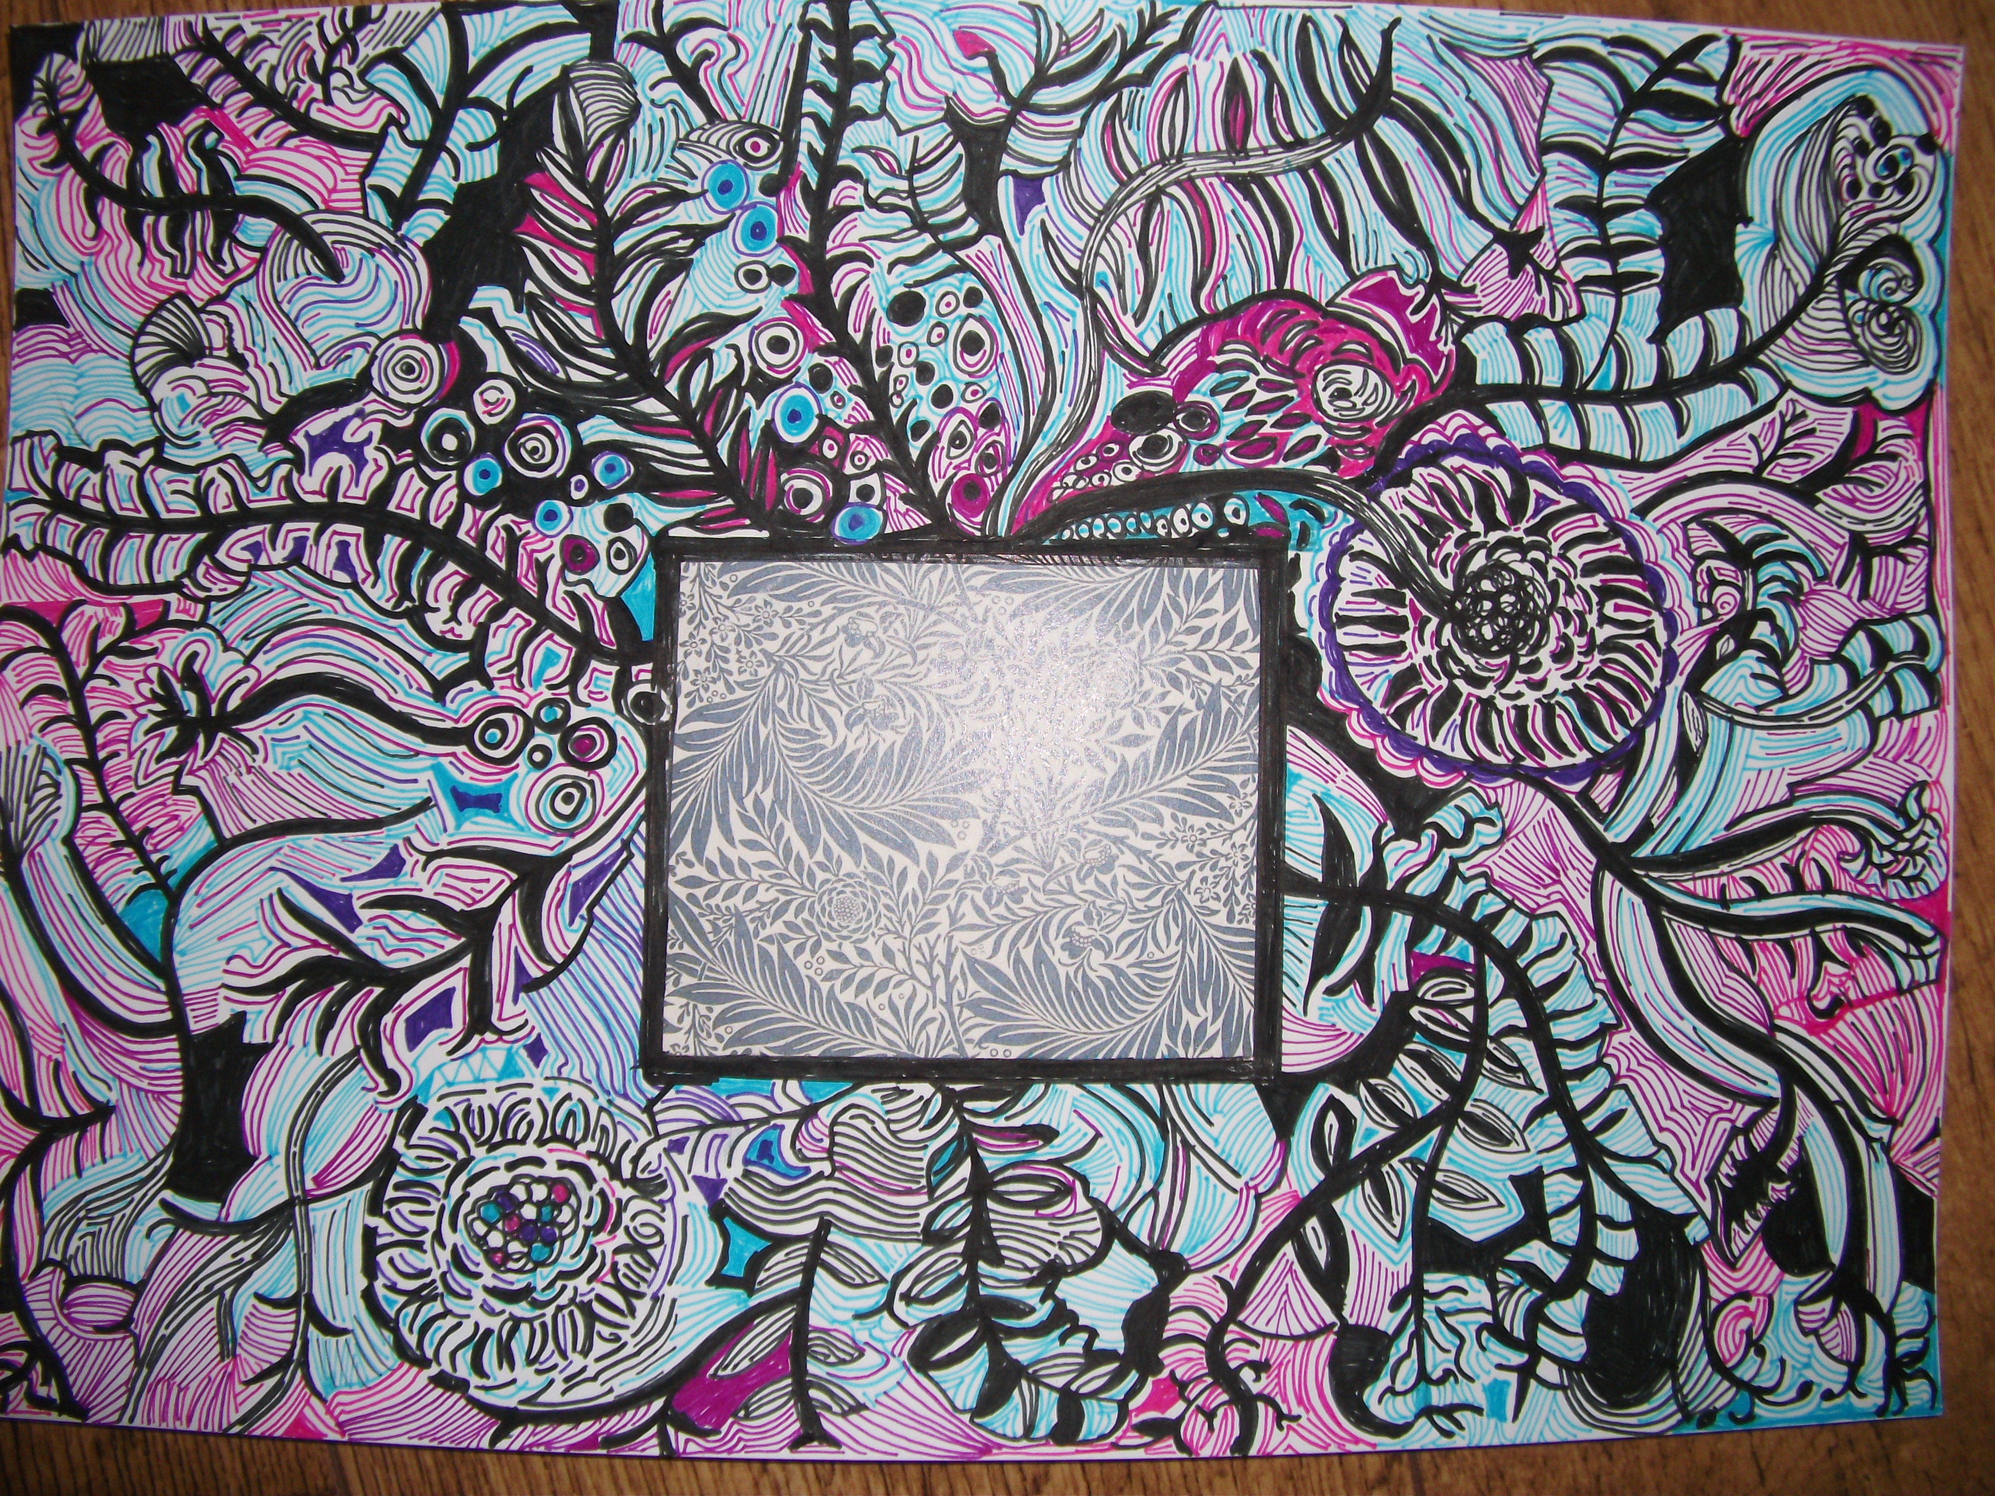
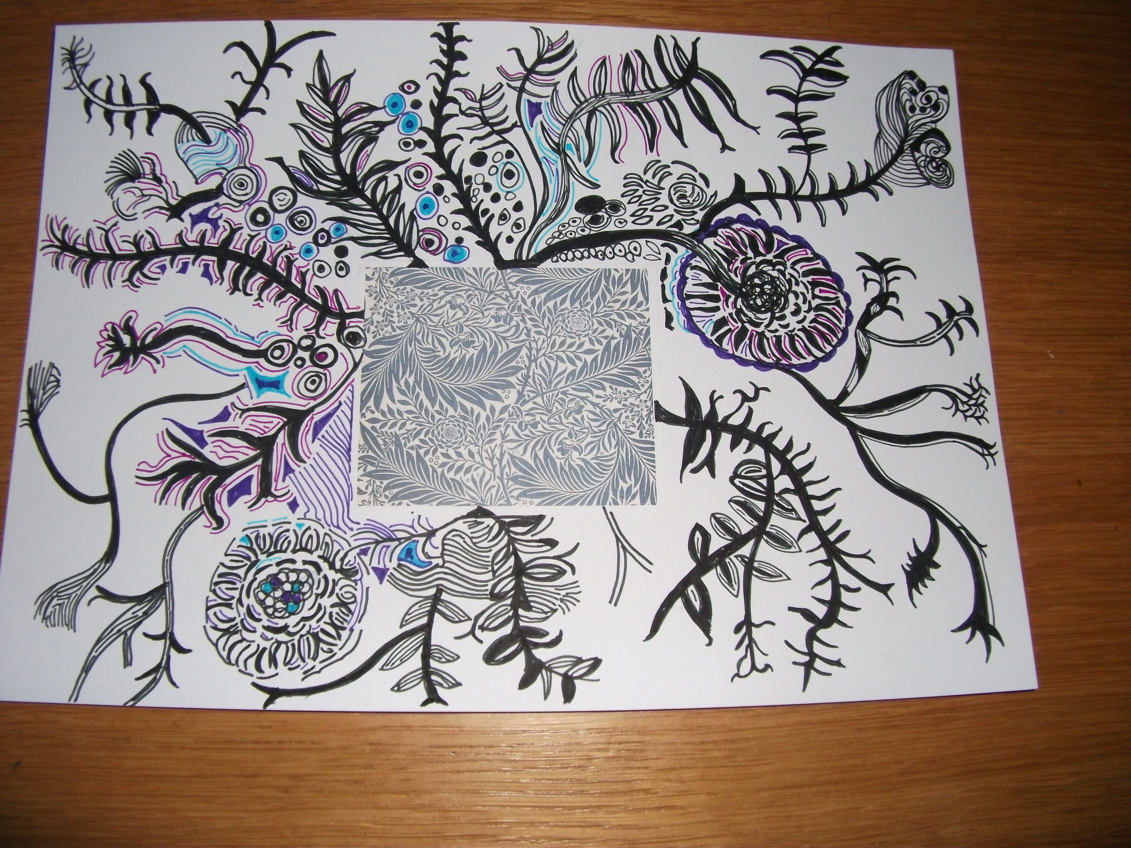
Use these examples of flowers art to help with your work

