Slide 2



Monday
Tuesday
Wednesday
Thursday
Friday

Slide 3

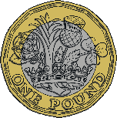
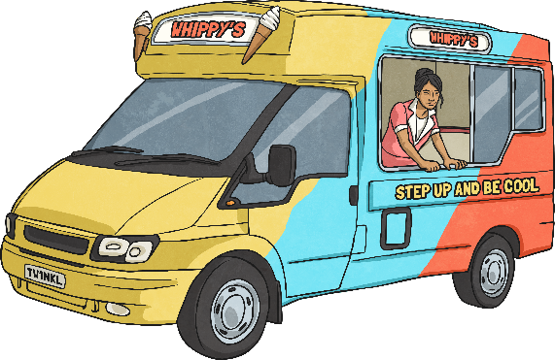
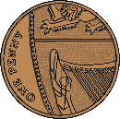
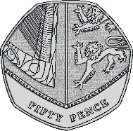
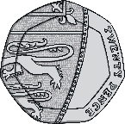
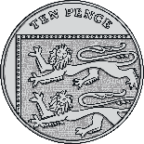


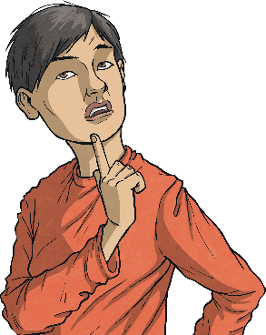


Menu
Week 1 Monday
Place Value
Problem Solving
Write 548 in words.
How much money in total?
five hundred
and forty-eight
£4 and 43 pence
Reveal answer
Reveal answer
+ and −
Reasoning
78 + 28 = 106
Reveal answer
Is my
part-whole model correct?
200
630 - 60 = 570
Reveal answer
× and ÷
131
79
7 × 3 = 21
Reveal answer
30 ÷ 3 = 10
Reveal answer
Explain why.

Slide 4
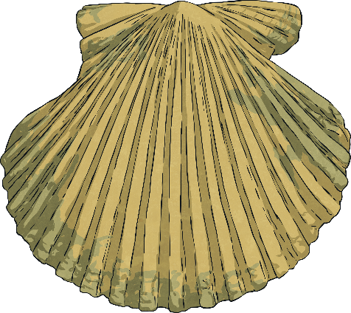
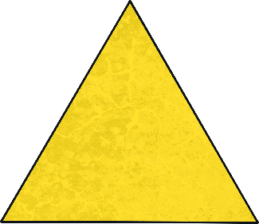



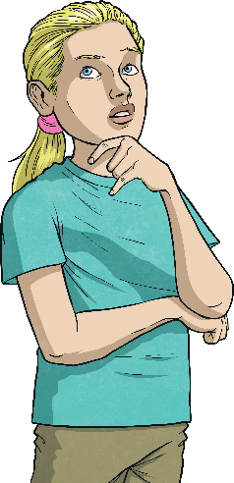
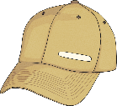

Menu
Week 1 Tuesday
Place Value
Problem Solving
How many if I have one hundred more?
How many sides are there in total?
598
498
9
Reveal answer
Reveal answer
+ and −
Reasoning
85 + 50 = 135
Reveal answer
If I count in multiples of eight, I will say the number 32.
430 - 25 = 405
Reveal answer
× and ÷
5 × 3 = 15
Reveal answer
Is Alison correct?
Explain why.
24 ÷ 3 = 8
Reveal answer

Slide 5
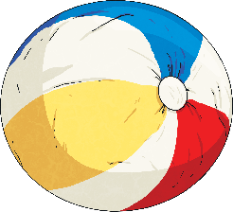

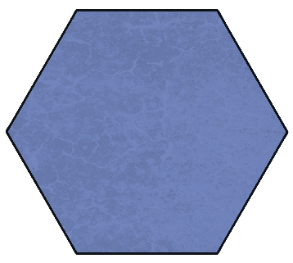


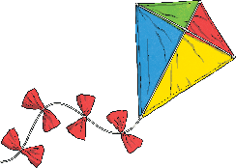
Menu
Week 1 Wednesday
Place Value
Problem Solving
Use the correct symbol to compare these numbers:
Find three different ways to complete this part whole model.
<
200
508 580
Reveal answer
+ and −
Reasoning
264 + 6 = 270
I have
drawn a line of symmetry on this hexagon.
Reveal answer
256 - 8 = 248
Reveal answer
× and ÷
4 × 3 = 12
Reveal answer
Is Henry correct?
Explain why.
15 ÷ 3 = 5
Reveal answer

Slide 6

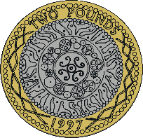


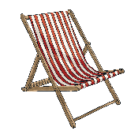
Menu
Week 1 Thursday
Place Value
Problem Solving
Reveal answer
Put these numbers in order from smallest to greatest:
How many parts of this shape need to be coloured in to show ?
1
3
533
335
353
553
555
335
353
533
553
555
Reveal answer
+ and −
Reasoning
74 + 26 = 100
Reveal answer
100 - 11 = 89
Reveal answer
These coins total £4 and 60 pence.
× and ÷
8 × 3 = 24
Reveal answer
Is Alison correct?
Explain why.
12 ÷ 4 = 3
Reveal answer

Slide 7
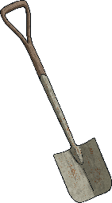
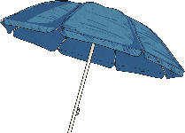





Menu
Week 1 Friday
Place Value
Problem Solving
Reveal answer
What are the next three numbers in this sequence?
23
How many buckets and spades
did Henry find in the sandpit?
4
8
12
|||| ||| | |||| |||| |||| | |||| ||||
16
20
24
Reveal answer
+ and −
Reasoning
6 + 7 + 8 = 21
I need to colour in six more parts to make ¾.
Reveal answer
523 - 200 = 323
Reveal answer
× and ÷
11 × 3 = 33
Reveal answer
Is Henry correct?
Explain why.
21 ÷ 3 = 7
Reveal answer

