Slide 1

A Warm Welcome to Nursery September 2021
Woodlands Primary School

Slide 2


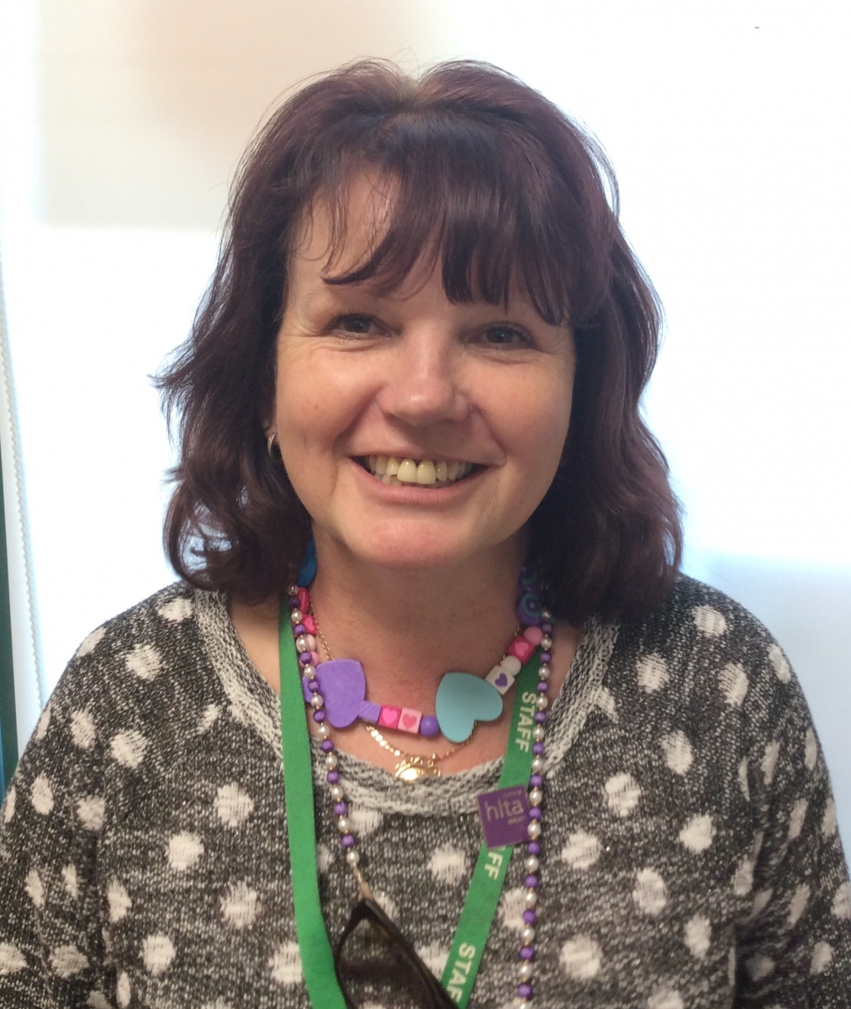


Meet the EYFS Team:
Mrs Ahmad
EYFS Lead & Hedgehogs Teacher
Mrs Webster
Badgers Teacher
Mrs Donoghue
Foxes Teacher
Miss Rowland
Foxes Teacher
Mr Barnes
Owls Teacher

Slide 3
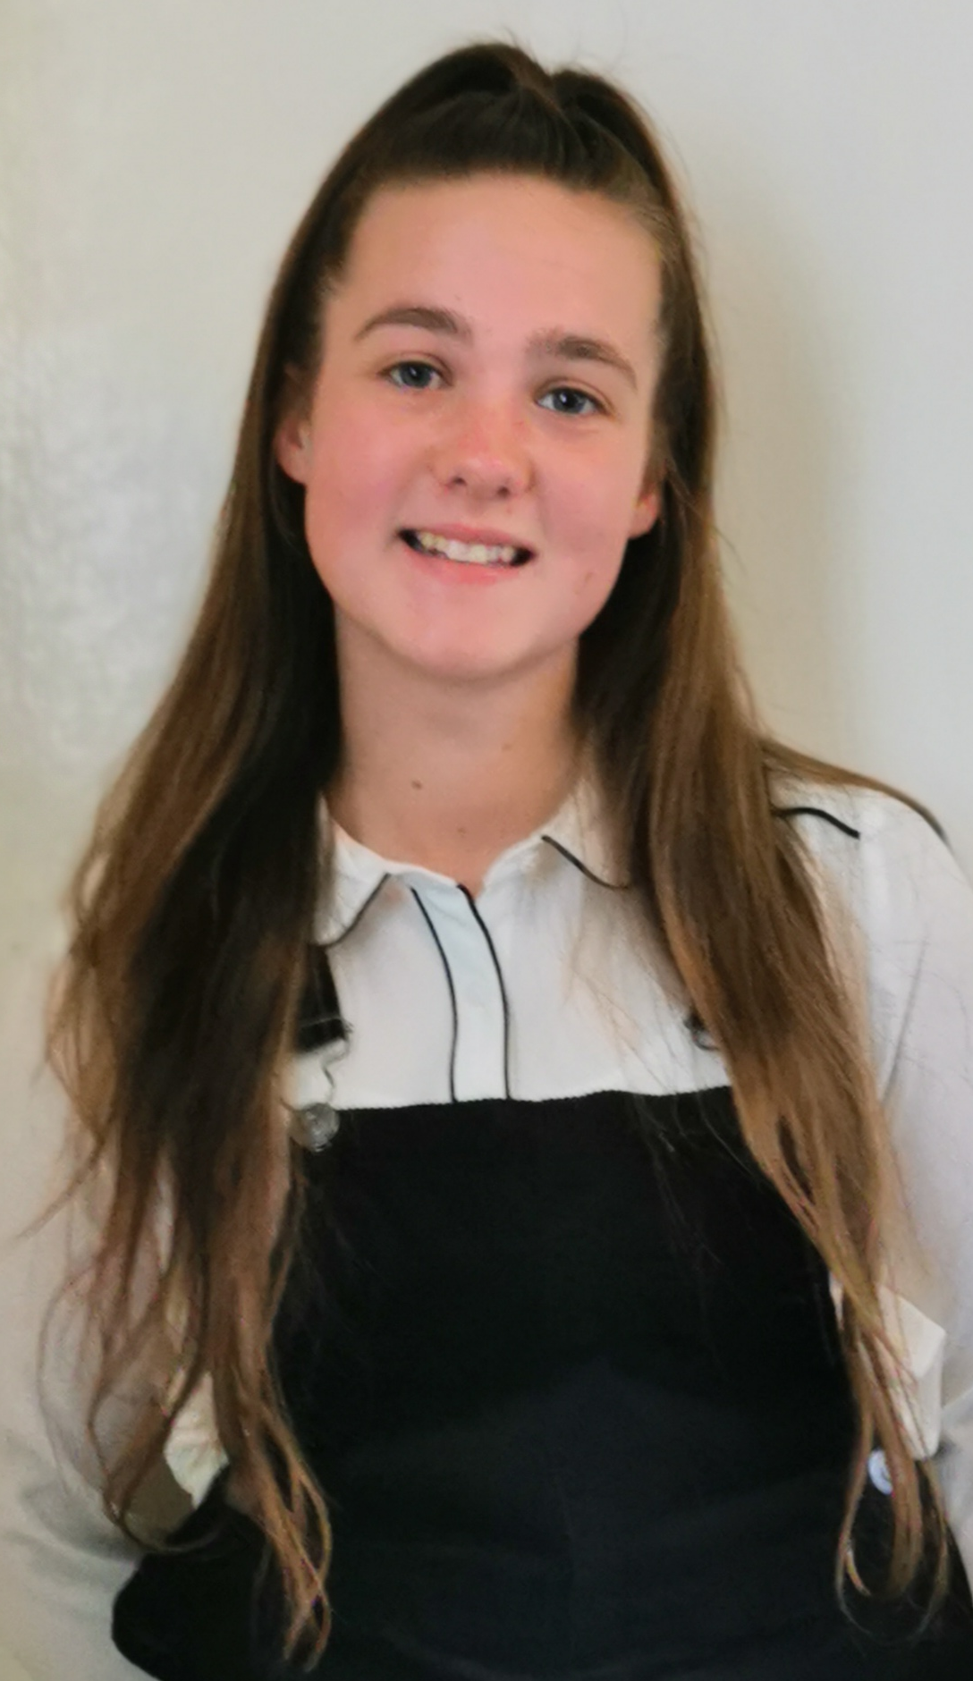
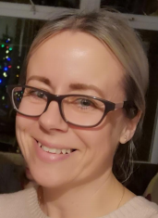
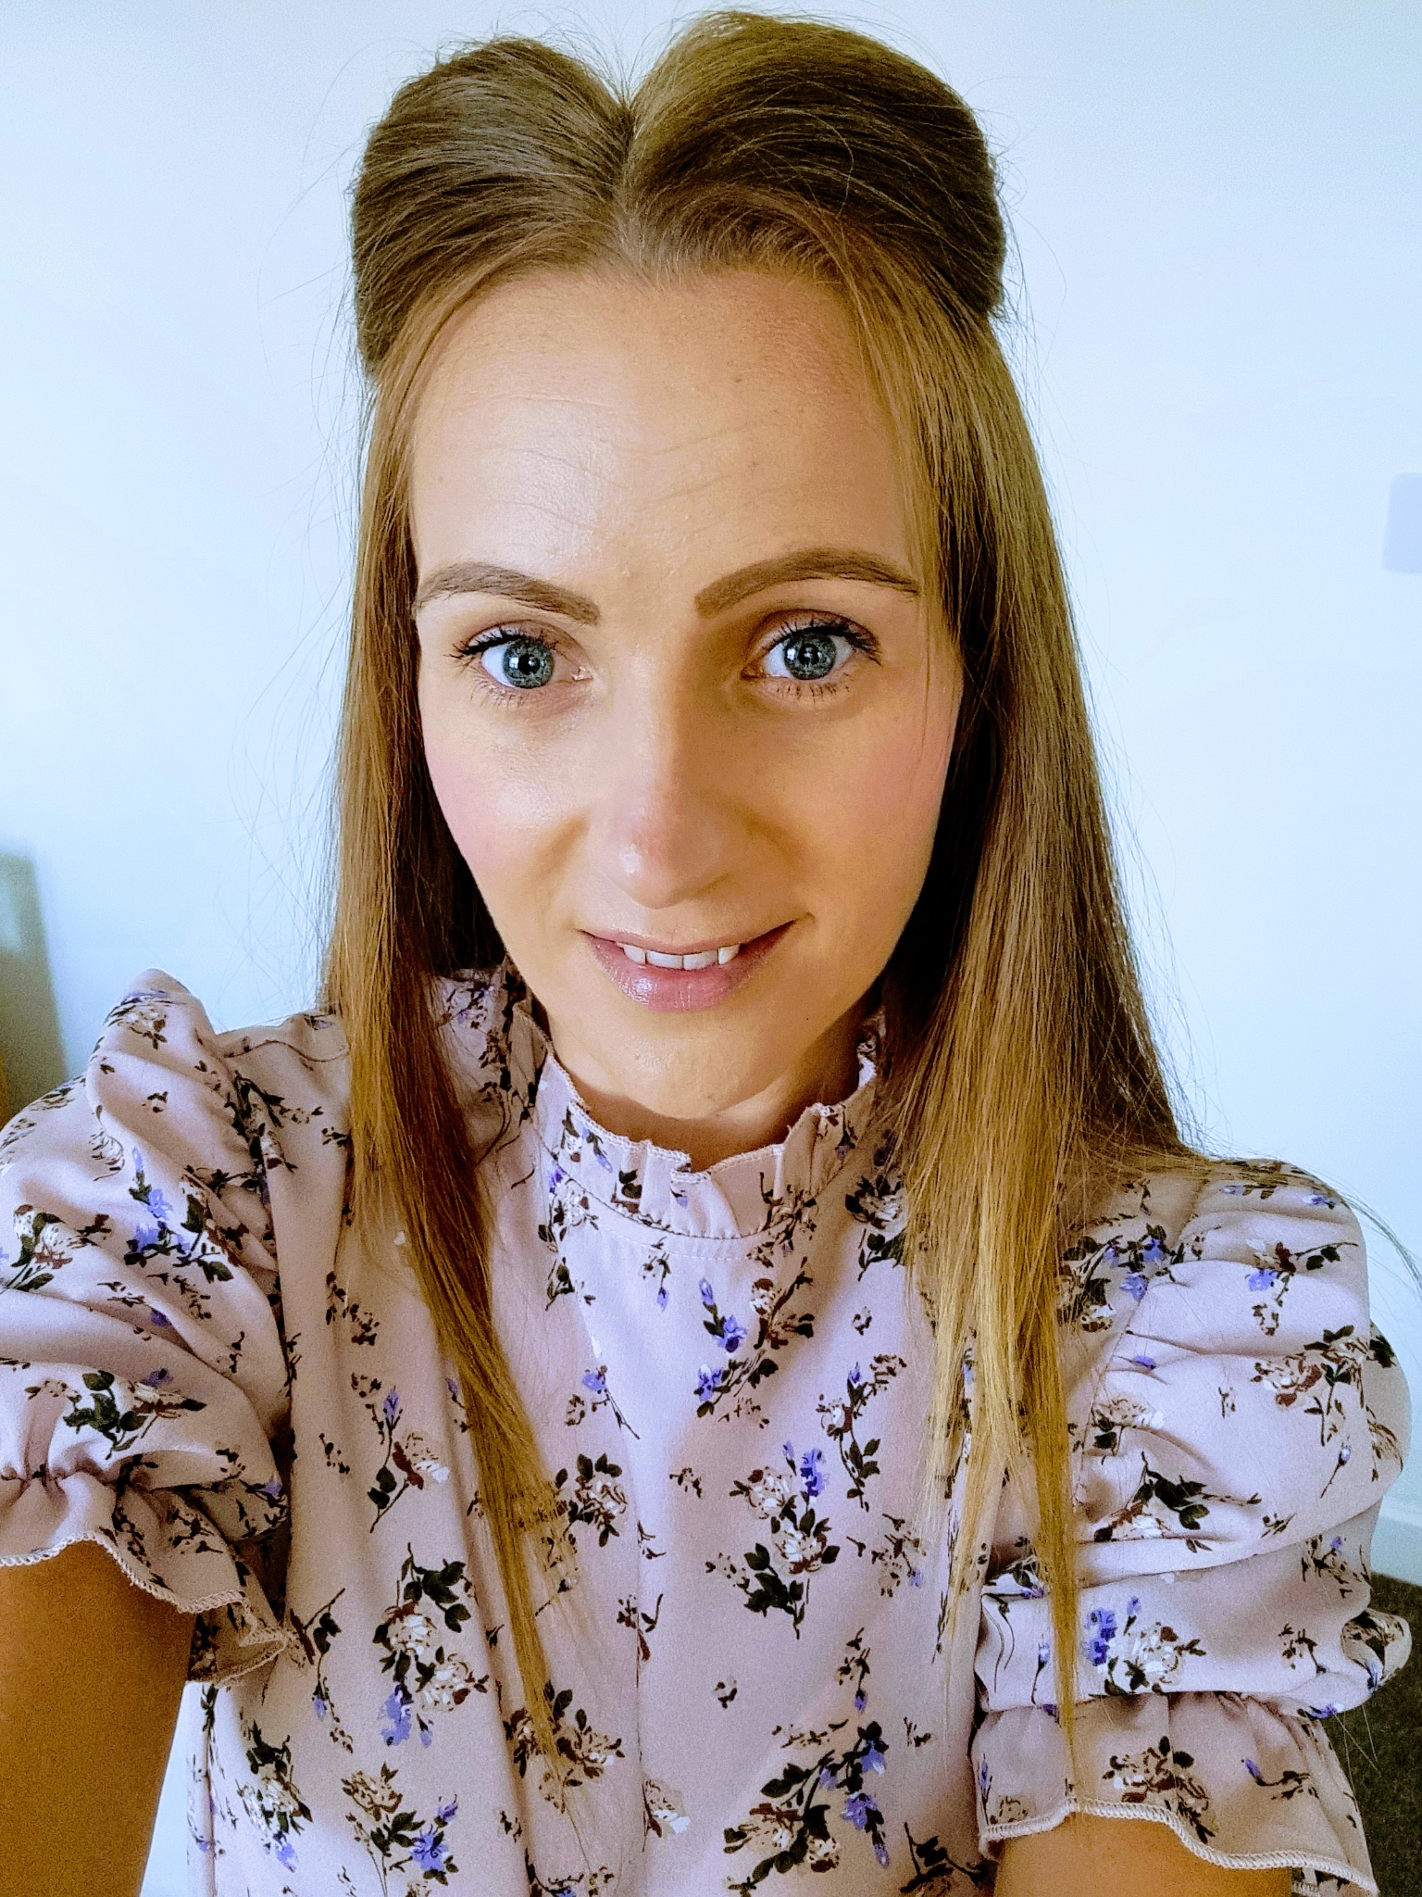
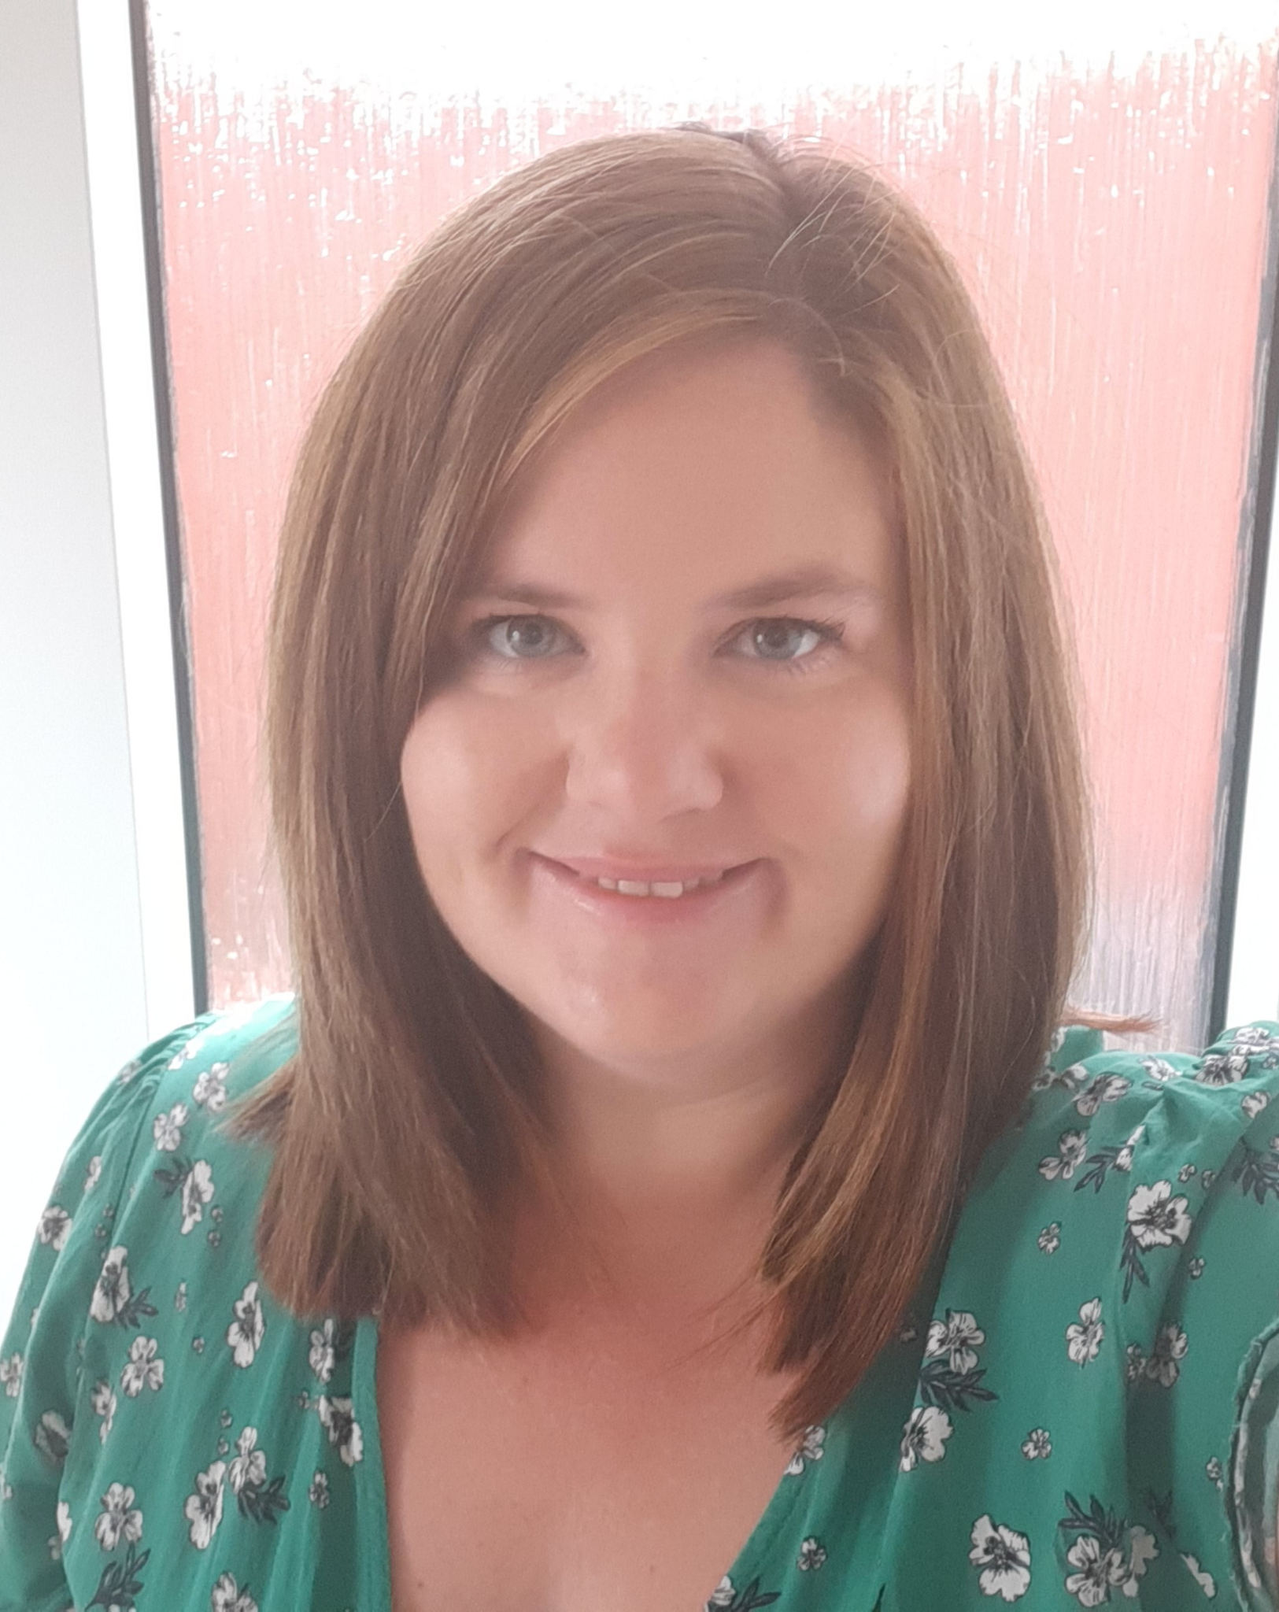
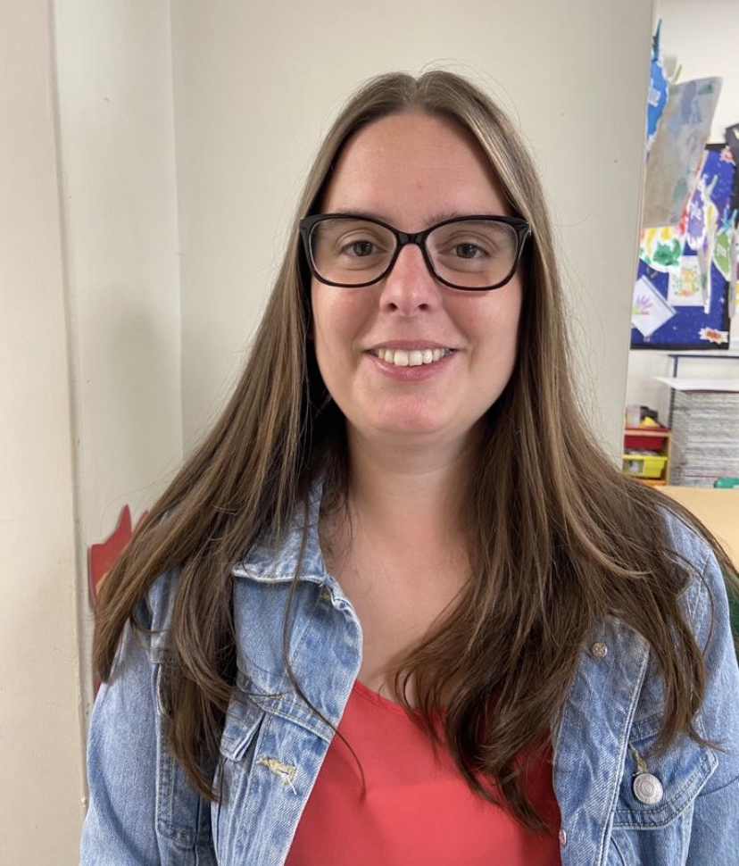
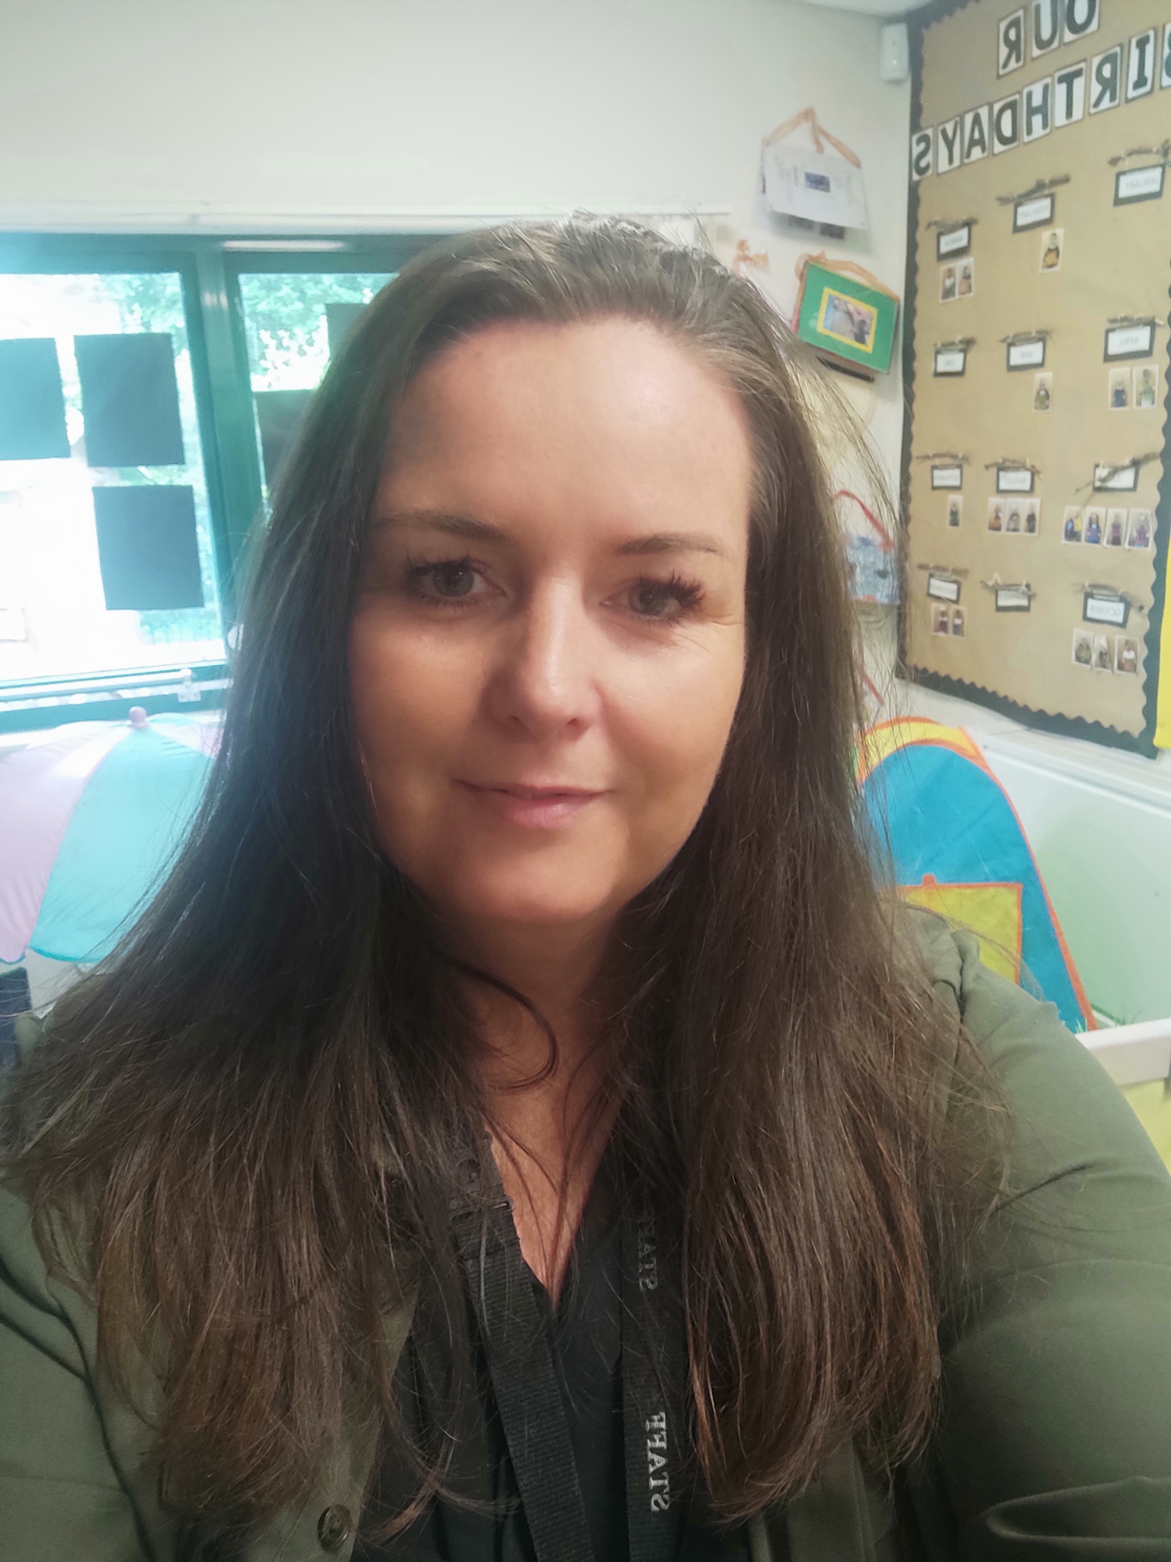
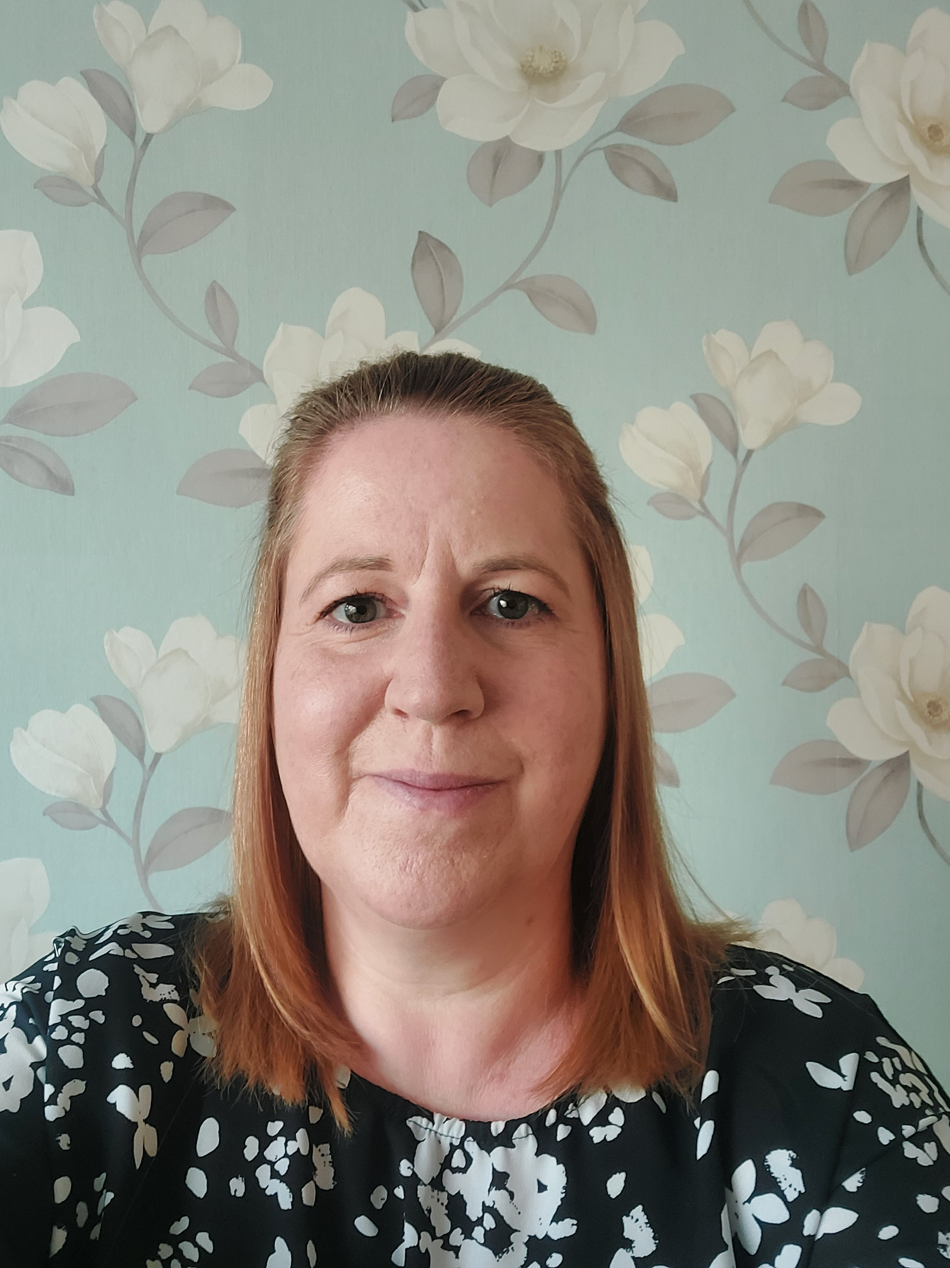
Meet the EYFS Team:
Miss Clay
Mrs Griffiths
Miss Morfoot
Miss Powell
Miss Wharton
Mrs Plage
Mrs Thompson

Slide 4
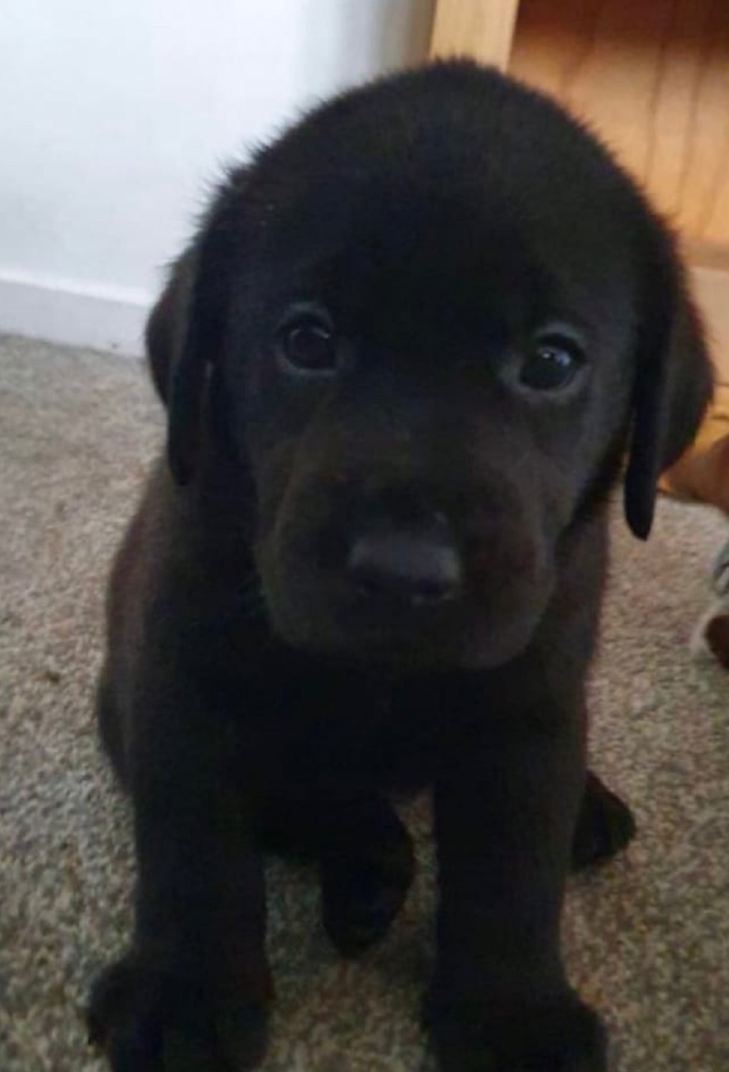
Meet Gus, our school dog:
Hello, my name is Gus and I am the Woodlands school dog. I can’t wait to meet you!

Slide 5
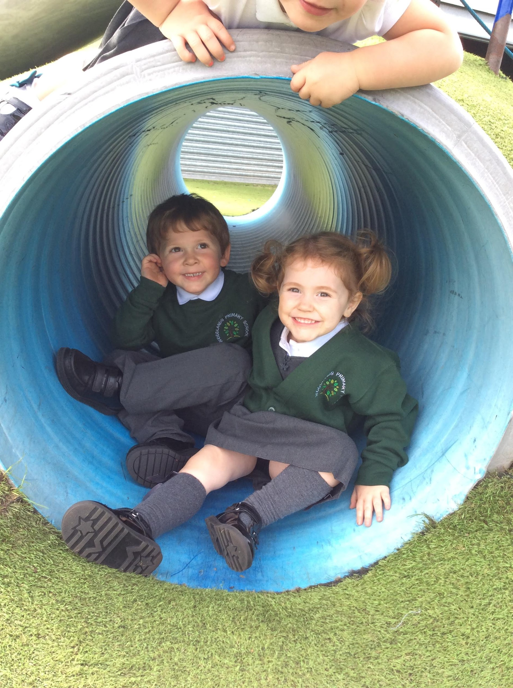
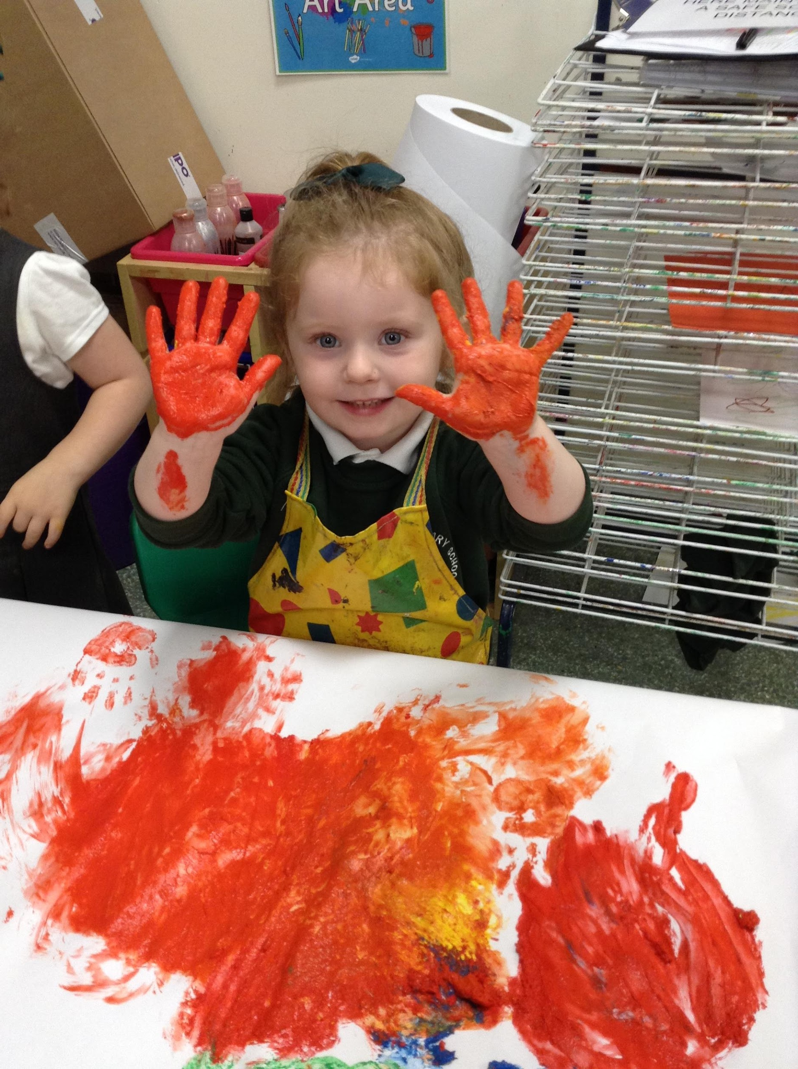
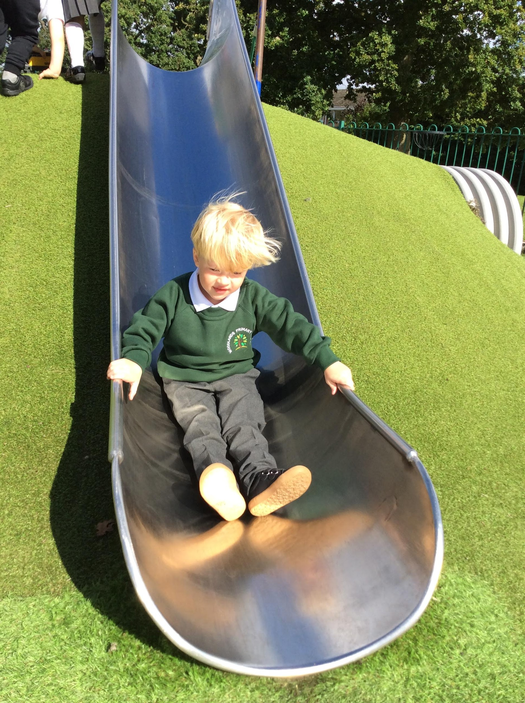
At Woodlands the children thrive upon having broad and balanced learning experiences.
At Woodlands we are passionate about teaching life skills such as team work, resilience and celebrating diversity in our community and the wider world.
At Woodlands we promote positive behaviour through encouraging children to be ‘Ready, Respectful and Safe’!

Slide 6
Making Contact
You will be invited to a virtual meeting via Google Meet. You will be emailed a link with a date and time by 11.06.21 for the Google Meet to take place over the course of the following two weeks. This is an opportunity for you to ask any questions or share any concerns, medical information, toileting issues or anything else you would like to inform us about. This will help us to plan how to best support your child when they join our school community.

Slide 7
Which class will my child be in?
We have two nursery classes at Woodlands: one is mixed with reception children and the other is nursery children only.
Nursery children in both classes will access the same learning opportunities.
At this moment the children have not been put into classes.
We will do this after we have had the Google meet with parents and we establish the days/sessions that parents have requested that their child/ren attend.
You will then receive an email informing you of which class your child will be in by 2nd July.

Slide 8
A day in the life of a Nursery child
Start times to be confirmed - Class doors open /settling in time
9:00am Learning input
Teacher led focused activities and continuous provision
Snack time
Phonics
Circle time to share news
Morning Nursery session ends
Lunch
Afternoon Nursery session begins
Learning input
Teacher led focused activities and continuous provision
Story / rhyme time
Home time to be confirmed
Pick up / drop off will be from your child’s classroom door

Slide 9
New Statutory EYFS Curriculum:
There are two main objectives behind the changes that will be in effect from September 2021
1. To improve outcomes for all children, particularly in language and literacy
2. To reduce teacher/practitioner workload so that staff can spend more time interacting with children.

Slide 10
7 Areas of Learning
There are three areas that are particularly important for building a foundation for igniting children’s curiosity and enthusiasm for learning, forming relationships and thriving. These are called the prime areas:
• Communication and Language
• Physical Development
• Personal, Social and Emotional Development
There are 4 other areas that support children through which the three prime areas are strengthened and applied. These are called the specific areas and are:
• Literacy
• Mathematics
• Understanding the World
• Expressive Arts and Design

Slide 11
The areas of learning are further broken down into:
Prime areas:
• Communication and Language: Listening, Attention and Understanding/Speaking
• Physical Development: Gross Motor Skills/Fine Motor Skills
• Personal, Social and Emotional Development: Building Relationships/Managing Self/Self – Regulation
Specific areas are:
• Literacy: Comprehension/Word Reading/ Writing
• Mathematics: Number/Numerical Patterns
• Understanding the World: People, Culture and Communities/ The Natural World/Past and Present
• Expressive Arts and Design: Creating with Materials/Being Imaginative and Expressive

Slide 12
Tapestry
Tapestry is an online learning journal which we use across Nursery and Reception.
This means that all children in EYFS have a personal online learning journal which records photos, observations and comments to build a record of their experiences during their time with us.
You will be invited to join this portal in the Autumn term to be able to view and comment on your child’s EYFS journey.

Slide 13
School uniform and other belongings
Please label all of your child’s belongings including; water bottles, lunchboxes, coats and school uniform.
Please limit your child’s bags to one backpack and a lunch box or one book bag and a lunchbox.
Shoes which your child can put on and take off on their own.
Over the summer holidays please encourage your child’s independent skills such as, putting on and fastening their coats, fastening trousers and managing buttons and zips.

Slide 14
When will my child start school?
In September, for a smooth transition and easier settling in period for the children, we stagger start dates. You will be advised of your child’s starting date/time before the 20th July.
Nursery will have different starting days and times due to their pre-agreed sessions (information to follow).
From your child’s first day they will continue to attend for their pre-agreed sessions.
Please follow all the guidance that will be sent about dropping off and collecting your child, to keep them safe.

Slide 15
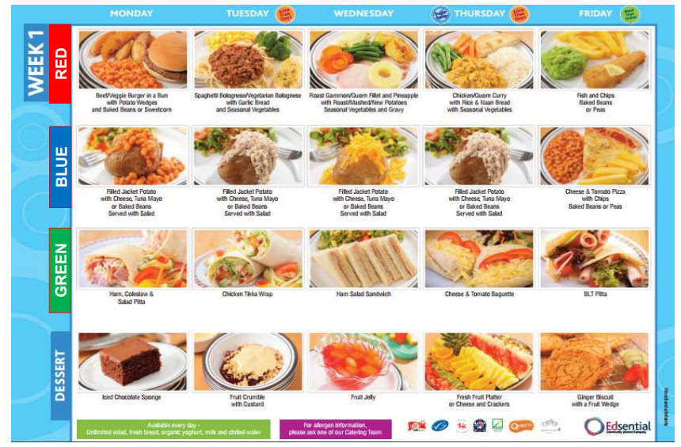
School lunches
Please find the lunch options on our website which follow a 3 week rotation.
There will an exciting new menu from September, carefully selected by current children in school.
We encourage the children to make their own lunch choices, so please support your child in making their decision before coming into school each morning.
Nursery children pay for their school dinners unless in receipt of FSM.
Please note
there may be limited options in September dependent on Covid-19.

Slide 16
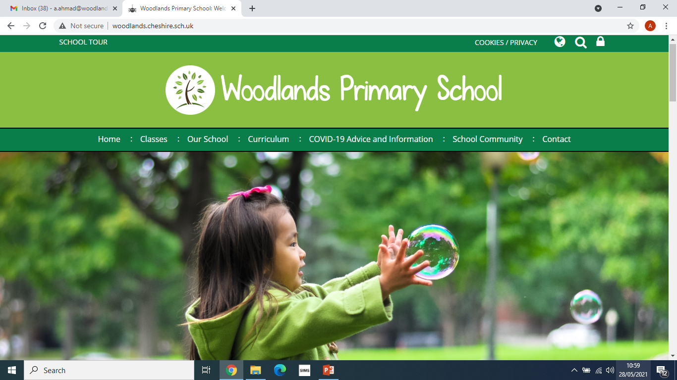
Our school website
This is our school website where you can access information about class pages, contact details, school menus, termly updates, and school events.
Please feel free to have a browse
www.woodlands.cheshire.sch.uk

Slide 17
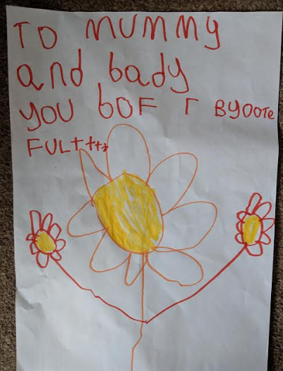
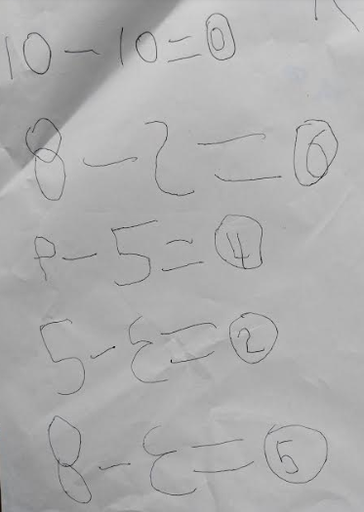
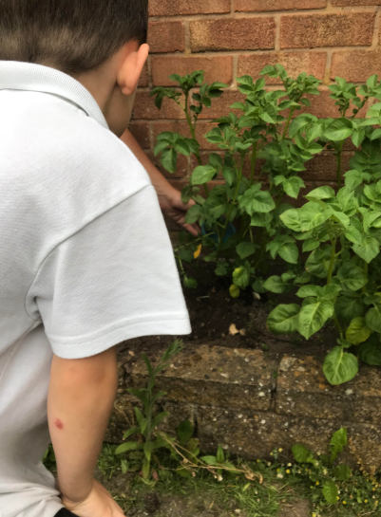
Emails from parents
Please feel free to send your news, pictures and achievements that you would like to share with your class teachers and friends.

Slide 18
These are our class emails:
badgers@woodlands.cheshire.sch.uk
foxes@woodlands.cheshire.sch.uk

Slide 19
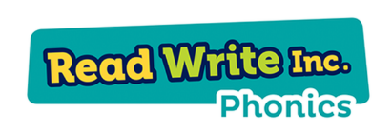
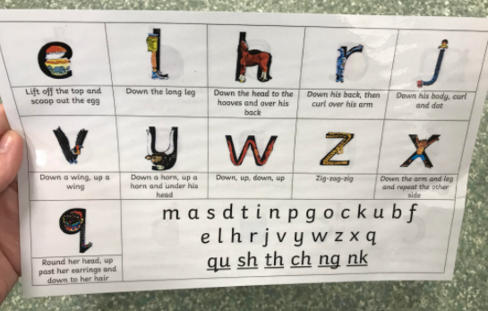
This is a fun way to learn phonics and it is used throughout the school. If you would like to support your child further at home with their phonics skills, you can read more about this online.
We will have a reading information meeting in the Autumn term to support you and your child

Slide 20
Important information:
Early Years Pupil Premium – Is extra funding paid to school to improve outcomes for eligible children. If you are in receipt of certain benefits, your child may also be entitled to receive free school meals. To check your child’s eligibility please visit the following site and follow the links for Early Years Pupil Premium:
www.cheshirewestandchester.gov.uk/EYpupilpremium
Attendance – It is imperative that your child attends school regularly and on time. Research shows that time missed from school directly impacts on learning and may cause undue stress on the child.
ParentPay – This is our online tool used for the delivery of parent communications, permission slips, newsletters and any costs such as dinner money, trips and visits and additional Nursery fees, etc. Your child will be allocated a unique login and details will be sent via a letter following your child's start date.
S4YC – This is a company that works closely with Woodlands and other local school offering onsite breakfast, after school and holiday clubs.

Slide 21
Covid-19
We adhere to the latest government guidelines and adjust our risk assessments in accordance which can be found on our school website
You will be notified of any changes which affect school, via email/ParentPay/text message.

Slide 22
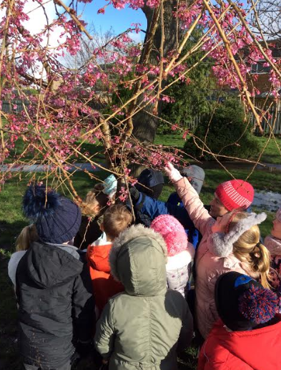
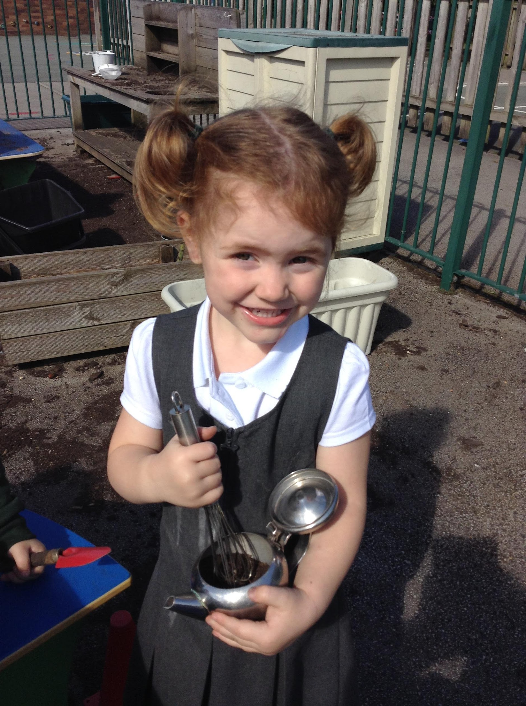
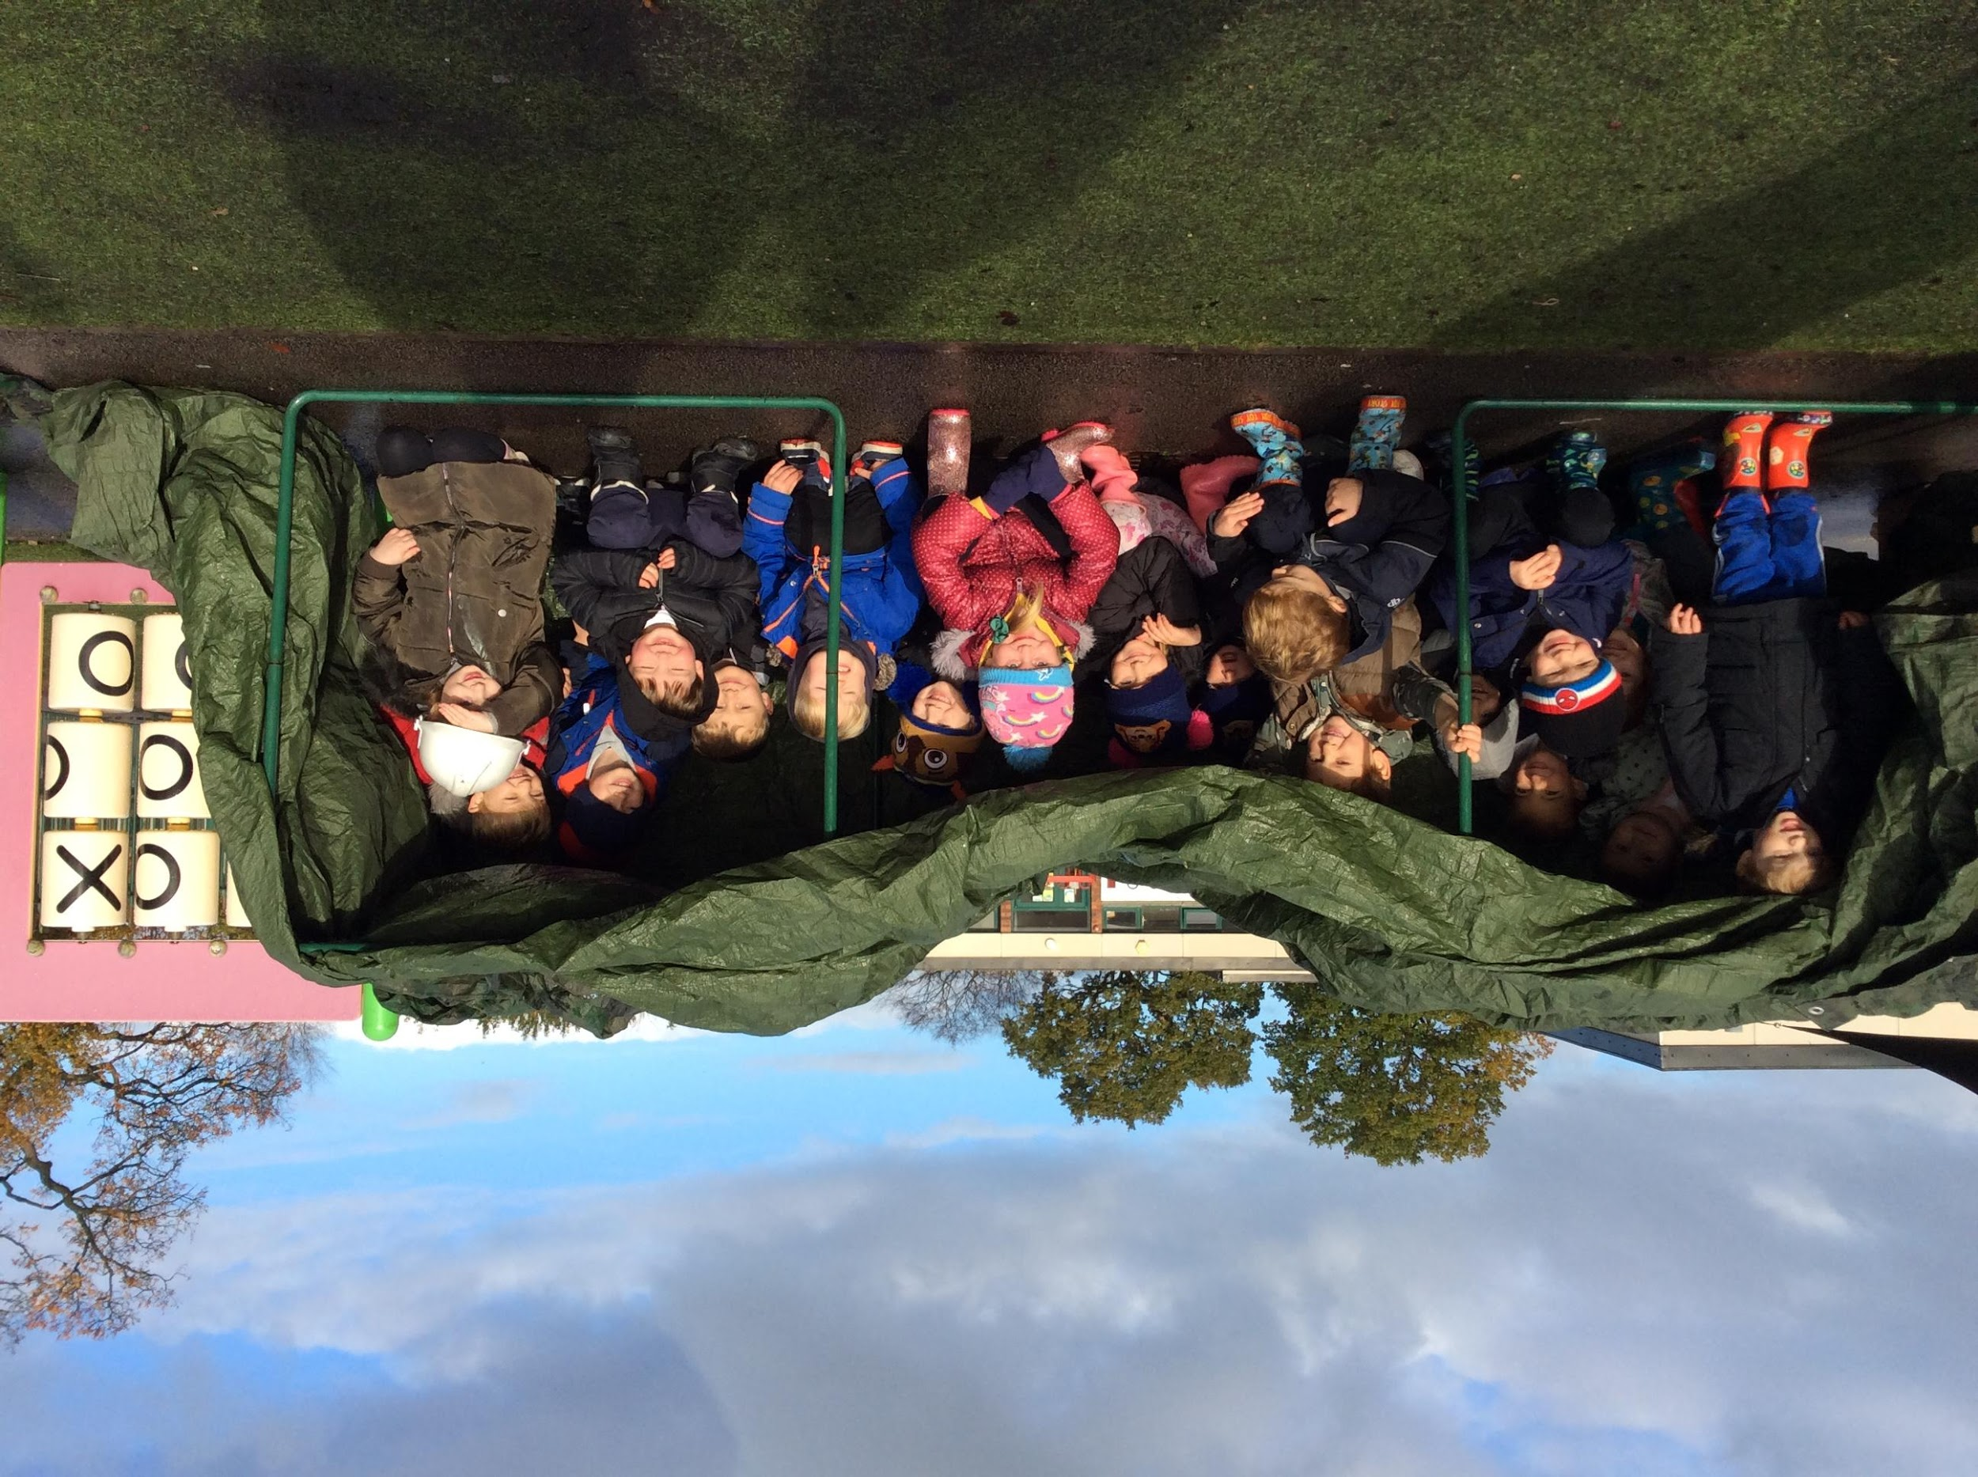
Outdoor learning in Nursery

Slide 23
We look forward to welcoming your children in September
If you have any queries, please do not hesitate to contact us. We will be more than happy to help!
To accompany this presentation the EYFS team have recorded a video for you and your child so that you can see what the learning environment looks like, to help you prepare for September.
Please take a moment to watch the video. It can be found on our website under September 2021 on our Nursery tab.
Have a lovely summer, see you all soon.
The Early Years Team.

