Slide 1


Phonics

Slide 2
Phonics is:
making connections between the sounds of our spoken words and the letters that are used to write them down.

Slide 3
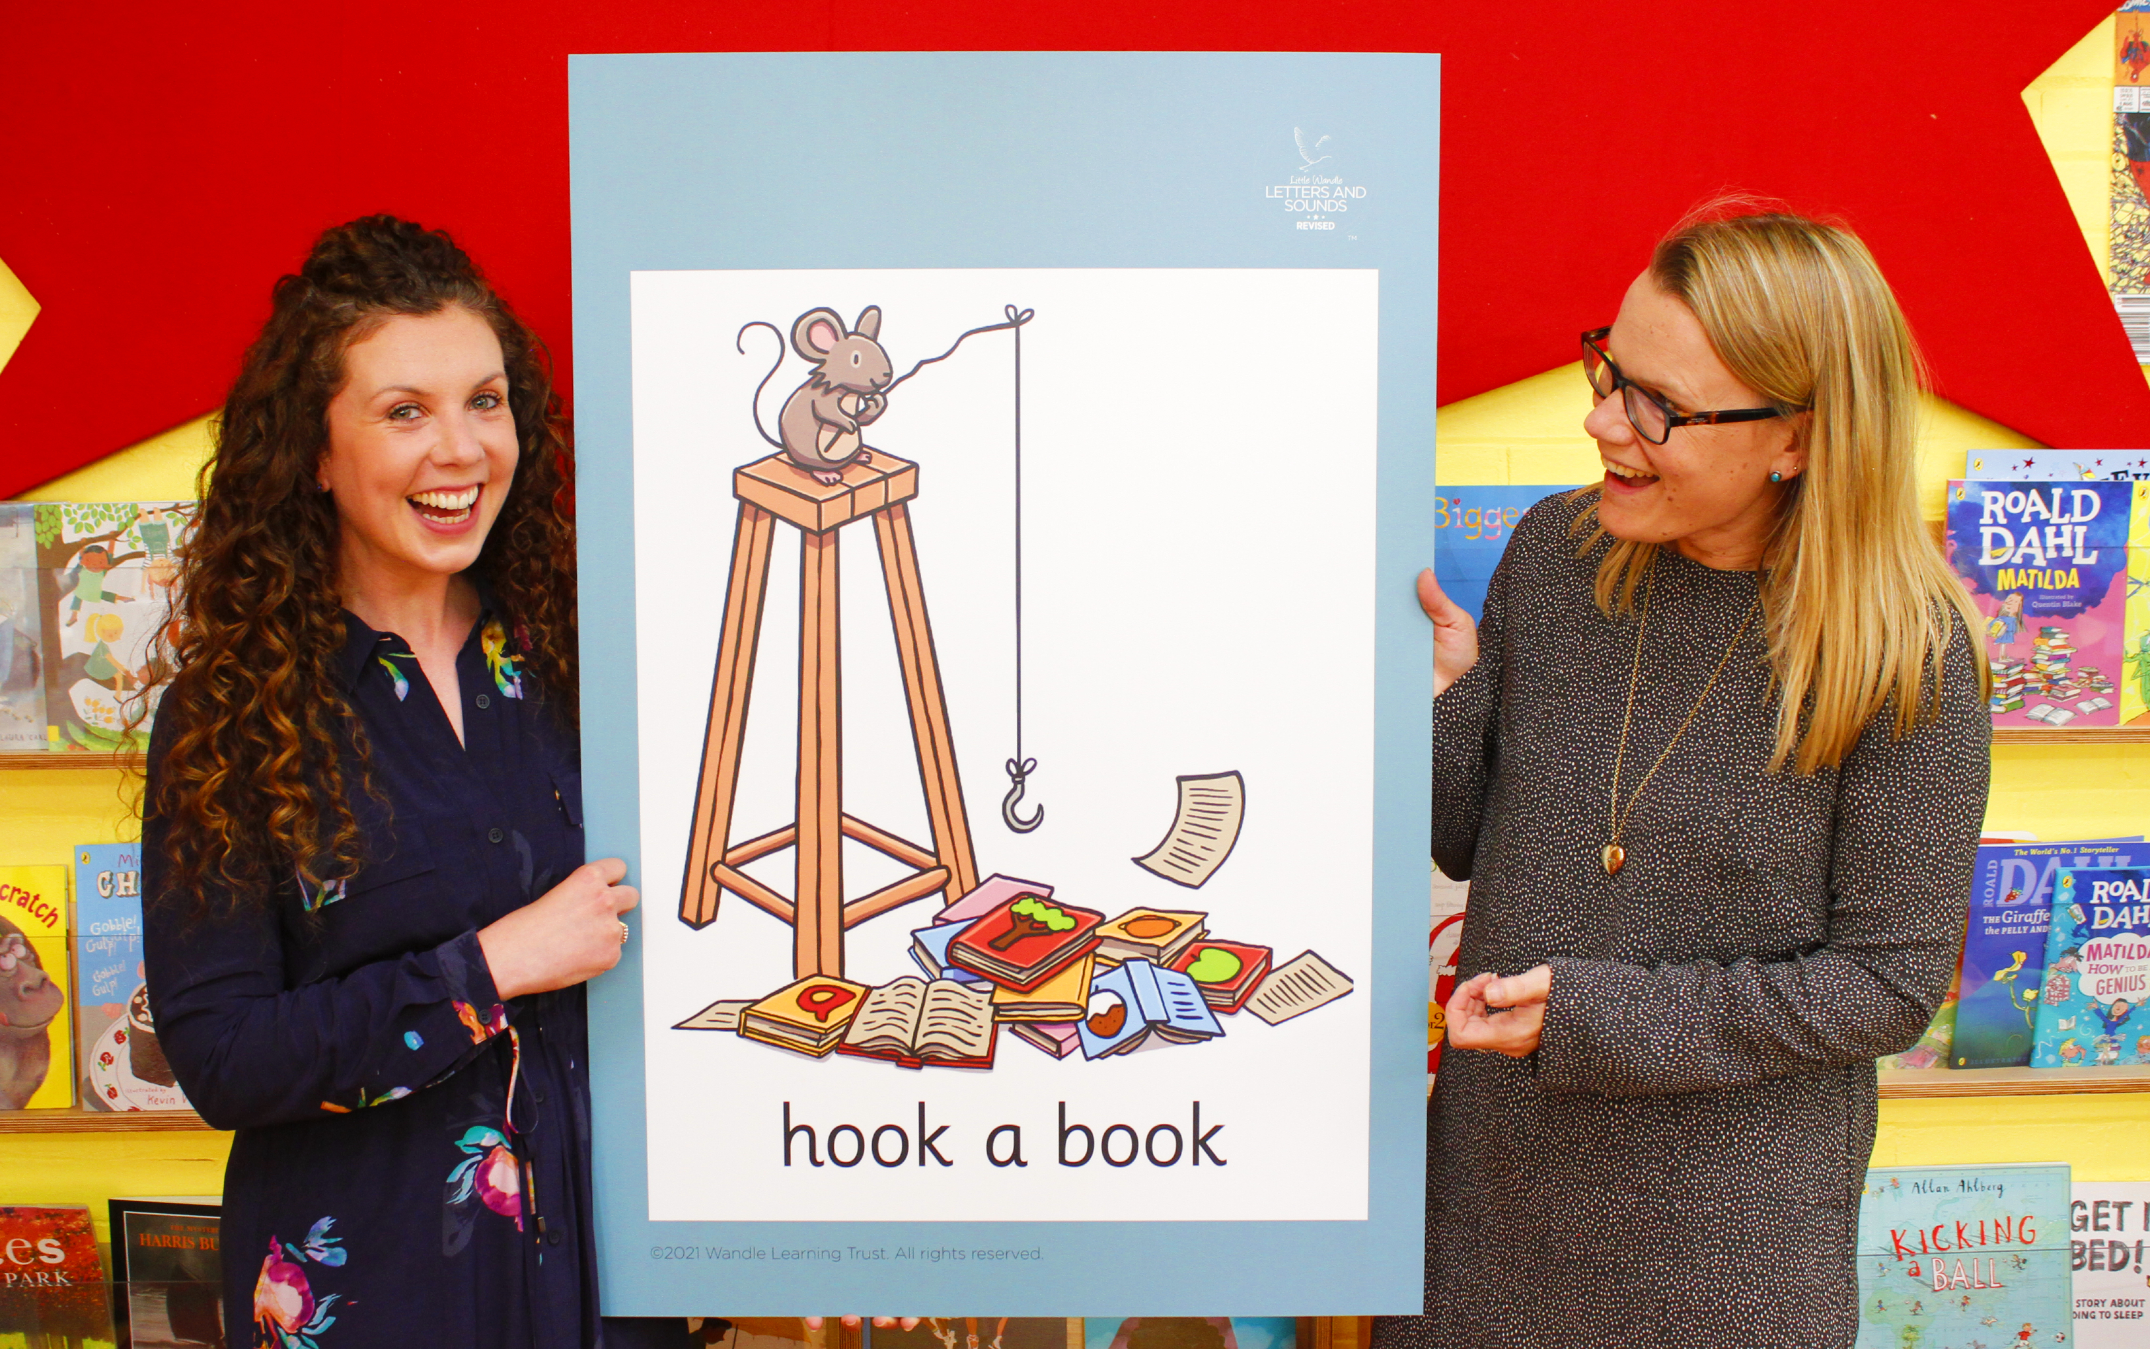
Little Wandle Letters and Sounds Revised
Our school has chosen
Little Wandle Letters and Sounds Revised as our systematic, synthetic phonics (SSP) programme to teach early reading and spelling.

Slide 4
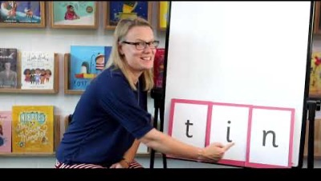
Blending to read words

Slide 5
Terminology
Phoneme
Split vowel digraph
Grapheme
Blend
Digraph
Segment
Trigraph

Slide 6
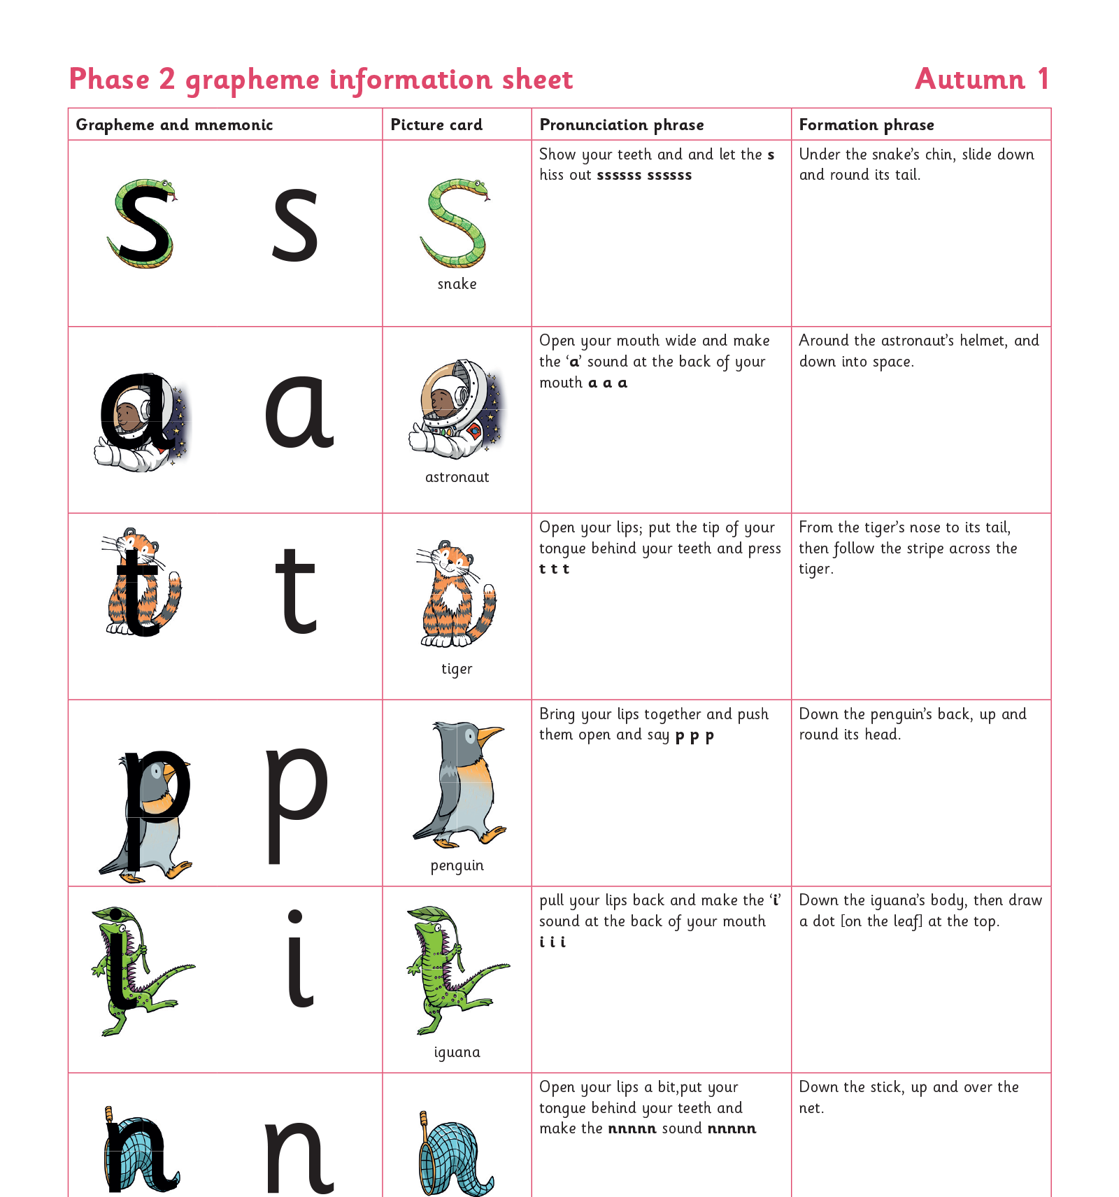
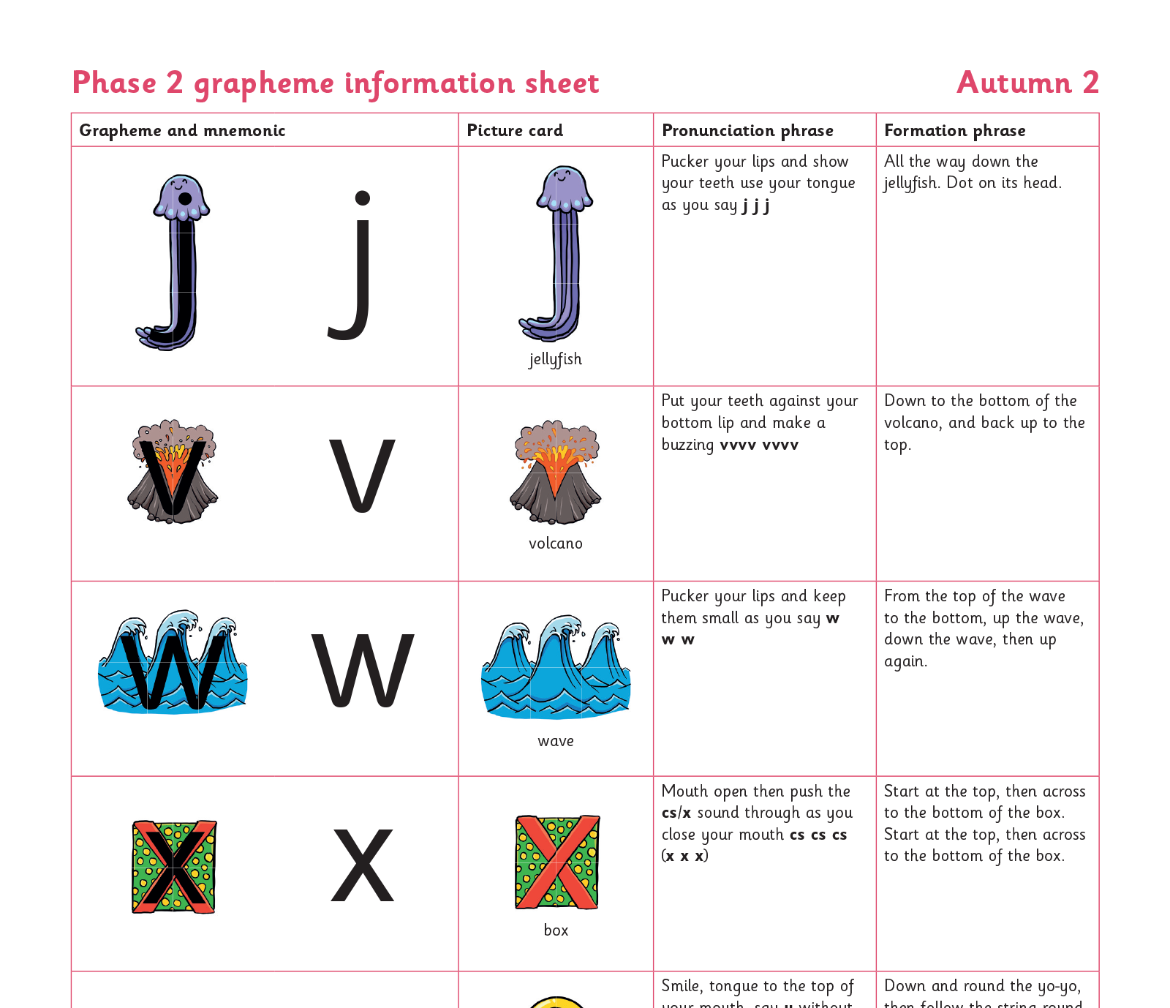
Teaching order

Slide 7
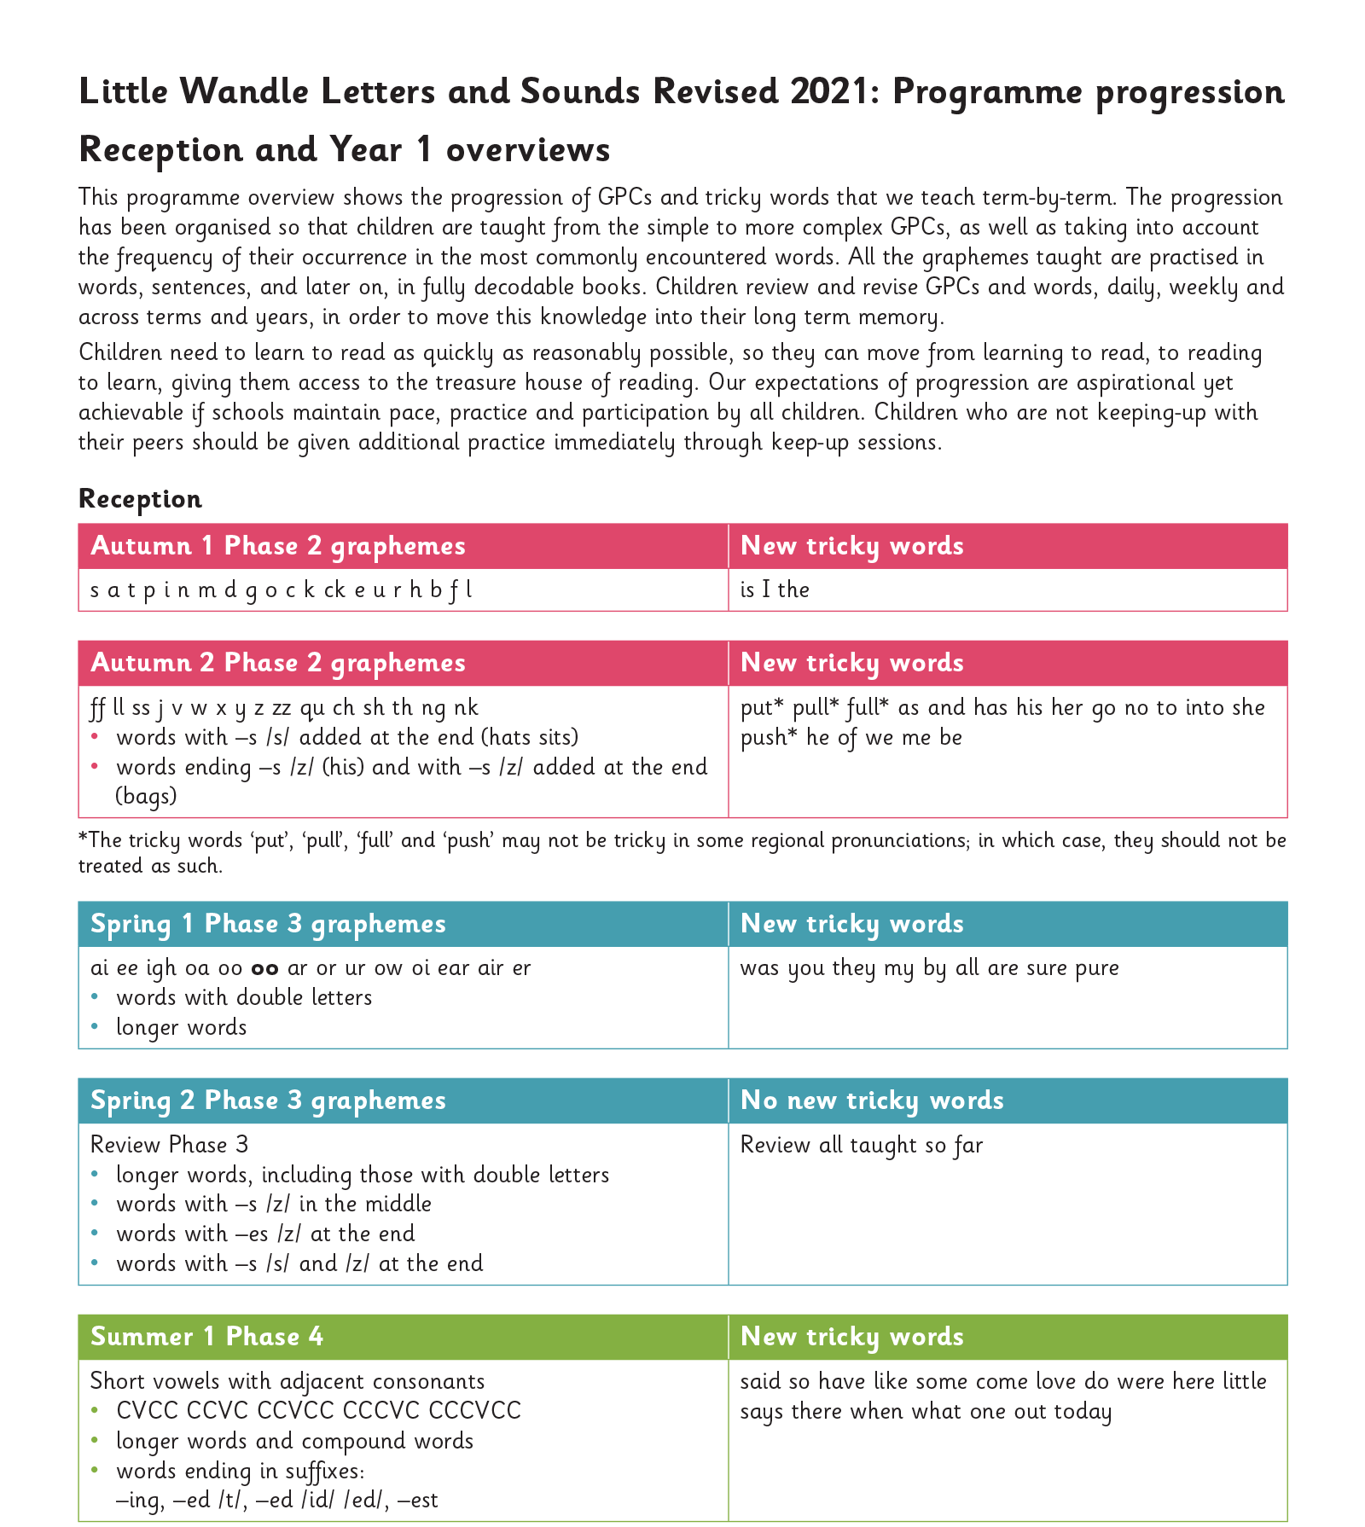
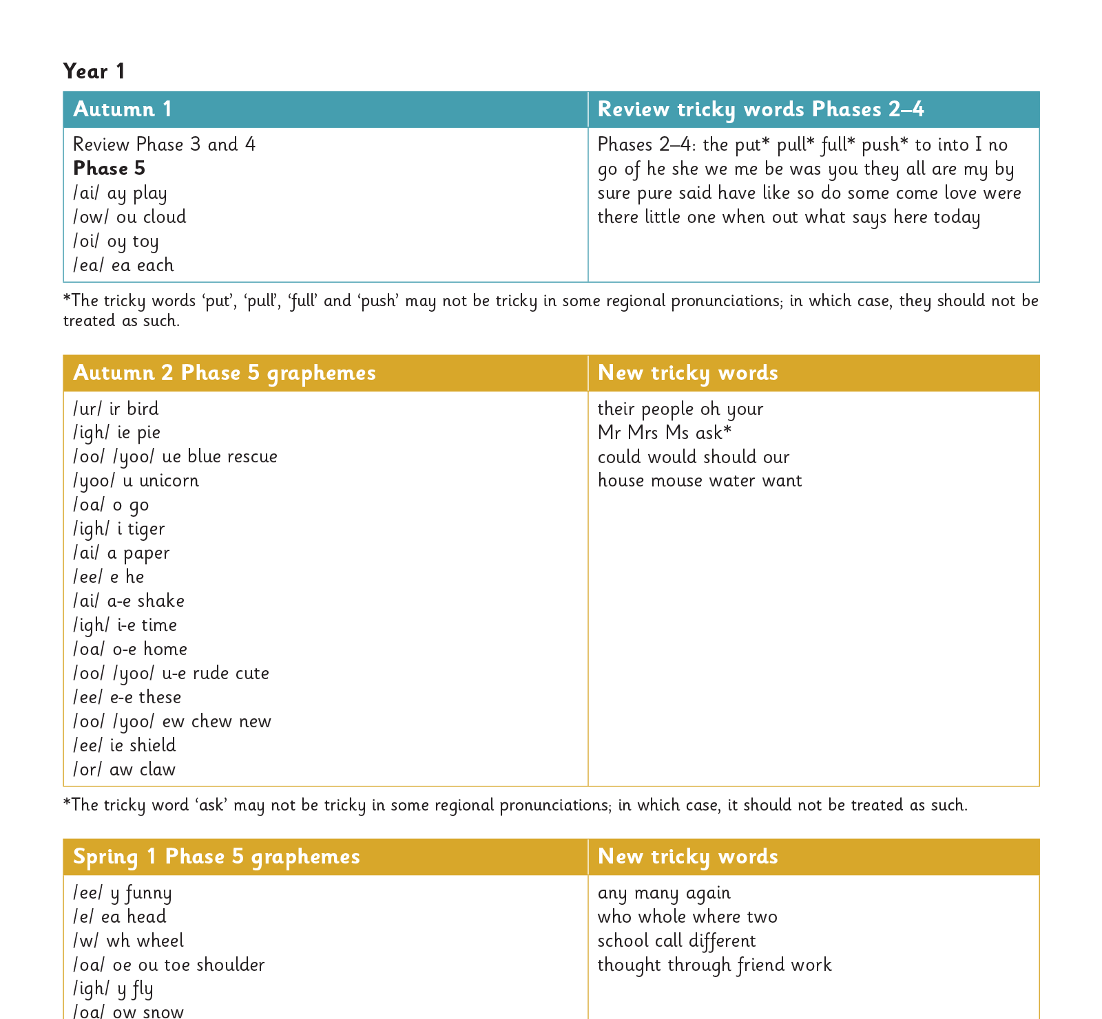
Gradually your child learns the entire alphabetic code:

Slide 8
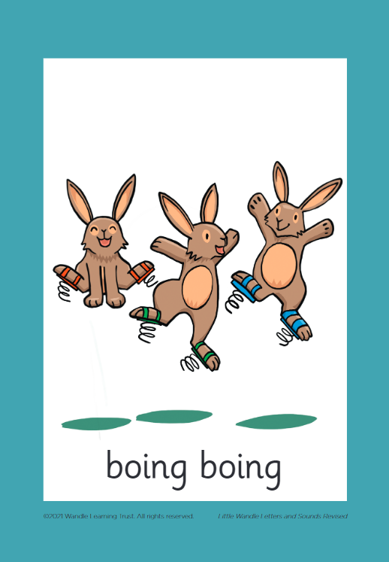



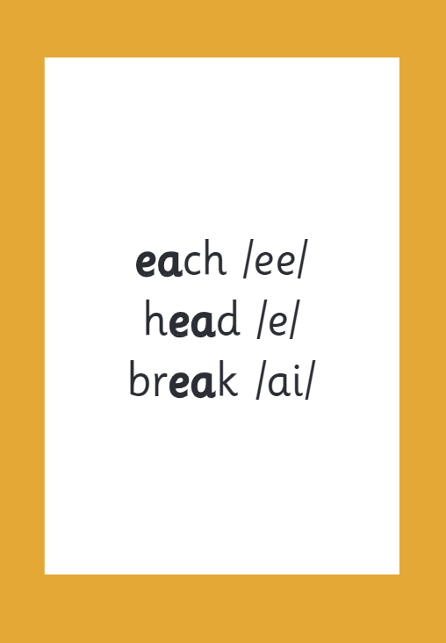

How we make learning stick

Slide 9
Reading and spelling

Slide 10

Spelling
Say the word.
Segment the sounds.
Count the sounds.
Write them down.

Slide 11
How do we teach reading in books?
Reading practice sessions are:
timetabled three times a week
taught by a trained teacher/teaching assistant
taught in small groups.

Slide 12
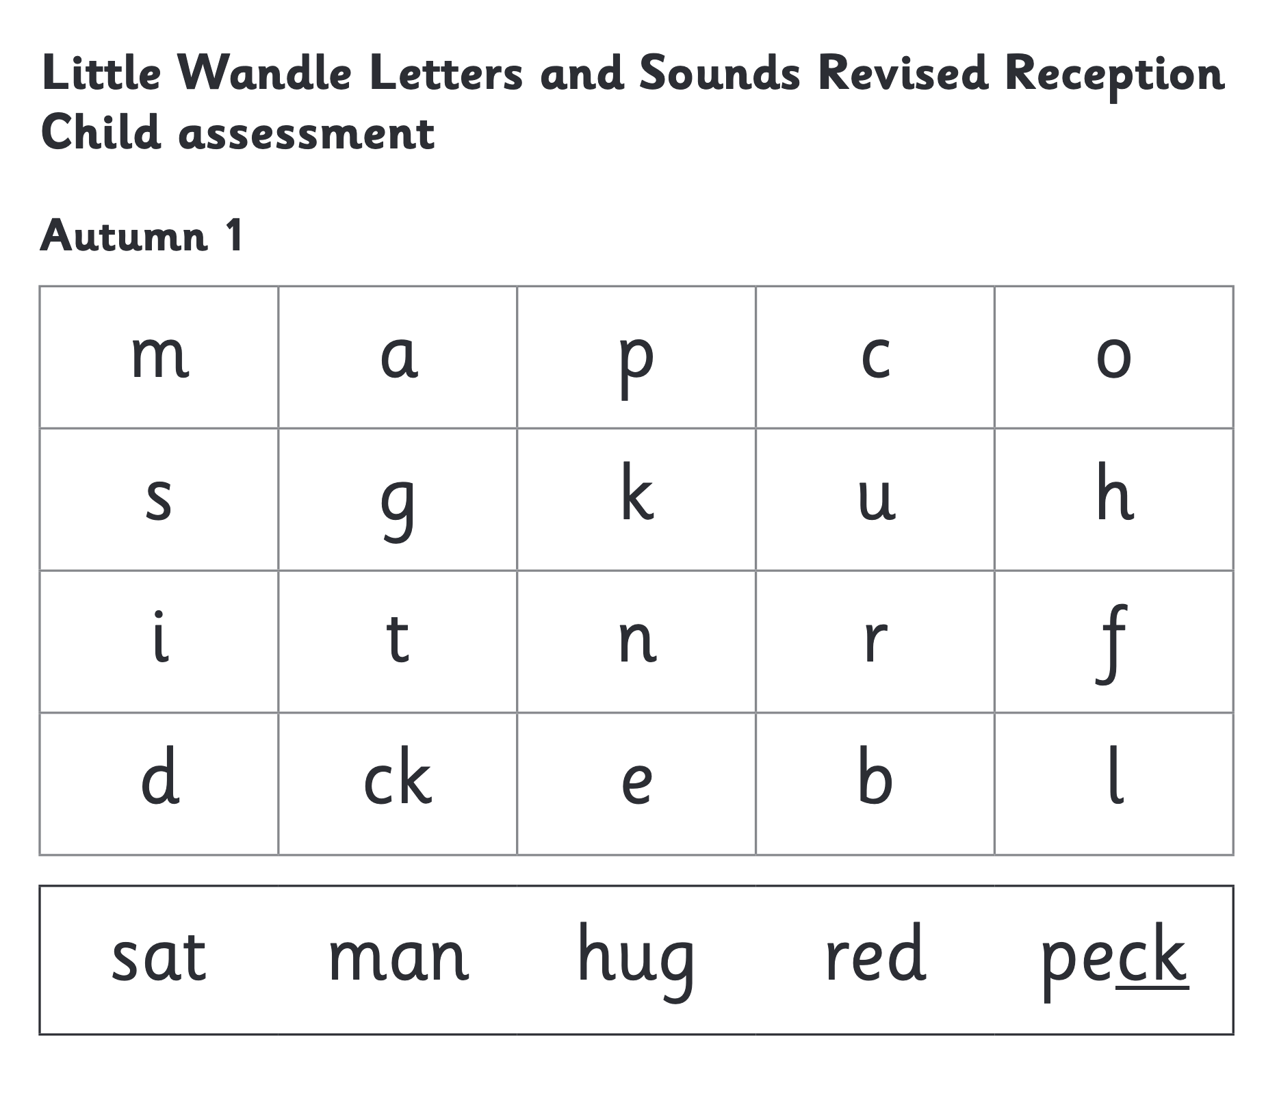
We use assessment to match your child the right level of book

Slide 13
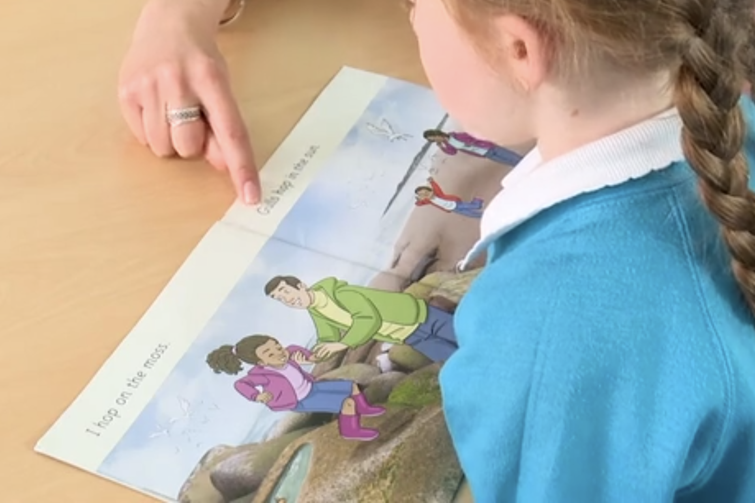
Reading a book at the right level
This means that your child should:
Know all the sounds and tricky words in their phonics book well
Read many of the words by silent blending (in their head) – their reading will be automatic
Only need to stop and sound out about 5% of the words by the time they bring the book home – but they should be able to do this on their own.

Slide 14
Reading at home

Slide 15

The most important thing you can do is read with your child
Reading a book and chatting had a positive impact a year later on children’s ability to…
understand words and sentences
use a wide range of vocabulary
develop listening comprehension skills.
The amount of books children were exposed to by age 6 was a positive predictor of their reading ability two years later.
Parental involvement in the development of children’s reading skills: A five-year longitudinal study (2002) Senechal, M. and Lefvre, J

Slide 16

Books going home

Slide 17
Listening to your child read their phonics book
Your child should be able to read their book without your help.
If they can’t read a word read it to them.
Talk about the book and celebrate their success.

Slide 18
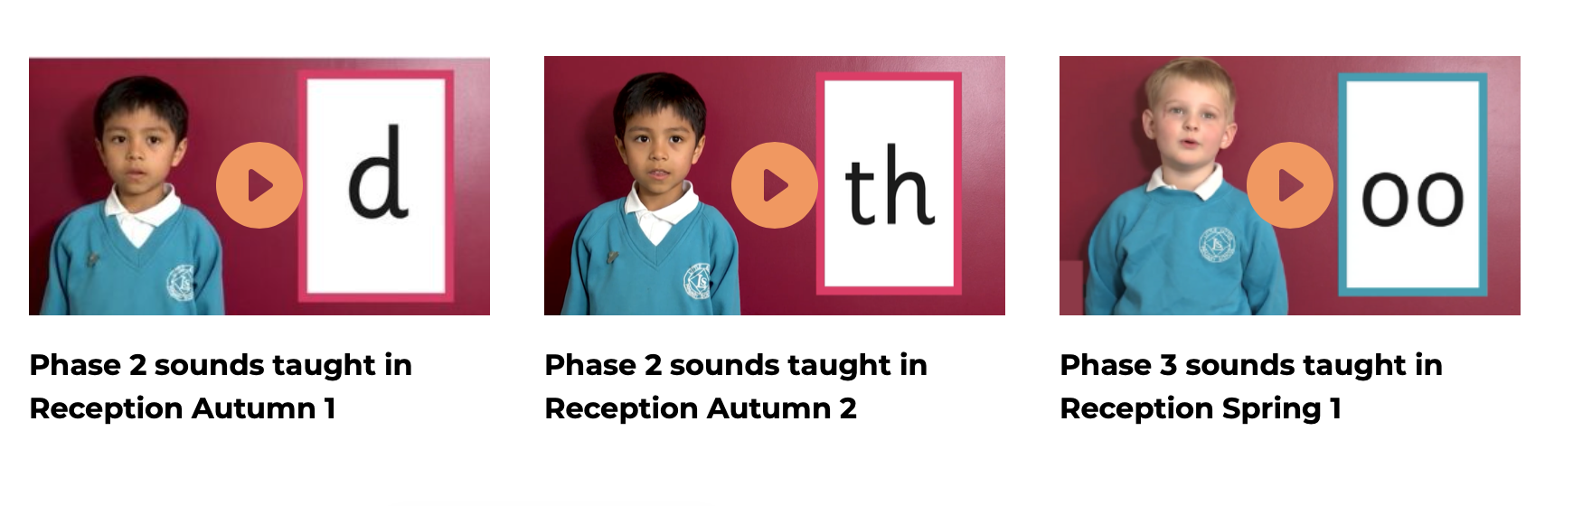
Supporting your child with phonics

Slide 19

Read to your child
The shared book is for YOU to read:
Make the story sound as exciting as you can by changing your voice.
Talk with your child as much as you can:
  Introduce new and exciting language
  Encourage your child to use new vocabulary
  Make up sentences together
  Find different words to use
  Describe things you see.

Slide 20
One of the greatest gifts adults can give is to read to children
Carl Sagan

