Slide 1
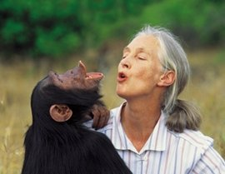
Jane Goodall

Slide 2
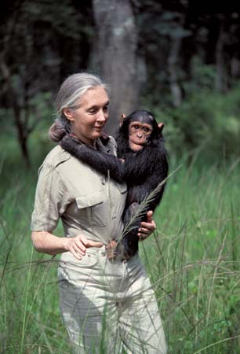
Facts about Jane Goodall
Born 3rd of April 1934
Born in London, England
British primatologist and anthropologist. Considered to be the world's foremost expert on chimpanzees.
Why is she a famous scientist?
Goodall studied chimpanzees in great detail, learning how they lived in groups, problem solved and interacted with their environment. She discovered that chimpanzees had the mental capacity to not only use simple tools but to actually make them as well, something that was previously thought to be uniquely human.
Goodall established the Jane Goodall Institute in 1977, it supports research while actively running a range of conservation programs to protect chimpanzees and the environment.

Slide 3
Further resources
Into the forest with Jane Goodall https://www.youtube.com/watch?v=5PwcY_axJwA
Jane Goodall life story
https://www.youtube.com/watch?v=pESavD4aXhc
How children can help? https://www.youtube.com/watch?v=pESavD4aXhc

