Slide 1
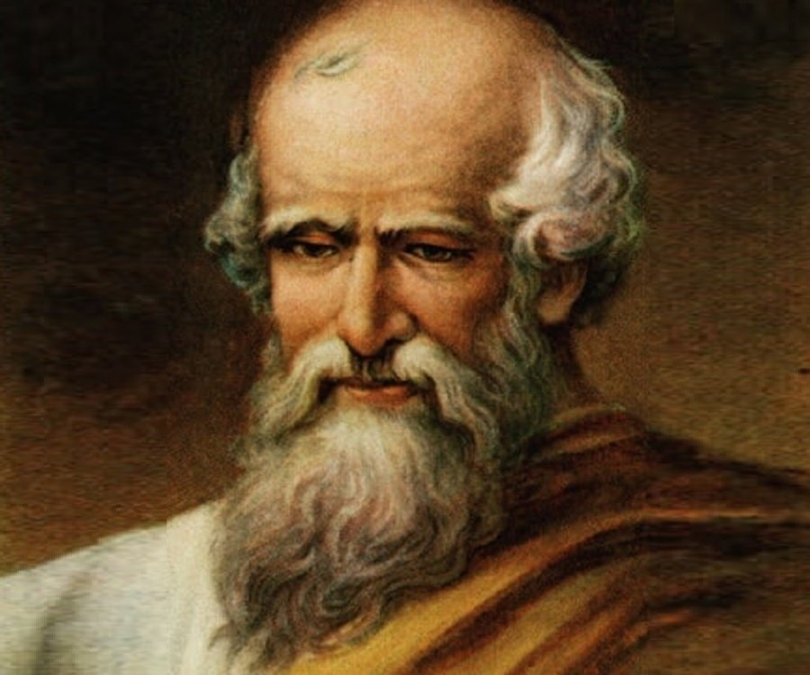
Archimedes

Slide 2

Facts about Archimedes
Born 287 BC
Born in Sicily
Archimedes was one of the greatest scientists in the Ancient world. Most commonly known these days for his advanced mathematics, he was also recognised as a weapons designer, engineer, inventor, astronomer (his father was also an astronomer), physicist and all-round scientist
Why is he a famous scientist?
He invented the Archimedes Screw which is a simple machine that moves water.
He helped the Greek Army build machines to stop the Romans invading.
Archimedes’ principle, which explains why heavy objects like ships float in water.

Slide 3
Further resources
Why do ships float? https://www.youtube.com/watch?time_continue=1&v=CvWrkxzCiaY&feature=emb_logo
Taking a bath https://www.youtube.com/watch?v=ijj58xD5fDI&feature=emb_logo
Real story about Archimedes https://www.youtube.com/watch?v=0v86Yk14rf8&feature=emb_logo

