Slide 1


Slide 2
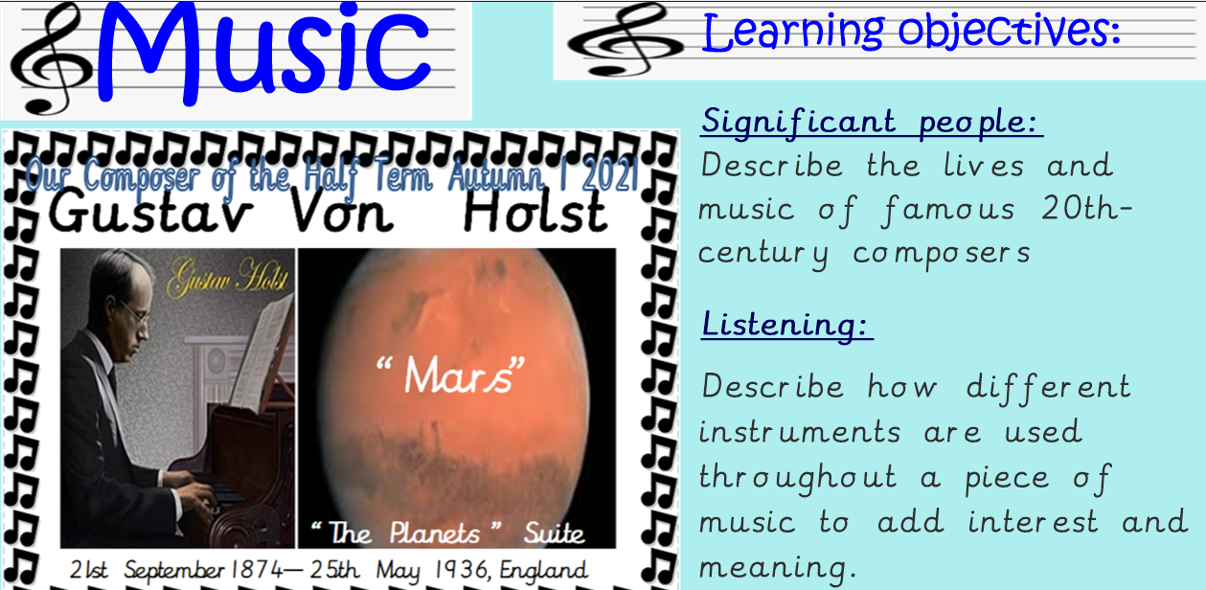
https://www.youtube.com/watch?v=cXOanvv4plU

Slide 3
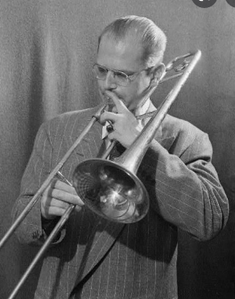

Gustav Holst (21 September 1874 - 25 May 1934) was a famous English composer. He was born in Cheltenham, Gloucestershire. He studied composition at the Royal College of Music in London. He also learned to play the trombone. He became Director of Music at St Paul’s Girls’ School, Hammersmith, (London). Some of his music was written for the pupils at this school: for example, the popular St Paul’s Suite (1912-1913) for string orchestra.

Slide 4
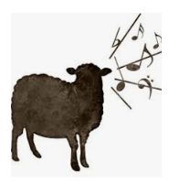
When Holst was a music student at the Royal College of Music, he was too poor to buy train tickets back home. He frequently walked the 100 miles from London to Cheltenham, with his trombone slung across his back. He used to practice along the way when he thought he wouldn’t disturb anyone. One time, though, a sheep farmer scolded him for making so much noise. He claimed it was making all of his sheep lamb too soon.

Slide 5
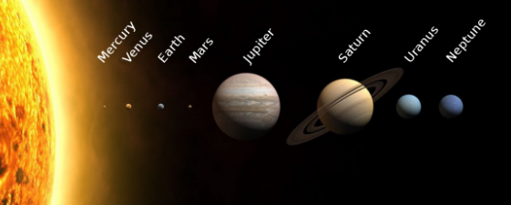
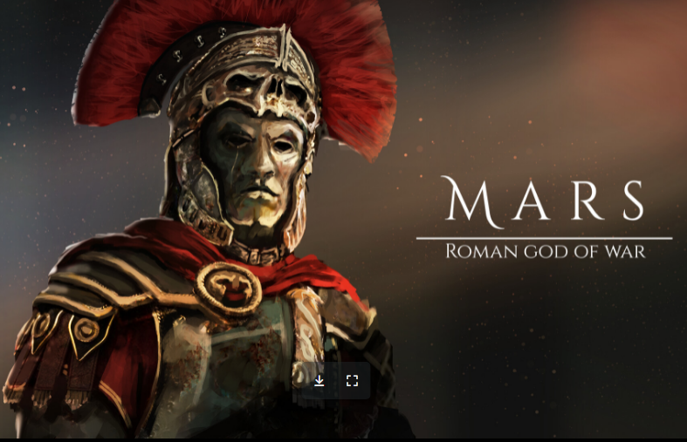
His most famous work is The Planets (1918). This is a suite of seven movements for orchestra, each about a different planet (the Earth is not included, and Pluto had not yet been discovered). The music does not really describe the planets, it describes the Roman gods after which the planets are named. Mars, for example, is the “Bringer of War”. It has a very exciting rhythm with five beats in a bar. Jupiter has a tune which has become famous as the hymn “I Vow to Thee, My Country”. He died of heart failure in London.

Slide 6
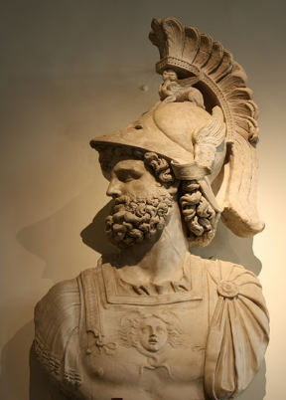
https://www.youtube.com/watch?v=cXOanvv4plU
In Roman religion, Mars was a very important god. His role was second only to Jupiter, the leader of the pantheon. Mars was the son of the God Jupiter and the Goddess Juno. His father, Jupiter, was the God of the sky and thunder. Jupiter was considered the chief, or central, guardian of Rome and was often considered to be witness to solemn oaths such as those undertaken by government officials or soldiers. His mother, Juno, was the protector of Roman women and was the patron Goddess of Rome.
Both his mother and father were renowned for strength and protection. Mars himself was the god of war and was, himself, seen as protector of the Roman Army. He was thought to be difficult, argumentative and unpopular among the gods, but was revered by men; especially soldiers. It was even reported that Mars was the father of Romulus and Remus, the twin brothers who were the founders of Rome.
Mars was known as the Roman god of war. He was said to love the violence and conflict. His persona represented military power and the noise and blood of battle.

