Slide 1
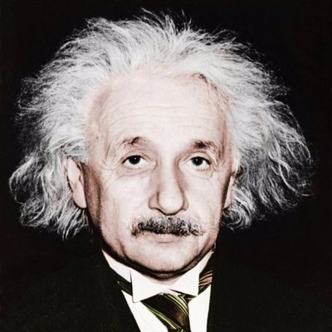
Albert Einstein

Slide 2
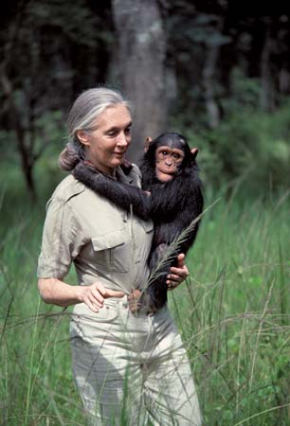
Facts about Albert Einstein
Born in 14 March 1879.
Born in Berlin, Germany
Albert Einstein came up with some amazing theories about light, matter, gravity, space and time and soon enjoyed world-wide fame!
Why is he a famous scientist?
Einstein is probably most famous for his ‘theory of relativity’ and the equation he made famous, e=mc², which proved that even the smallest amount of mass (basically the stuff that’s in everything!) can be turned into a huge amount of energy.
Einstein thought the way people understood gravity was wrong and he worked on a new theory to prove it – he was later able to test he was right with a solar eclipse!
Soon Einstein became a very famous name! After publishing his Theory of Relativity and correctly predicting the effects of a solar eclipse, Albert enjoyed world-wide fame.

Slide 3
Further resources
Short introduction https://www.youtube.com/watch?v=2Md8xj8SzPg
Albert Einstein life story https://www.youtube.com/watch?v=QCcbsbRC2ts
How Einstein's work changed the world? https://www.youtube.com/watch?v=cFo5BjSB_YI

