Slide 1
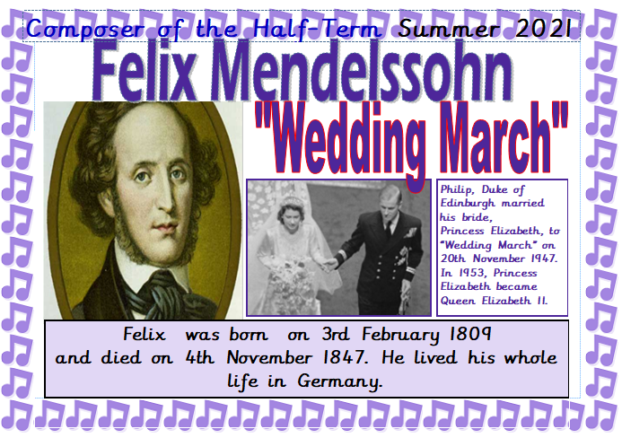

Slide 2
https://www.youtube.com/watch?v=reu4GvUjm5o
London Symphony Orchestra playing “Wedding March”
https://www.youtube.com/watch?v=a4VvmFui0mw
Highlights of Royal Wedding ( 3.45-4.00, “Wedding March”)

Slide 3
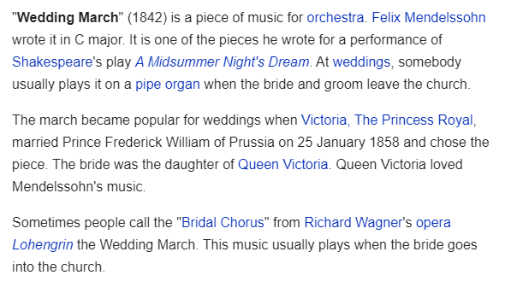

Slide 4
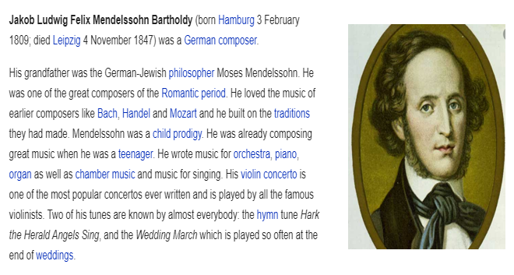

Slide 5
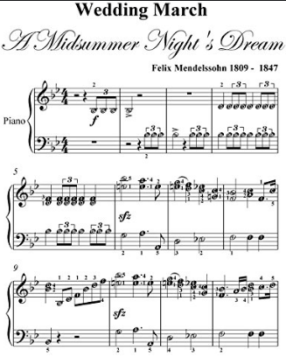
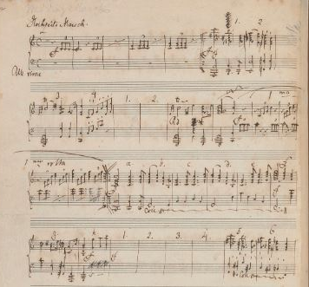
https://www.youtube.com/watch?v=reu4GvUjm5o
Mendelssohn’s hand written sheet music (above) and a printed copy
(right)

Slide 6
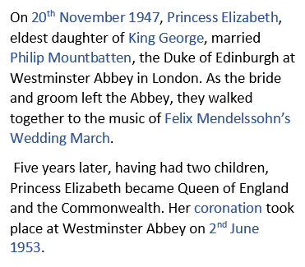
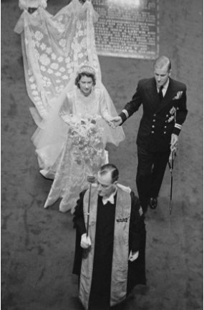
https://www.youtube.com/watch?v=a4VvmFui0mw

Slide 7
