Slide 1
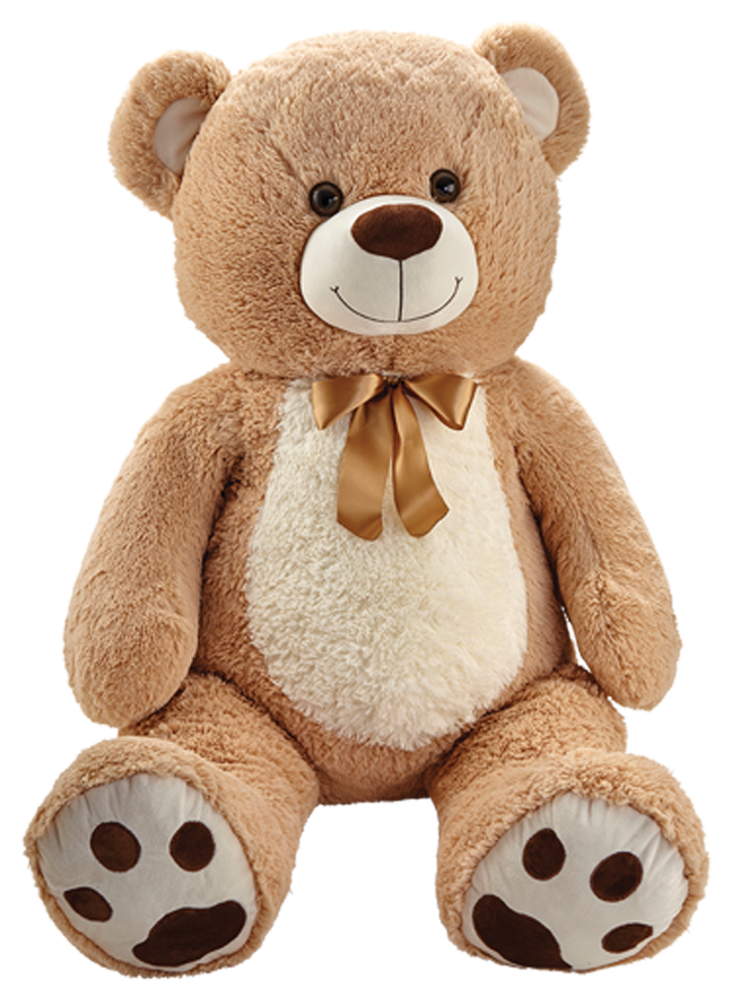

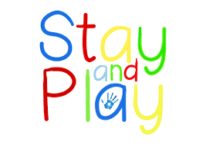
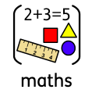

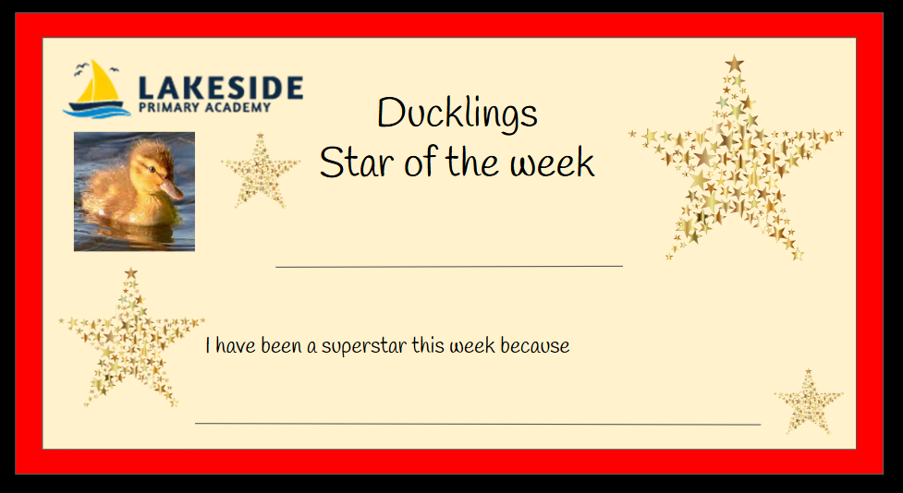
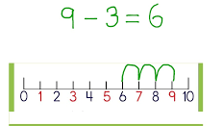
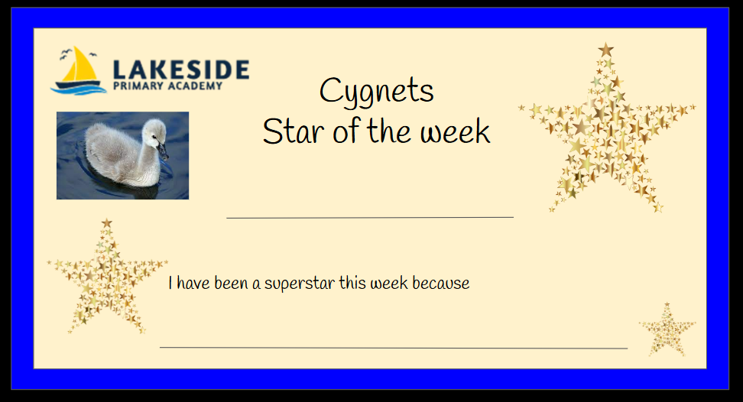

Early Years Newsletter 25th April 2025
We value your support in helping your child with their learning at home and we would like to invite you to join us in school to take part in an activity and to learn with them in the classroom.
Please see the dates for your child's session:
We have had a super busy week this week in Early Years. We have been finding out all about the different parts of the plant. We learnt about the roots, stem, leaves and flowers and how they all have a job to do to keep the plants healthy. After we read our story this week we started to make our own plant pots to look like minibeasts ready for planting our seeds next week. We have enjoyed having a go at playing board games in maths this week practising our counting and taking turns. Outside we have been building lots of dens and drawing lots of pictures. Next week we are looking at vegetables and finding out the different parts of plants we can eat.
Counting back
Kienna
Ducklings:
Friday 9th May 1:30pm-3:00pm
Monday 19th May 1:30pm-3:00pm
Cygnets:
Monday 12th May 1:30pm-3:00pm
Monday 9th June. 1:30pm-3:00pm
Being brave and trying her best
This week in Maths we have been counting back from different numbers. We have learnt how to use a numbertrack to count back and solve problems with first, then and now stories. First the old man planted 5 beans, then the birds ate 2 beans, now there are 3 beans.
Minsa
Having a go and trying her best
Notes:
soft : easy to change shape , prickly: like spikes , hard,: not easy to break. smooth: an even surface, rough: uneven surface

Slide 2




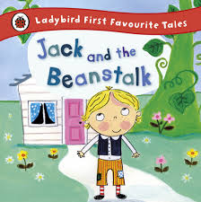
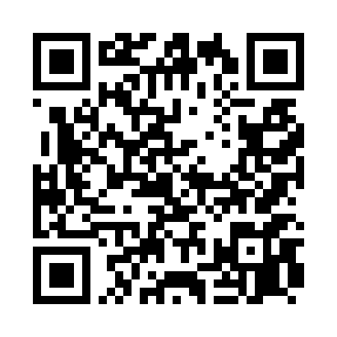
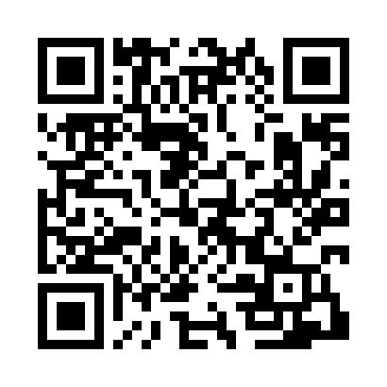
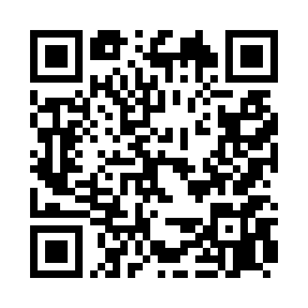
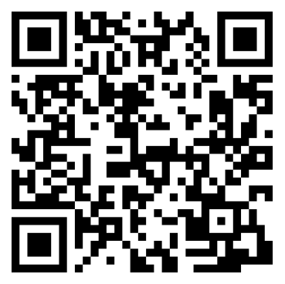





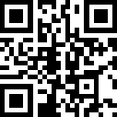
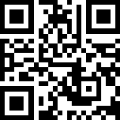
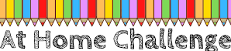

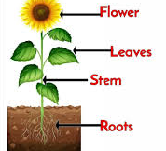
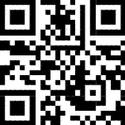
This week our emotion is 'loved'
This week we have been thinking about choices and how sometimes we are unsure of what we want. We have learnt that sometimes we made good choices and sometimes our choices are not always the right ones but by making mistakes can help us to learn.
Words we are
learning…
Here are links for the special friends sounds:
Steal
Giant
Snooze,
Snatched
poor
Song of the week:
Jack and the Beanstalk: https://tinyurl.com/25kb2jwr
https://tinyurl.com/bhu3y59a
Roots, stem, leaves, flower,
Need sun and air and a little rain shower.
Some activities you could try at home with your child this week:
Plant your own seeds at home. You could collect seeds from fruits and have a go at planting them.
Have a go at playing a game of snakes and ladders to practise counting on and counting back.
Scan here to listen to a bedtime story!
https://tinyurl.com/2xutvpm2

