Slide 1

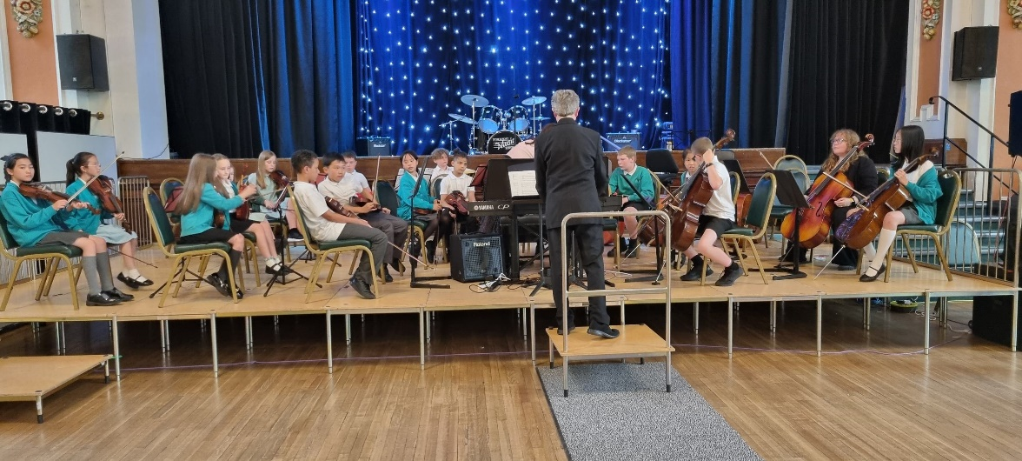
What does ‘Music’ look like at
Ladybridge Primary?
1. Curriculum
KAPOW Primary Curriculum is used from EYFS to year 4, it contains 5 elements, listening and evaluating, creating sound, notation, improvising and composing, performing - singing and playing:
Rhythm work – children copy, create and compose rhythm using symbols.
Sol-fa – children learn pitch through voice and instruments
Voice – Children use their voices expressively and creatively Playing - tuned and un-tuned instruments musically
Listening - with concentration and understanding to a range of high quality live and recorded music
Experimenting - with, creating, selecting and combining sounds using the inter-related dimensions of music
Rhythm symbols
In year 5 and 6 the Music Curriculum builds on skills and knowledge from EYFS and LKS2, it has 8 elements :
Rhythm work – children learn to, create and compose complex and compound rhythms using symbols.
Sol-fa – children read and play or sing tunes using sol-fa
Play and Perform – the music service teach the children to play an orchestral instrument, children play in our school orchestra, reading music on a stave, they play their musical instruments with increasing accuracy, fluency, control and expression
Improvise and compose music - for a range of purposes using the inter-related dimensions of music
Listen – with attention to detail and recall sounds with increasing aural memory
Use and understand staff and other musical notation
Appreciate and understand a wide range of high quality live and recorded music drawn from different traditions and from great composers and musicians
Develop an understanding of the history of music
Graphic score
2. Performing
We encourage all children in KS2 to join the choir, the choir perform regularly at venues such as the Town Hall, St. George’s Church, and at an arena as part of the Young Voices concert with 8000 other pupils!

Slide 2
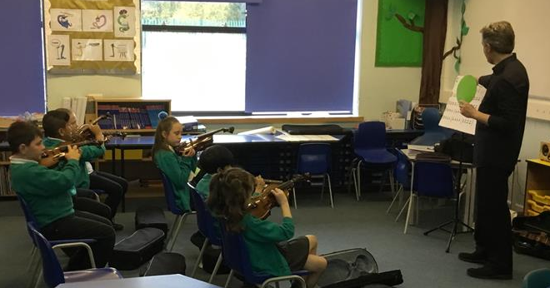

3. Learning to play an instrument
Children in year 5 and 6 learn to play an brass instrument. Ladybridge is an ‘In Harmony’ school, we work closely with Stockport Music Service. Children are signposted to join local youth ensembles.
Children of all ages have the opportunity to learn to play guitar or ukulele.
Qualified teachers from the Music Service and a local provider teach the children as a whole class, in small groups and individually.
4. Assessment
Music is assessed against the EYFS outcomes for learning and against National Curriculum outcomes for Years 1-6.
School use KAPOW assessment and assessment trackers that encompass all elements of the music curriculum and measure progression of skills over time. Assessment is reported termly to the SLT and the Governing Body.
Assessment methods include peer and self-assessment of both performance and written work.
5. Inclusion
Children who excel in music are encouraged to join local youth choirs and music groups. Children also receive certificates of achievement awarded by the Music Service.
We are a Resourced Primary School and have more than twice the national average of children with EHCPs and SEND support plans. Our inclusive practice ensures that all children with SEND needs have differentiated lessons or adult support in order that they can achieve in music, make good progress and join in with performances in the community or in school. Data shows that our SEND population make good progress in music.
6. Professional Development
Being an In Harmony school ensures that when the Music Service teach the children, teachers and support staff learn alongside the children, ensuring that CPD is a constant thread throughout the Key Stages. KAPOW has training videos for teachers who are not music specialists. In addition to this the Music Service and the National College provide CPD that school staff can attend.

