Slide 1
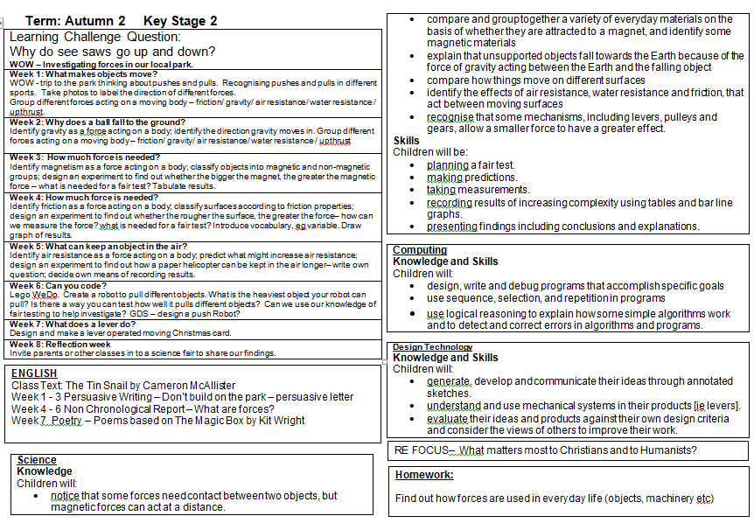
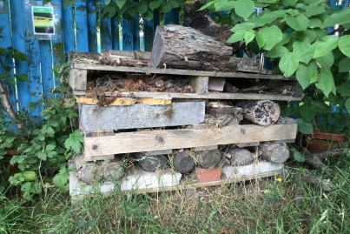
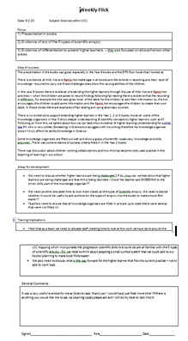
What does ‘Science’ look like at
Ladybridge Primary?
1. Curriculum mapping
Science lessons are taught through the Learning Challenge Curriculum, the National Curriculum strands are explored through a four yearly cycle in KS 2 and a two yearly cycle in KS 1. In addition to this the 5 types of Scientific Enquiry, the progression skills and key vocabulary are also mapped out.
Learning follows a clear sequence in each year group and throughout school to ensure progression of knowledge and skills. Lessons are sequences lesson by lesson, unit by unit, and year by year, to recap and build on prior learning.
Cross curricular links are made with Geography and History – For example during Geography Rainforests work is also carried out in Habitats, Rocks & Evolution work is carried out during Geography work on Natural disasters and History work on Stone Age & Iron Age.
EYFS children have access to the Science led activities in the continuous provision.
Half termly planning goes into greater detail and can be found in the planning folder on the system.
2. Sampling
Lesson observations inform staff about how Science is being taught and how children are learning. Learning walls and displays reflect the learning that is taking place.
Pupil voice informs staff that pupils are enjoying their Science lessons and are engaged.
Weekly book flicks alongside ALL staff allow for positives to be shared, and inconsistencies/areas for development to be identified.
3. CPD
Opportunities to attend Science Co-ordinator meetings.
Use of Learning Leads and the forum.
Regular discussions/feedback/updates with AD – Assistant Head and Curriculum lead.
Evidence of a series of History lessons being taught.

Slide 2
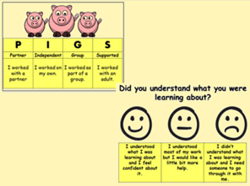
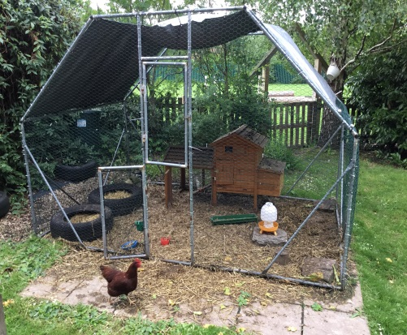
4. Assessment
Where possible, we aim to allow pupils to self-assess their own work in order for them to see where they have made errors and self- correct them – we do this through HOT marking, which can be seen with a pink highlighter, self-correction can be seen with a purple pen.
Learning organisers are in all children’s workbooks and they are filled in at the beginning, during and at the end of a topic.
TAFs, linked to the Curriculum Progression documents are used to assess the children, this data is then analysed by subject leaders.
5. Learning environment
The 5 types of Scientific Enquiry are displayed in all classrooms.
Learning walls reflect activities carried out, key questions and answers. Alongside these working walls, key vocabulary is added taken from our progressive History vocabulary lists.
6. Celebrations
Science themed events, for example ‘stargazing’.
Home Learning projects are set for children to participate in developing their knowledge as a family.
Chickens are on site and are looked after by the staff and children at school.
Pond and outdoor spaces are being developed.
Annual Science Week, linked to ….

