Slide 1
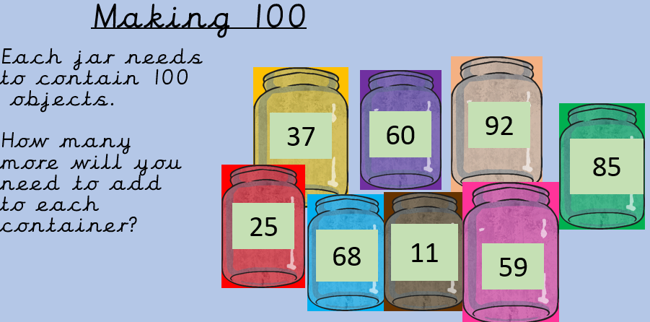
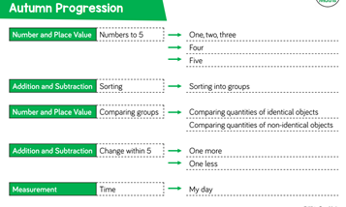
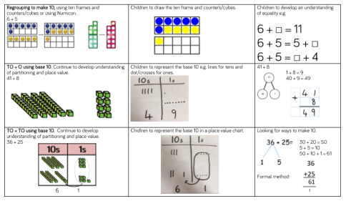
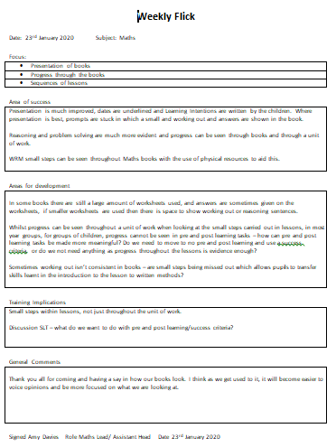

What does ‘Maths’ look like at
Ladybridge Primary?
1. Curriculum mapping
Our Maths Curriculum use the White Rose Scheme of work to support teaching and learning, which allows pupils to be exposed to a range of fluency, reasoning and problem solving activities. We use a Concrete, Pictorial and Abstract (CPA) approach in maths. Learning follows a clear sequence in each year group and throughout school to ensure progression of knowledge and skills.
Quality First Teaching in all year groups, a range of questioning strategies , times tables focus and the use of Post Learning Assessments at the end of units, enhance opportunities to develop application within maths problem solving and reasoning.
We use the White Rose Calculation policy to ensure that the progression of maths is clear throughout the year and key stages and pupils previously learnt knowledge is built on, this focuses on the use of concrete, pictorial and abstract methods.
In addition to this, daily flashback activities at the start of a maths lesson ensure learning is embedded, providing children with questions about something learnt last year, last term, last week and the previous day.
Our maths lessons are planned from our yearly overviews which allow us to produce more detailed half termly plans. Weekly planning is saved to the system.
2. Sampling
Most days, we speak to pupils informally about what maths learning looks like in their classroom. We want all our pupils to have a voice and to be heard. We use learner voice to impact on the way we teach maths in our school. For those pupils who struggle with maths, we want to find out how they would like us to help them to make progress and enjoy their learning.
Weekly book flicks alongside ALL staff allow for positives to be shared, and inconsistencies/areas for development to be identified. In addition, we can ensuring progression over a unit and effective use of small steps.
Pupil voice informs staff that pupils are enjoying their maths lessons and are engaged.
3. CPD
NCETM – we are currently working alongside Alexandra Park Primary School as part of an NCETM group to prepare for Mastery.
Information and ideas from this are shared with staff in meetings, following meetings, staff then share successes with each other in an additional meeting.

Slide 2
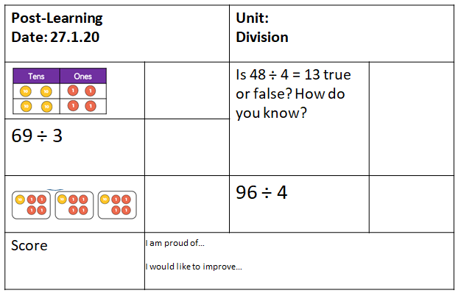
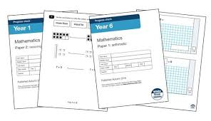
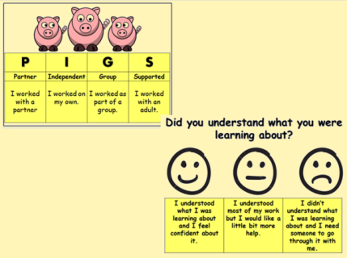
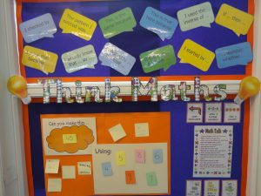
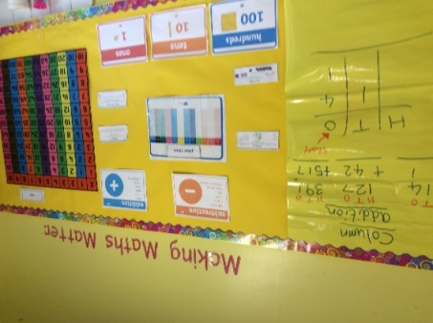
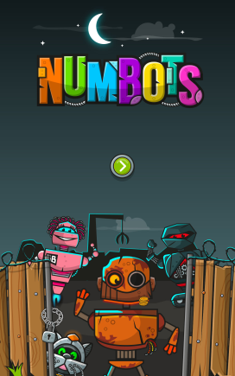
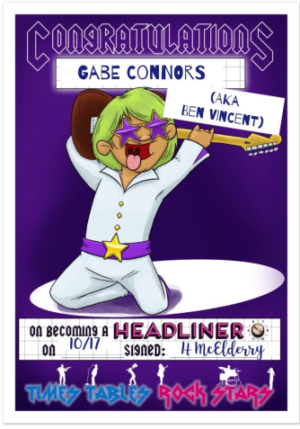
4. Assessment
HOT marking, during lessons, which can be seen with a pink highlighter, allows pupils and teachers to identify misconceptions. Pupils then self-correct with a purple pen.
During our formal assessment weeks, the White Rose assessments are used in line with the units of work which have been covered. These scores are then converted to allow staff to monitor the progress being made.
At the end of each unit of work, children complete a Post-Learning Assessment which allows them to track their learning, these also informs teachers’ future planning, including Flashback 4 work.
Children are encouraged to self-reflect on their learning, progress and areas for development at the end of each unit.
5. Learning environment
At Ladybridge Primary the teaching of Maths is inclusive through quality first teaching. We are following the White Rose mastery approach, provision for pupils is age appropriate and follows the CPA (concrete, pictorial, abstract) approach. SEN Support plans outline specific targets for our pupils with additional needs.
In addition we offer support through:
Multisensory approaches to learning
Use of iPads
Mathematics Interventions
Speech and language (SALT)
Learning Support Service (LSS)
6. Celebrations
Children from Year 1 upwards take part in Numbots and/or Times Tables Rockstar to encourage a mastery of key calculation facts, such as multiplication and division facts. Certificates are given weekly for those children who have made progress and used the programmes frequently.
Maths is also recognised as one of our Aiming High Awards for pupils who push themselves out of their comfort zone in Mathematics lessons..

