Slide 1
Subject: Geography Key Stage: 1
WHERE WE LIVE

Slide 2
Title: Where We Live
Curriculum links:
KS1 Geography National Curriculum
Name, locate and identify characteristics of the four countries and capital cities of the United Kingdom and its surrounding seas.
LIs:
Name the countries that make up the UK.
Recall facts about the UK.
Describe the Union Jack flag.
Create a flag to represent where we live.

Slide 3
Instructions for use:
Most tasks have been differentiated to three levels with the orange boxed task being the easier of the three and the grey being the more challenging.
For mixed ability classes we suggest keeping all tasks and directing your students towards their appropriate level. For setted classes you can delete the tasks you feel are not appropriate.
Throughout we have added questions in orange that can be used to prompt conversation, draw further information from your students and deepen their understanding.
Please feel free to edit the order of the slides so this lesson is consistent with your approach.
Additional information can be found in the notes section of each slide.

Slide 4
What do you know about this picture?
Notes:
Image credit: http://www.pngall.com/united-kingdom-uk-map-png

Slide 5

Today we are learning about the United Kingdom and the Republic of Ireland.
This is a picture of what they look like.

Slide 6
Title: Where We Live Date: Monday, 14 September 2020
Name the countries that make up the UK
Recall facts about the UK
Describe the Union Jack flag
Create a flag to represent where we live

Slide 7
Where do we live?
Notes:
The Big Picture links to lesson content to the real world and events happening outside of school
It acts as a point of interest to inspire conversations and engage students
Image credit: https://geographical.co.uk/competitions/where-in-the-world

Slide 8
This is also a picture of the United Kingdom and Ireland. It now has colour and labels.
Can you find Ireland?
Notes:
Image credit: https://www.hope-education.co.uk/product/primary/geography/maps/simple-map-of-the-uk/he1206847

Slide 9
This is the Republic of Ireland
It is not a part of the United Kingdom
Notes:
Image credit: https://www.hope-education.co.uk/product/primary/geography/maps/simple-map-of-the-uk/he1206847

Slide 10
Can you find the names of the countries in the UK?
How many countries are in the UK and what are they called?

Slide 11
There are 4 countries in the UK:
Scotland
Northern Ireland
Wales
England

Slide 12
Which country do we live in?
Where on the map do we live?

Slide 13
We are going to do some research!
Use the internet (or atlases) to find the answers.

Slide 14
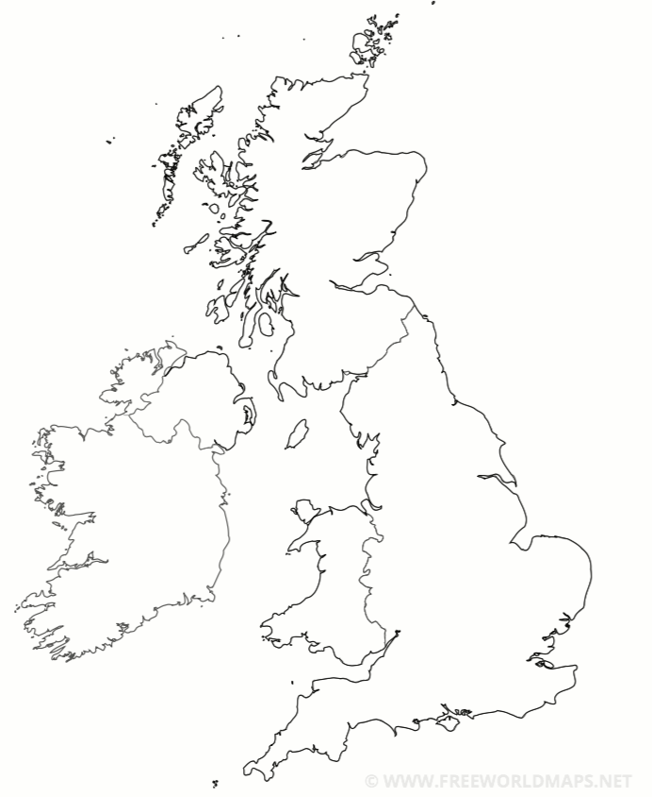
The UK and the Republic of Ireland
Label the countries on the map:
  England, Scotland, Wales, Northern Ireland, Republic of Ireland
Capital cities:
Write the name of the country underneath its flag
England | Scotland | Wales | Northern Ireland | Republic of Ireland
The capital is: __________ | The capital is: __________ | The capital is: __________ | The capital is: __________ | The capital is: __________
Notes:
Image credit: https://www.freeworldmaps.net/europe/united-kingdom/pdf/uk-pdf-outline.pdf
https://en.wikipedia.org/wiki/Flag_of_England
https://en.wikipedia.org/wiki/Flag_of_Wales
https://en.wikipedia.org/wiki/Flag_of_Scotland
https://en.wikipedia.org/wiki/Ulster_Banner
https://en.wikipedia.org/wiki/Flag_of_Ireland

Slide 15
The UK and the Republic of Ireland
Label the countries on the map:
Write the name of the country next to its flag
Write an interesting fact about each country:
  England:
  Scotland:
  Wales:
  Northern Ireland:
  Republic of Ireland:
England | Scotland | Wales | Northern Ireland | Republic of Ireland
The capital is: __________ | The capital is: __________ | The capital is: __________ | The capital is: __________ | The capital is: __________
Notes:
Image credit: https://www.freeworldmaps.net/europe/united-kingdom/pdf/uk-pdf-outline.pdf
https://en.wikipedia.org/wiki/Flag_of_England
https://en.wikipedia.org/wiki/Flag_of_Wales
https://en.wikipedia.org/wiki/Flag_of_Scotland
https://en.wikipedia.org/wiki/Ulster_Banner
https://en.wikipedia.org/wiki/Flag_of_Ireland

Slide 16
England | Scotland | Wales | Northern Ireland | Republic of Ireland
The capital is: London | The capital is: Edinburgh | The capital is: Cardiff | The capital is: Belfast | The capital is: Dublin
Scotland
Northern Ireland
Republic of Ireland
Wales
England

Slide 17
This is the Union Jack.
It is the flag of the United Kingdom.
Notes:
Image credit: https://en.wikipedia.org/wiki/Flag_of_the_United_Kingdom

Slide 18
St George's cross (patron saint of England)
St Patrick’s cross (patron saint of Ireland)
St Andrew’s cross (patron saint of Scotland)
What do you notice about the flags of the patron saints of England, Ireland and Scotland, and the Union Jack?
Notes:
Image credit: https://en.wikipedia.org/wiki/Saint_George%27s_Cross
https://en.wikipedia.org/wiki/Saint_Patrick%27s_Saltire
https://en.wikipedia.org/wiki/Flag_of_Scotland

Slide 20
Notes:
Image credit: https://en.wikipedia.org/wiki/Flag_of_the_United_Kingdom

Slide 21
The UK is made up of England, Scotland, Wales and Northern Ireland so its flag is a collage of flags from England, Scotland, and Ireland (when the flag was made Wales was a part of England).

Slide 22
Flags represent groups of people. As well as people from different countries, other groups of people also have flags.
This flag represents LGBT+ people and is called the Pride Flag. The colours have different meanings:
Red = Life
Orange = Healing
Yellow = Sunlight
Green = Nature
Blue = Peace
Purple = Spirit

Slide 23
This is the Buddhist flag. Buddhist people and temples may fly it.
The colours match those which came out of Buddha’s body.
Notes:
Image credit: https://en.wikipedia.org/wiki/Buddhist_flag

Slide 24
All flags have special meanings and designs.
Create a flag that represents where we live.
Think about:
The colours you will use
The pictures you will use
The things that are important to everyone here

Slide 25
Art gallery!
Walk around the classroom and look at everyone’s work.
For every flag, write down one thing you like about it on the sticky note near the flag.
Notes:
Image credit: https://www.ronchinigallery.com/exhibitions/conrad-marca-relli/

