Slide 1
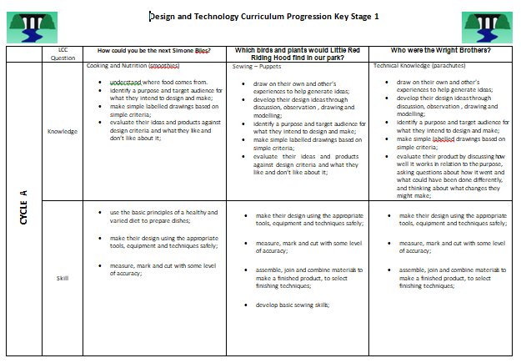
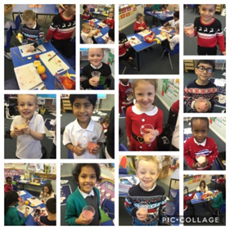

What does ‘Design and Technology’ look like at Ladybridge Primary?
1. Curriculum mapping
Our Design and Technology curriculum is incorporated into our cross-curricular Learning Challenges. Each half term, children will focus on a different topic area with a subject as a main driver’. At least one out of the six half terms will be driven by the Design and Technology curriculum.
The Learning Challenge curriculum will link Design and Technology with other subjects. This allows children to further progress their skills and knowledge in different subjects such as history, science, art, music and geography. Children can then see how subjects can link to each other.
The national curriculum is used to ensure a good coverage across the school’s curriculum. This means that all areas are covered, with skills being revisited in order to further develop them and ensure progression year on year.
2. Sampling
Pupil voice highlights the skills the children enjoy and wish to develop further. This helps to ensure teachers know where to take the children’s learning and progression of their skills.
Coverage of the skills in each year group, taught in design and technology are assessed termly to ensure coverage and progression.
Regular book flicks, involving all teaching staff, with a focus on design and technology every term.
3. CPD
Subject leader attends workshops for all primary Design and technology leaders in Stockport. Good practice and new innovations are shared. This is then shared with all teachers at Ladybridge to support making their design and technology lessons enjoyable and ensuring they have a purpose.

Slide 2
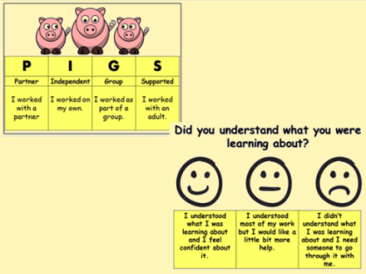
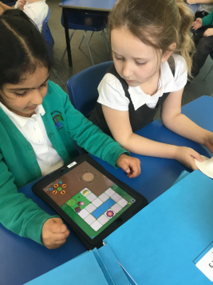
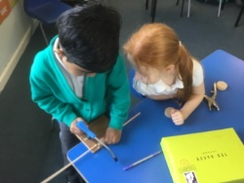
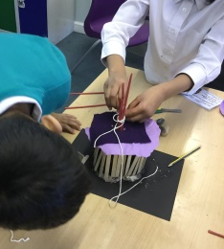
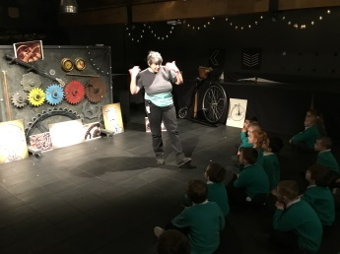
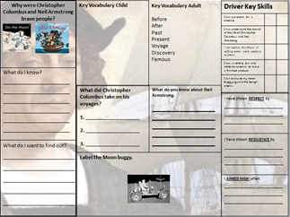
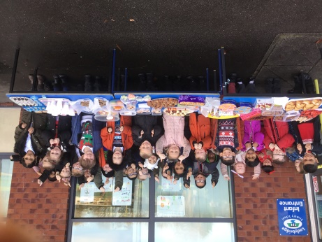
4. Assessment
Children are clear what they are learning through clear and accurate learning intentions. Children are understand how they demonstrate their understanding through clear, meaningful, differentiated ‘chilli challenge’ activities.
Where possible, we aim to allow pupils to self-assess their own work in order for them to see where they have made errors and self correct them – we do this using a success criteria. Evaluating is a key part in design and technology to ensure the children understand what skills they need to develop further. Children also feedback on their own understanding using faces and they indicate how they have worked.
5. Learning environment
At Ladybridge, the teaching of design and technology is inclusive and supportive, ensuring the children have the correct equipment to develop their skills and knowledge. Children learn and develop skills through understanding and investigating current designs, what equipment and materials would ‘work best’, practising using new equipment and materials and evaluating their finished products, ensuring they are fit for purpose against the success criteria..
Design and technology is a very ‘hands on’ part of the curriculum, where children will develop their skills through trial and era, testing their resilience and perseverance. Where possible, outer agencies are invited into school to give the children expert knowledge to extend their initial ideas and skills, as well as well thought through class trips to support their learning.
6. Celebrations
Our learning challenge work is displayed in the classroom, building up every week showing the succession of lessons.
Children complete a knowledge organiser throughout the learning challenge to show what skills and knowledge they have learnt. This gives the children a tremendous sense of prise and achievement.
Every half term the children complete a homework project linked to the learning challenge question. This quite often can be linked to design and technology, where the children can demonstrate their skills and knowledge to create a project for a purpose.

