Slide 1


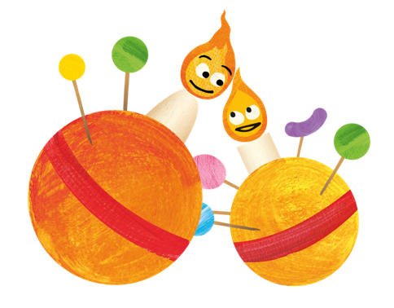
Christingle Collective Worship 2020

Slide 2

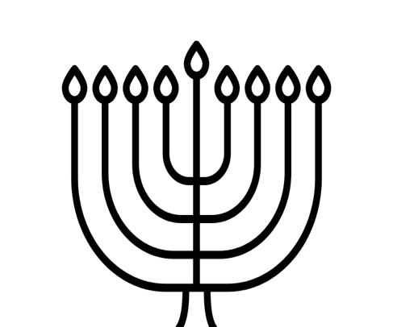

Notes:
Welcome
Welcome the children and staff.
At this time of year, the days get shorter and the nights get longer. Different religions and cultures all over the world use lights as part of their winter-time celebrations to bring hope and happiness into these dark times (you could show Diwali lamps, Hanukah lamps, Yule logs, street lighting, or have a selection on the assembly table).

Slide 3
Then Jesus again spoke to them, saying, “I am the Light of the world; he who follows Me will not walk in the darkness, but will have the Light of life.” (John 8:12)
While I am in the world, I am the Light of the world.” (John 9:5)
I have come as Light into the world, so that everyone who believes in Me will not remain in darkness. (John 12:46)

Slide 4
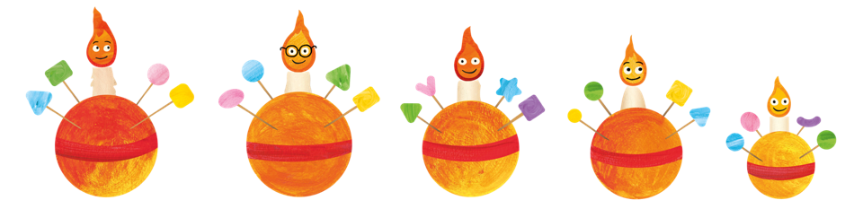
The Christingle characters
Notes:
Display slide of Christingle characters touching flames to pass their light along.

Slide 5
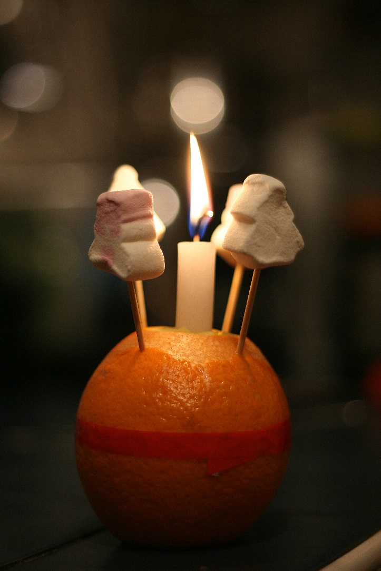
What is a Christingle?
A Christingle is made from an orange, red ribbon, four small sticks, dried fruits or sweets and a lit candle.
Christingle means ‘Christ’s Light’.
Christingles are used by Christians to celebrate Jesus as the Light of the World.
Christingles are usually used during church services and school assemblies during Advent.
“Christingle reinvented” by [Vincent Angler] is licensed under CC BY 2.0

Slide 6
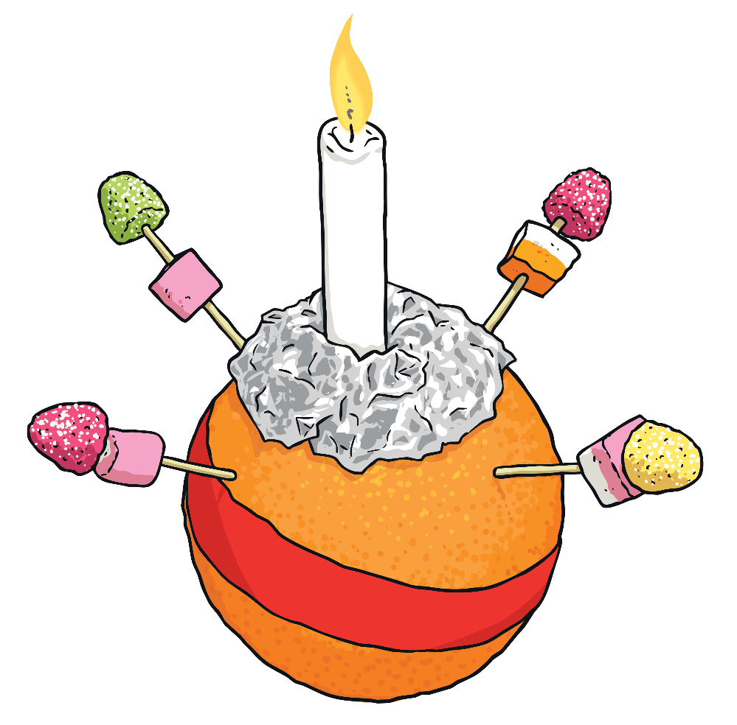
What Do the Parts of the Christingle Represent?
Each part of the Christingle has an important meaning.
The lit candle represents Jesus as the Light of the World.
The fruits or sweets skewered on sticks represent
the fruits of the Earth.
The four sticks represent the four compass directions and the four seasons.
The red ribbon (or red paper frill) represents the blood of Jesus.
The orange represents the world.

Slide 7
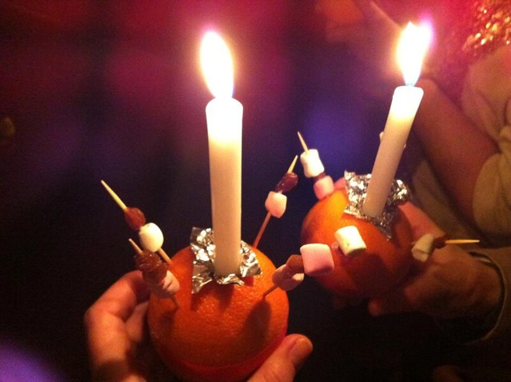
Notes:
Explain that you are going to ask the teachers from each class to come up and light a class Christingle so that the light of love and hope can be shared with everyone in school. [Ask the teachers to line up with their backs to the children. Light their candles. One at a time turn around and say their class name followed by the key Bible verse ‘let your light shine before others’ e.g. “Tiger Class, let your light shine before others.”

Slide 8
How could you bring light into someone’s darkness ?
Give away a toy you don’t play with any more. | Send a card or letter to someone you have not seen for a while. | Donate something to a local foodbank or charity. | Smile at everyone you meet. | Tidy up a mess you didn’t make, without complaining.
Choose to play with someone you don’t normally play with. | Pay someone a compliment. | Pick up some litter. (Make sure you wash your hands!) | Write a thank you note to someone who helps you eg the postman | Feed the birds or help nature in another way.
Try to reuse an item of rubbish you would usually throw away | Ask an adult what you can do to help them today. | Tidy up your bedroom without being asked | Read a story to a younger child. | Allow someone else to go in front of you in a queue.
Donate some clothes to a charity shop | Make or bake treats for a friend or neighbour | Make a card for a friend or neighbour. | Help clear up after a meal and do the washing up | Paint a stone or write a lovely letter and leave it in a public space for a stranger to find.
Hold the door open for someone as many times as you can today. | Try to make people laugh today as much as possible. | Help a friend or family member without being asked. | Make a drink or snack for someone. | Write a note to a family member and hide it somewhere eg under their pillow

Slide 9
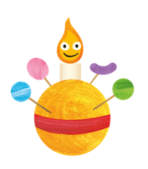
Matthew 5.14-16 New International Version (NRSV)
Jesus said:
^{14 ’}You are the light of the world. A town built on a hill cannot be hidden.¹⁵ Neither do people light a lamp and put it under a bowl. Instead they put it on its stand, and it gives light to everyone in the house. ¹⁶ In the same way, let your light shine before others, that they may see your good deeds and glorify your Father in heaven.’
Notes:
Hearing God's word
Explain that Christians believe God is love. They believe He was born into the world as Jesus to bring hope, comfort and joy to those who feel sad, lost or lonely. For children such as Jamie and others like him (show image of Jamie on slide) who struggle with their mental health, everyday can feel dark without any hopeful light.
In the Gospel of Matthew in the Bible, Jesus spoke about this hopeful light;
Helper read: Matthew 5:14-16 New International Version (NIV)

Slide 10
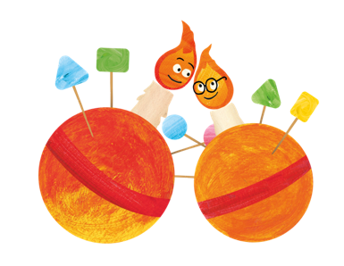
‘Jesus said “I’m the light of the world.” And he also said, “You’re the light of the world”. But how does that light get from Jesus to us, and into the world? Christingles are best lit from one another: when our own flame has been lit with the light of God’s love, our next job is to pass it on – that’s how the light and love of God will spread through the world.’
Revd Ally Barrett
Notes:
Christians believe that when Jesus was born, a light came into the world that offered hope to the hopeless and reminded us all that as a family of human beings we all have one thing in common: the power to transform lives through kindness and love. Jesus asks His followers to pass on the light of God’s love, not keep it to themselves. The light from a candle is one of the few things that can be shared as many times as you like without running out.
Put on some quiet, reflective music and have a helper read this passage, very slowly as a large central candle is lit. If you can, tape a cross onto this candle to demarcate it as representing Jesus. Have a line of children and/or adults light their smaller candles from the central one, passing the flame along the line.

Slide 11

Song : This Little Light of Mine

Slide 12
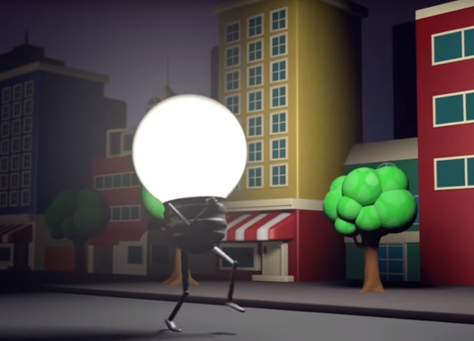
Song : This Little Light of Mine

