Slide 1
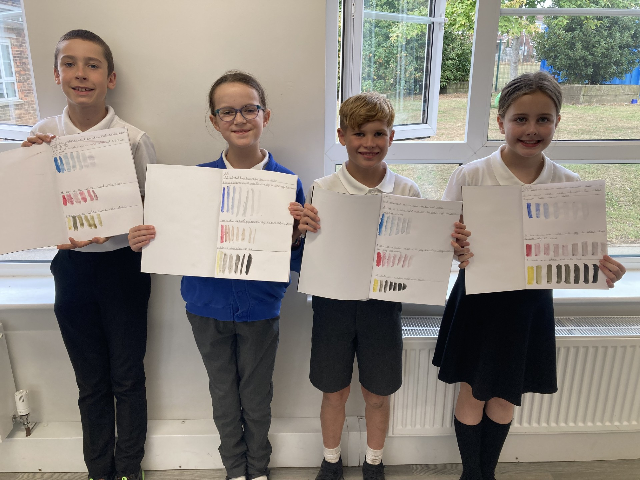
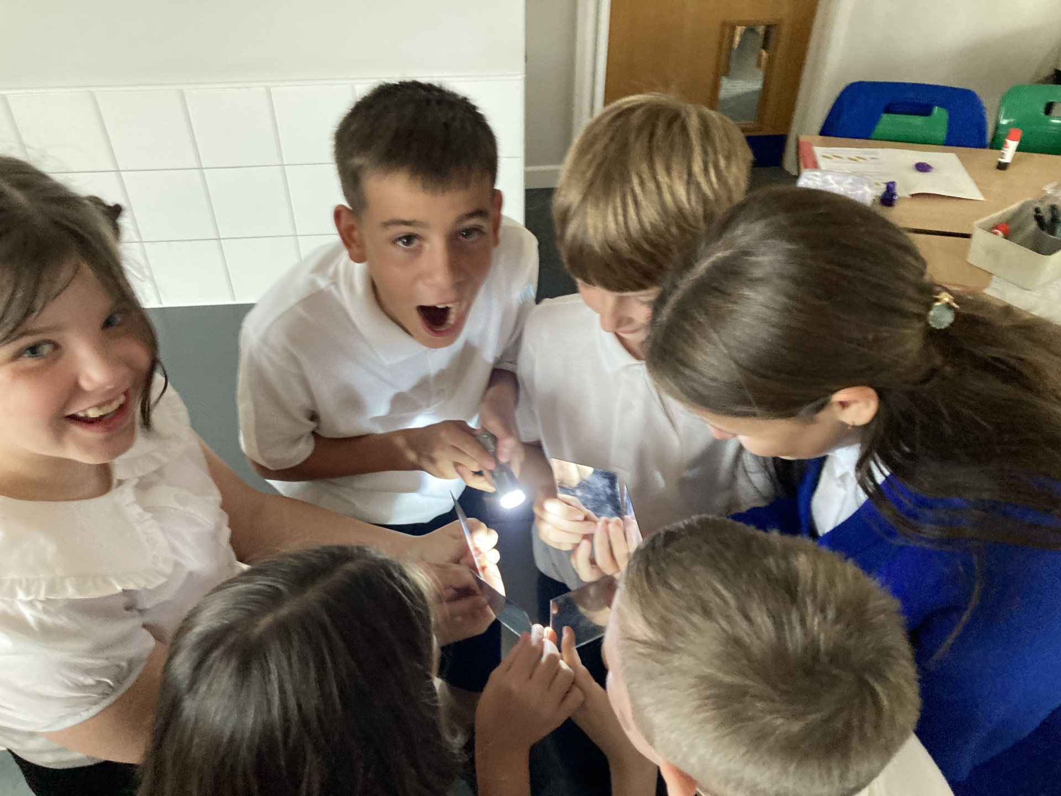
Year 6
Ben Lodge and Carina Duquemin

Slide 2


Meet the Team
Ben Lodge
Carina Duquemin
Emma Sanderson
Tom Coe

Slide 3
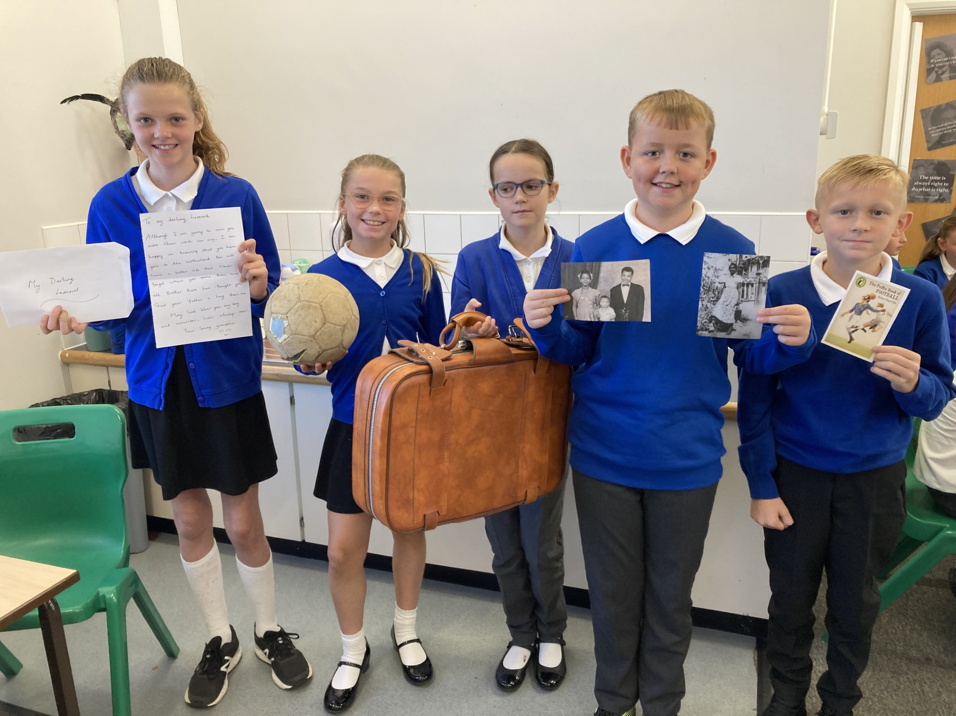
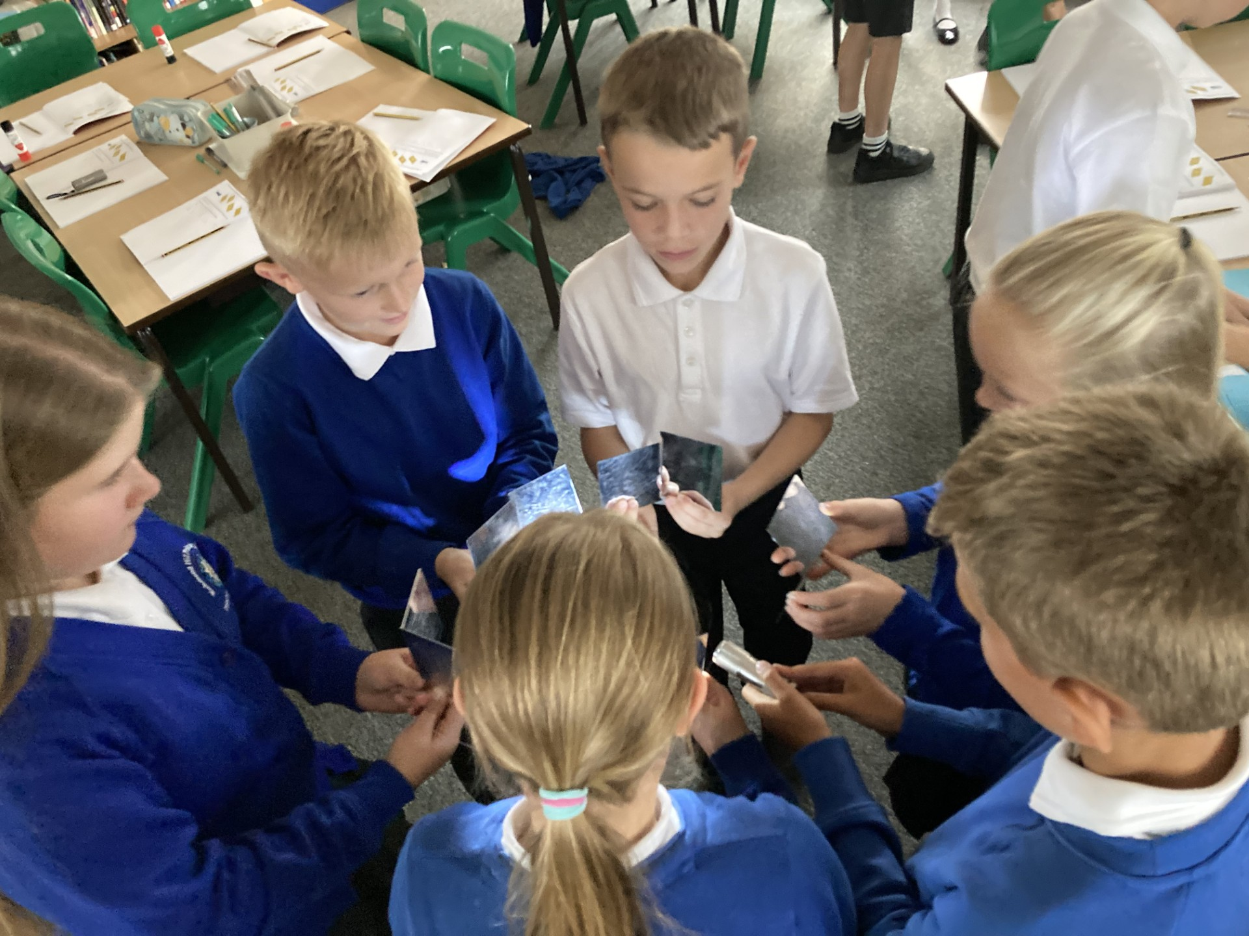
Purpose
The main aim is to ensure your child is secondary ready.
Independent
Confident
Combined scores

Slide 4

Home-learning
Maths – 1 x work in arithmetic booklet to consolidate learning
Reading – 1 text in reading booklet and reading for pleasure
Spellings – 1x biweekly test on a Friday

Slide 5
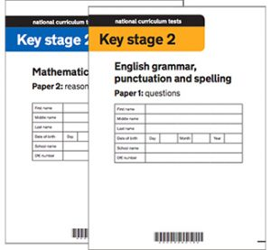
Statutory Assessments
The statutory key stage 2 tests are timetabled from Monday 11th May to Thursday 14th May 2025.
How will SATs week look?
Which subjects will be tested?
What if my child requires access arrangements?

Slide 6
Residential
Residential is a great way to end the year. It is a celebration of all the children’s hard work and a fantastic finale for them before they head in their different directions into KS3.
Where are we going?
What activities will there be?
What if my child is nervous for this?

Slide 7
Transition
31st October is the closing date for secondary school applications.
What does transition look like?
What if my child needs extra support?

Slide 8

We are always available at: year6@richmond.doncaster.sch.uk

