Slide 1
Working together
How can we keep our children safe online?

Slide 2
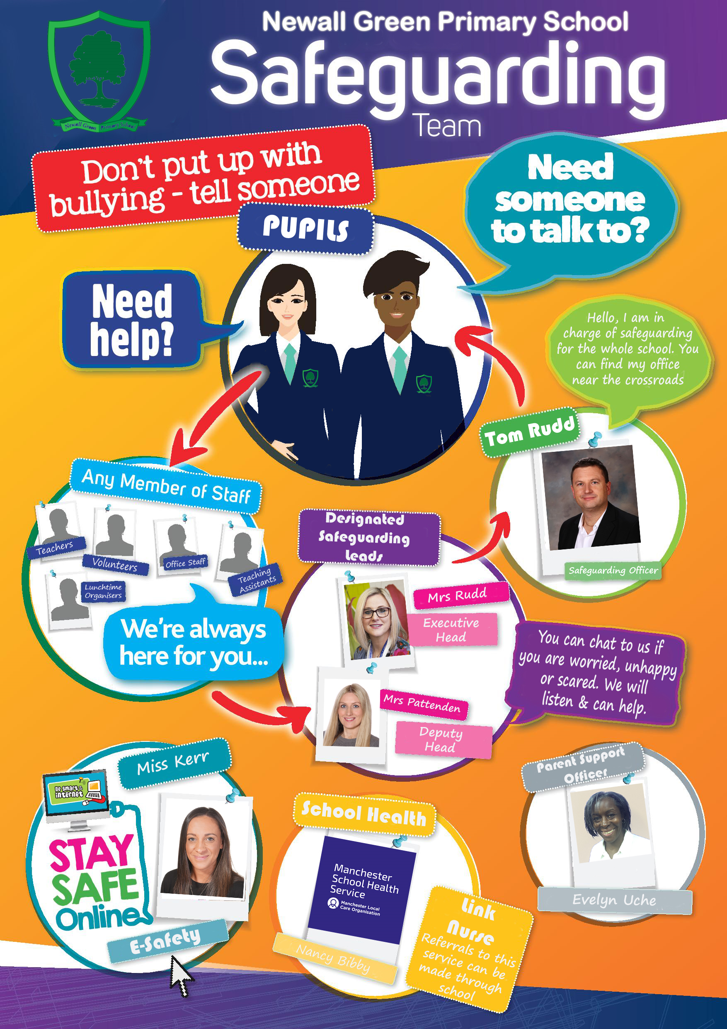
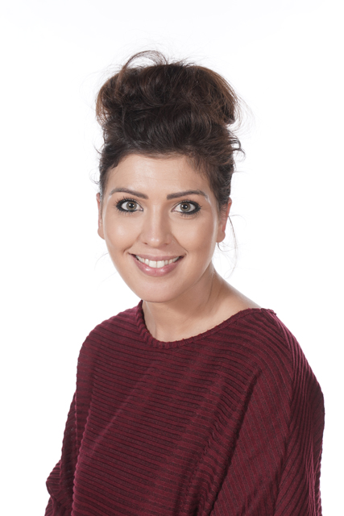
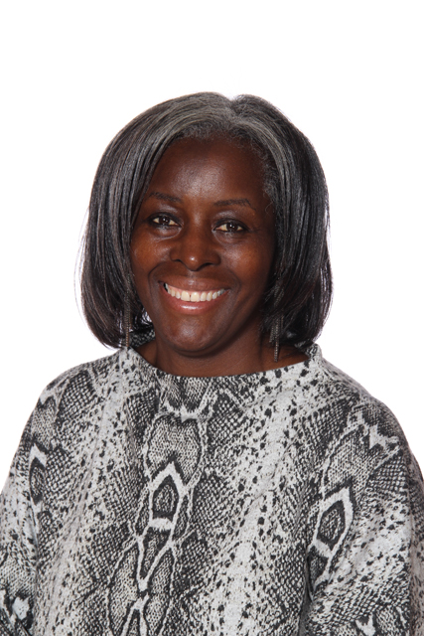
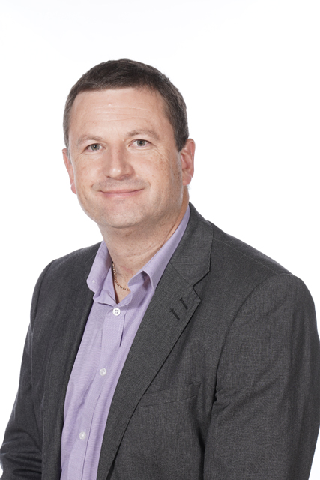
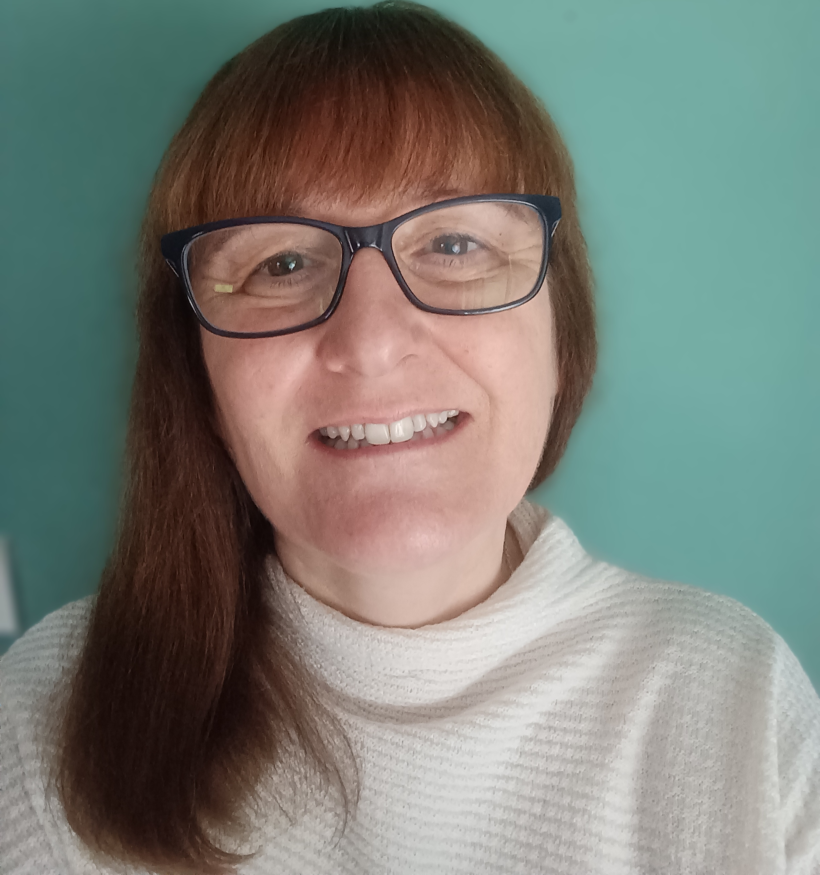
Hello there
Mrs Campbell
Eve
Tom Rudd
Assistant Head and PSHE lead
Parent Support Officer
Designated Safeguarding Lead
Amanda Jackson
School Counsellor

Slide 3
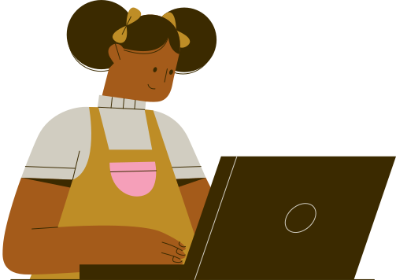
At Newall Green, our children’s mental and emotional health, safety, happiness and wellbeing is very important to us.
We know that our children are growing up in a digital world and that being online is a big part of their lives. The internet is a fantastic resource and has many, many positives. Within school, we use it regularly with our children as an educational resource and it has opened up so many opportunities to explore people, places and events.
We do not want our children to see being online as ‘negative’ or something that they should avoid.
However, there are many risks involved and as a school we have become increasingly concerned about the impact that negative experiences online is having on our children.

Slide 4
Agenda:
What problems are we facing?
What do we do in school to support?
Help and advice for parents/carers to keep children safe online.

Slide 5
So far this year, we have dealt with 9 serious incidents involving inappropriate behaviour online. This ranges from bullying to threatening behaviour and sharing/receiving inappropriate videos/images.
WhatsApp groups cause the most issues outside of school.
Groups can be used to exclude children – they are added and then deleted which can be very upsetting.
Some children in the group add their ‘other friends’ who the other children in the group do not know and in some cases they can be much older.
Inappropriate messages/voice notes are shared with images that are not appropriate for children to view.
A sort of ‘mob mentality’ can form where children comment or share messages that they wouldn’t normally in a 1:1 situation.
The groups are active very late at night and into the early hours of the morning.

Slide 6
Most of our pupils recently answered a questionnaire about E-Safety. They were asked 25 questions. Here are some of the results:
20% said that they did not feel safe online.
56% said that they had seen a picture or video online that really upset them.
38% said that they had received bullying or nasty messages on more than one occasion.
30% said that they had previously sent messages, pictures or comments that they now regret and would not do again.
63% said that spent 3 or more hours online a day.
36% feel bullied online.

Slide 7
Most of our pupils recently answered a questionnaire about E-Safety. They were asked 25 questions. Here are some of the results:
16% have been contacted by a stranger who pressured them to meet.
6% had been asked to send nude/semi-nude photos.
18% have been pressured to share information about themselves.
29% have been sent upsetting/inappropriate images/content.
22% felt under pressure to appear perfect online.
43% felt they spent too much time online.

Slide 8
They were also given an ‘other’ option to write down any other experiences they had received. Here are some of the responses:
“I have received racist abuse.”
“I have had racist comments.”
“Someone kept asking me for my parents’ bank details but I didn’t know them.”
“People swearing at me.”
“Being friends with people that I don’t know and then they want me to add their friends.”
“Getting scammed.”
“Verbal harassment.”
“Making me feel like I’m not good enough to be here.”
“Everyone is rude and swears at you all the time.”

Slide 9
What do we do as a school?
Rights respecting
Article 2 – All adults should always do what is best for you
Article 17 – Right to collect information from the media and to be protected from information that could harm you.
Peace Mala school
– ‘Treat others the way that you would like to be treated’
Antibullying week
- Make a noise about bullying.
Displays around school
Behaviour policy and whole school charter

Slide 10
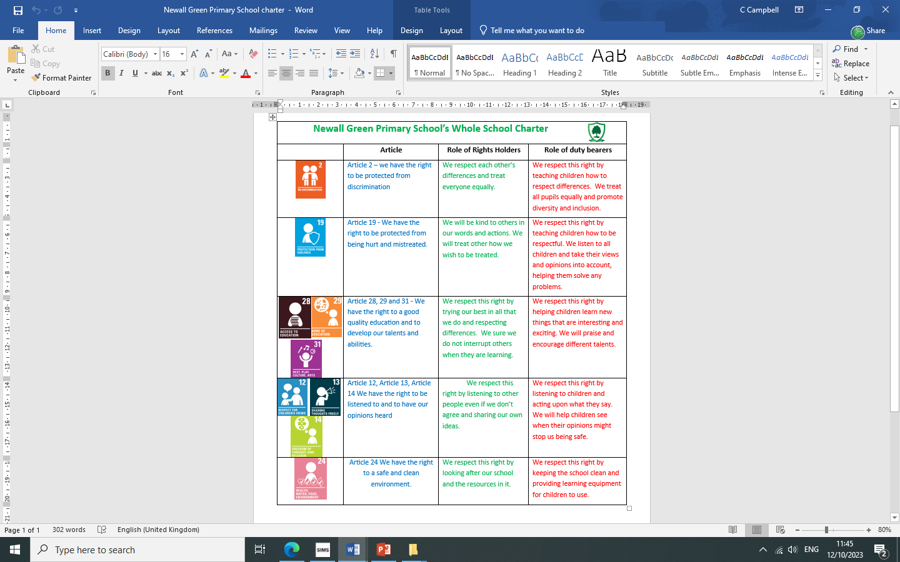

Slide 12
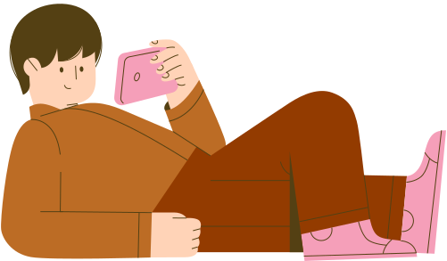
Year 1
Know that the internet can also be a negative place where online abuse, trolling, bullying and harassment can take place, which can have a negative impact on mental health.
Know that people sometimes behave differently online, including by pretending to be someone they are not.
Learn about the importance of using the internet safely
Learn what information we should not share online.
Year 2
Basic rules to keep safe online, including what is meant by personal information and what should be kept private; the importance of telling a trusted adult if they come across something that scares them
How the internet and digital devices can be used safely to find things out and to communicate with others
The role of the internet in everyday life
That not all information seen online is true
Our PSHE curriculum
Year 3
The importance of keeping personal information private and how data is shared online.
Strategies for keeping safe online, including how to manage requests for personal information or images of themselves and others
What to do if frightened or worried by something seen or read online and how to report concerns, inappropriate content and contact.
Recognise things appropriate to share and things that should not be shared on social media; rules surrounding distribution of images.

Slide 13
Year 4
To use ICT safely including using software features and settings
Know how information and data is shared and used online.
Know that for most people the internet is an integral part of life and has many benefits
Know about the benefits of rationing time spent online, the risks of excessive time spent online and the impact of positive and negative content online on their own and others’ mental and physical wellbeing
To know why social media, some computer games and online gaming, for example, are age restricted
To know where and how to report concerns and get support with issues online
Year 5
recognise what it means to ‘know someone online’ and how this differs from knowing someone face-to-face; risks of communicating online with others not known face-to-face
why someone may behave differently online, including pretending to be someone they are not; strategies for recognising risks, harmful content and contact; how to report concerns.
about the importance of keeping personal information private; strategies for keeping safe online, including how to manage requests for personal information or images of themselves and others; what to do if frightened or worried by something seen or read online and how to report concerns, inappropriate content and contact
Our PSHE curriculum
Our PSHE curriculum
Year 6
The benefits of the internet; the importance of balancing time online with other activities; strategies for managing time online
how to recognise that habits can have both positive and negative effects on a healthy lifestyle
recognise ways in which the internet and social media can be used both positively and negatively
recognise if a friendship (online or offline) is making them feel unsafe or uncomfortable; how to manage this and ask for support if necessary

Slide 14
Thank you!
I would now like to welcome Hannah Shad from Manchester Healthy Schools.

