Slide 1
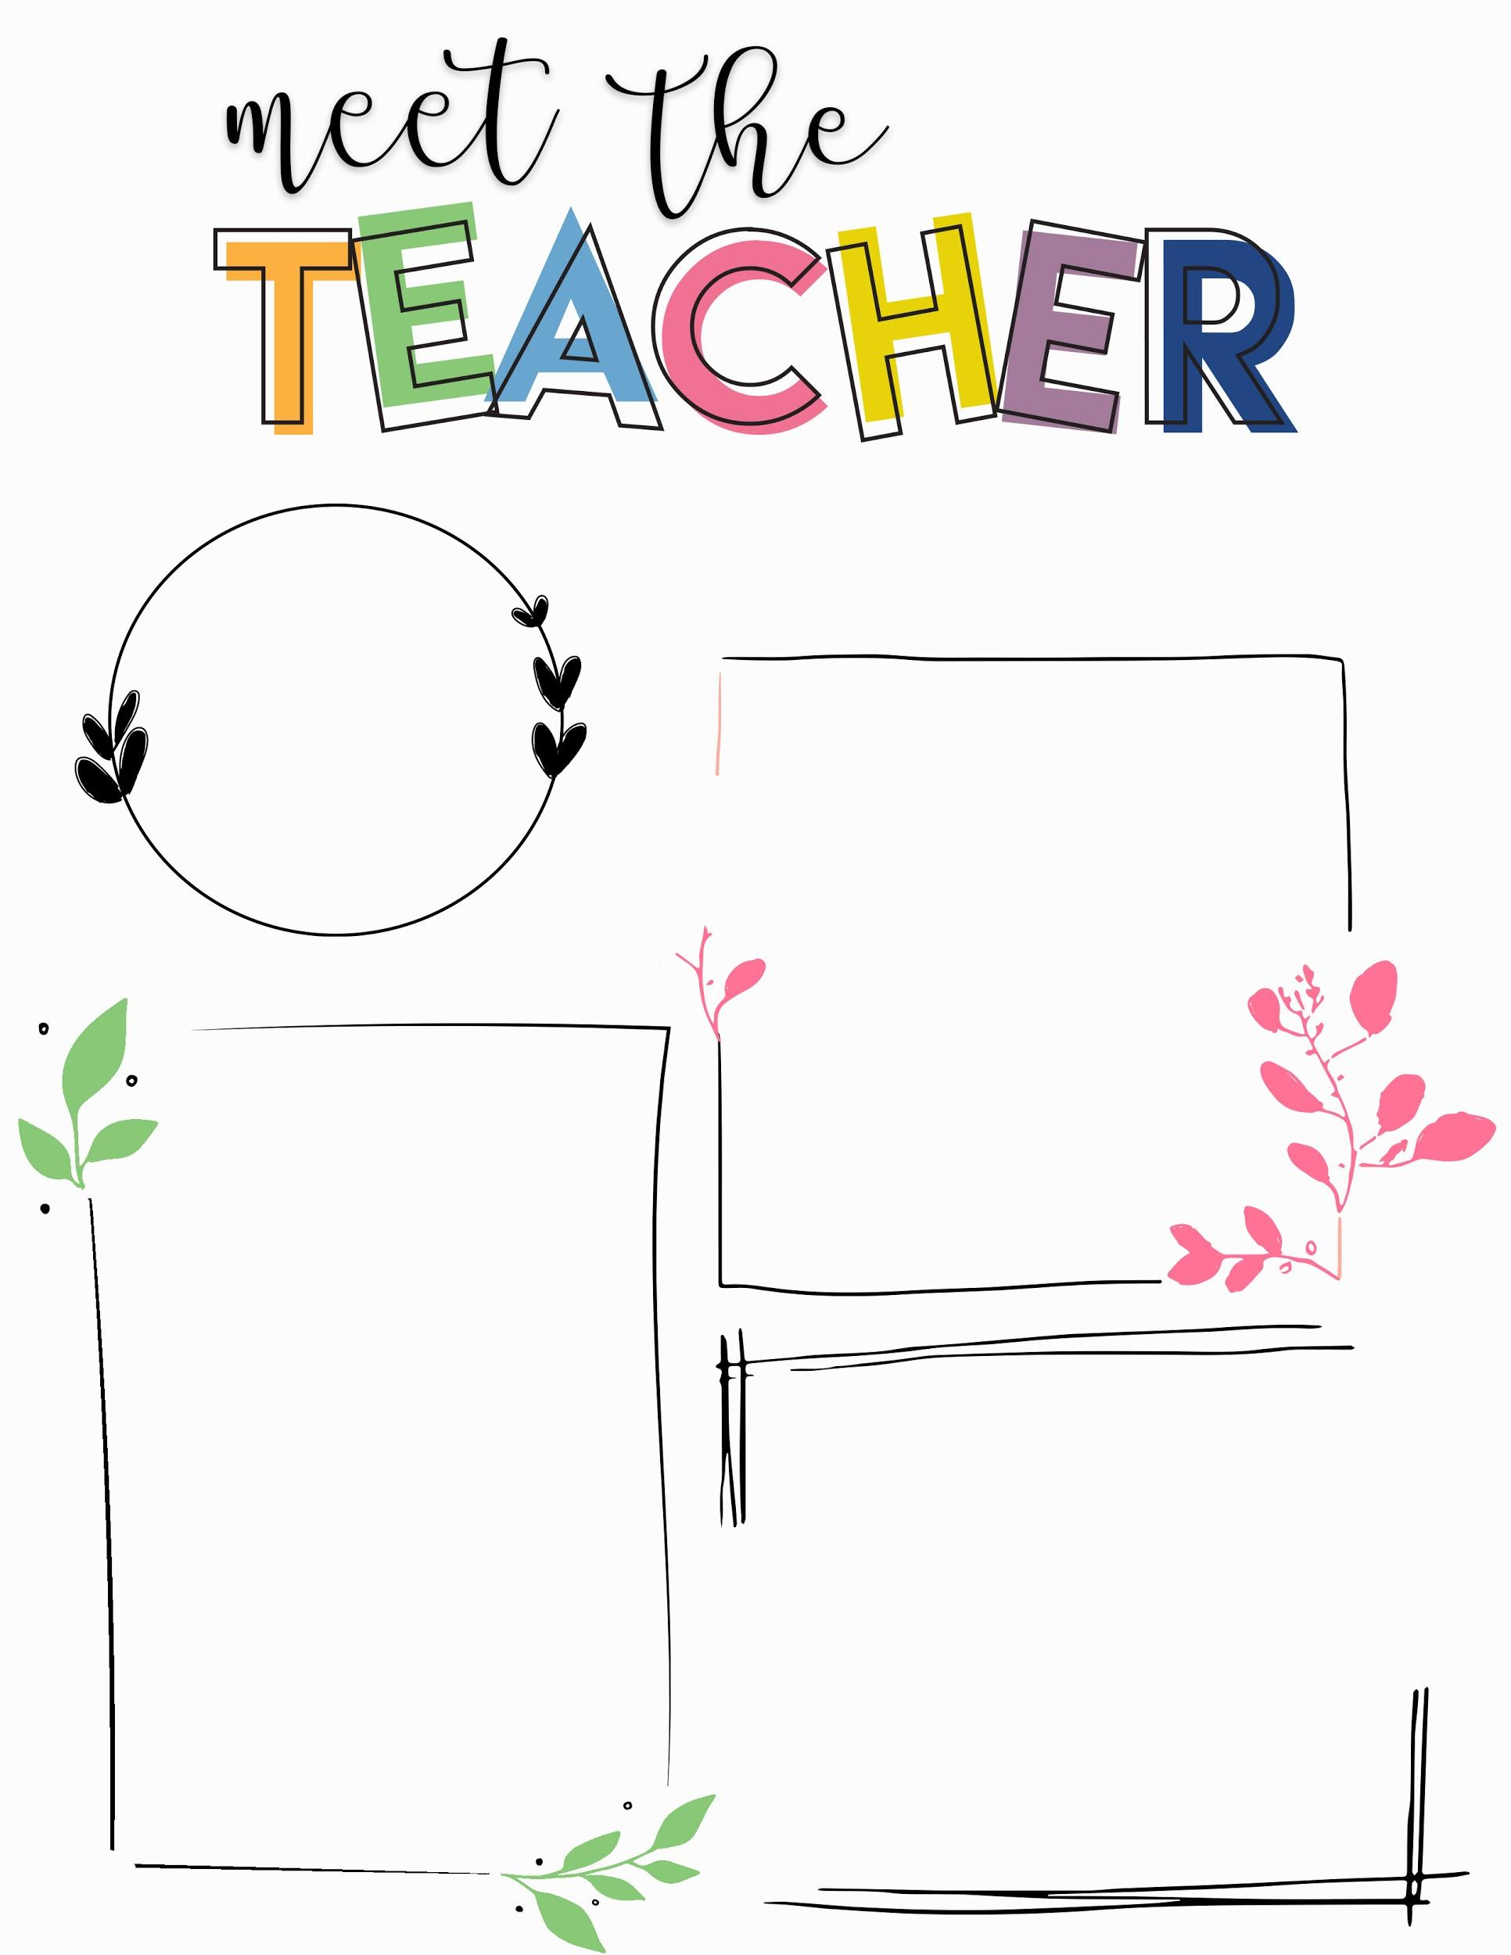
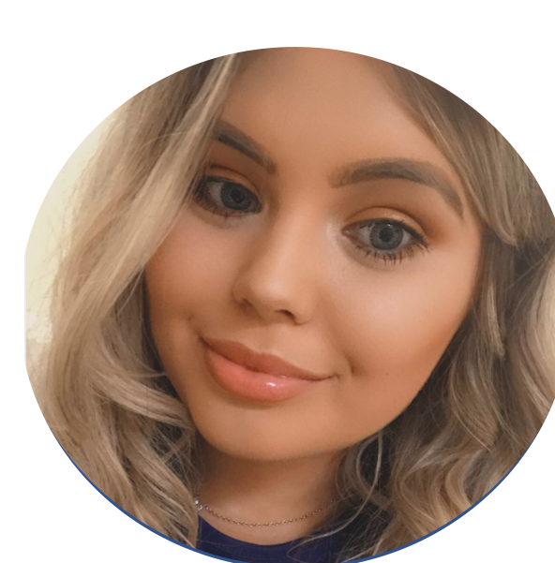
Miss Bamforth
Hello!
I’m Miss Bamforth. I am a 3rd year student teacher from Manchester Metropolitan University. I have come to the lovely Newall Green Primary School, to complete my final placement. I am very excited to be working with 1KF. All of your children have been very welcoming and kind, you should be extremely proud.
Getting to know me:
I love animals, especially my husky, Storm.
My favourite colours are pink and yellow.
I love Disney and Harry Potter films.
I like going on long walks and to the cinema.
In my spare time, I love to read.
My Experience:
I have previously been located within a ks2 and EYFS setting.
I am very excited to teach 1KF until February half term. I am looking forward to working with all of the children, staff and parents to make amazing memories this year.

