Slide 1

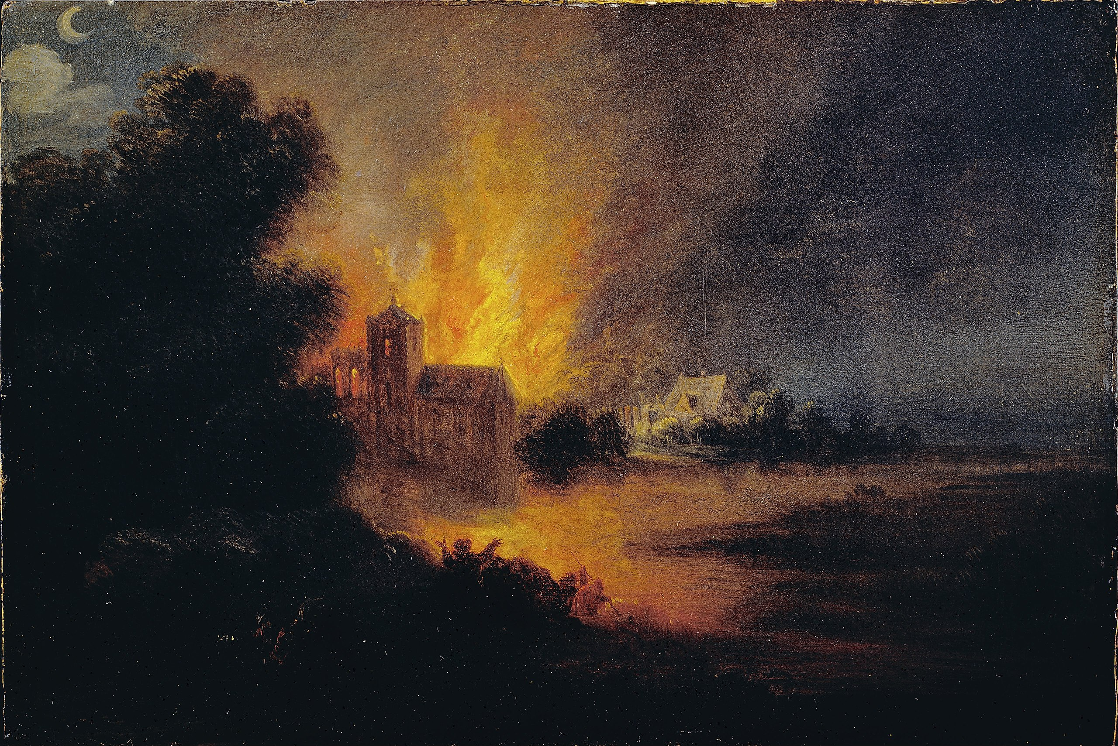
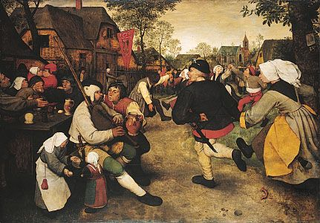
Newall Green Primary School Knowledge Organiser
Art Focus – Flemish Art
Year Group – 5 Term – Summer 1
Key vocabulary:
Hue – a colour in its purest form.
Tint – when an artist adds white to a colour in order to lighten it.
Shade – when an artist adds black to a colour in order to darken it.
Tone – when an artist adds grey to a hue.
Atmosphere – a feeling or mood created pictorially.
Tonal contrast – It is created when light tones and dark tones lie alongside each other.
Composition – the arrangement and placement of objects in a piece of art.
Scale – an object’s size in relation to another object.
Focal point – the area the viewer’s eyes are naturally drawn to.
Form – the shape in artwork.
Key facts to retain:
The key characteristics of Flemish Art.
The influence that Flemish Art has left.
How to blend different colours together.
How to mix primary and secondary colours to create tertiary colours.
What I should already know:
What the primary colours are.
What secondary colours are and how to mix them.
How to create simple line drawings to paint.
How to manipulate perspective in paintings.
Supporting images:

