Slide 1

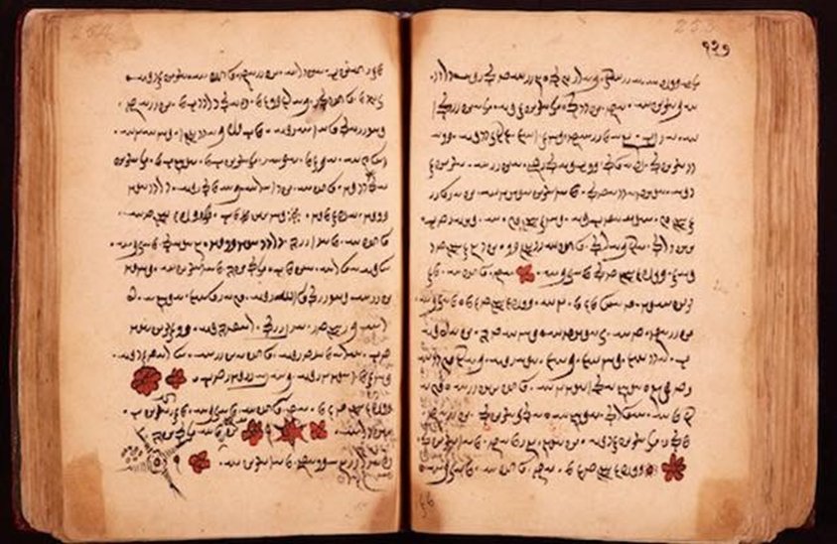
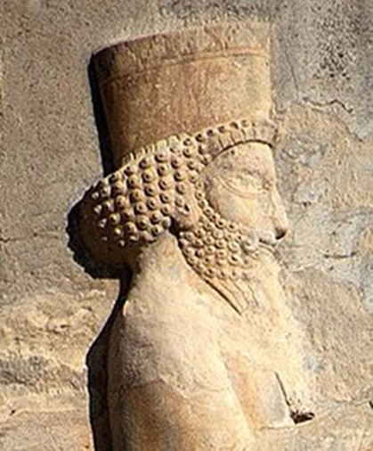
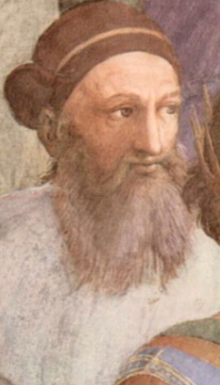
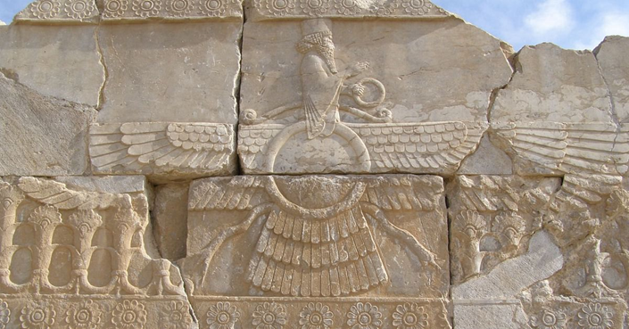
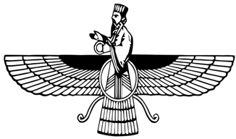
Newall Green Primary School: Knowledge Organiser
Term: Summer 1
Year group: 5 Date: April 2022
Focus:
Zoroastrianism – symbolism, comparisons, places of worship, teachings
Key vocabulary:
Monotheism
The belief in one, true entity which created existence.
Dualism
The notion that there are forces of goodness and evil at constant odds throughout humanity.
Prophet
A religious leader/founder.
Omniscient
All seeing and all knowing.
Gathas
17 hymns originating from Zoroaster from which we gain our understanding of the religion.
Aša
The cosmic force peace and creativity.
Druj
The cosmic force of destruction and chaos.
The Threefold Path
A benchmark for all humans to live a good life. Includes good deeds, good words and good thoughts.
Zoroaster
The religious leader and founder of Zoroastrianism.
Ahura Mazda
The mean, creative deity of Zoroastrianism.
Key facts to retain:
Zoroastrianism originated in ancient Iran, around 1500-1000BC.
Zoroaster created the Gathas around this period. These were hymns which is where we get much of the liturgy from.
A monotheistic religion with elements of dualism.
The main creative deity is Ahura Mazda.
Earthly occurrences are often categorised as entities .
What I should already know:
That Zoroastrianism has links to many other religions and is widely considered one of the starting blocks for Christianity and Judaism.
That Zoroastronists believe there is a constant battle between good and evil.
The Threefold Path.
The religion became the main practice throughout the Persian Empire.
Key beliefs and teaching from the Gathas.
Supporting experiences:

