Slide 1
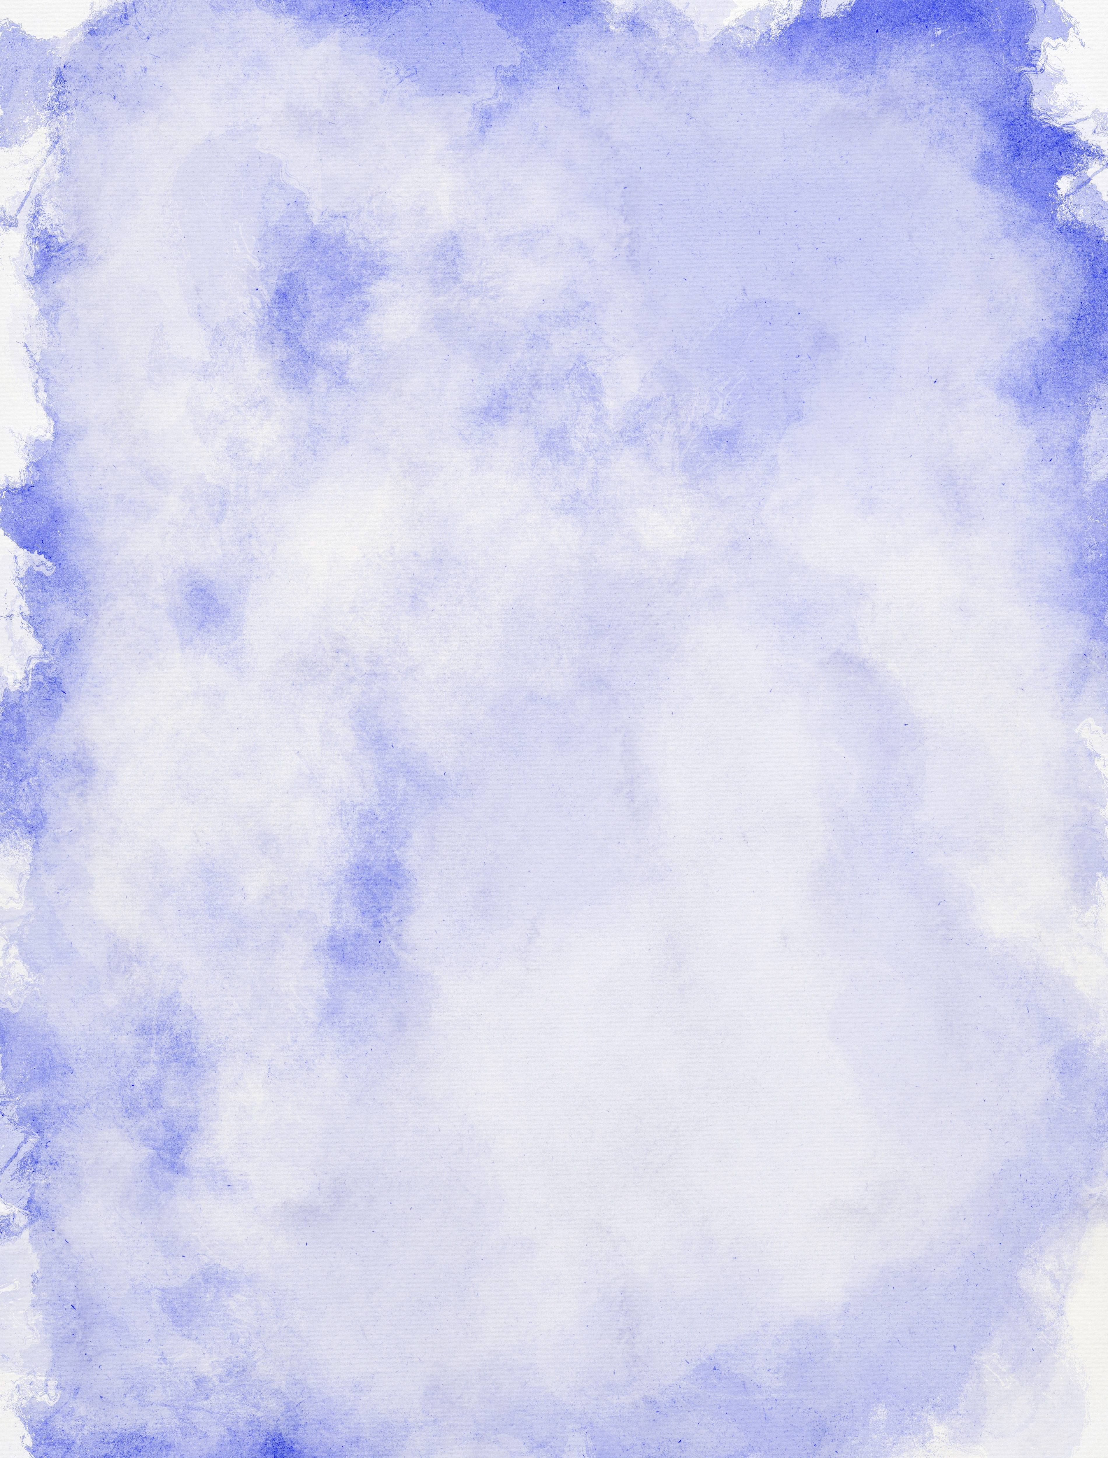





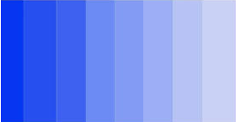


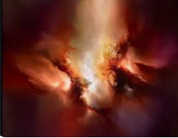
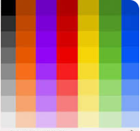
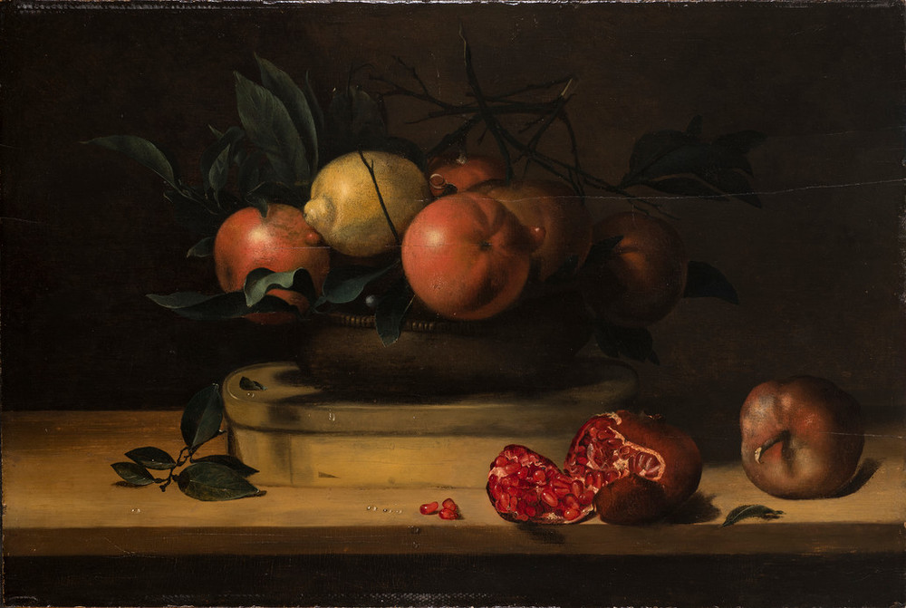


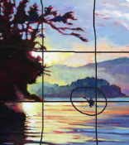
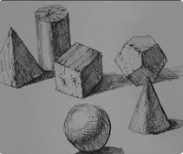
Newall Green Primary School Knowledge Organiser
Art Focus – Still life – Louise Moillon
Year Group – 5 Term – Summer 2
Key vocabulary:
Trompe l’oeil – the use of realistic imagery, colour and perspective to create the optical illusion that the depicted objects exist in three dimensions.
Still life - a work of art that shows inanimate objects from the natural or man-made world.
Hue – a colour in its purest form.
Tint – when an artist adds white to a colour in order to lighten it.
Shade – when an artist adds black to a colour in order to darken it.
Tone – when an artist adds grey to a hue.
Atmosphere – a feeling or mood created pictorially.
Tonal contrast – It is created when light tones and dark tones lie alongside each other.
Composition – the arrangement and placement of objects in a piece of art.
Scale – an object’s size in relation to another object.
Focal point – the area the viewer’s eyes are naturally drawn to.
Form – the shape in artwork.
Key facts to retain:
Who Louise Moillon was and how she created her artwork.
The artistic techniques used to create a realistic still life piece of art.
How to draw simple shapes to depict fruit and flowers using .
How to create a sense of realism using shading and layering paint.
What I should already know:
What the primary colours are.
What secondary colours are and how to mix them.
How to create simple line drawings to paint.
How to manipulate perspective in paintings.
What the Flemish art style is
Supporting images:
WALT 1: Understand who Louise Moillon was and the work she created
WALT 2: shade circles and round fruit
WALT 3: Understand the concept of composition
WALT 4: Complete a piece of artwork in the style of Louise Moillon.
WALT 5: Evaluate a piece of artwork.

