Slide 1

Year 6 SATs
Presentation for Parents, Carers & Guardians
Notes:
Hannah

Slide 2
What are the SATs?
SATs are the Standardised Assessment Tests that are given to children at the end of Key Stage 2.
The SATs take place over four days, starting on Monday 11th May ending on Thursday 14th May.
The SATs papers cover: grammar, punctuation and spelling, reading and maths.
Writing is assessed using evidence collected throughout Year 6. There is no Year 6 SATs writing test.
Notes:
Note that this government guidance (https://www.gov.uk/government/news/changes-to-key-stage-2-assessment-dates-in-2023) outlines changes in dates for 2023. This includes guidance on KS2 timetable variations if schools have pre-planned activities on Friday 12th May.

Slide 3
When and how the SATs are completed?
The tests take place during normal school hours, under exam conditions.
Children are not allowed to talk to each other from the moment the assessments are handed out until they are collected at the end of the test.
After the tests are completed, the papers are sent away to be marked externally.
The results are then sent to the school in July.

Slide 4
During SATS week, the children will be invited into school at 8.30 for breakfast, including hot chocolate or apple/orange juice.
This is a time for them to talk to friends and settle in.
The tests will start soon after the register at 9am.
Most children will be completing the tests in the hall; some children are in small groups or working individually with an adult.
After each test, the children are given extra play to un-wind and we are there to support them with any issues or worries.

Slide 5
Specific arrangements for SATs
Children who have support as part of day-to-day learning in school may be allotted specific arrangements, including:
Additional (extra) time;
Tests being opened early to be modified;
An adult to scribe (write) for them;
Using word processors independently;
An adult to read for them (including a translator);
The use of prompts or rest breaks;
Arrangements for children who are ill or injured at the time of the tests. This does not apply if your child missed any tests due to a holiday.
Notes:
The DfE Key Stage 2 access arrangements guidance (https://assets.publishing.service.gov.uk/government/uploads/system/uploads/attachment_data/file/1109963/2023_key_stage_2_access_arrangements_guidance.pdf) gives more details on this, including which arrangements need prior permission.
It should be noted that there are cases when pupils can have access to multiple arrangements (e.g. addition time and a scribe). These are detailed in the above document.
Also note, any pupil can ask for a question to be read to them, though not explained to them. In mathematics, words and numbers may be read but mathematical symbols cannot be read.

Slide 6
The results
Tests are marked externally. Once marked, the tests will be given the following scores:
A raw score (total number of marks achieved for each paper);
A scaled score (see below);
A judgement on if the National Standard has been met.
Scaled scores (the raw score converted into a scaled score based on national averages) range from 80 to 120.
A scaled score of 100 or more shows the pupil is meeting the National Standard.
A scaled score of 110 or more shows the pupil is working above the National Standard.
Notes:
Hannah
This year, the test results will be available on the PAG on Tuesday 4th July (https://assets.publishing.service.gov.uk/government/uploads/system/uploads/attachment_data/file/1110107/2023_key_stage_2_assessment_and_reporting_arrangements.pdf section 9.1)
There is no separate test that would indicate a pupil is working above the national standard.
A scaled score of less than 99 would indicate a pupil is working below the national standard.
To have a scaled score, pupils must have a minimum raw score (determined each year). If the pupil does not achieve the minimum raw score, they have not demonstrated sufficient understanding of the KS2 curriculum in the subject.

Slide 7
Grammar, Punctuation and Spelling: Monday 11th May
Grammar, punctuation and spelling consists of two papers.
Paper 1 focuses on all three elements (grammar, punctuation and spelling or GPS). The paper lasts for 45 minutes.
Paper 2 consists of a spelling test only. It should take approximately 15 minutes, although this is not a set amount of time (pupils will be given as much time as they need to complete the test).

Slide 8
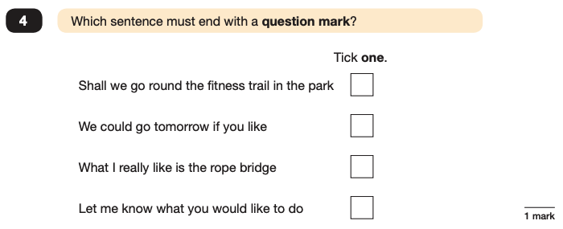
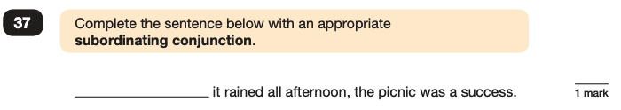
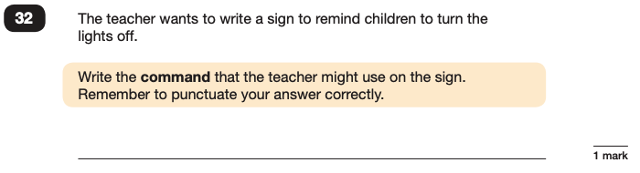
Grammar, Punctuation and Spelling: Paper 1 (GPS)
Example questions:
✓
e.g. Although, While
e.g. Switch off the lights! Please turn off the lights.
Notes:
For questions 32 and 37, there are various correct answers.

Slide 9
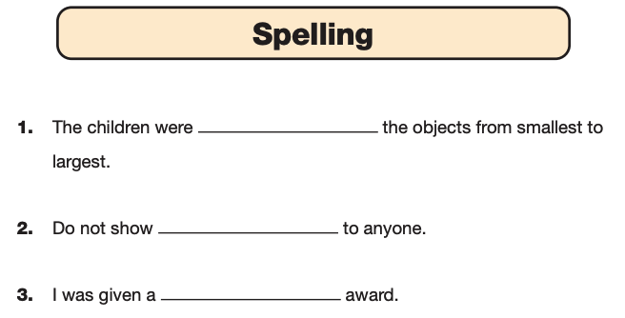
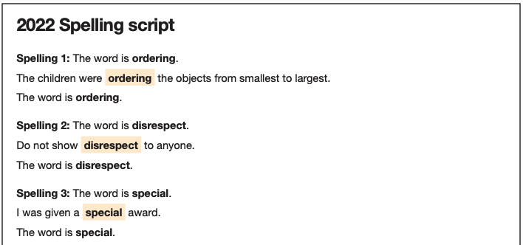
Grammar, Punctuation and Spelling: Paper 2 (spelling)
Paper 2 is a shorter paper that focuses solely on spellings.
Example questions:
Notes:
There is a spelling script that accompanies this. Example:
The word is creature. The dragon is an imaginary creature. The word is creature.

Slide 10
Reading: Tuesday 12th May
There is one reading test that lasts for 60 minutes.
The test is designed to measure if the children’s comprehension of age-appropriate reading material meets the national standard. There are three different set texts for children to read. These could be any combination of non-fiction, fiction and/or poetry.

Slide 11

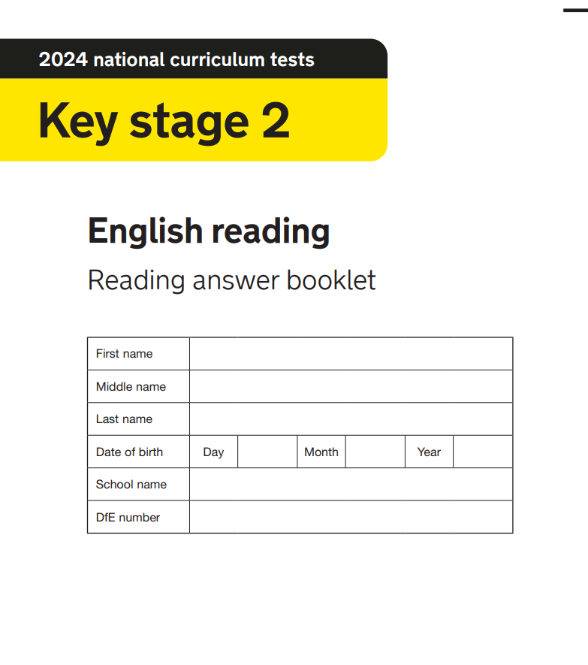
Reading
The children will read three texts in a reading booklet and answer questions in a separate booklet.
Notes:
Question styles include:
Multiple choice questions
One-word answers
Short answer questions
Multiple mark (long answer) questions

Slide 12
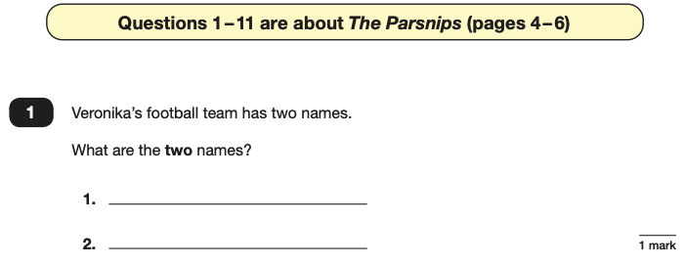
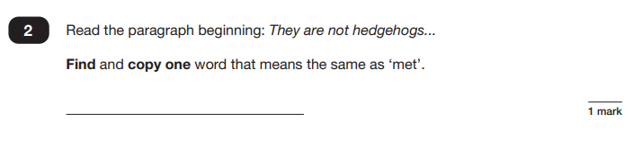
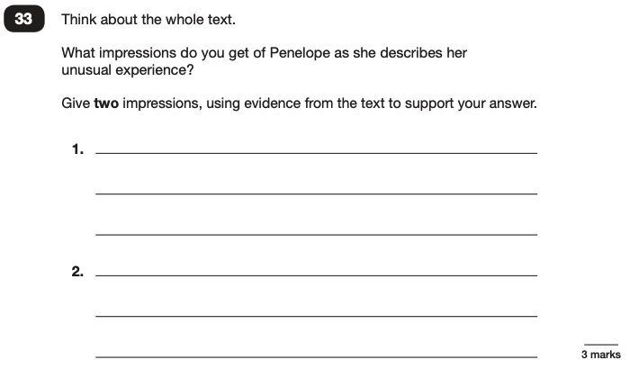
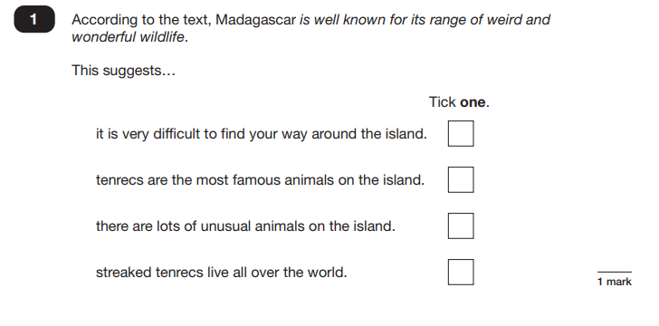
Reading
The reading SATs paper requires a range of answer styles.
Notes:
Question styles include:
Multiple choice questions
One-word answers
Short answer questions
Multiple mark (long answer) questions

Slide 13
Maths: Wednesday 13th May and Thursday 14th May
The maths assessments consist of three tests.
Paper 1: Arithmetic (30 minutes) – Wednesday 14th May
Paper 2: Reasoning (40 minutes) – Wednesday 14th May
Paper 3: Reasoning (40 minutes) – Thursday 15th May

Slide 14
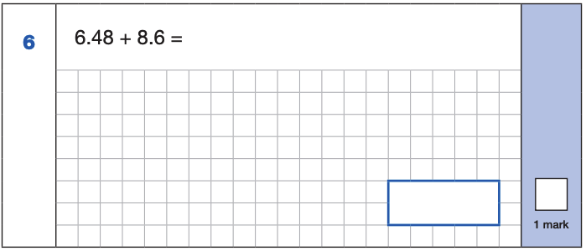
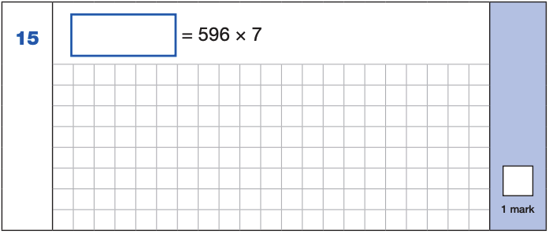
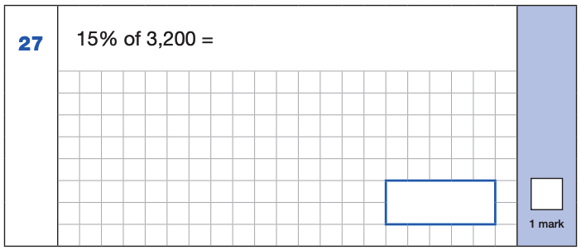
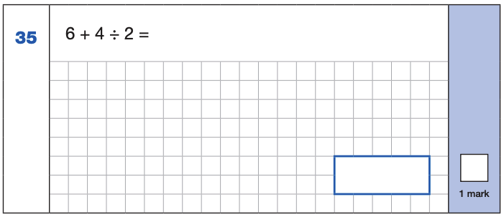
Maths Paper 1 (Arithmetic)
The maths arithmetic paper has a total of 40 marks and lasts for 30 minutes.
Example 1 mark questions:
4,172
6.48
+ 8.6 .
15.08
¹
596
x 7
4172
⁶ ⁴
15.08
10% of 3,200 = 320
5% of 3,200 = 160
15% of 3,200 = 480
4 ÷ 2 = 2
6 + 2 = 8
480
8
Notes:
These are examples of how children could solve the calculations. There are some that could/ should be solved mentally as it is far quicker that way (40 marks in 30 minutes does not allow for 1 minute + per mark).
Answers should always be given in their simplest form unless stated otherwise.

Slide 15
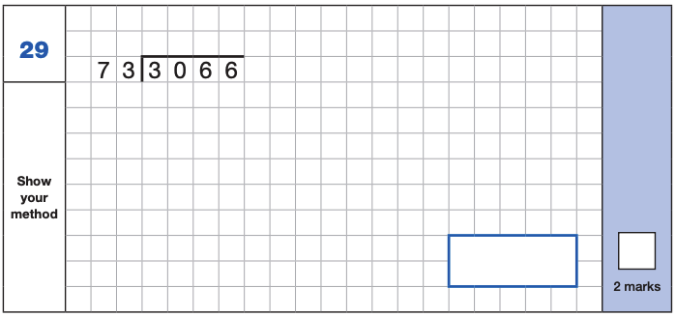
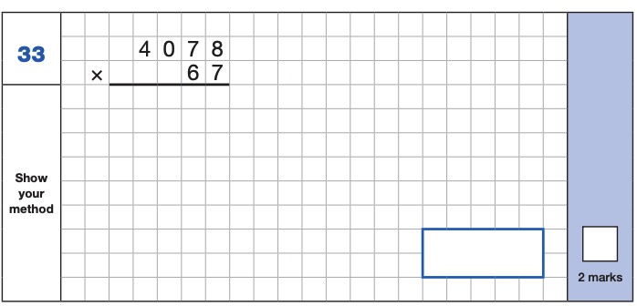
Maths Paper 1 (Arithmetic)
Example 2 mark questions:

Slide 16
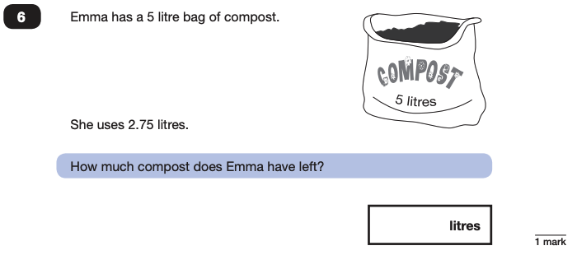
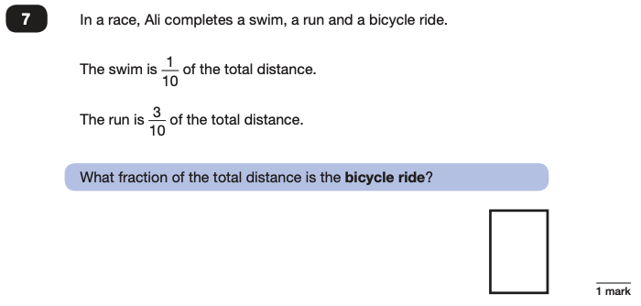
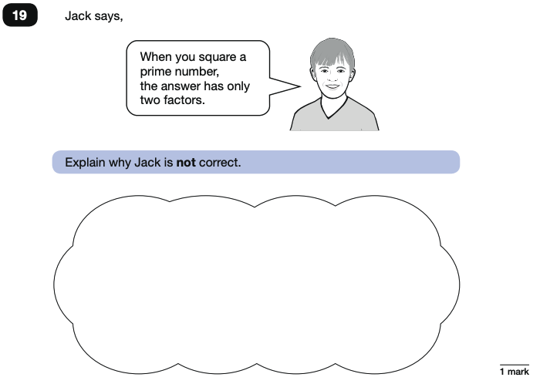
Maths Papers 2 and 3 Example Questions
These tests have a total of 35 marks each and lasts for 40 minutes each.

Slide 17
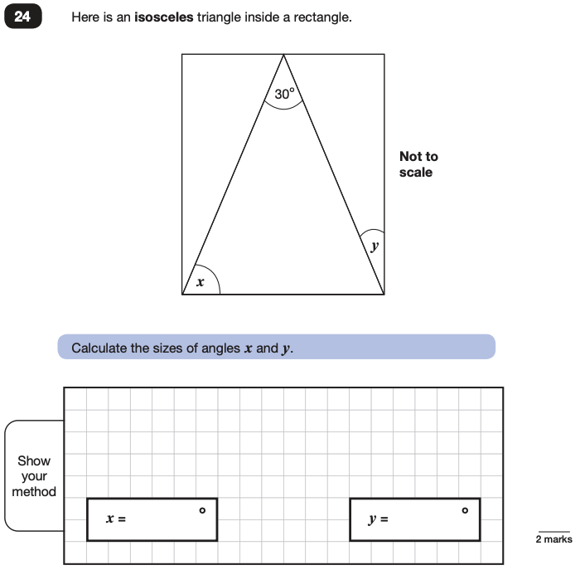
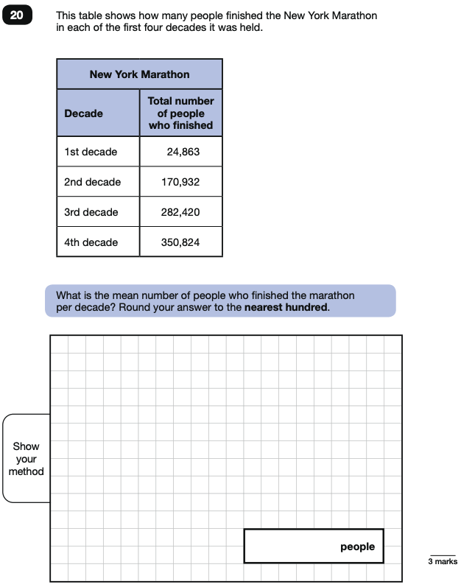
Maths Papers 2 and 3 Example Questions
Notes:
Helen - Note that this is a three mark question.

Slide 18
Things to remember about SATs
SATs focus on what children know about Maths and English.
They will not reflect how talented they are at science, geography, art, P.E…, and they certainly won’t highlight all of their amazing personal characteristics.
SATs don’t tell the whole story.
Their results will say if they did or did not meet a certain standard but not necessarily by what margin. These thresholds change each year according to the overall national performance, so what was classed as ‘meeting the expected standard’ this year might not be the same as last year. We will be able to provide you with more detailed feedback.
Notes:
Hannah

Slide 19
What to do if you are worried about your child
SATs often induce a certain degree of worry or anxiety but there is, of course, a tipping point.
SATs anxiety should not:
Affect a child’s appetite
Affect a child’s sleep
Affect a child’s personality
Induce panic, tears or disengagement from lessons or hobbies
Be a reason not to attend school.
If any of the above are evident, SATs may be causing an excessive degree of anxiety and may benefit from some additional support. This isn’t about removing the reality of SATs but rather equipping your 10 or 11-year-old with the ability to better cope with the situation.
Notes:
Helen

Slide 20
What to do if you are worried about your child
Talk to the school
Sometimes concerns present at home and not at school. If you notice a change in your child, talk to the school so that everyone concerned can offer the support needed.
Talk to your child
Talk to your child about what aspect of SATs concerns them the most. If you can help them pinpoint what is bothering them the most, you can take specific steps to help reassure them.
Encourage your child to talk to their teacher
Try not to project your own anxieties or views about the SATs
Children can be very intuitive. If they see that you are anxious, this could add to their own anxieties.
Notes:
Hannah It may also be appropriate to discuss if there are any changes at home that could add stress to the child (e.g. moving house, a new sibling, recent bereavement).
There may be media coverage around the SATs, parents may want to discuss this with their children (positive or negative).

Slide 21
On the Thursday afternoon, we will have a celebration in Firbank park with ice cream and rounders to celebrate the children completing their SATS week. We will also be doing lots of nice activities on the Friday. After this week, life in Y6 gets very busy with lots of exciting activities! Please keep a look out for updates on the website for Y6 events such as the production, leavers disco and leavers assembly.
Notes:
Helen
It may also be appropriate to discuss if there are any changes at home that could add stress to the child (e.g. moving house, a new sibling, recent bereavement).
There may be media coverage around the SATs, parents may want to discuss this with their children (positive or negative).

Slide 22

2026 Leavers! Hoodie / T-shirt orders need to be placed by Friday 1st May. This QR code will take you straight to the ordering page:
Notes:
Hannah
It may also be appropriate to discuss if there are any changes at home that could add stress to the child (e.g. moving house, a new sibling, recent bereavement).
There may be media coverage around the SATs, parents may want to discuss this with their children (positive or negative).

Slide 23

Notes:
Helen
It may also be appropriate to discuss if there are any changes at home that could add stress to the child (e.g. moving house, a new sibling, recent bereavement).
There may be media coverage around the SATs, parents may want to discuss this with their children (positive or negative).

Slide 24
SATS Week
Monday 11th May - Grammar, Punctuation and Spelling - Paper 1 and 2
Tuesday 12th May – Reading paper
Wednesday 13th May - Maths Paper 1: Arithmetic and Paper 2: Reasoning
Thursday 14th May - Maths Paper 3: Reasoning
Notes:
Note that this government guidance (https://www.gov.uk/government/news/changes-to-key-stage-2-assessment-dates-in-2023) outlines changes in dates for 2023. This includes guidance on KS2 timetable variations if schools have pre-planned activities on Friday 12th May.

