Slide 1
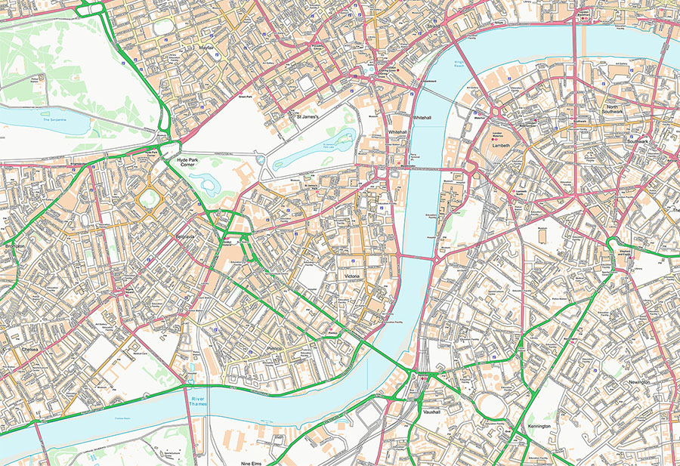





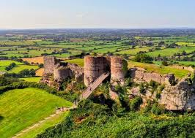


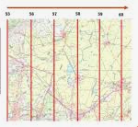

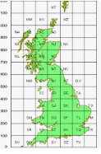
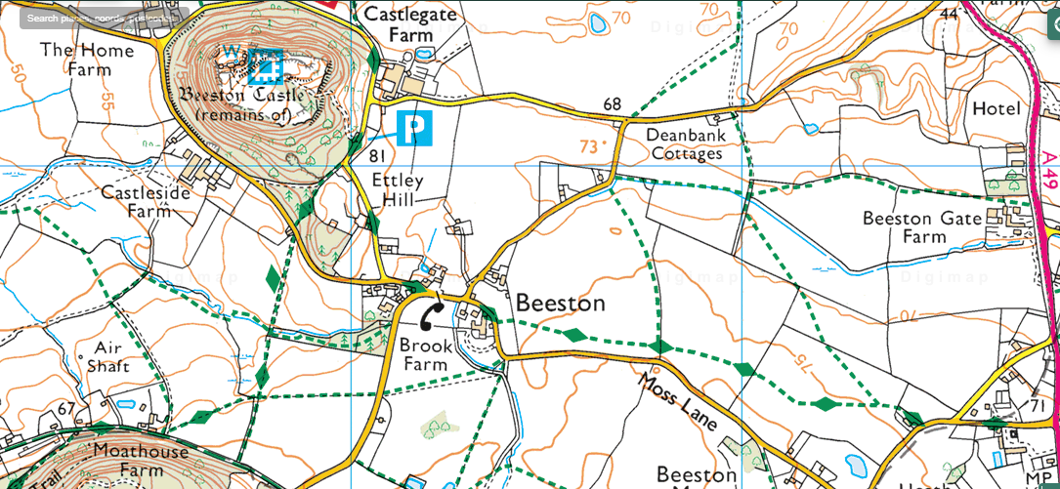
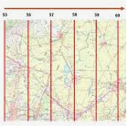
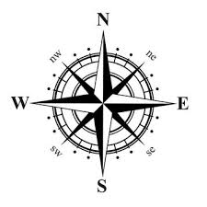
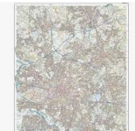

Newall Green Primary School Knowledge Organiser
Subject:Geography Term:Spring 2
Year group:5 Date: February 2026
Focus:
Maps and Beeston Castle
Key vocabulary:
Atlas – A collection of maps often of each country in the world.
Compass - A tool used for showing direction.
Digital map - A map that uses technology such as a satnav.
Easting - The numbers used in a grid reference that run west to east.
Grid references - The numbered squares on a map used to locate a place.
National grid - A system used to split Great Britain into 100km squares.
Northing - The numbers used in a grid reference that run south to north.
Ordnance survey maps - Detailed maps of Great Britain where each square represents 1km squared (1km²).
Symbols - small pictures, letters or lines that represent a feature.
WALT 1: Recognise map symbols
Intervention Absent
WALT 2: Understand and use compass points for direction DITL
Intervention Absent
WALT 3: Use grid references to locate places
Intervention Absent
WALT 4: Sketch maps of our local area
Intervention Absent
WALT 5: Understand the features and use of the Cheshire Plain DITL
Intervention Absent
WALT 6: Understand how caves are formed
Intervention Absent
END OF UNIT QUIZ
What I should already know:
Use world maps, atlases and globes to identify the United Kingdom and its countries, as well as the countries, continents and oceans studied at this key stage
Use simple compass directions (North, South, East and West) and locational and directional language [for example, near and far; left and right], to describe the location of features and routes on a map
Supporting experiences: Trip to Beeston Castle

