Slide 1


Slide 2
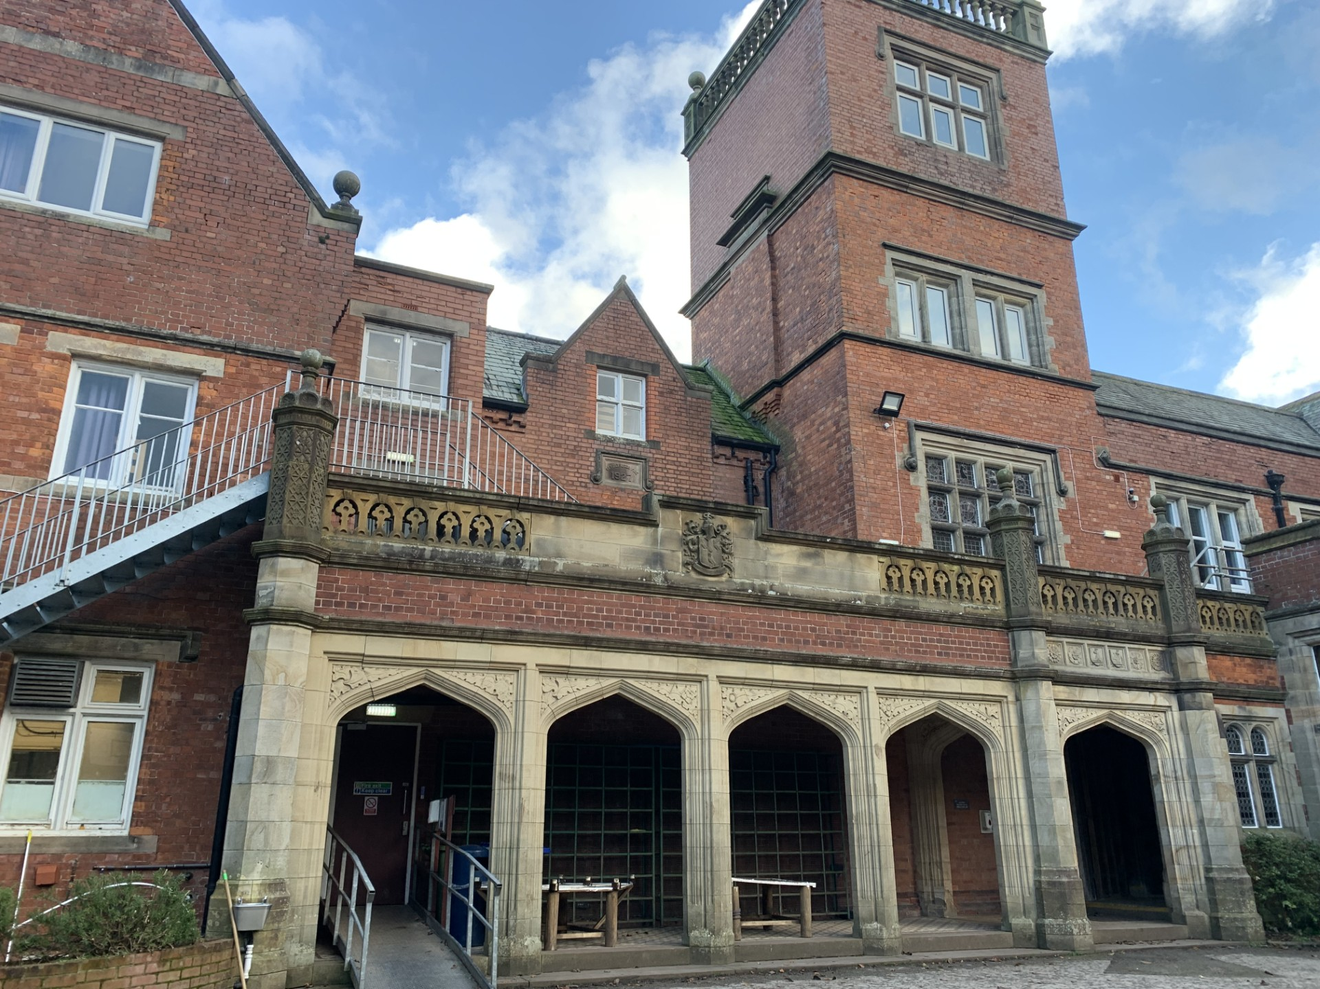
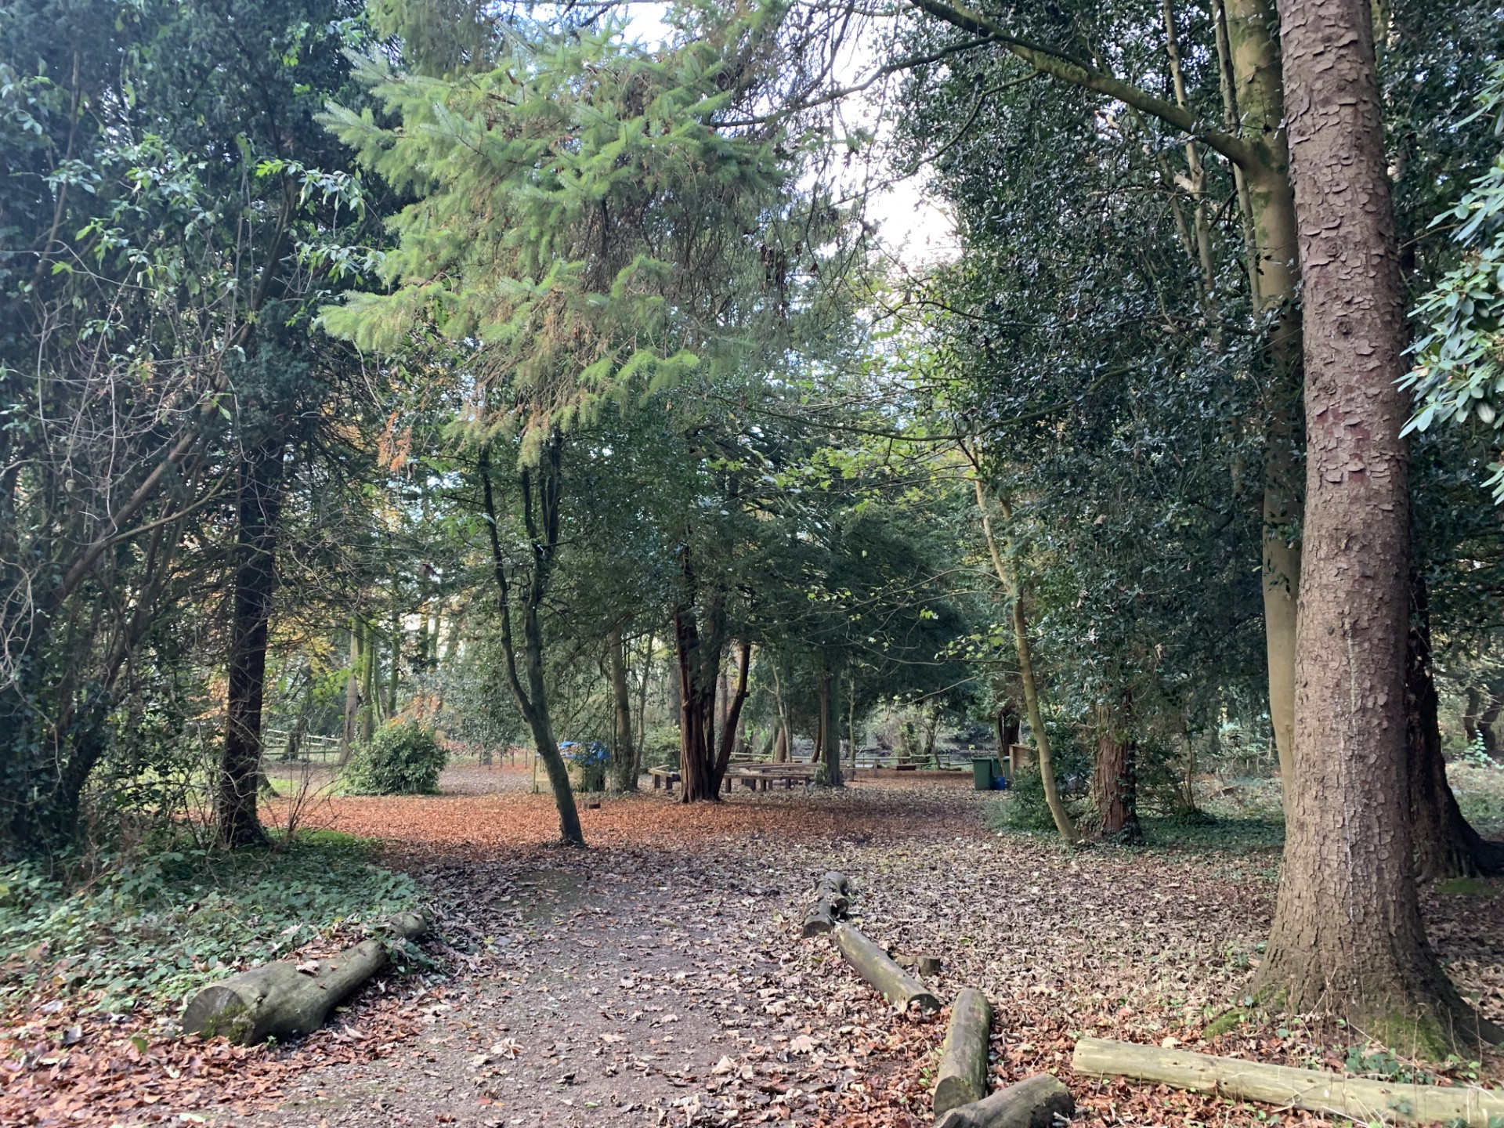
Y6 Residential Wednesday 11th March – Friday 13th March

Slide 3
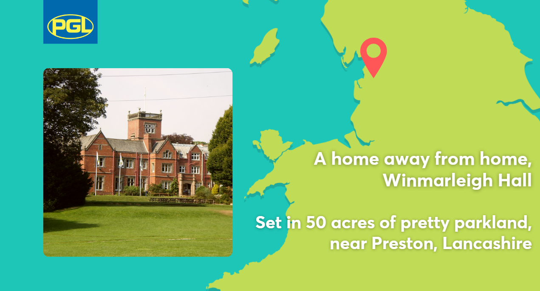

Slide 4
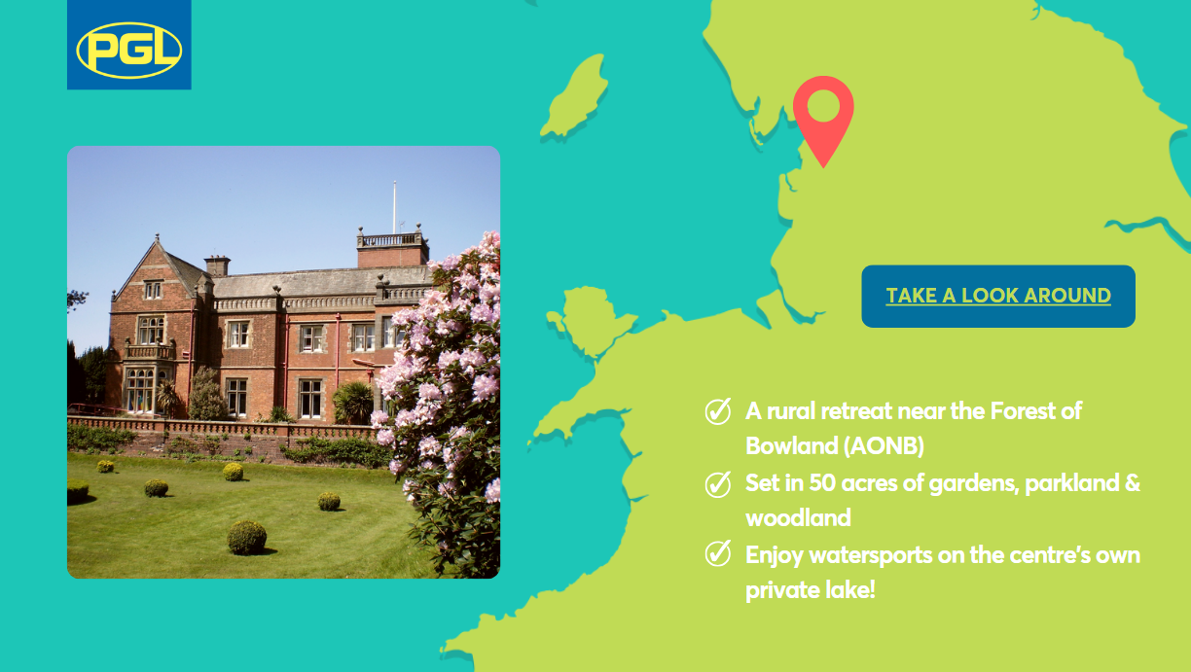

Slide 5
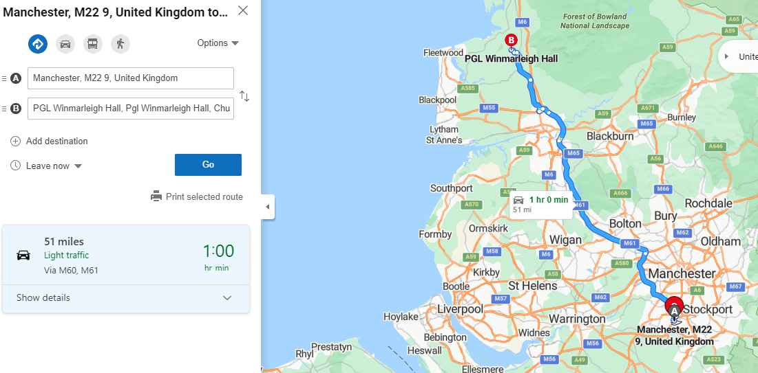
Buses will depart at 10:30 on Wednesday
We will return to school by 3:00 on Friday

Slide 6

Notes:
Matt

Slide 7
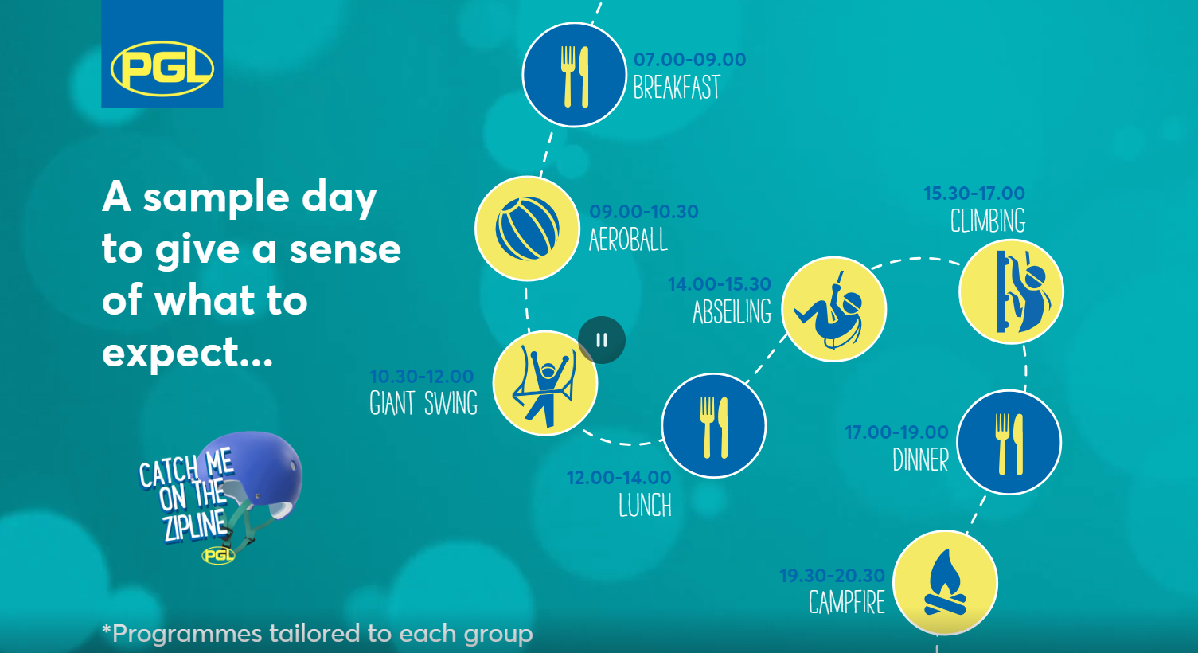

Slide 8
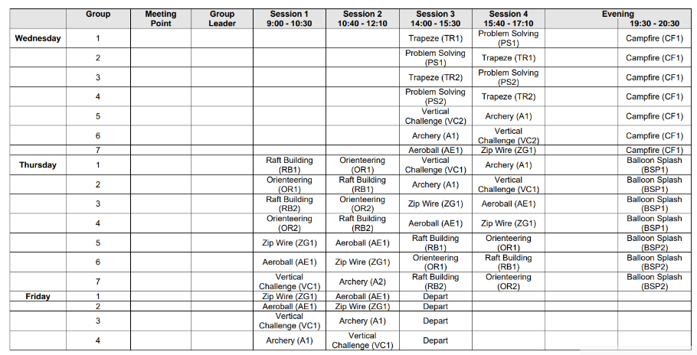

Slide 9
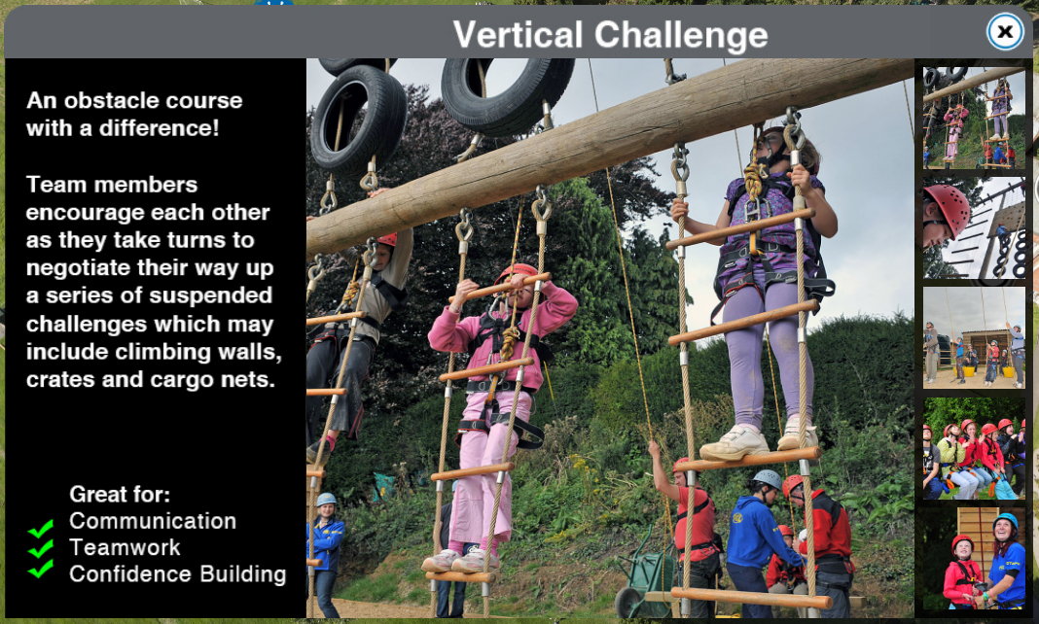
Notes:
Hannah

Slide 10
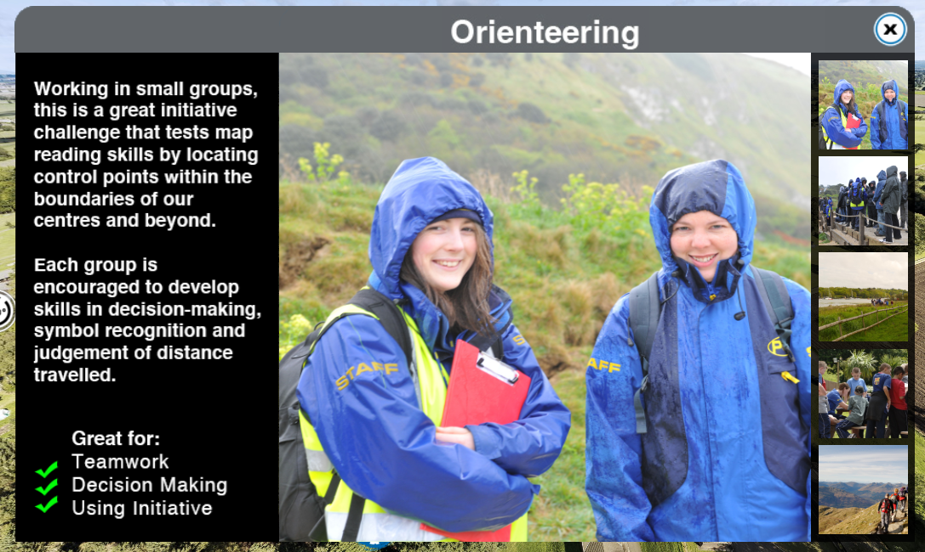
Notes:
Hannah

Slide 11
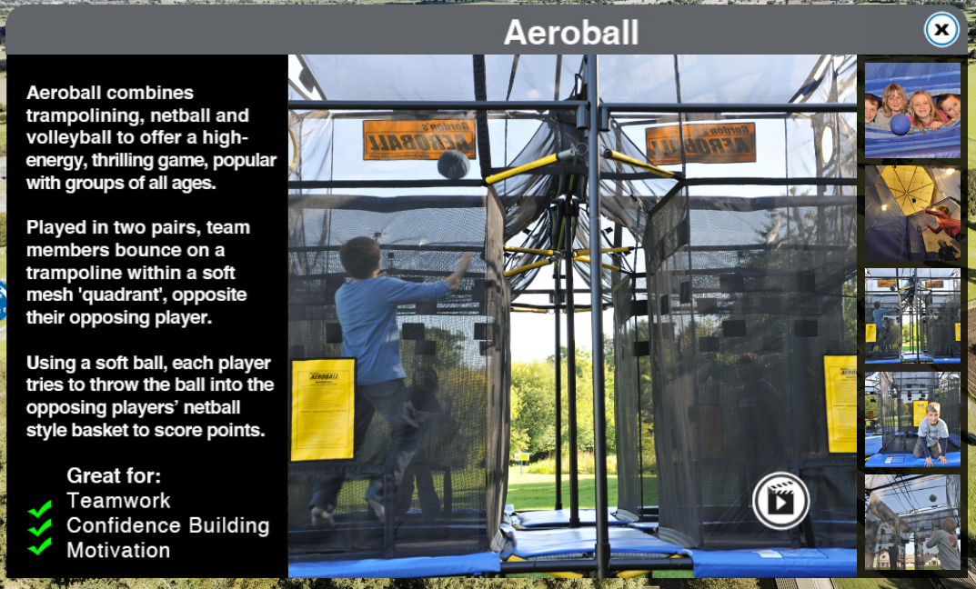
Notes:
Hannah

Slide 12
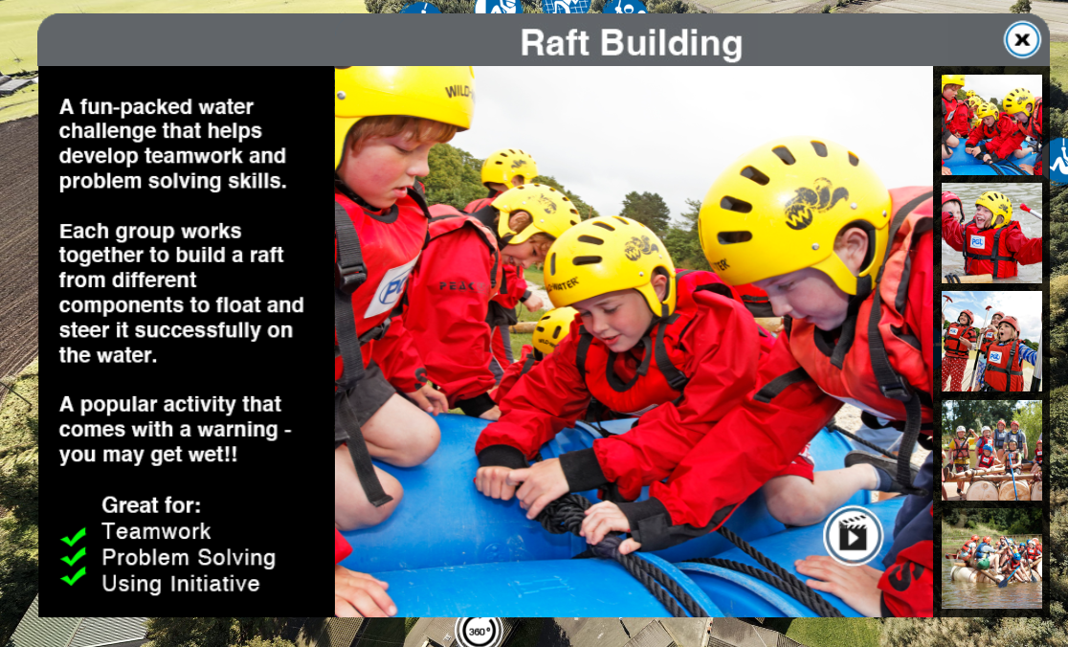

Notes:
Jake

Slide 13
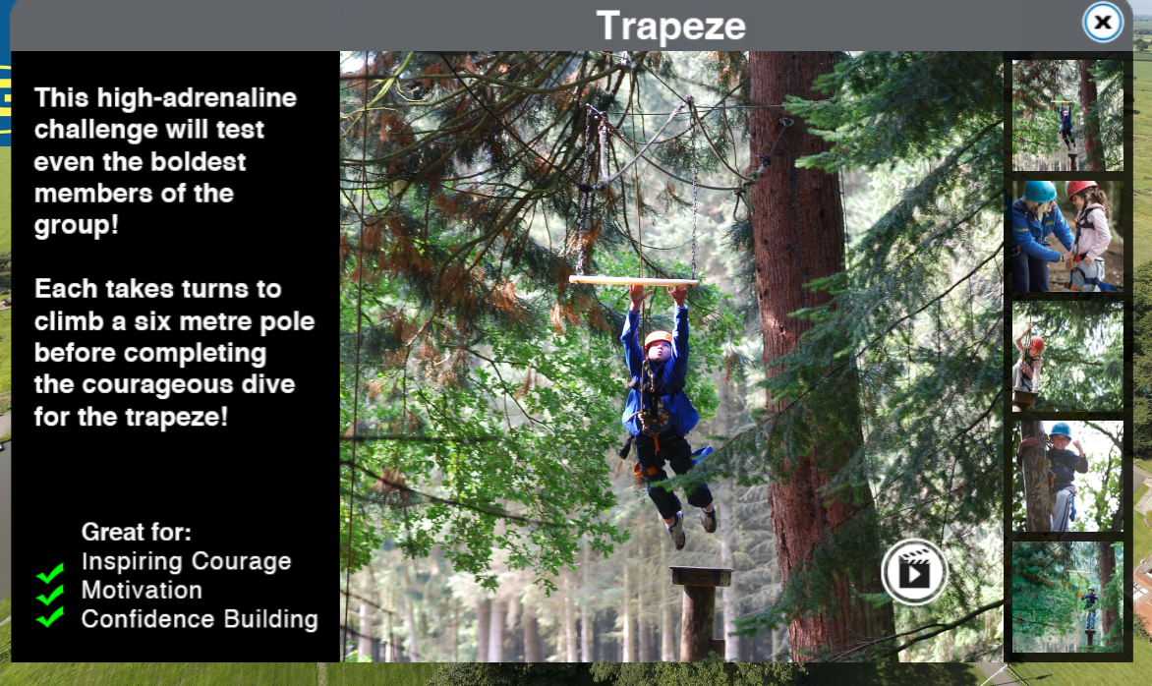
Notes:
Jake

Slide 14
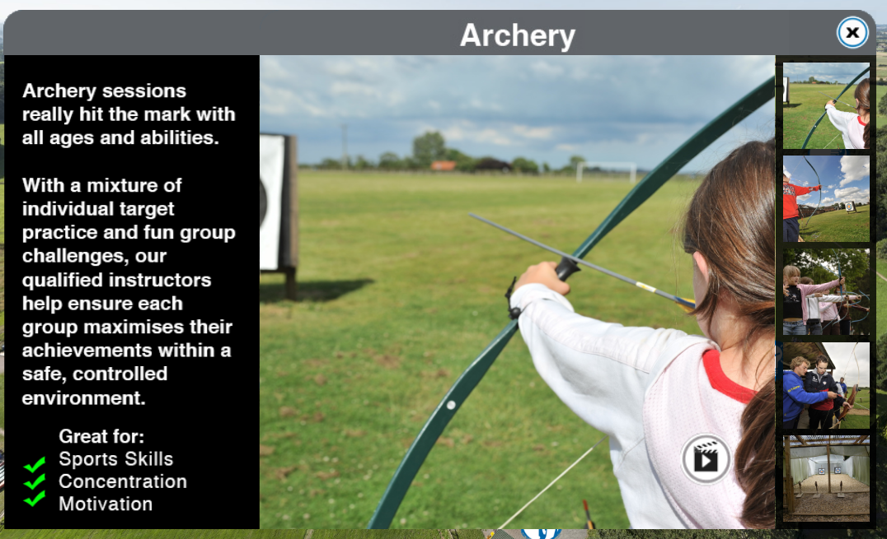
Notes:
Jake

Slide 15
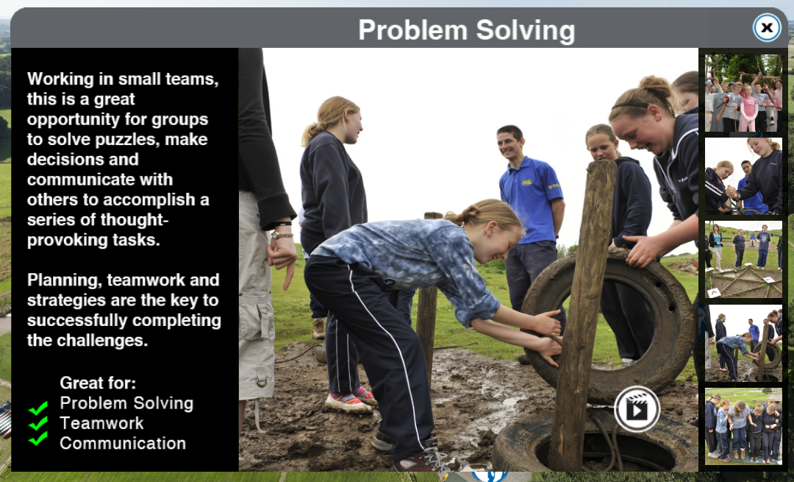
Notes:
Jake

Slide 16
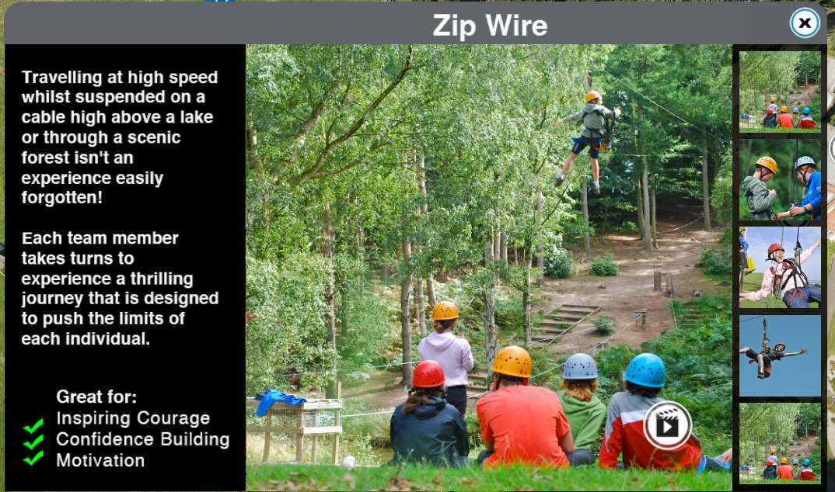
Notes:
Jake

Slide 17
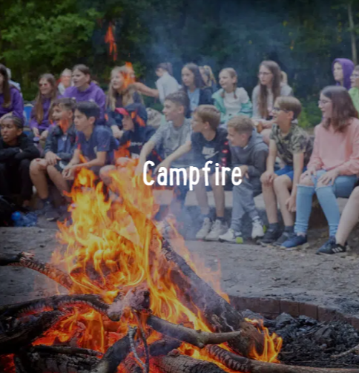
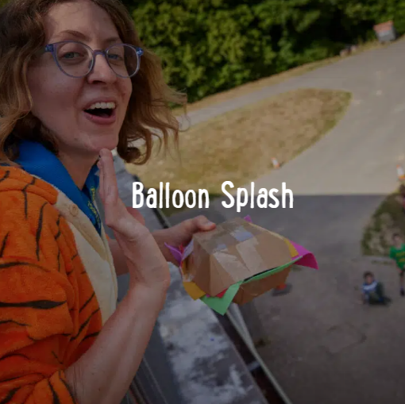
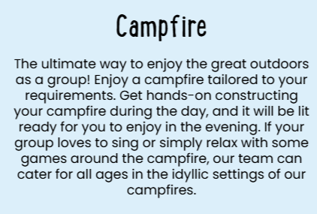
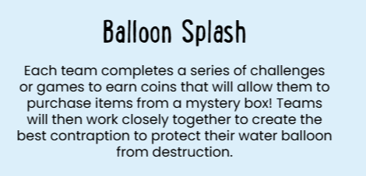
Evening Activities:
Notes:
Jake

Slide 18
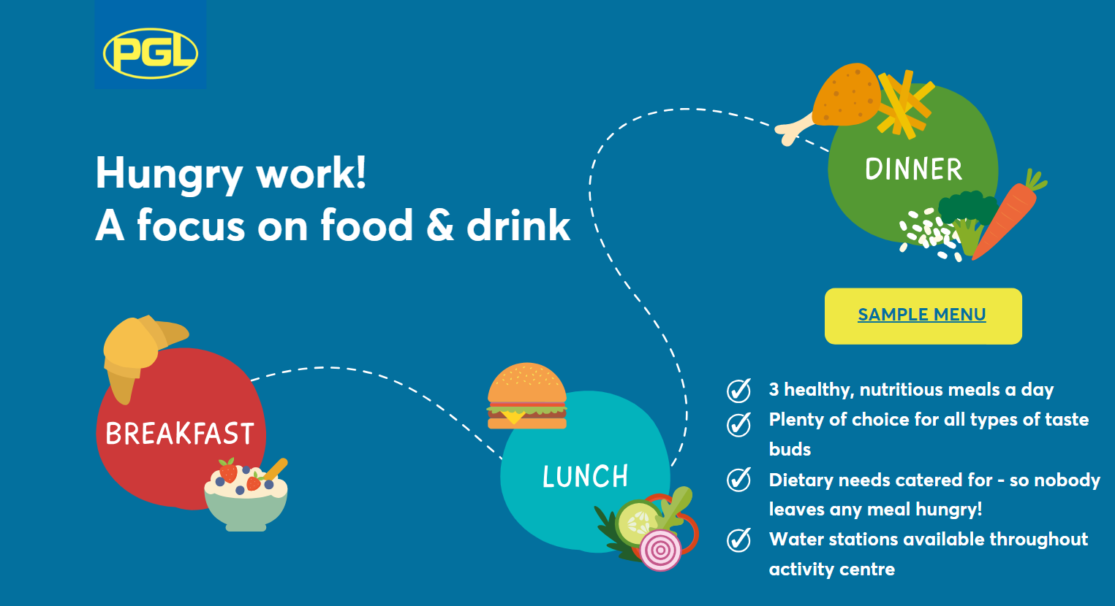
Notes:
Hannah

Slide 19
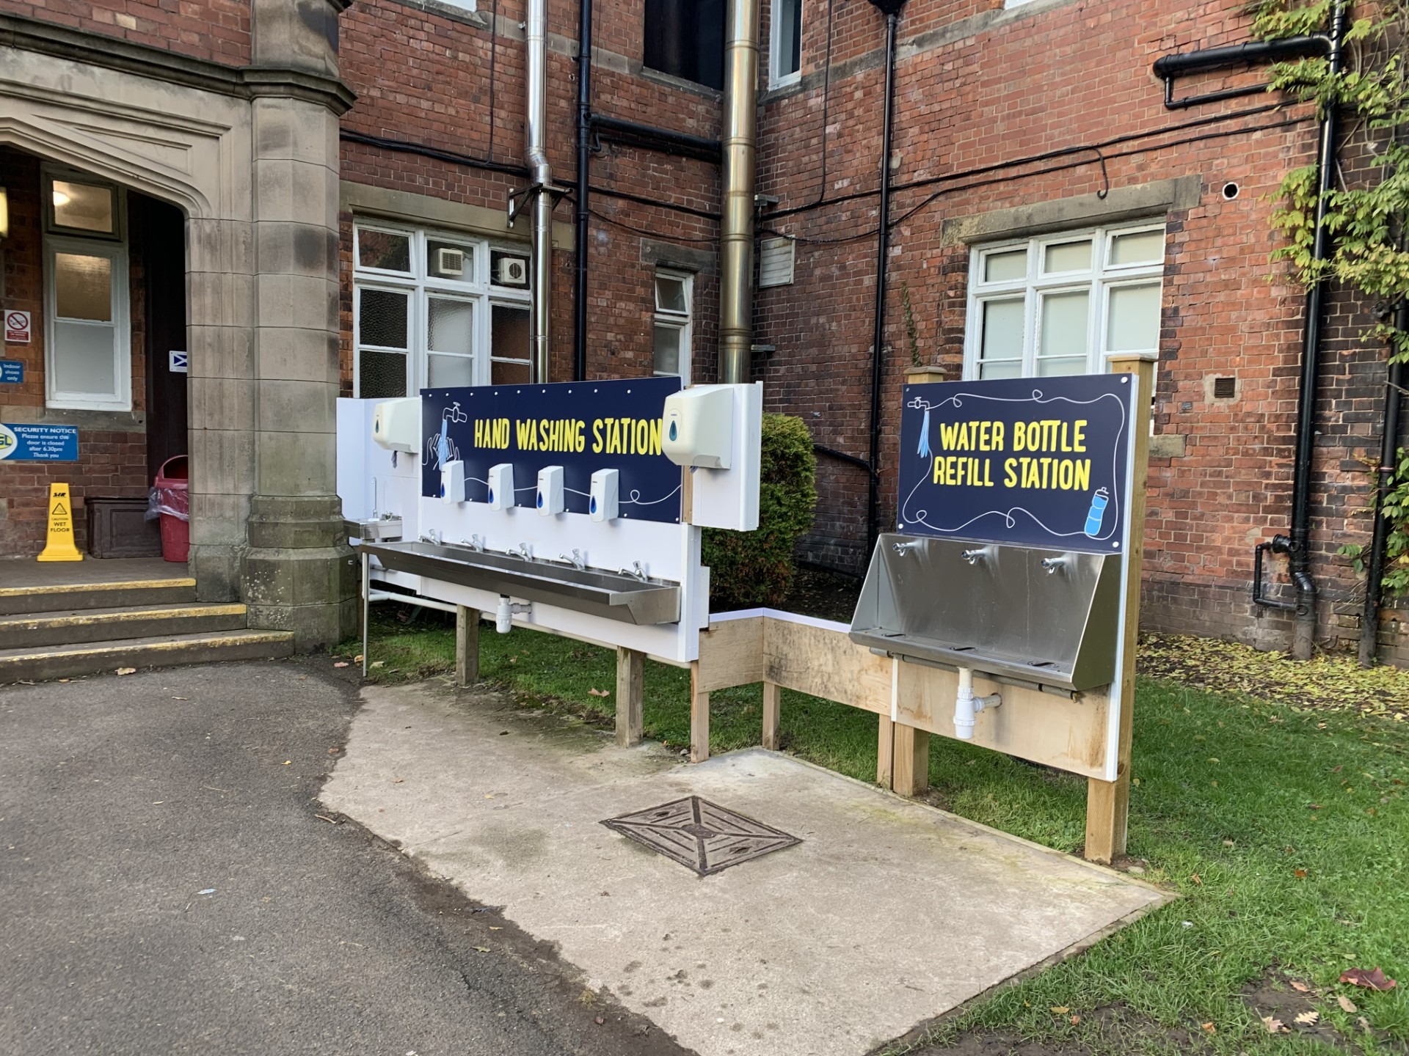
Entrance to the dining area.
Notes:
Lucy

Slide 20
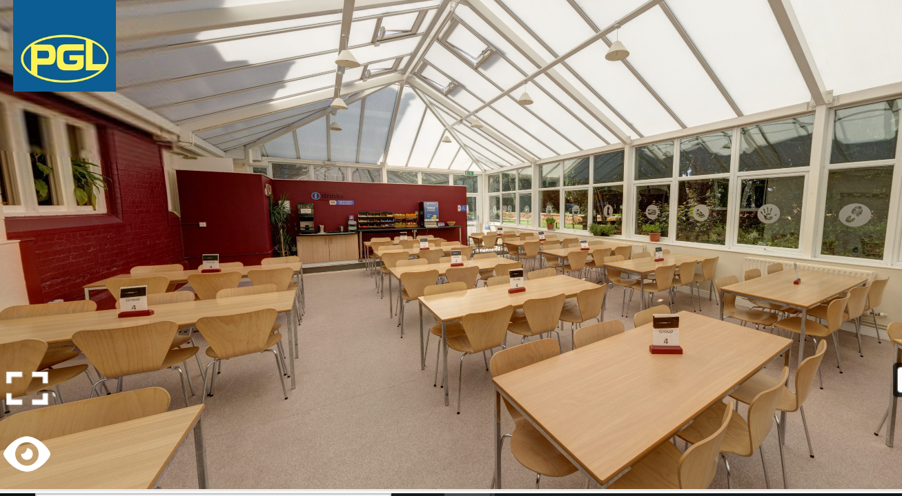
Dining Area
Dining hall
Notes:
Lucy

Slide 21
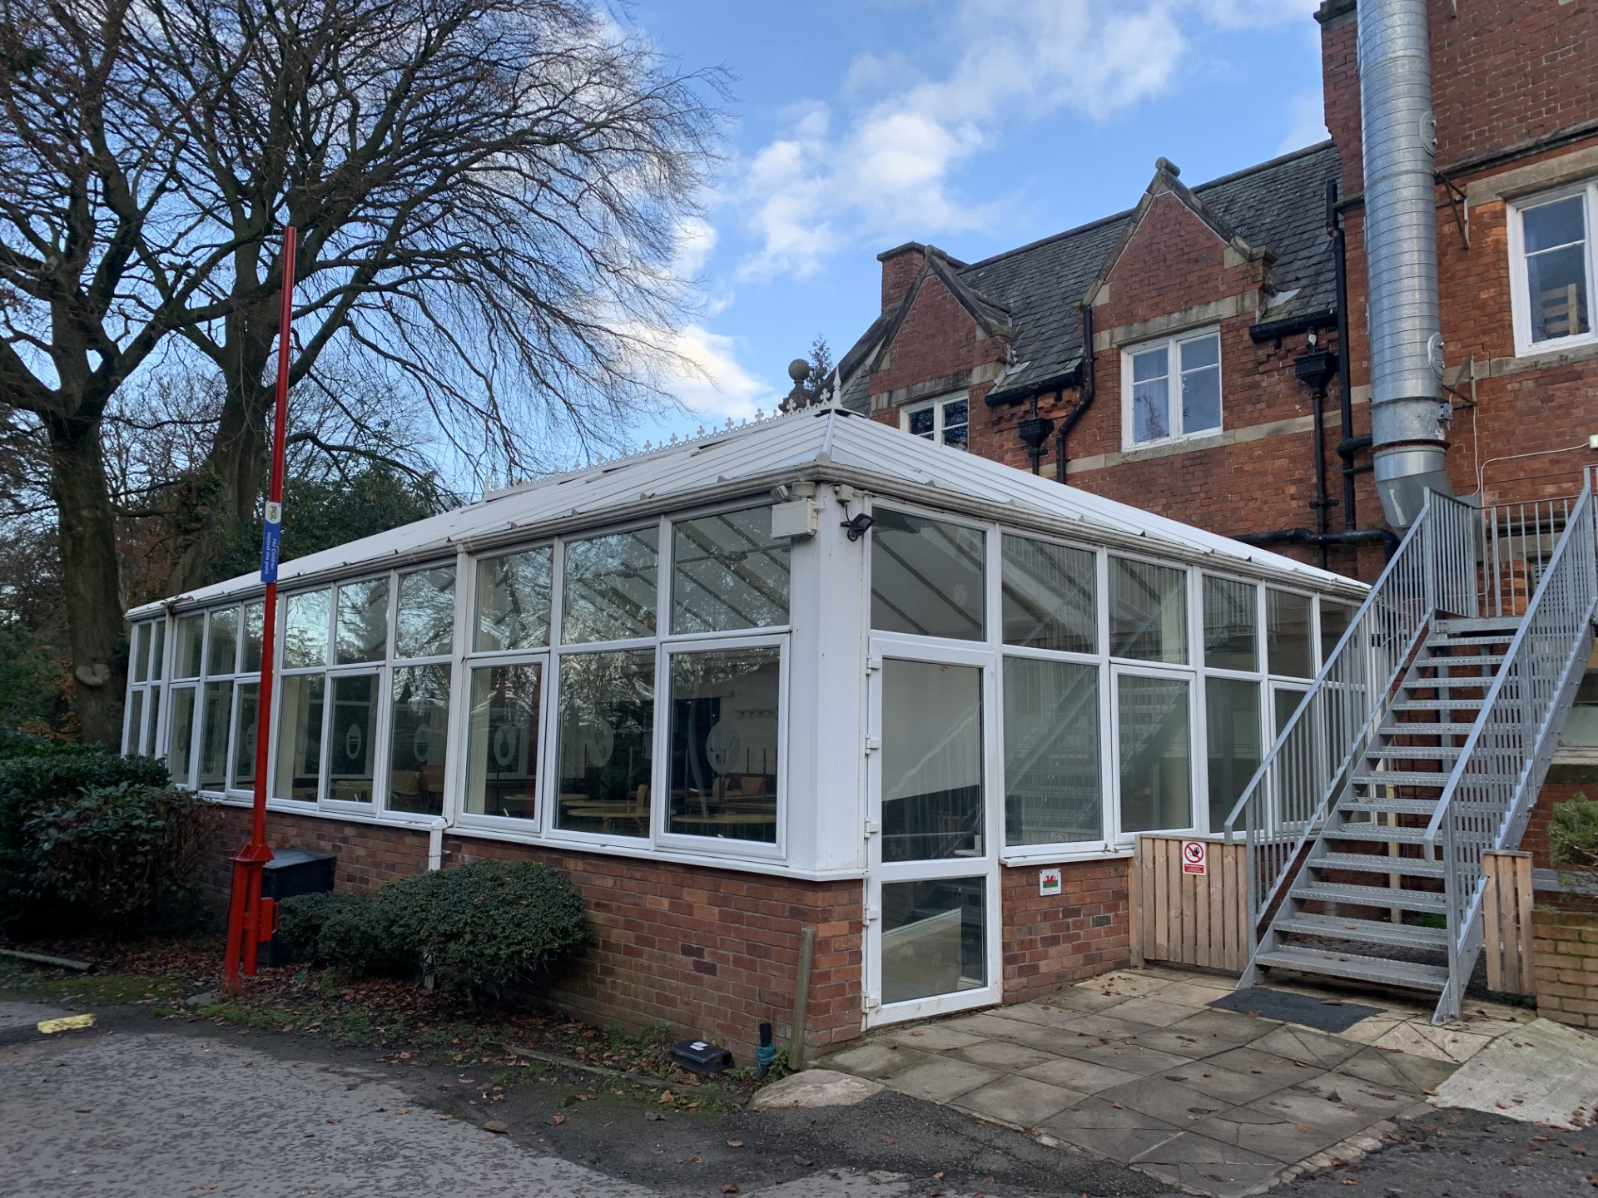
Dining hall
Notes:
Lucy

Slide 22
Wednesday 11th - Lunch
Children will need a packed lunch on the day we depart
If your child is entitled to free school meals, they will be provided with a packed lunch
We will eat this on arrival at PGL before our first activities
Notes:
Hannah

Slide 23
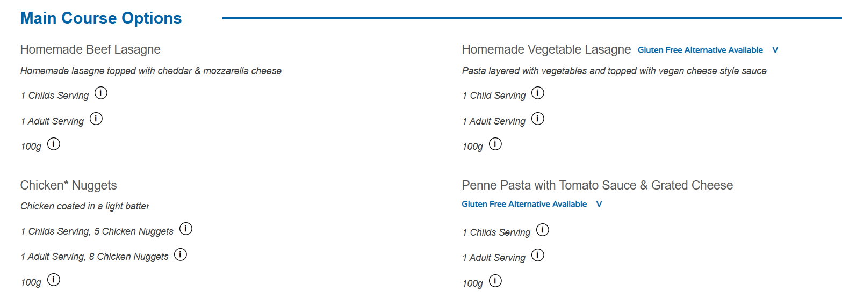
Wednesday Evening Meal

Slide 24
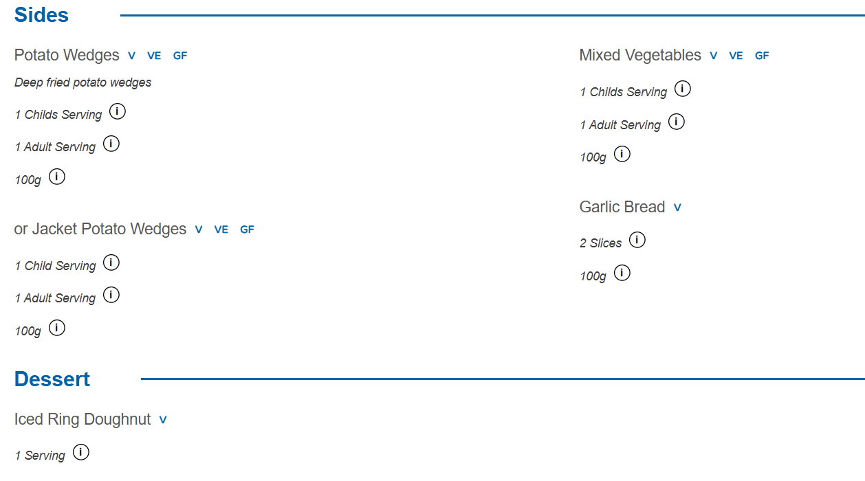
Wednesday Evening Meal

Slide 25
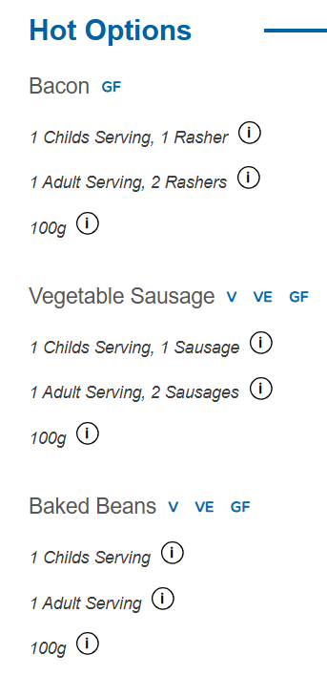
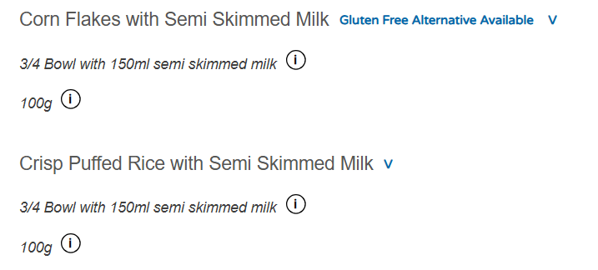
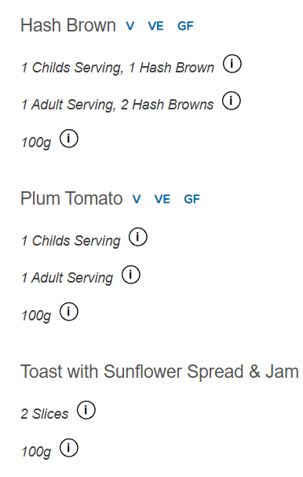
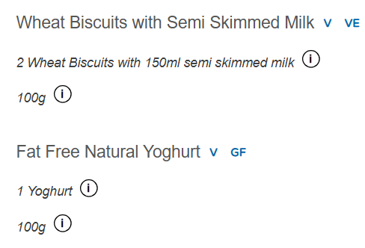
Thursday Breakfast

Slide 26
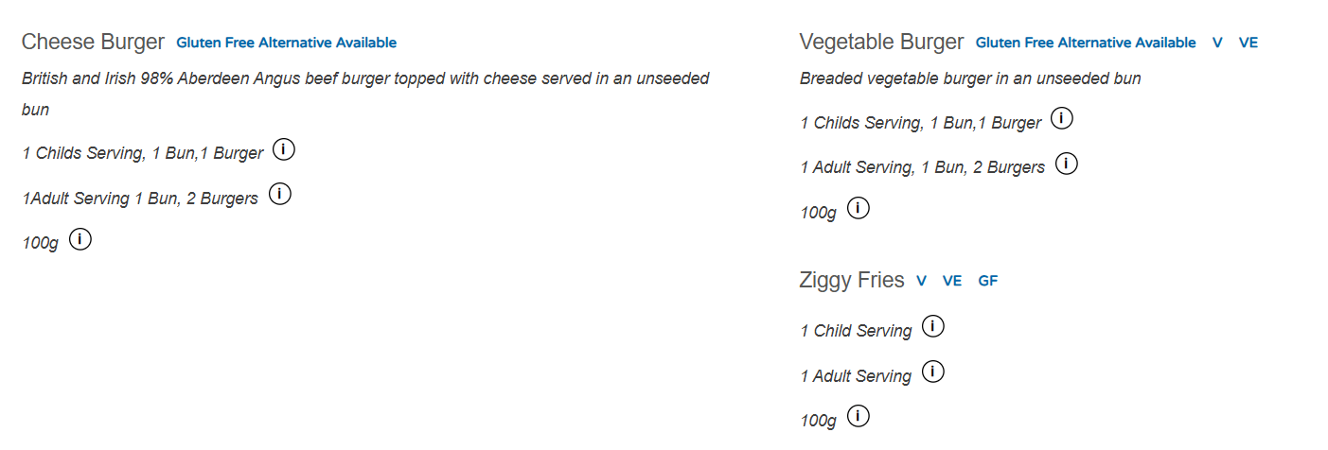
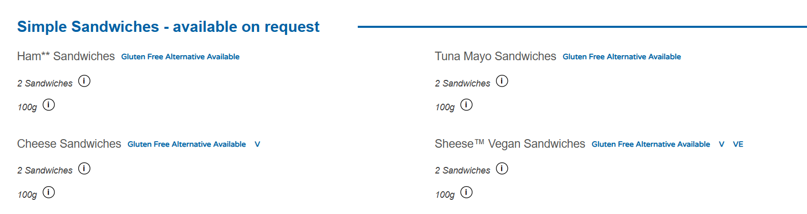
Thursday Lunchtime

Slide 27
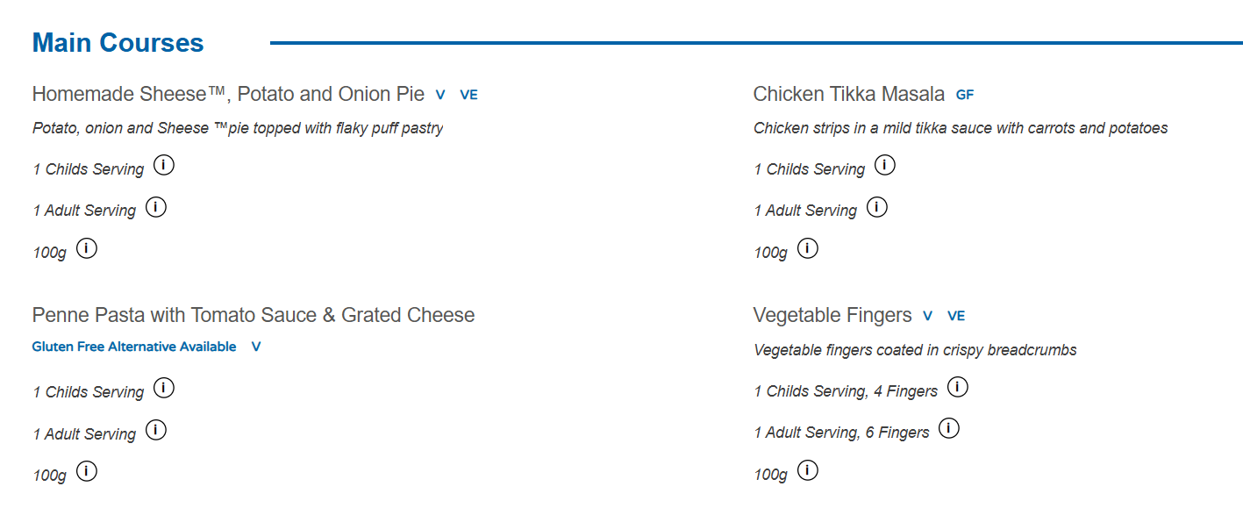
Thursday Evening

Slide 28
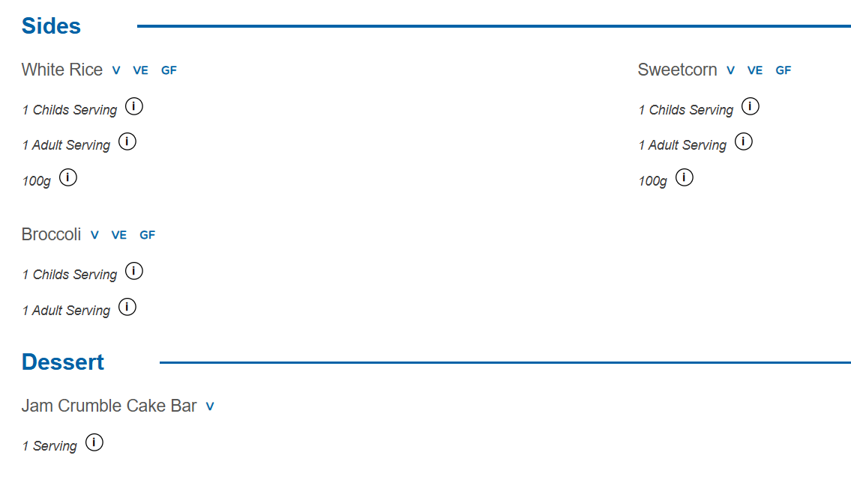
Thursday Evening

Slide 29
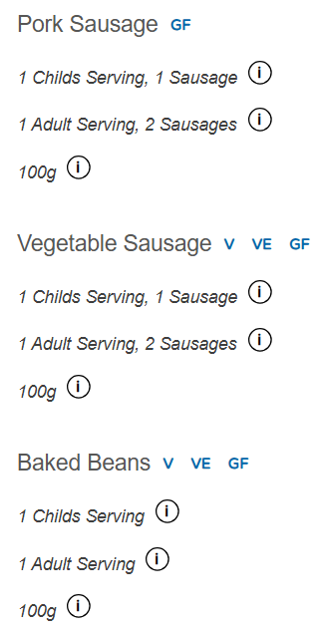
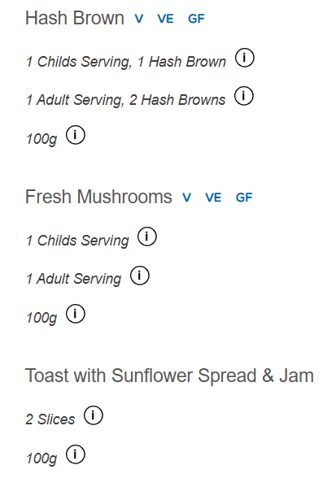
Friday Breakfast

Slide 30
Friday Lunch:
A packed lunch will be provided by PGL before we head back to school. This will include a sandwich, fruit, desert and drink.
Notes:
Lucy

Slide 31
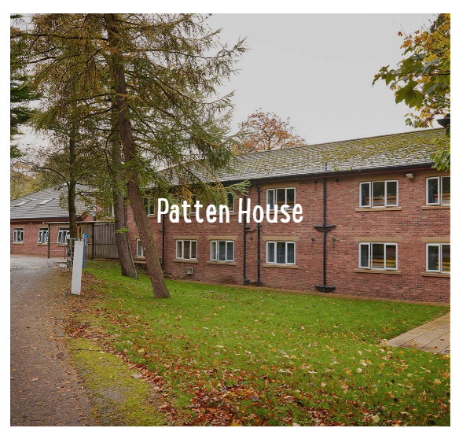
Accommodation
Children will be asked to write down 3 preferences of who they would like to be in a room with.
Staff accommodation will be on the same corridor as the children’s.
Notes:
Matt

Slide 32
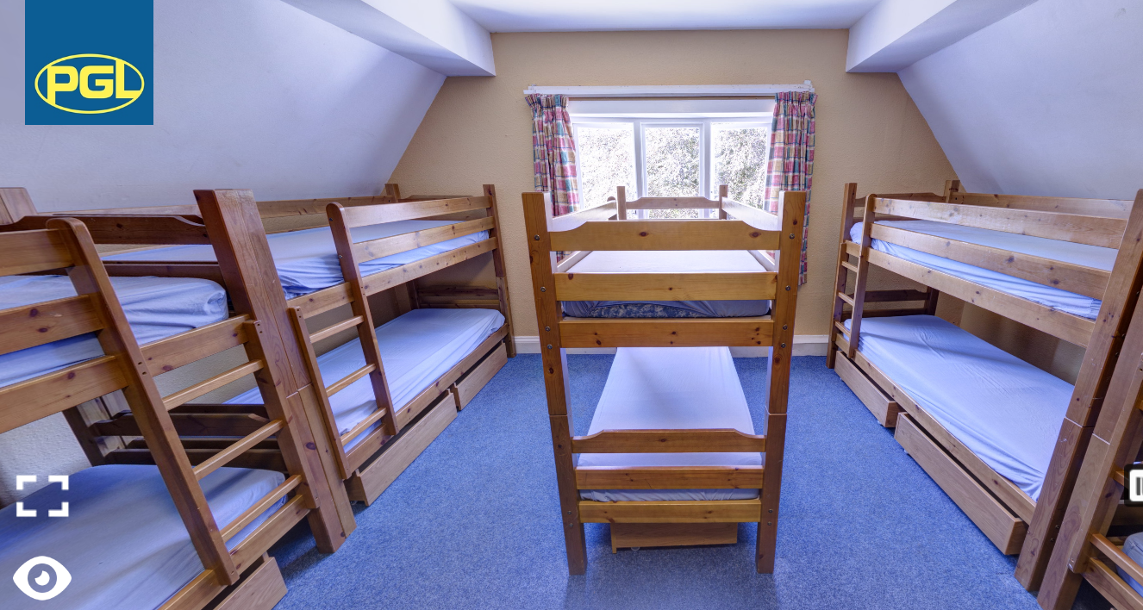
All rooms have bunk beds. There are rooms of 4, 6 and 8.

Slide 33
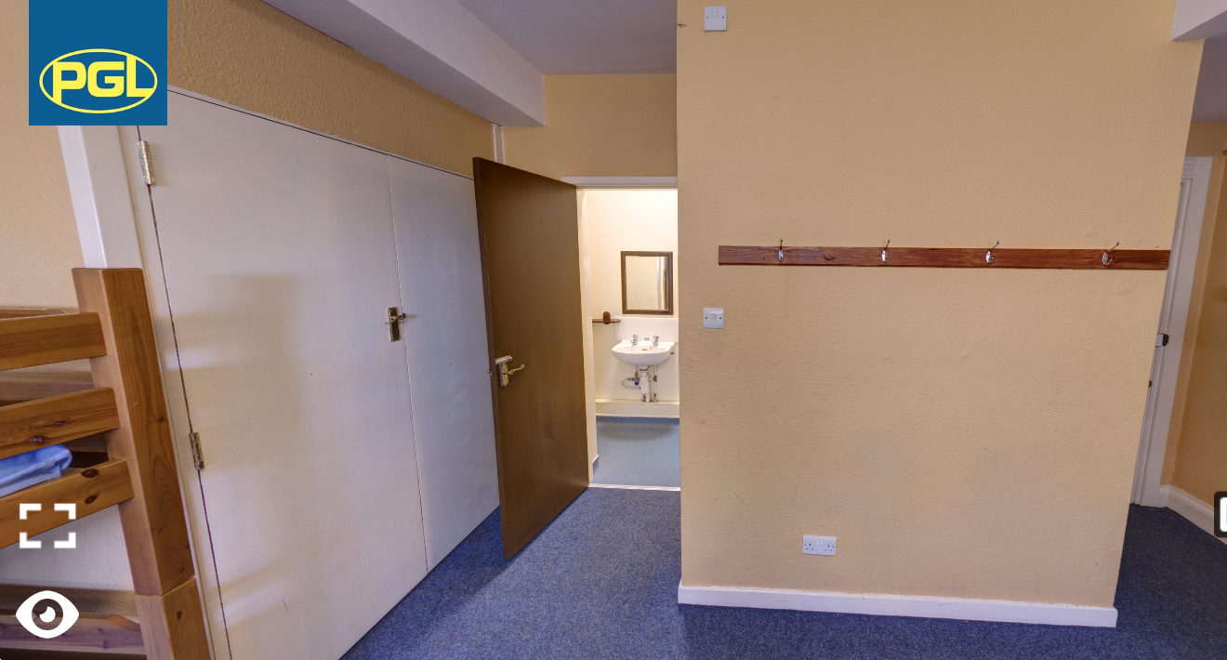
All rooms have an en-suite with toilet, sink and showering facilities.

Slide 34
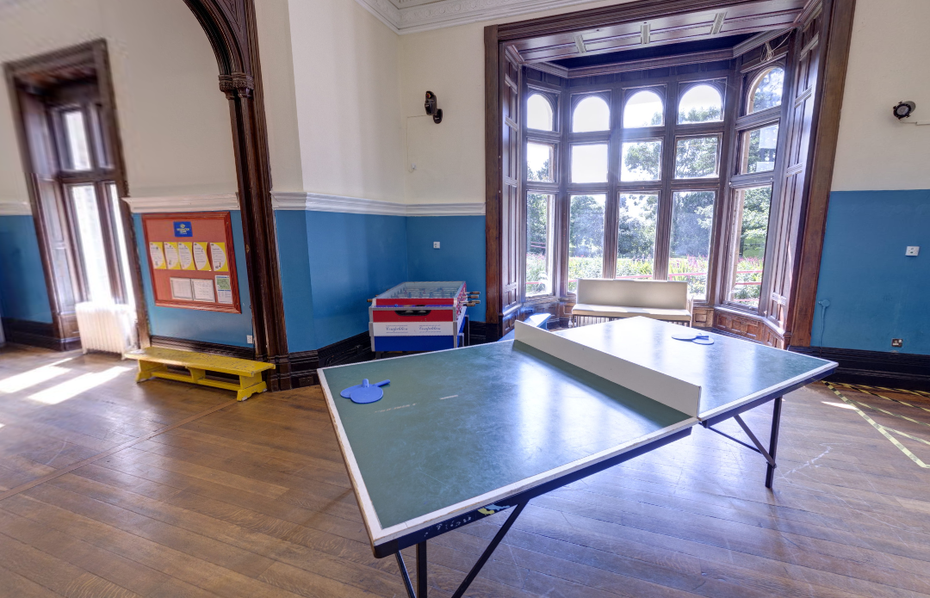
Games Room

Slide 35
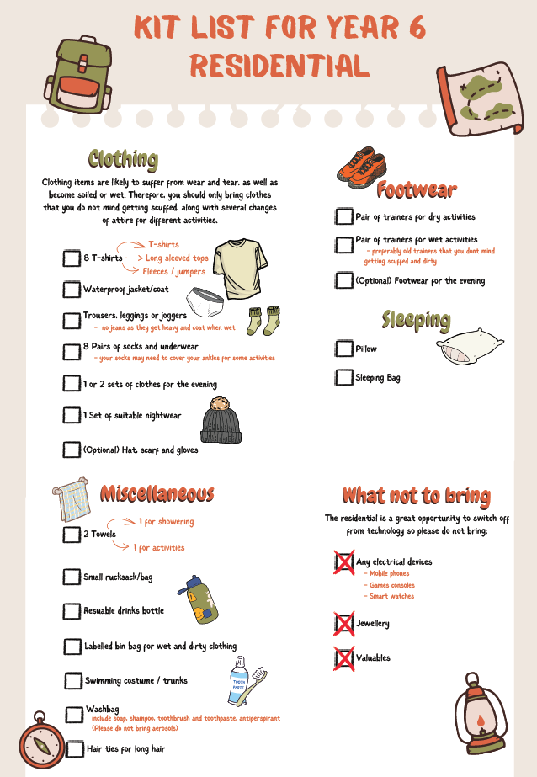
Key items:
Sleeping bag
Pillow
Re-useable water bottle
Old clothes
Towel
Hat and gloves
Jumpers / long sleeve tops
Waterproof clothing
Extra pair of shoes – no crocs / sliders for activities
Names on every item!
No electrical devices
Notes:
Matt

Slide 36
Safety
All PGL activity instructors are first-aid trained
All PGL staff are enhanced DBS checked
Fully-qualified activity instructors
There is on site 24 hour security
Teacher accommodation is next to the children’s and is clearly signposted so the children know which rooms to go to if they need anything during the night
Notes:
Hannah

Slide 37
Behaviour
Children must be able to follow school rules/adult instructions to be trusted to go on the residential.
If anyone does not follow the rules whilst on the trip, you will be contacted and asked to come and collect your child.
Any electrical devices found on the trip will be confiscated and a consequence put in place once we return to school.
Notes:
Jake

Slide 38
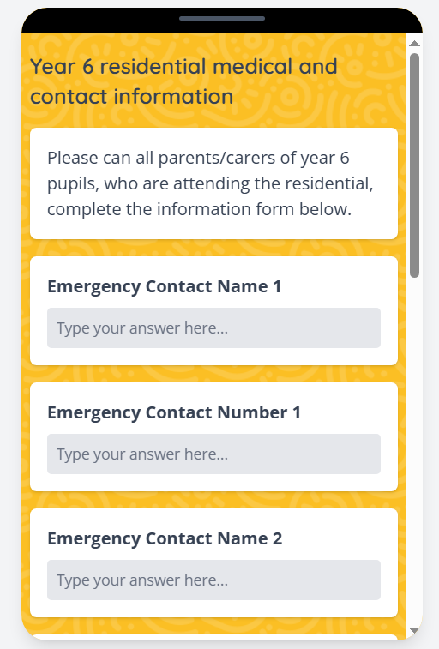
Emergency contact/medical forms
You will have received a link to complete this on School Spider
We cannot take your child on the residential without this information
Notes:
Jake

Slide 39

Photographs
A residential page has been added to the school website for us to upload photos whilst we’re on the trip.
You will receive a text message with a password to access this page.
Please do not share the images on social media as some children do not have photo permissions.
Notes:
Jake

Slide 40
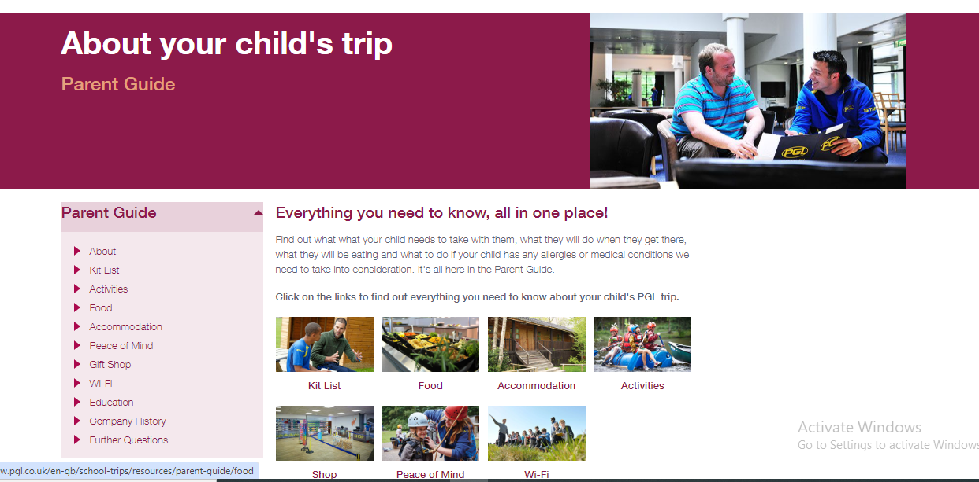
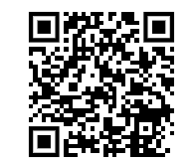
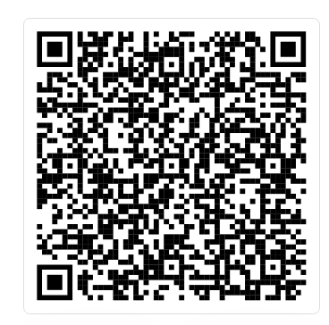
360 degree tour of Winmarleigh PGL Site
Notes:
Jake

Slide 41


