Slide 1

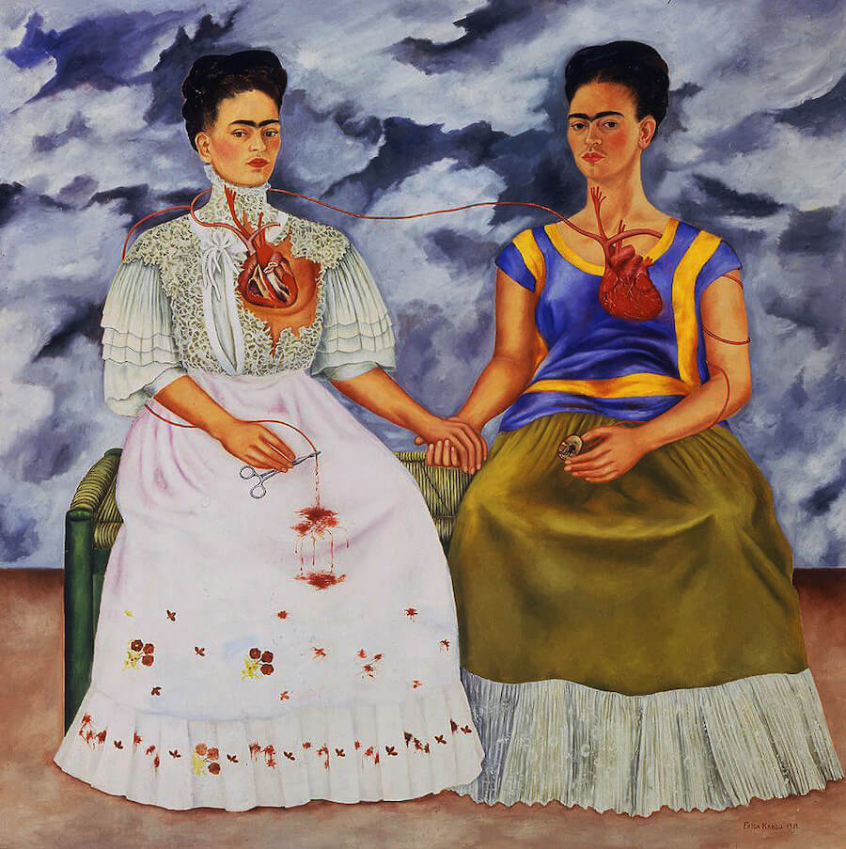
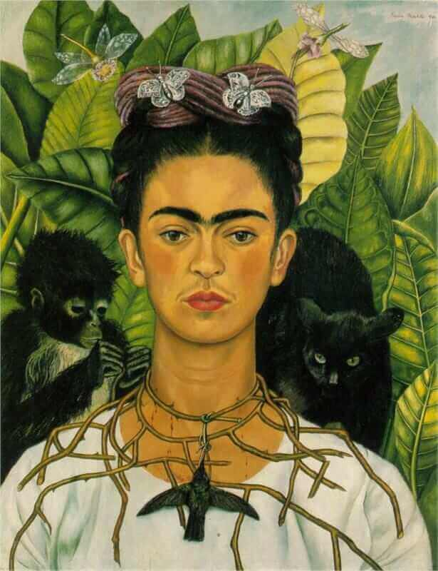
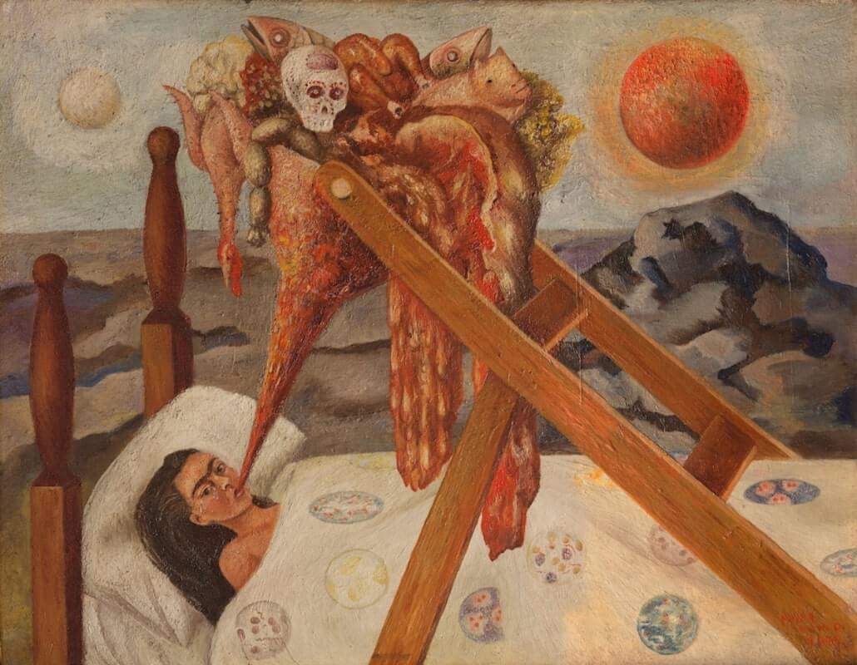
Newall Green Primary School Knowledge Organiser
Art Focus – self portraits – Frida Kahlo
Year Group – 5 Term – Spring 1
Key vocabulary:
Hue – a colour in its purest form.
Tint – when an artist adds white to a colour in order to lighten it.
Shade – when an artist adds black to a colour in order to darken it.
Tone – when an artist adds grey to a hue.
Atmosphere – a feeling or mood created pictorially.
Tonal contrast – It is created when light tones and dark tones lie alongside each other.
Composition – the arrangement and placement of objects in a piece of art.
Scale – an object’s size in relation to another object.
Focal point – the area the viewer’s eyes are naturally drawn to.
Form – the shape in artwork.
Self portrait – a painting completed by the artist of themself
Key facts to retain:
Who Frida Kahlo was and how she created her artwork.
Information about her artistic style, influences, and themes she explored through her art.
That paintings can have hidden meanings.
How to use a range of artistic techniques to create an eternal piece of artwork.
What I should already know:
How to create detailed portraits
How to accurately draw facial features
Artwork can have hidden meanings
How to mix paints accurately including tints, shades and tones
How to manipulate composition
Supporting images:
WALT 1: Evaluate the work of Frida Kahlo
WALT 2: Create interpretations of artwork by Frida Kahlo
WALT 3: Experiment sketching different items found in nature
WALT 4: Recognise what is meant by ‘immortal images’
WALT 5: Create an immortal piece of art influenced by Frida Kahlo

