Slide 1

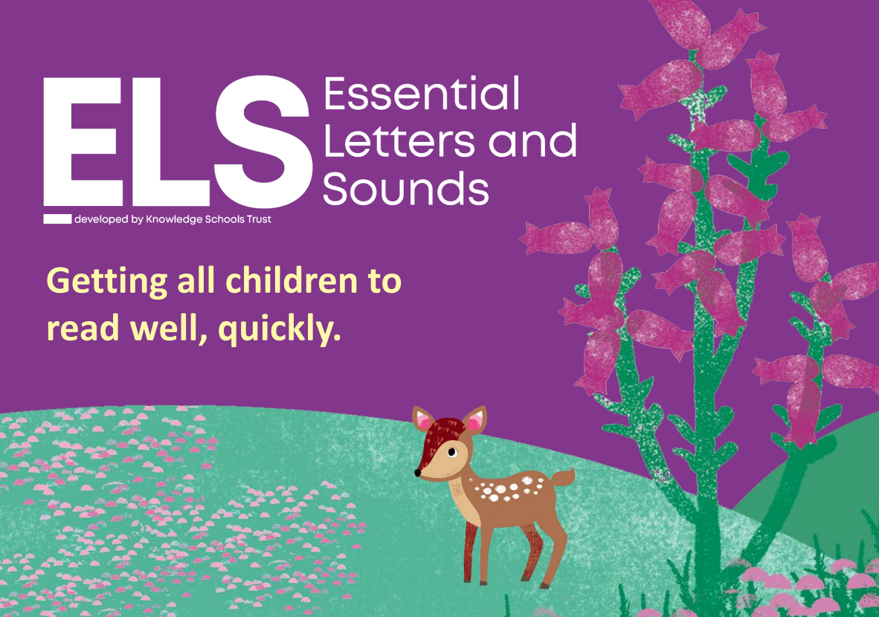

We follow the Essential Letters and Sounds (ELS) which is accredited by the government. The programme ensures that all teachers are teaching phonics in the same way, using the same resources – this means children are familiar with the routines of our daily sessions.
Through our teaching, children will experience a love of books and language whilst rapidly acquiring the skills they need to become fluent independent readers and writers.
Notes:
Begin by explaining what Phonics is. Explain that learning to read the English language is complex and that this information session will give parents & carers the understanding of what Phonics is, the terminolgy used in Phonics and how ELS gives children the skills and knowledge to read well, quickly.

Slide 2
Phonics and Early Reading Meeting
What is phonics?
Phonic terms explained
Letter sounds and their pronunciation
How Phonics s taught in school
Reading Books
How children are supported in school
How to support children at home
Notes:
Begin by explaining what Phonics is. Explain that learning to read the English language is complex and that this information session will give parents & carers the understanding of what Phonics is, the terminolgy used in Phonics and how ELS gives children the skills and knowledge to read well, quickly.

Slide 3
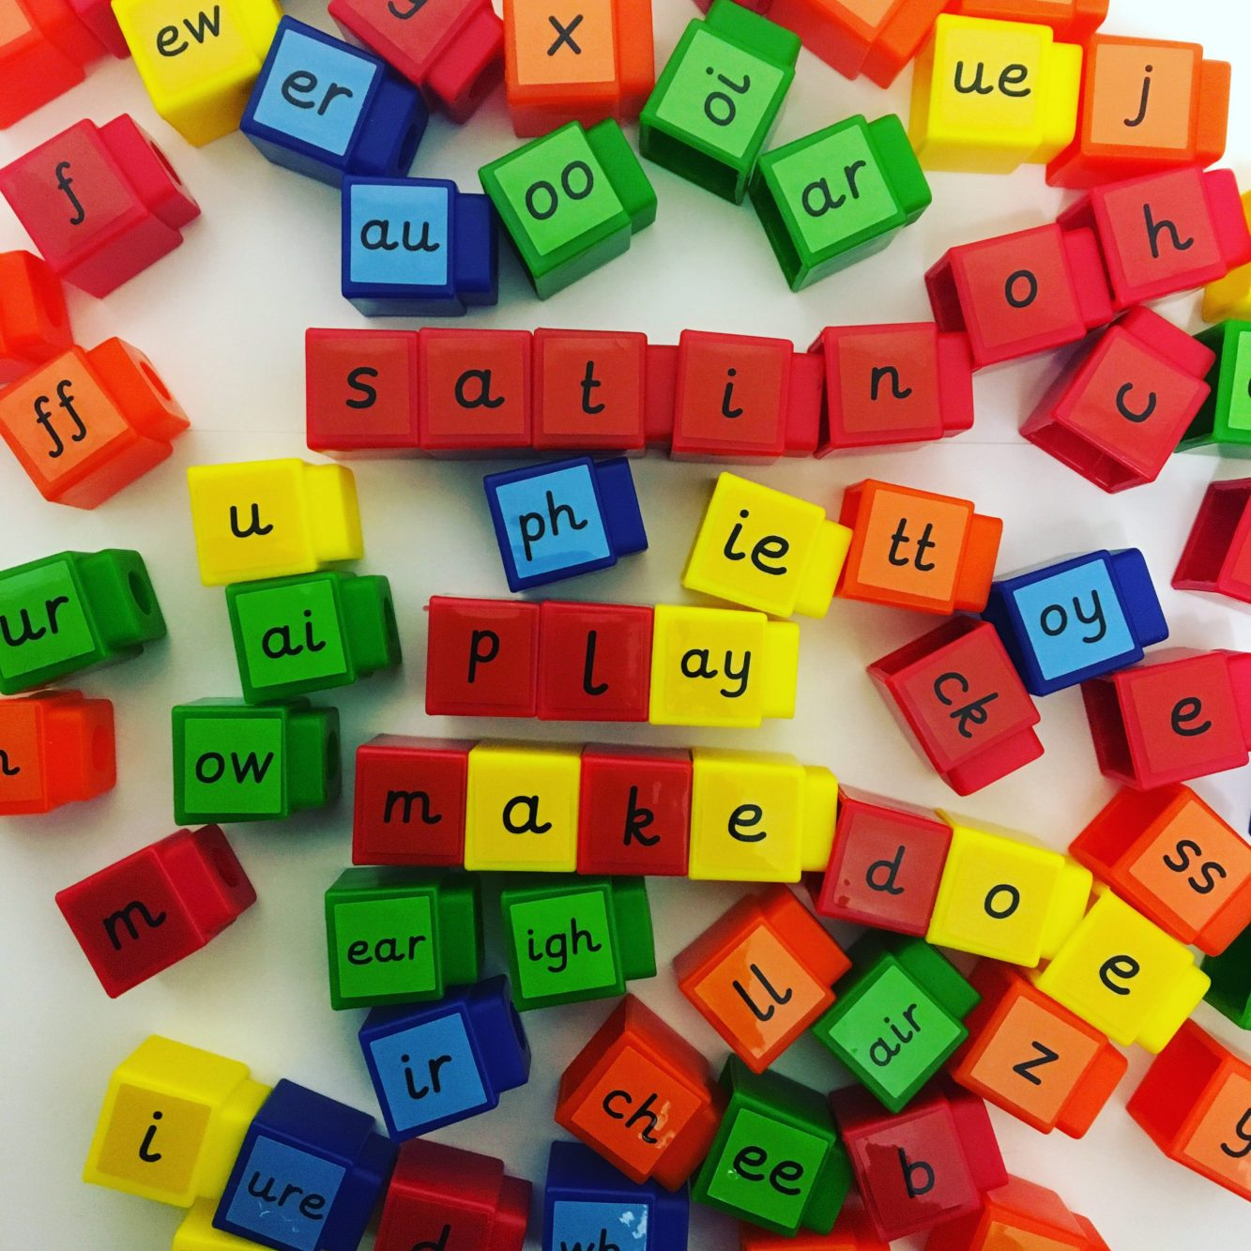
Phonics…
An approach to teaching reading and writing - vital skills for all children which will pave the way for an enjoyable and successful school experience… and future life.
The English language has 26 letters and
44 sounds.
Each of the 44 sounds (phonemes) is
represented by a grapheme (the written
representation of a sound).
There are over 100 ways to spell those sounds!
Notes:
Begin by explaining what Phonics is. Explain that learning to read the English language is complex and that this information session will give parents & carers the understanding of what Phonics is, the terminolgy used in Phonics and how ELS gives children the skills and knowledge to read well, quickly.

Slide 4
Terminology
Phoneme: the smallest single identifiable sound in a word.
For example, in the word 'cat' there are three phonemes c/a/t.
Grapheme: the written representation of a sound.
Digraph: two letters making one sound. Eg sh in 'shop'.
Trigraph: three letters making one sound. Eg igh in 'night'.
Split digraph: two vowel letters split by a consonant. Eg a-e in 'cake’.
Blend: Merging phoemes to read a word
Segment: Breaking down a word into phonemes to sound it out or write it down.
Notes:
Use flashcards to put this into context. Show parents examples of graphemes, digraphs, trigraphs and split digraphs. Where possible, make the link between same sound, different spelling.
Example:
<a>
acorn
<ai>
rain
<ay>
play
<a-e>
name
<eigh>
eight
<ey>
they
<ea>
great
<aigh>
straight

Slide 5
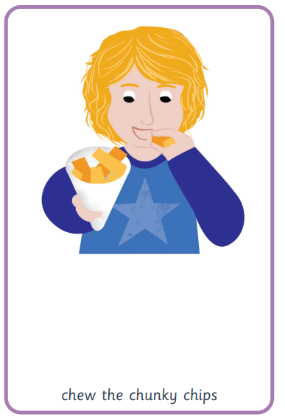
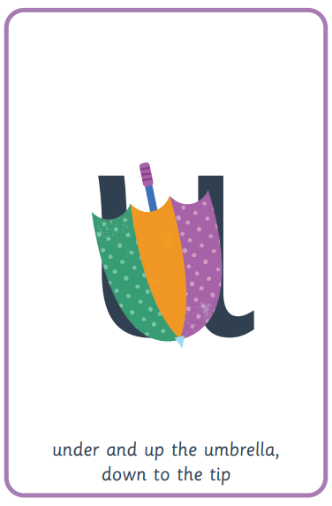
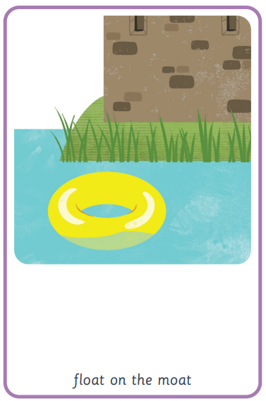
How do we teach phonics?
Use a simple, consistent approach to teaching phonics.
Pictures, mnemonics
and rhymes to support learning
and recall.
Teach phonics every single day from the early days of Reception and the routines and resources are consistent, meaning children know what to expect every day.
Assess each child every 5 weeks. Parents/carers are informed of any sounds children don’t know so they can be supported both at school and home.
Notes:
Phonics teaches the link between the spoken sounds of our language and the written version of that sound – the code of our language.
As systematic synthetic phonics programme breaks this down into tiny steps for children to piece together which allows them to decode to read and then spell using the sound to spelling correspondences they have learnt.
We use a simple, consistent approach to teaching phonics.
Your child will experience the same classroom routines within each lesson which reduces cognitive load and maximises the chances of success.
All children are supported within the lesson to use their new phonic knowledge independently.
In every single ELS lesson, your child will make the direct application to reading.

Slide 6
How do we teach phonics?
Lots of opportunities review new sounds & graphemes taught - through independent/group activities and games
Lots of opportunities for oral blending eg /c/ /oa/ /t/
Decoding words - say each of the written sounds in a word before blending them together to read the word. This is a challenging process for children to learn and takes time to master.
Sounds are taught in a specific order, starting in Reception, which children building on their learning to enable them to progress to reading fluently as quickly as possible. Ideally, this will be by the end of Year 1.

Slide 7
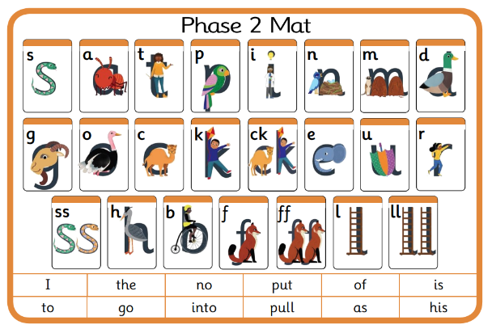
What is Taught in a Phonics Lesson?
Fast paced - 4 new sounds are taught per week along with new tricky words each day
Each lesson includes
Revision of sounds learned and practice of reading and saying new sounds
Oral blending and segmenting
Reading, captions and sentences
Writing sounds, words and sentences
Review sessions and weeks are added in – no new sounds are taught, but children focus on saying, reading and writing those sounds learned already.
Notes:
In ELS we do not ask children questions before we have taught them.
For example, when teaching a new sound, rather than asking children if they know any words with the sound in - we give the children 3 words that contain that sound. You can try this with your children at home.

Slide 8
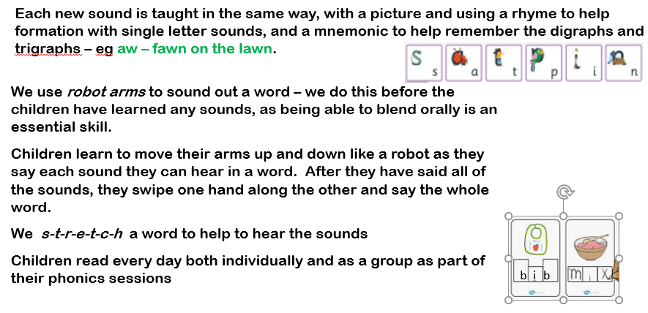
How do we teach phonics?
Notes:
In the beginning of Reception, we learn to read words and then captions, phrases and sentences. As children learn more of the code of our language we are able to build more complex sentences for them to read.
Here we have a sentence from Year One. We build the code for the children and as this knowledge grows we are able to read more complex sentences.

Slide 9
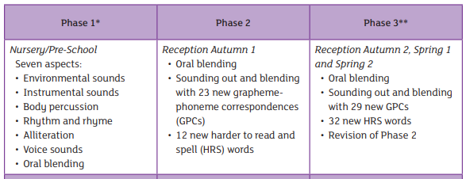
ELS Progression
Notes:
In Reception your children will learn all the single letter sounds and begin to learn diagraphs and trigraphs.

Slide 10
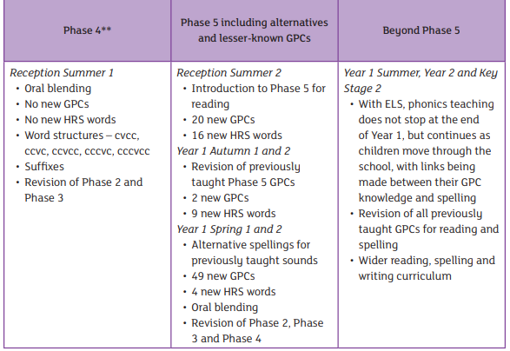

ELS Progression
Following this teaching progression, children develop skills to be able to identify, read and spell words which include a wide range of alternative spellings.
Eg, by the end of Year 1 it is expected that children can read, write and recognise all of the different ways to write sh

Slide 11
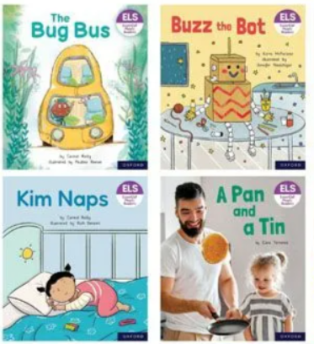
Reading in School
There are many opportunities to read in Reception and Year 1:
As a class: reading words, captions and then sentences every day in phonics
Individually: every day in phonics and more frequently when required
Paired: at least once per week in the Friday phonics session plus every day during phonics sessions in review weeks
Notes:
We want children to only have success when learning to read
Decode – explain this meaning
Fluency – recognising the sound for spelling within the word and blending fluently
expression – model this for the children in school, when reading at home we want children to start to think about expression and intonation. For example, if someone is asking a question let’s get the children to make their voices sound like they are asking a question.

Slide 12
Reading a Book at the Right Level
When children bring home a reading book from school they will:
Have been taught all the sounds and tricky words in their phonics book so they know them well
Be able to read many of the words by blending (eventually doing this in their head)
Only be reading books with words which are entirely decodable or are tricky words they have been taught.
Be able to read their book confidently
Aim to read their book 4 times across the week working on these skills:
decode
fluency
expression
Notes:
We want children to only have success when learning to read
Decode – explain this meaning
Fluency – recognising the sound for spelling within the word and blending fluently
expression – model this for the children in school, when reading at home we want children to start to think about expression and intonation. For example, if someone is asking a question let’s get the children to make their voices sound like they are asking a question.

Slide 13
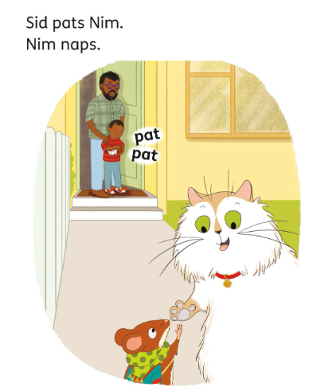
How Children Read Books in School
Do you see any sounds/tricky words you know?
Start at the first word and point to each word as you read.
Magic word? Look at the graphemes carefully. Say each sound and blend them together to read it.
Tricky word? Recognise it and say it.
Read the sentence 3 times:
First time – blending/ decoding slowly
Second time – read it a bit quicker
Third time – read it with expression
Talk about what you’ve read – use the pictures to help when stories are limited!
Notes:
We want children to only have success when learning to read
Decode – explain this meaning
Fluency – recognising the sound for spelling within the word and blending fluently
expression – model this for the children in school, when reading at home we want children to start to think about expression and intonation. For example, if someone is asking a question let’s get the children to make their voices sound like they are asking a question.

Slide 14
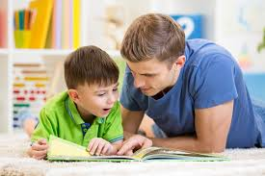

Listening to Your Child Read their School Reading Book
Your child should be able to read their book with little or no help from you.
If they can’t read a word, sound it out for them or read it for them and ask them to repeat it/read it to you several times.
Encourage your child to read each sentence 3 times – decode, quicker, expression.
Talk about the book and of course, celebrate their success!
Reading should be enjoyable – if you have any concerns, come and see us.
Notes:
We want children to only have success when learning to read
Decode – explain this meaning
Fluency – recognising the sound for spelling within the word and blending fluently
expression – model this for the children in school, when reading at home we want children to start to think about expression and intonation. For example, if someone is asking a question let’s get the children to make their voices sound like they are asking a question.

Slide 15
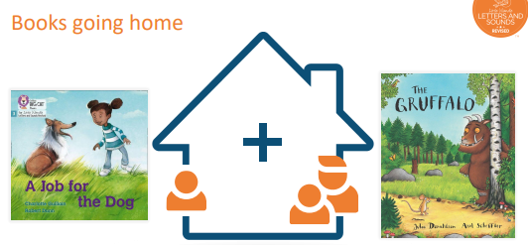
Books Coming Home Each Week
Library book for you to read to your child
Reading book for your child to read to you
Notes:
We want children to only have success when learning to read
Decode – explain this meaning
Fluency – recognising the sound for spelling within the word and blending fluently
expression – model this for the children in school, when reading at home we want children to start to think about expression and intonation. For example, if someone is asking a question let’s get the children to make their voices sound like they are asking a question.

Slide 16

The Importance of Reading to Children
We want our children to develop a love of reading.
Research shows that reading a book and chatting about enables children to:
Understand words and sentences
Use and understand a wide range of vocabulary
Develop listening and comprehension skills
Notes:
Reading until they are 3 improves outcomes in YR, reading until they are 5 improves outcomes in Y6 and reading until they are 8 improves outcomes aged 16!
Children who achieved the Early Learning goals for literacy are 11 times more likely to achieve the expected outcomes in Maths at the end of KS2. Reading underpins everything.
We want all our children to leave primary school able to read well and confidently – you can support us in this journey.

Slide 17
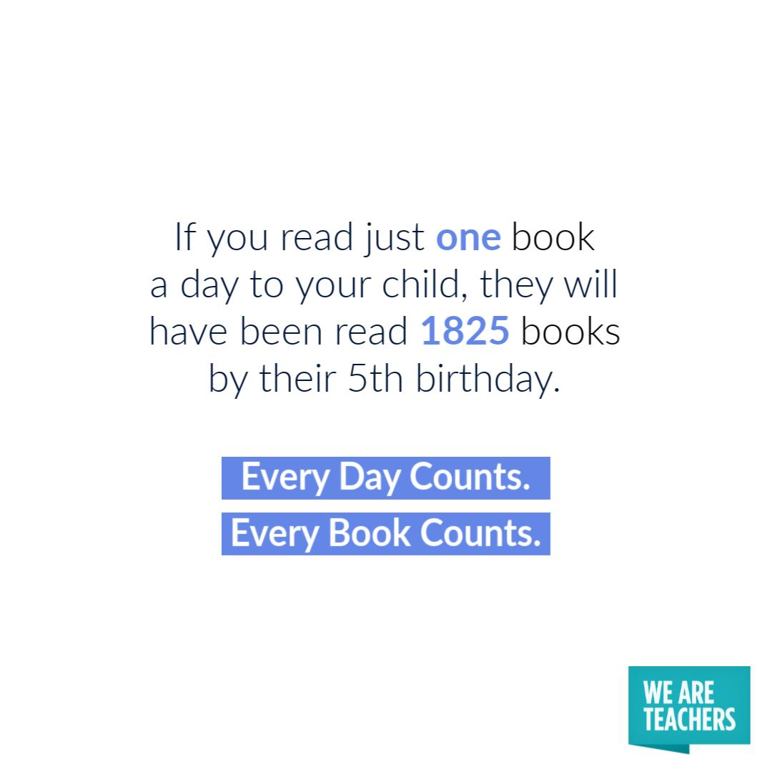
The Importance of Reading to Children
• There is no need to buy lots of expensive books - join the library
• Explore a range of fiction and non-fiction books.
• Encourage interest in a range of books.
When reading to your child:
Make the story sound as exciting as you can by changing your voice.
Talk with your child as much as you can:
Introduce new and exciting language
Encourage your child to use new vocabulary
Make up sentences together
Find different words to use
Describe things you see
Talk about the illustrations in the book
Reading a bedtime story as often as possible to your child improves their outcomes later in school.
Notes:
Reading until they are 3 improves outcomes in YR, reading until they are 5 improves outcomes in Y6 and reading until they are 8 improves outcomes aged 16!
Children who achieved the Early Learning goals for literacy are 11 times more likely to achieve the expected outcomes in Maths at the end of KS2. Reading underpins everything.
We want all our children to leave primary school able to read well and confidently – you can support us in this journey.

Slide 18
Pronouncing pure sounds
Children need to use pure sounds when we are pronouncing the sounds and supporting children in reading words.
c a t not cuh a tuh
If we mispronounce these sounds it makes reading much harder for our children.
There are videos of the pronunciation of pure sounds on the phonics page of our school website where you can hear the correct pronunciation of the sounds.
Notes:
If we use the ‘uh’ sound after the pure sound we are teaching the schwa.
For example instead of /c/ /a/ /t/ we teach /cuh/ /a/ /tuh/ - cuhatuh – not a word! IT makes blending harder if you teach or use a schwa after the initial sound.

Slide 19
Supporting your child with reading
at home
Practise segmenting and blending.
Listen for initial sounds and then sounds within words.
Look for familiar sounds and words in the world around you.
Play word games eg I spy, rhyming words, robot talk games
Practise hearing, saying and writing new sounds we learn in school.
Practise taught sounds and read school books as many times as you can – over learning will mean children become fluent readers quicker
Notes:
We want children to only have success when learning to read
Decode – explain this meaning
Fluency – recognising the sound for spelling within the word and blending fluently
expression – model this for the children in school, when reading at home we want children to start to think about expression and intonation. For example, if someone is asking a question let’s get the children to make their voices sound like they are asking a question.

Slide 20

Supporting your child with writing at home
Say the word – warm it up – stretch the word – robot talk the word – blend the word – count the sounds within the word – say the word
For captions and sentences, if there are any tricky words, encourage them to find the word on their mat and say the letters to help remember how to spell it.
For all other words, we encourage children to use the stretching strategies to sound the words out. So, for The lady rode her bike to the office, we would expect something like:
The laidee road her bighk to the ofis.
Notes:
Use the spelling sequence to model rain
Say the word – warm it up – stretch the word – robot talk the word – blend the word – count the sounds within the word – say the word
You can talk about how you support your children with their writing in school.

Slide 21

Thank you for supporting your child at home
In Summary:
Phonics is taught daily in Reception and Year 1
Phonics is a way of teaching children to hear, say and recognise the sounds in words
Each sound is introduced with a rhyme and a picture to help children learn and remember them – we appreciate you helping your child to practise hearing, saying, reading and writing these sounds at home
New reading books are sent home on Fridays and will include sounds and tricky words that the children have previously learned
Ideally the reading book should be read at home 4 times, but once books get longer we understand that this isn’t always easy to manage.
We are aiming for fluency when children read – in school we sound out first, then read quicker, then say ‘make it sound exciting’
Please comment next to the title of the book in the reading record to let us know how your child has got on with their book at home
Magic words can be sounded out
Tricky words can not be sounded out – we just need to learn and remember them
Notes:
Use flashcards to put this into context. Show parents examples of graphemes, digraphs, trigraphs and split digraphs. Where possible, make the link between same sound, different spelling.
Example:
<a>
acorn
<ai>
rain
<ay>
play
<a-e>
name
<eigh>
eight
<ey>
they
<ea>
great
<aigh>
straight

