Slide 1



Slide 2

Aims of today’s session
The National Curriculum for Maths
Mastery approach to Maths
What ‘Maths- No Problem!’ is
Why we have chosen ‘Maths- No Problem!’
Overview of ‘Maths- No Problem!’ in Years 1 and 2
What does your child’s daily Maths lesson look like?
How you can help at home

Slide 3

“Mathematics is a creative and highly inter-connected discipline that has been developed over centuries, providing the solution to some of history’s most intriguing problems. It is essential to everyday life, critical to science, technology and engineering, and necessary for financial literacy and most forms of employment. A high-quality mathematics education therefore provides a foundation for understanding the world, the ability to reason mathematically, an appreciation of the beauty and power of mathematics, and a sense of enjoyment and curiosity about the subject.”

Slide 4

Aims of the 2014 National Curriculum
The national curriculum for mathematics aims to ensure that all pupils:
become fluent in the fundamentals of mathematics, including through varied and frequent practice with increasingly complex problems over time, so that pupils develop conceptual understanding and the ability to recall and apply knowledge rapidly and accurately.
reason mathematically by following a line of enquiry, conjecturing relationships and generalisations, and developing an argument, justification or proof using mathematical language
can solve problems by applying their mathematics to a variety of routine and nonroutine problems with increasing sophistication, including breaking down problems into a series of simpler steps and persevering in seeking solutions.
Notes:
Break down on the next page- see all of these activities across the week

Slide 5
Curriculum Coverage
FLUENCY – Being able to recall facts and solve calculations with speed. This also relates to solving simple word problems.
REASONING – Being able to explain the steps in a process, how an answer was found, or explaining mistakes or misconceptions in a process.
PROBLEM SOLVING – Children are able to solve complex problems that require recall of facts, reasoning, and logical thinking. Children are also required to think about representing questions in different ways to help solve a problem.

Slide 6

What is a ‘mastery’ approach to Maths?
Mastering Maths means pupils of all ages acquiring a deep, long-term, secure and adaptable understanding of the subject.
Mathematics teaching for mastery assumes everyone can learn and enjoy mathematics.
Mastery Involves a development or three forms of knowledge:
Factual – I know that
Procedural – I know how
Conceptual – I know why
Notes:
- The 2014 NC brought with it the term mastery in Maths
The phrase ‘teaching for mastery’ describes the elements of classroom practice and school organisation that combine to give pupils the best chances of mastering maths.
What this looks like on our classrooms
Lesson design links to prior learning to ensure all can access the new learning and identifies carefully sequenced steps in progression to build secure understanding.
Examples, representations and models are carefully selected to expose the structure of mathematical concepts and emphasise connections,
Procedural fluency and conceptual understanding are developed in tandem because each supports the development of the other.

Slide 7
What does this look like in our classrooms?
Lesson design links to prior learning and learning organised into small steps
Images and manipulatives are carefully chosen
Fluency and understanding are taught in tandem
Questioning, short tasks, explanation, demonstration, and discussion
Use of precise vocabulary
Immediate intervention if gaps develop
Key number facts are learnt to automaticity
Notes:
What this looks like on our classrooms
Lesson design links to prior learning to ensure all can access the new learning and identifies carefully sequenced steps in progression to build secure understanding.
Examples, representations and models are carefully selected to expose the structure of mathematical concepts and emphasise connections,
Procedural fluency and conceptual understanding are developed in tandem because each supports the development of the other.
Pupils are taught through whole-class interactive teaching, enabling all to master the concepts necessary for the next part of the curriculum sequence.
In a typical lesson, the teacher leads back and forth interaction, including questioning, short tasks, explanation, demonstration, and discussion, enabling pupils to think, reason and apply their knowledge to solve problems.
Use of precise mathematical language enables all pupils to communicate their reasoning and thinking effectively.
If a pupil fails to grasp a concept or procedure, this is identified quickly, and gaps in understanding are addressed systematically to prevent them falling behind.
Significant time is spent developing deep understanding of the key ideas that are needed to underpin future learning.
Key number facts are learnt to automaticity, and other key mathematical facts are learned deeply and practised regularly, to avoid cognitive overload in working memory and enable pupils to focus on new learning.

Slide 8
What is ‘Maths- No Problem!’?
‘Maths- No Problem!’ is a series of textbooks and workbooks written to meet the requirements of the 2014 English national curriculum. It is based on the recommendations of experts who have studied the approach to teaching Maths in Singapore.
The MNP Primary Series was assessed by the DfE’s expert panel, which judged that it met the core criteria for a high-quality textbook to support teaching for mastery.
As a result, the MNP Primary Series are recommended textbooks for schools to ensure children reach a mastery standard.
Notes:
Singapore approach to mathematics
Singapore established a new way of teaching maths following their poor performance in international league tables in the early 1980’s.Based on recommendations from notable experts, Singapore maths is a combination of global ideas delivered as a highly-effective programme of teaching maths.The effectiveness of this approach is demonstrated by Singapore’s position at the top of the international benchmarking studies and explains why their programme is now used in over 40 countries including the United Kingdom and the United States.
Singapore has become a “laboratory of maths teaching” by incorporating established international research into a highly effective teaching approach. With its emphasis on teaching pupils to solve problems, Singapore Maths teaching is the envy of the world.Based on recommendations from notable experts such as Jerome Bruner, Richard Skemp, Jean Piaget, Lev Vygotsky, and Zoltan Deines, Singapore maths is an amalgamation of global
One of highest performing countries in terms of maths
Teach the concepts of mathematicsProblem solving is at the heart of mathematics and should be the focus of what is taught in schoolsThe focus is not on rote procedures, rote memorisation or tedious calculation but on relational understandingPupils learn to think mathematically as opposed to reciting formulas they don’t understandIs a way of teaching that allows students to develop a greater sense of number and how to use and manipulate numbers to solve a variety of problemsA highly effective approach to teaching maths based on research and evidencePupils are encouraged to solve problems working with their core competencies, in particular:VisualisationGeneralisationMake decisions ideas delivered as a highly-effective programme of teaching methods and resources.

Slide 9
Why have we chosen to use ‘Maths- No Problem! at St Werburgh’s?
Children will have a greater conceptual understanding of number and calculation. They will be able to visualise and generalise more readily due to a more in-depth understanding.
All children will be fully supported through accessing concrete equipment and use of visual models to support understanding.
Rapid graspers will be challenged through exposure to unfamiliar problems, development of reasoning skills and by exploring multiple ways to manipulate numbers and solve problems.
All learners will access teaching of content which matches the expectations of the curriculum in England and be supported further, if needed. The resources match the expectations for formal written methods set out by the government, alongside greater understanding in order to reach ‘mastery’.
Notes:
Our Maths data is already very strong
This will make it even better- well rounded confident mathematicians who can apply their skills in a variety of contexts

Slide 10
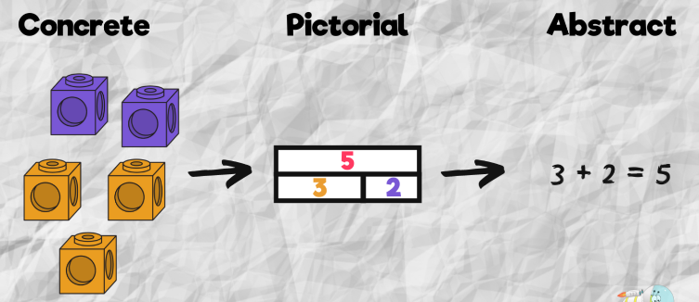
Notes:
CPA approachConcrete, pictorial, abstract (CPA) is a highly effective approach to teaching that develops a deep and sustainable understanding of maths. The CPA approach is the mainstay of maths teaching in Singapore and of MNP.

Slide 11
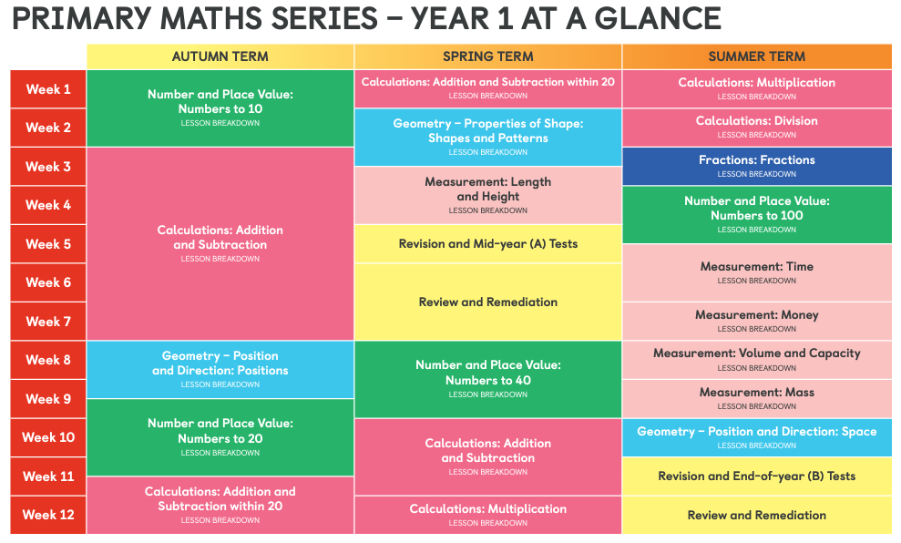
Overview of Maths- No Problem! in Year 1
Notes:
It is a spiral curriculum
Year 1 very heavy number based
Lots of opps to review and assess so all chn keep up not catch up
Each chapter has a series of lessons to follow all which follow the same structure
Children master the key objectives before moving on- it’s a very progressive curriculum

Slide 12
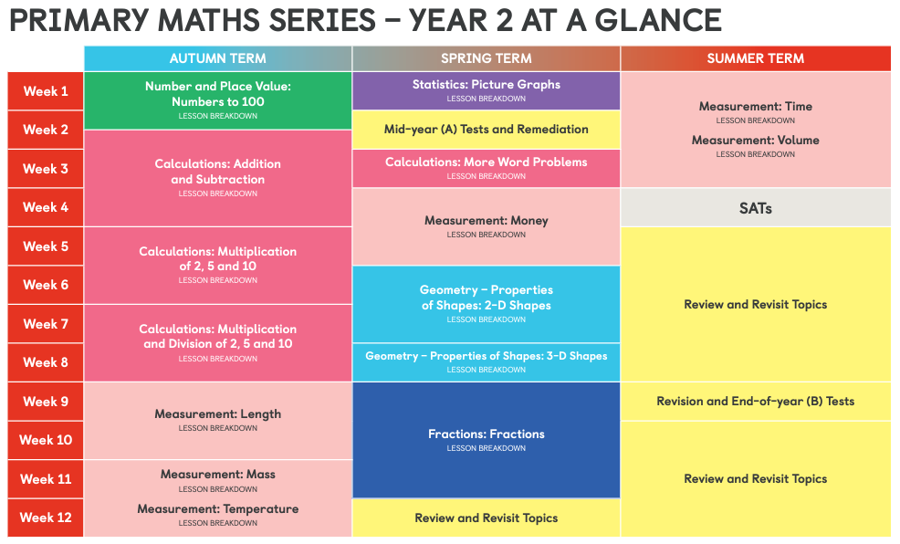
Overview of Maths- No Problem! in Years 1 and 2
Notes:
Data handling brought into Year 2 for the first time when the 2014 NC was introduced
Some topics e.g. percentages, area not introduced until KS2

Slide 13
What does your child’s daily Maths lesson look like?
All lessons follow the same structure in KS1.
Explore
Master
Guided Practice
Independent Practice
Notes:
This might take more then one day to achieve particularly at the start of year 1 or when brand new concepts are being introduced/start of new chapters. Some lessons will be reviews and assessments.
Let’s look at that four part sequence over a year 1 lesson- taken from spring when the children are beginning to work with add/subtract within numbers to 20. Chn are learning in this lesson to subtract by subtracting ones.

Slide 14
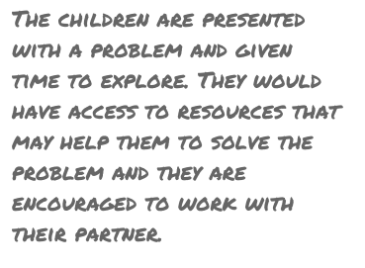
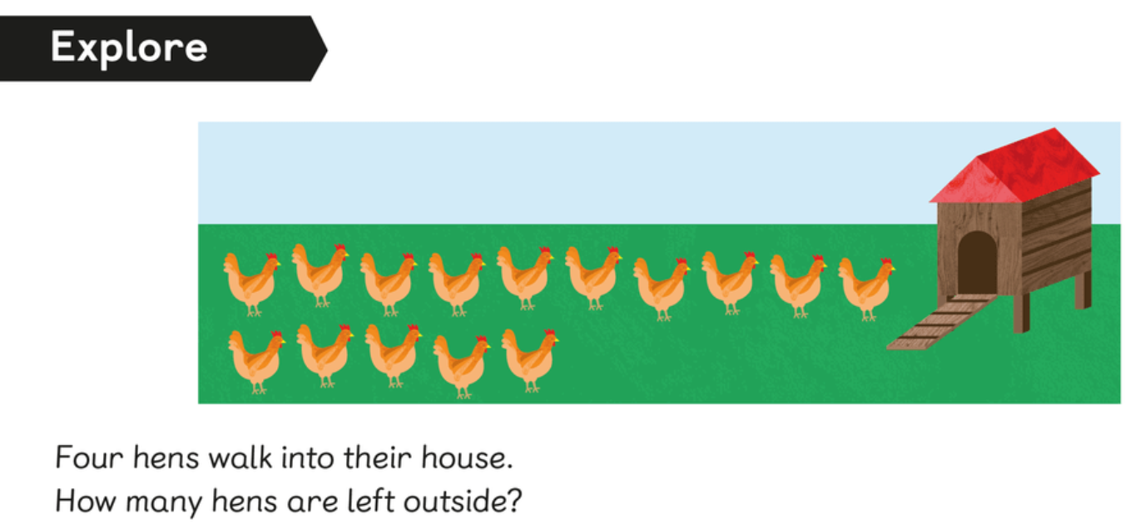
1. Explore
Notes:
Children come together in mixed-ability pairs to discuss the ‘Explore’

Slide 15
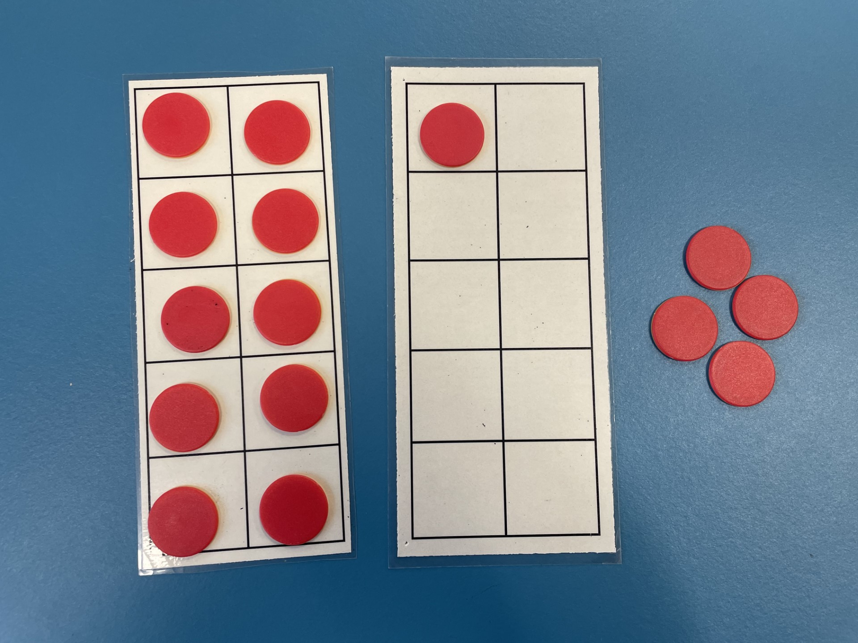
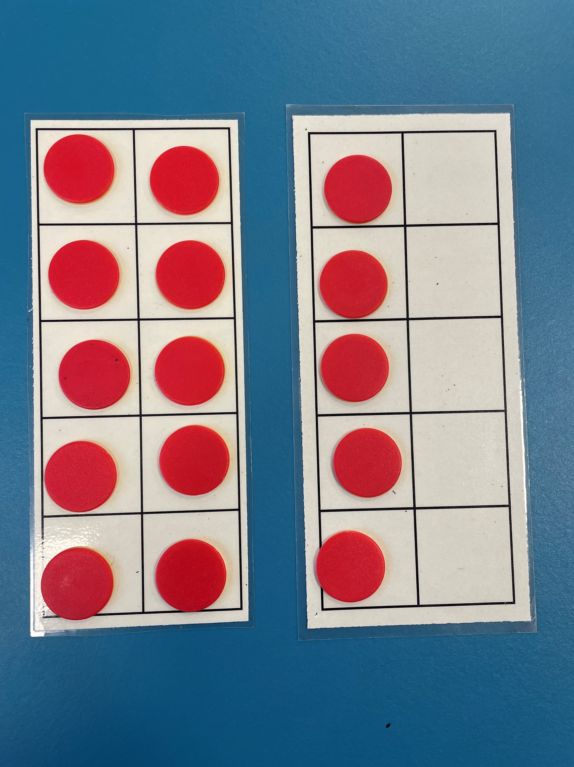
Notes:
Sometimes chn will be given specific manipulatives that the teacher has chosen to guide the children but at other times children may select how they would like to represent this problem with a view to being as efficient as possible.

Slide 16
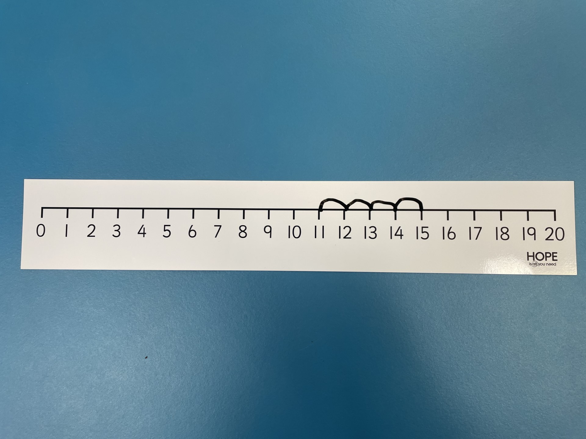
Notes:
Children like to show their methods and will then often be given the chance to journal their methods.
Over the year the chn make huge progress in showing their strategies and methods- this is given more structure initially but children are also given free reign to show their ideas.

Slide 17
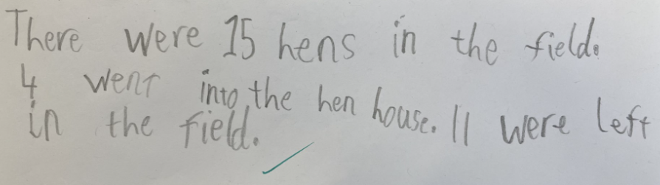
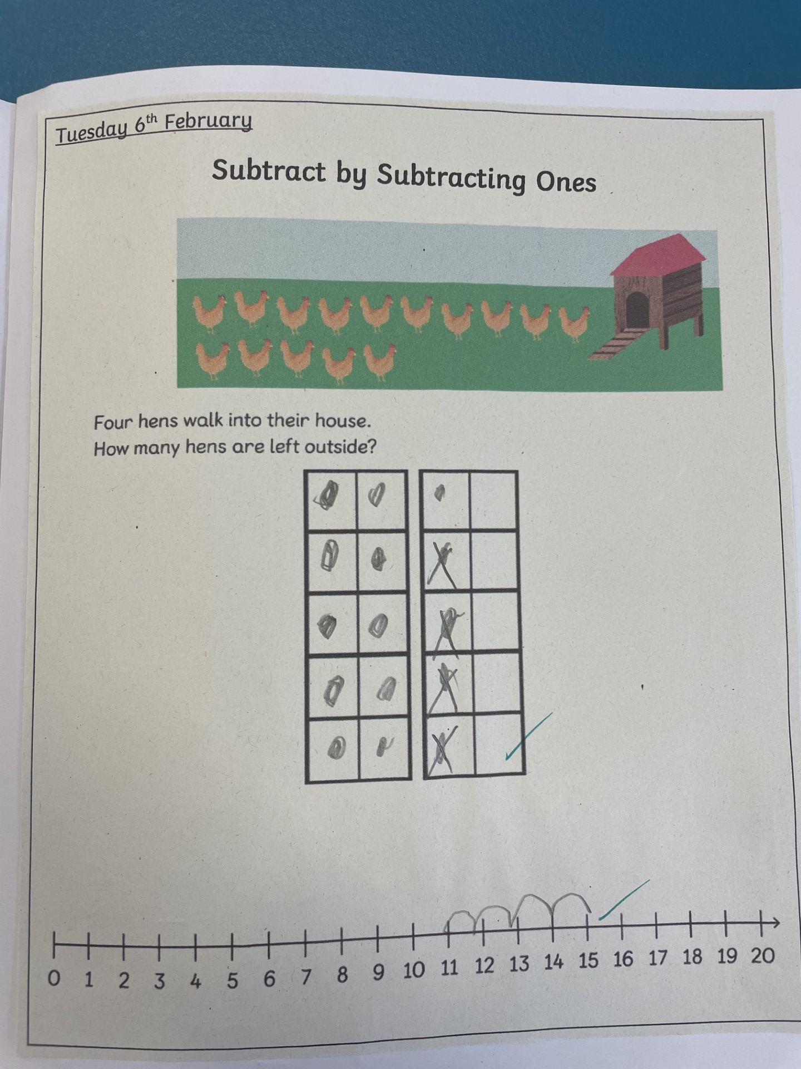
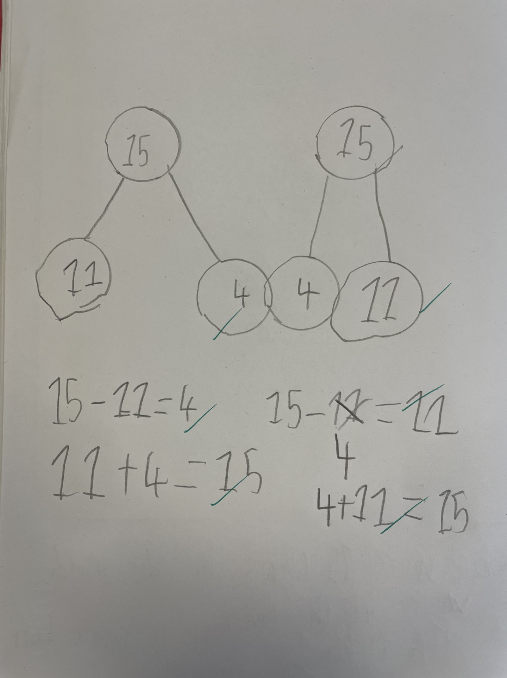

Slide 18
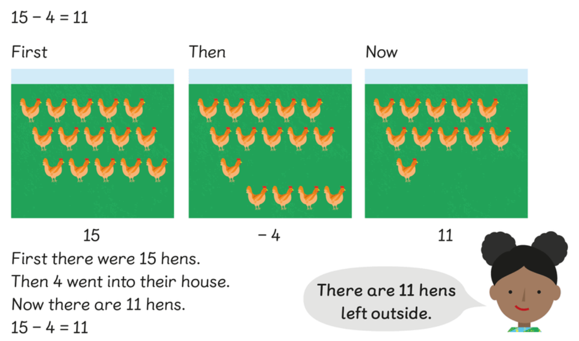
2. Master
Notes:
Group of characters
Show their methods and compare to the chns ideas- aiming for efficiency

Slide 19
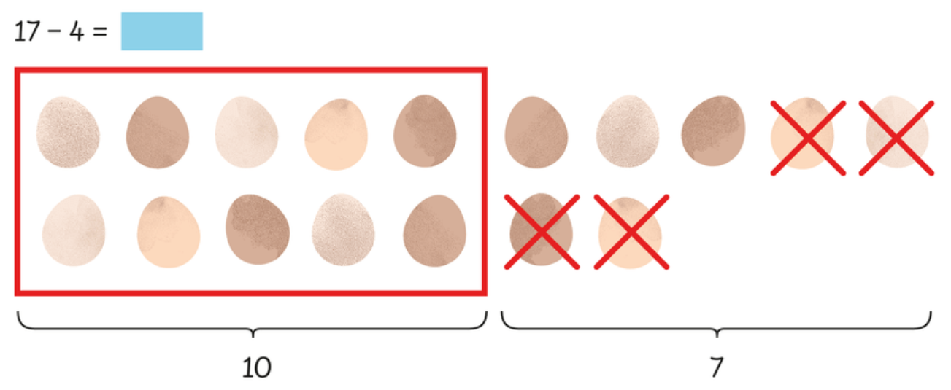
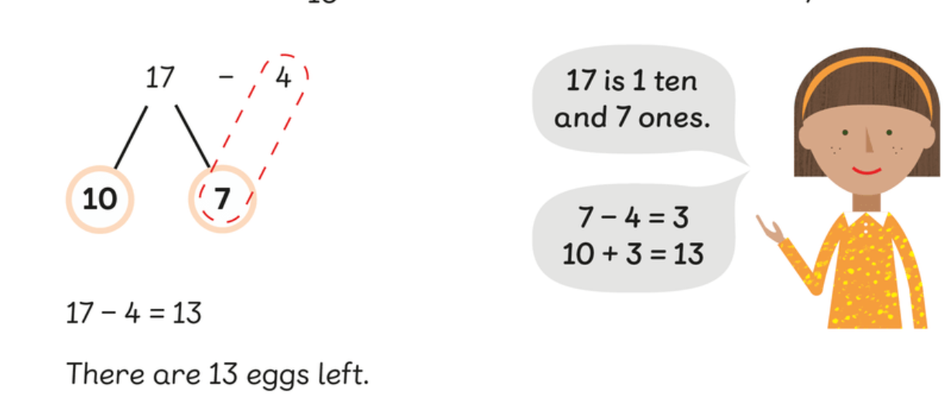

Slide 20
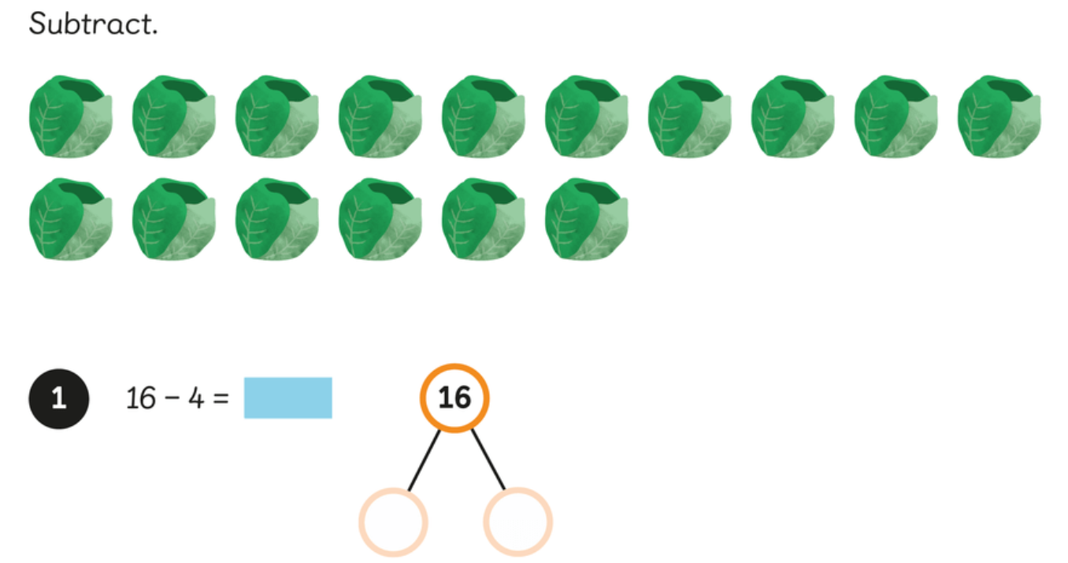
3. Guided Practice
Notes:
Chn work together getting more abstract
I do, we do, you do approach

Slide 21
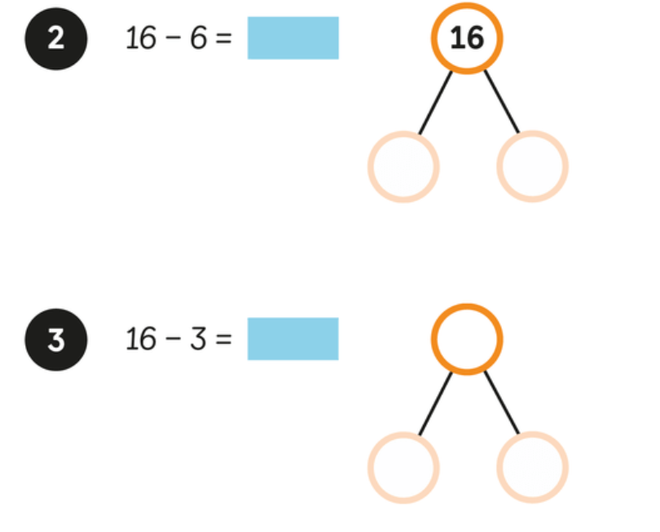

Slide 22
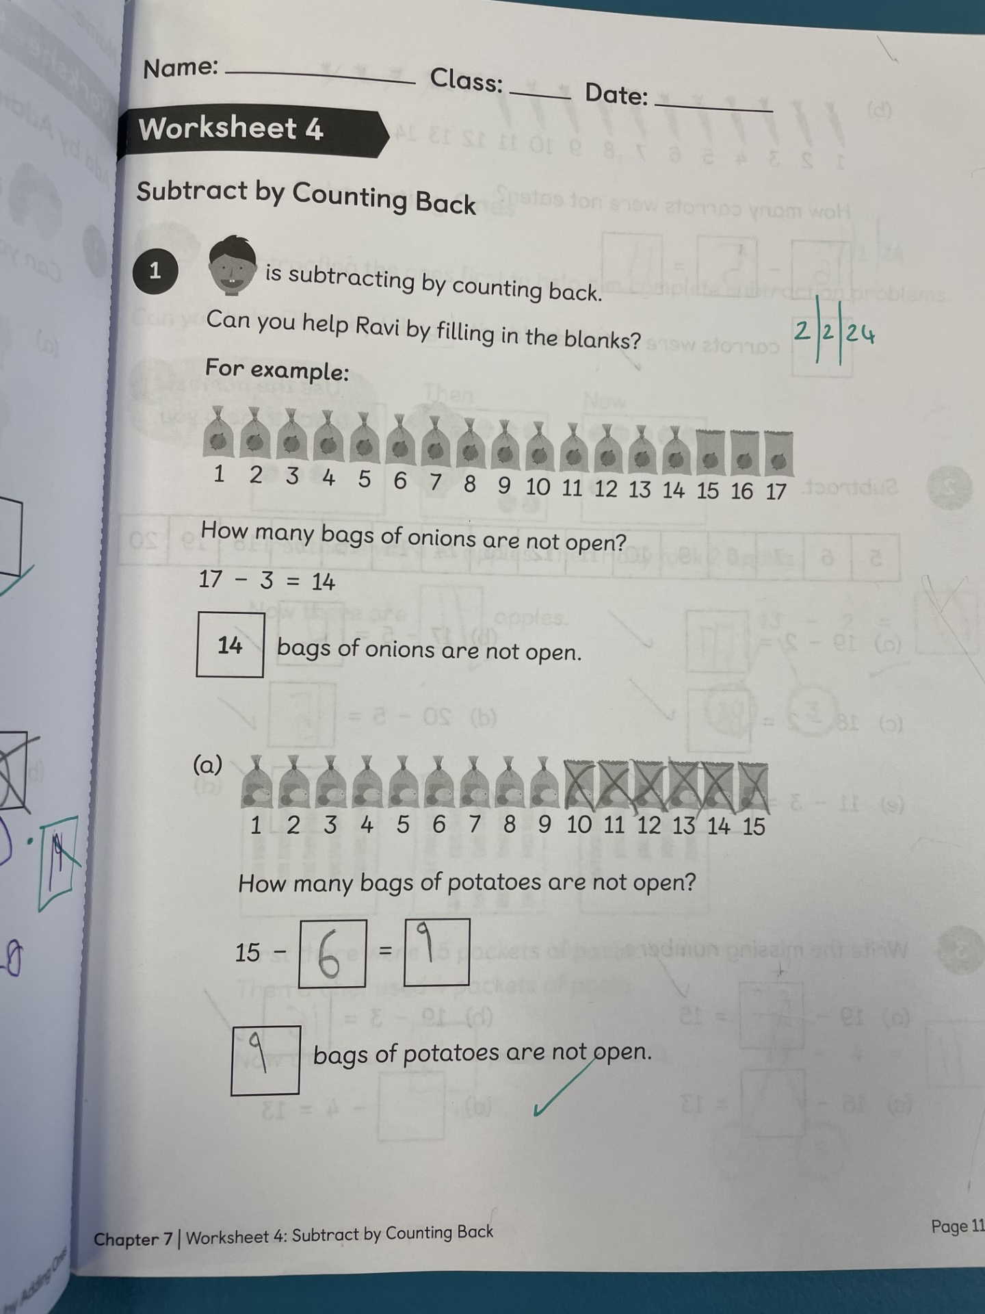
4. Independent Practice
Notes:
Characters there to help
Very pictorial
Chn are encouraged to have a go- can have access to equipment and then come back and ask for help when they need it
Chn self-correct in purple pen
Challenge really increases throughout the activity
Some chn might be asked to come to an adult for a guided version of it
Gaps are addressed immediately to ensure all chn keep up

Slide 23
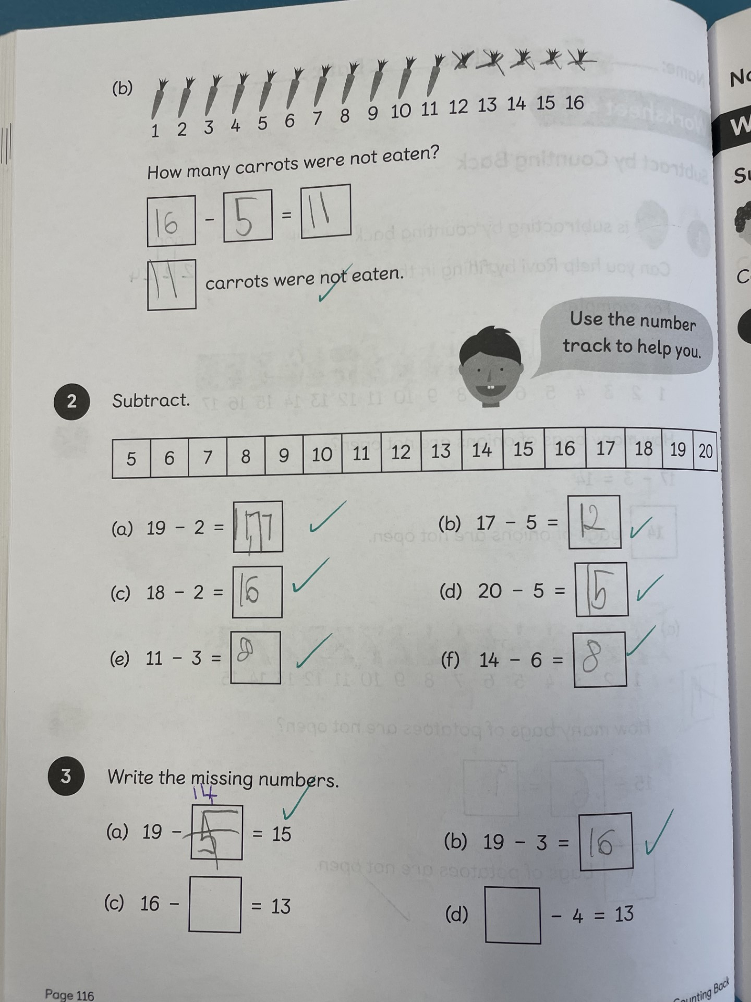

Slide 24
https://www.youtube.com/watch?v=nv3Mbfr-u1g
Notes:
Notice the mixed pairs- keep all chn involved
The high focus on vocab
Making links to other areas e.g. subitizing
Stem sentences- lots of echoing and repetition to keep all chn on track
Starting with the concrete

Slide 25
How you can help at home
Attitudes towards Maths
Look for the Maths in everyday contexts e.g. cooking, bath time, money etc.
Let your child teach you!
Number sense
Singing
Top marks and ICT Games
Notes:
Be positive-don’t let chn believe they can’t do it- maths is for everyone
Chn are often more responsive to incidental activities where they don’t realise they are learning- also helps them to recognise the importance of maths
Methods are very different- let them take the lead where possible- try not to confuse them with your methods are saying things like just put a zero on the end, let’s do some adds
Biggest impact at young age is number sense- sequencing, greater than, fewer than, more/less, counting from different points
Singing

Slide 26
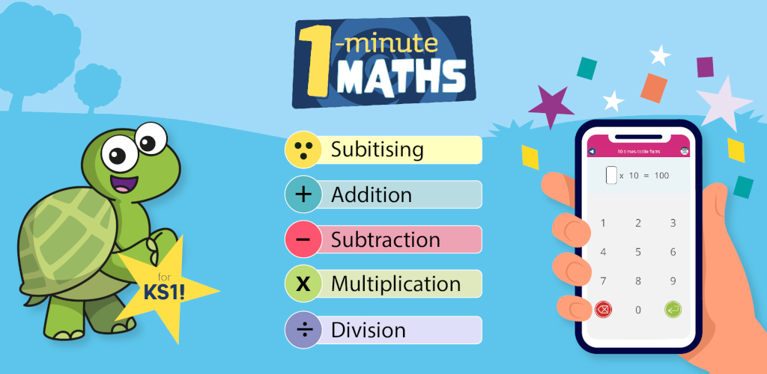

Slide 27
