Slide 1


SATs Information Evening Year 6 Parents
Tuesday 30th October 2025

Slide 2
What are the SATs?
What is the current situation regarding SATs at Key Stage 2?
What is the format and content of the current assessments?
What support is being given at school?
What support can I give at home?

Slide 3
What are the SATs?
End of Key Stage test for 11–year–olds
What will the tests cover?
Reading, grammar, punctuation & spelling (GPS), mathematics
How long are the tests?
Five and a half to six hours altogether – across four days
When are the tests?
The tests are on set days in the week commencing the 11th May 2026.
What will the teacher assessment cover?
Writing, Maths & Reading (10% of schools sampled for Science)

Slide 4
What has changed in recent years?
Children have been working on the current national curriculum since 2014. As a result, the Standards and Testing Agency (STA) changed the tests so that they assess the new curriculum.
Pupils have been taking the new style tests since May 2018.
Schools are no longer reporting levels at the end of the year, instead every pupil registered will receive:
a raw score (number of raw marks awarded)
a scaled score (100 is the expected score and anything below is deemed to have not met the national standard)
confirmation of whether or not they attained the national standard
Notes:
Levels abolished, this is in part in response to concerns about the validity and reliability of levels and sub-levels. These concerns had an impact on pupils’ learning, but also on the relationships between primary and secondary schools and the trust in their assessments. This you will all hopefully have begin to get your heads around with the assessment meetings we have offered, meet the teacher and parent consultations.

Slide 5
What are scaled scores?
Scaled scores are used all over the world.
The national curriculum tests are designed to be as similar as possible year on year, but slight differences in difficulty will occur between years.
Scaled scores maintain their meaning over time so that two pupils achieving the same scaled score on two different tests will have demonstrated the same attainment.
Notes:
More information on the sheet for you to read though, however a quick summary
They help test results to be reported consistently from one year to the next.
For example, on our scale 100 will always represent the ‘national standard’. However, due to the small differences in difficulty between tests, the ‘raw score’ (ie the total number of correct responses) that equates to 100 might be different (though similar) each year.

Slide 6
How are scaled scores interpreted?
A pupil’s scaled score will be based on their raw score.
The raw score is the total number of marks a pupil receives in a test, based on the number of questions they answered correctly.
The pupil’s raw score will be translated into a scaled score using a conversion table.
A pupil who achieves the national standard will have demonstrated sufficient knowledge in the areas assessed by the tests.
This will mean that they are well placed to succeed in the next phase of their education.
Notes:
A pupil’s scaled score will be based on their raw score. The raw score is the total number of marks a pupil receives in a test, based on the number of questions they answered correctly. The pupil’s raw score will be translated into a scaled score using a conversion table. A pupil who achieves the national standard will have demonstrated sufficient knowledge in the areas assessed by the tests. This will mean that they are well placed to succeed in the next phase of their education.

Slide 7
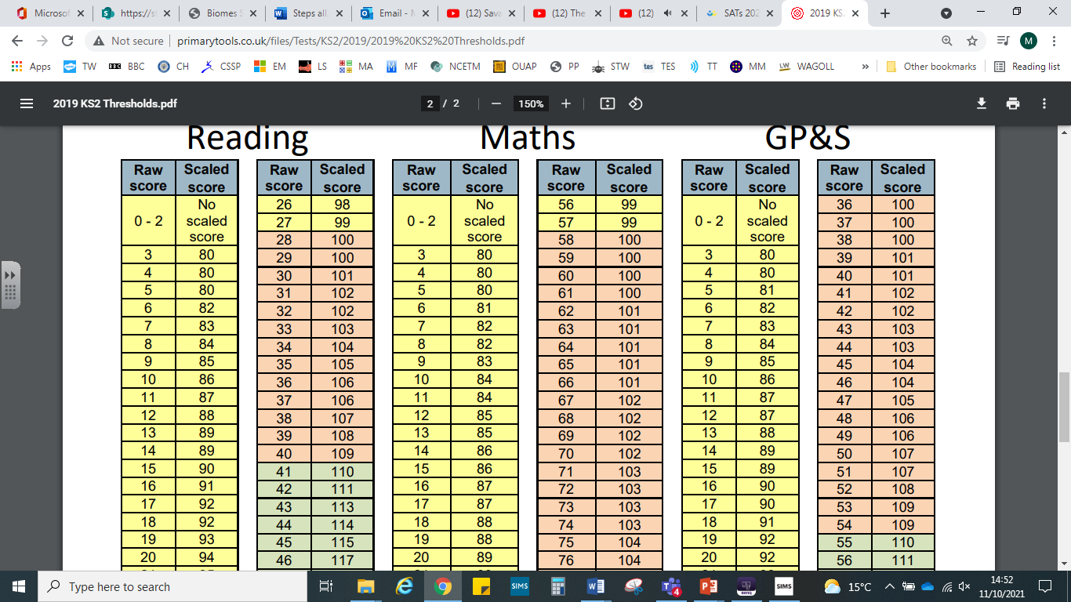
How are scaled scores interpreted?
Notes:
A pupil’s scaled score will be based on their raw score. The raw score is the total number of marks a pupil receives in a test, based on the number of questions they answered correctly. The pupil’s raw score will be translated into a scaled score using a conversion table. A pupil who achieves the national standard will have demonstrated sufficient knowledge in the areas assessed by the tests. This will mean that they are well placed to succeed in the next phase of their education.

Slide 8
What should most children achieve?
The typical characteristics of pupils at the national standard are illustrated by the test performance descriptors.
These are included in the KS2 DFE assessment framework.
Notes:
However, as with all tests, pupils can achieve their marks in a number of different ways. If a pupil achieves the national standard this doesn’t imply that the pupil has mastered all of the knowledge and skills indicated in the test performance descriptor.
See additional sheet of information for reference.

Slide 9
SAT’s Week Timetable
 | Monday | Tuesday | Wednesday | Thursday | Friday
AM Session 1 | Grammar, Punctuation & Spelling | Reading Paper | Maths - Paper 1 Arithmetic | Maths - Paper 3
AM Session 2 |  |  | Maths - Paper 2
SATs week is from Monday 11th to Thursday 14th May 2026

Slide 10
SAT’s Week Timetable
Monday May 11th 2026: Spelling, punctuation and grammar (Grammar/Punctuation Test) – 45 minutes
Monday May 11th 2026: Spelling, punctuation and grammar (Spelling Test) – 20 minutes
Tuesday May 12th 2026: Reading Test – 60 minutes
Wednesday May 13th 2026: Maths Paper 1 (Arithmetic) – 30 minutes
Wednesday May 13th 2026: Maths Paper 2 (Reasoning) – 40 minutes
Thursday May 14th 2026: Maths Paper 3 (Reasoning) – 40 minutes
*timings and details correct as of October 2025

Slide 11
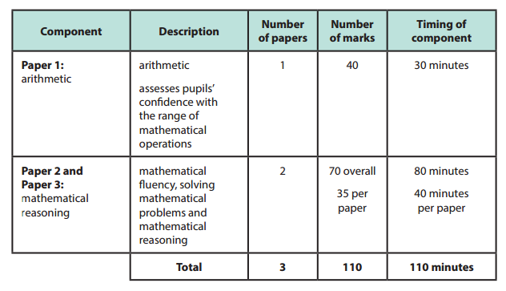
Structure of the Maths Tests
Secure use of written methods will be essential.
Notes:
HB to talk through with parents and point out eh key differences form previous years and what we as a school have done to prepare pupils

Slide 12
Structure of the Maths Tests
Paper 1
Paper 1 (arithmetic) will be comprised of constructed response questions, presented as context-free calculations.
The majority of the arithmetic calculations will be worth one mark, however, two marks will be available for long multiplication and long division.
Notes:
HB to talk through with parents and point out eh key differences form previous years and what we as a school have done to prepare pupils

Slide 13
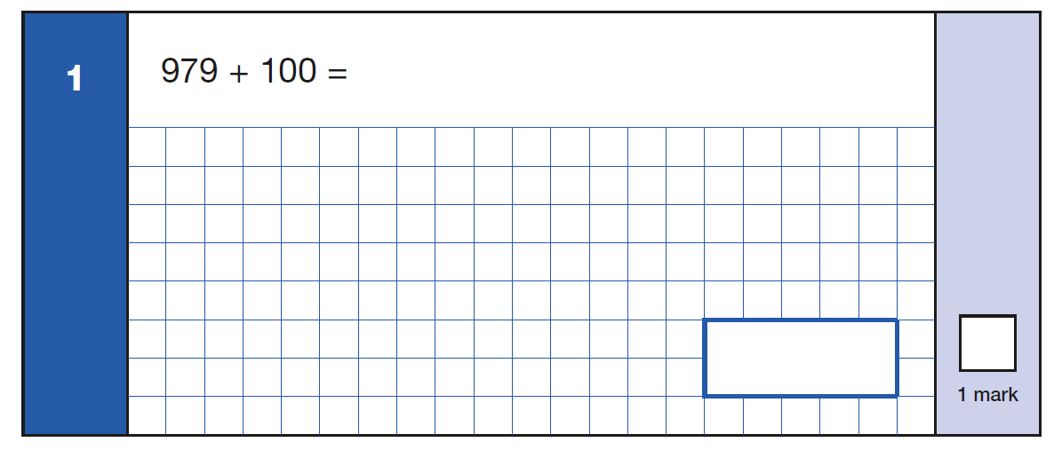
Sample Maths Questions
Notes:
Class Teacher –
The top left one is from the arithmetic paper the other 2 are form test paper 1, some reasoning

Slide 14
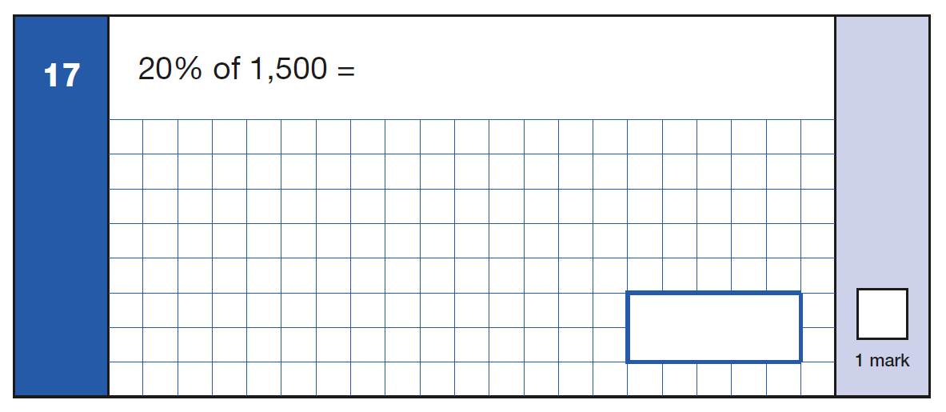
Sample Maths Questions
Notes:
Class Teacher –
The top left one is from the arithmetic paper the other 2 are form test paper 1, some reasoning

Slide 15
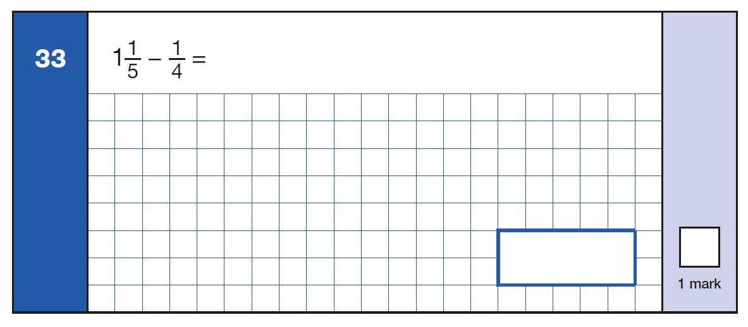
Sample Maths Questions
Notes:
Class Teacher –
The top left one is from the arithmetic paper the other 2 are form test paper 1, some reasoning

Slide 16
Structure of the Maths Tests
Papers 2 and 3
Mathematical problems presented in a wide range of formats to ensure children can fully demonstrate mathematical fluency, solving problems and reasoning.
Will include both selected response and constructed response questions.
Notes:
HB to talk through with parents and point out eh key differences form previous years and what we as a school have done to prepare pupils

Slide 17
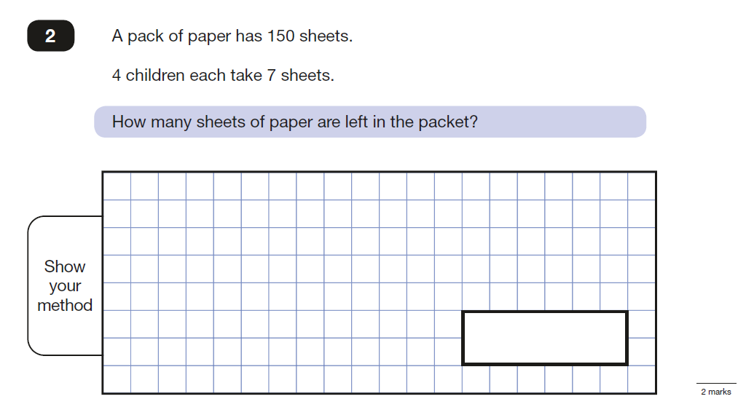
Sample Maths Questions
Notes:
Class Teacher –
The top left one is from the arithmetic paper the other 2 are form test paper 1, some reasoning

Slide 18
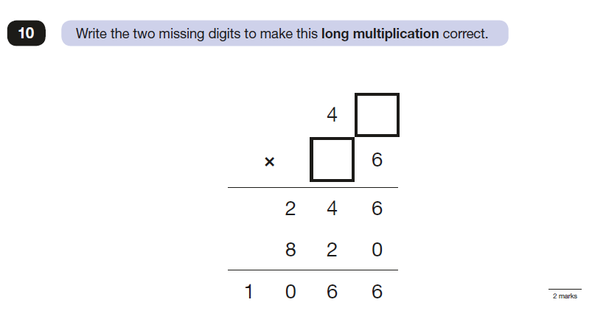
Sample Maths Questions
Notes:
Class Teacher –
The top left one is from the arithmetic paper the other 2 are form test paper 1, some reasoning

Slide 19
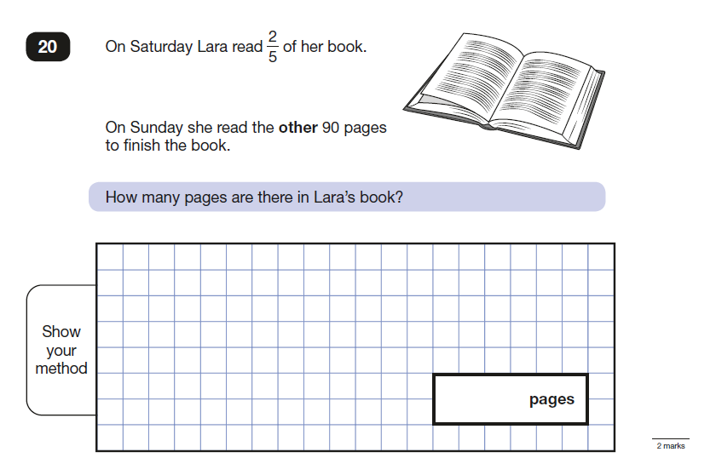
Sample Maths Questions
Notes:
Class Teacher –
The top left one is from the arithmetic paper the other 2 are form test paper 1, some reasoning

Slide 20
Sample Maths Questions
There are 9 larger strands of the New Curriculum, each split into sub-strands: -
Number / Place Value (6)
Calculation (9) ‘Number’
Fractions, Decimals & Percentages (12) Overall (36)
Ratio (4)
Algebra (5)
Measurement (9) ‘Geometry, Measure & Statistics’
Geometry – Shape (5) Overall (20)
Geometry – Position (3)
Statistics (3)
N.B. Fractions / Ratio take up almost a half of the number curriculum (16/36 or 4/9) and nearly 1/3 of the total curriculum (16/56 or 2/7)
Notes:
Class Teacher –
The top left one is from the arithmetic paper the other 2 are form test paper 1, some reasoning

Slide 21
Reading
Regular reading
Type of text
Reading aloud
Asking questions
Notes:
HB to talk through and point out that nothing has changed with regard to the administration of the test.

Slide 22
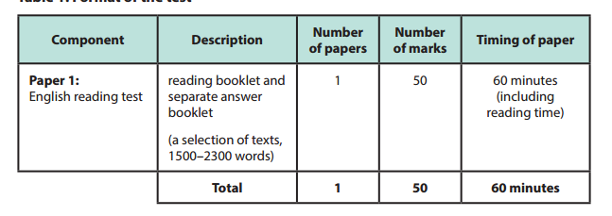
Structure of the Reading Test
Children need to manage their time and become very good at skimming and scanning
Notes:
HB to talk through and point out that nothing has changed with regard to the administration of the test.

Slide 23
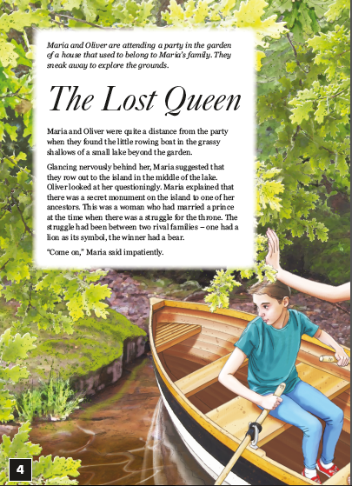

Sample Reading Paper
Notes:
Class teacher

Slide 24
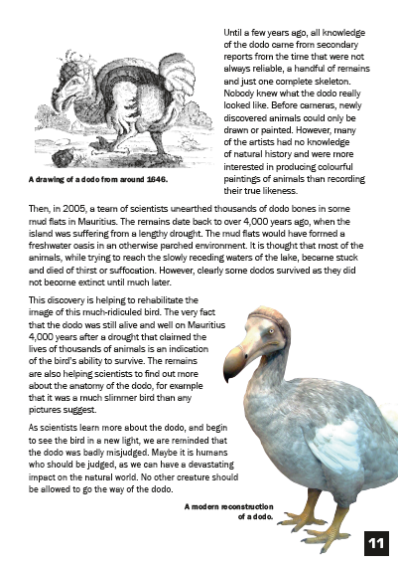

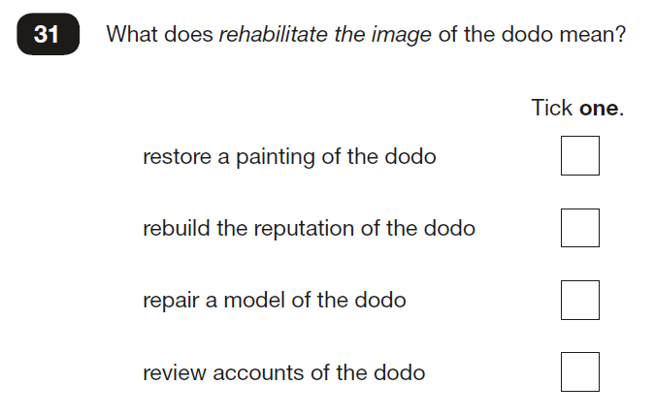
Sample Reading Paper
Notes:
Class teacher

Slide 25
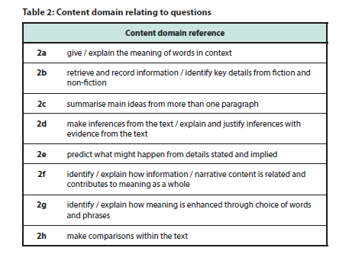
Structure of the Reading Test
Notes:
HB to talk through and point out that nothing has changed with regard to the administration of the test.

Slide 26
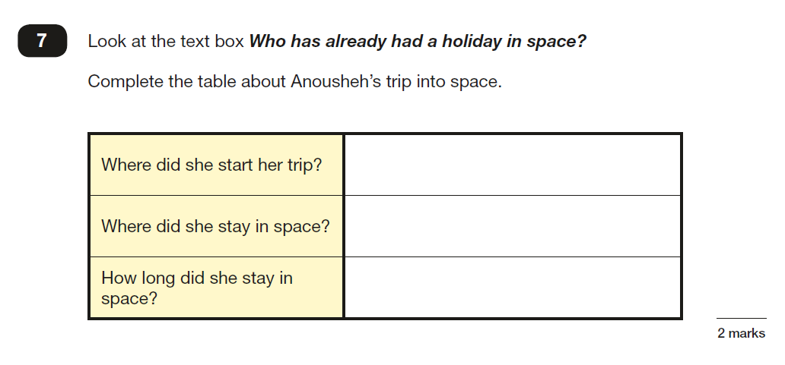
Sample Reading Questions
Notes:
Class teacher

Slide 27
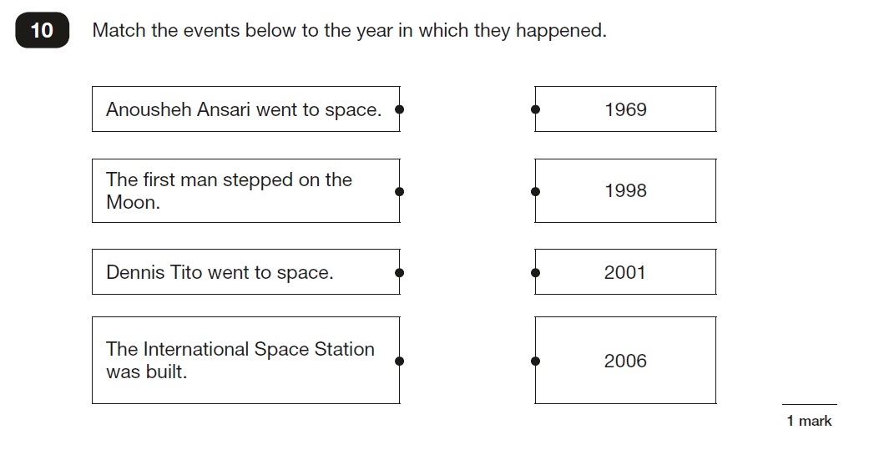
Sample Reading Questions
Notes:
Class teacher

Slide 28
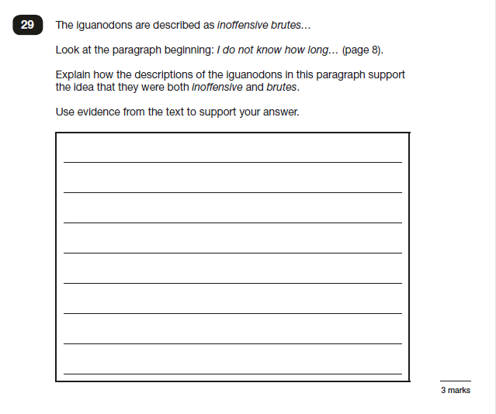
Sample Reading Questions
Notes:
Class teacher

Slide 29
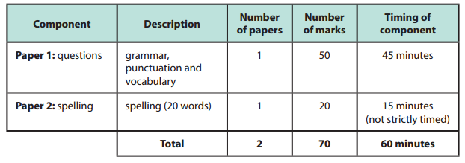
The Grammar, Punctuation and Spelling Test (GPS)
This year, marks will be deducted if sentences are not punctuated with full stops and capitals or if the capital letter does not look like a capital letter! Furthermore, if capital letters are wrongly included, they will also not receive a mark for that answer.
Upper and lower case letters must be clear.
Notes:
Plug the curriculum evening coming up to support this – 22nd October

Slide 30
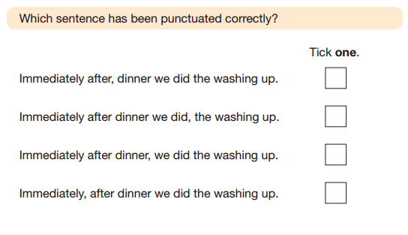
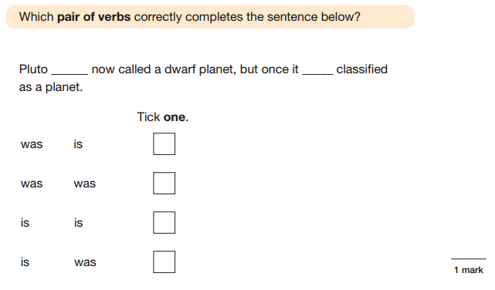
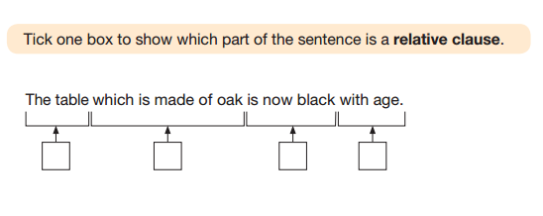
Sample GPS Questions
Notes:
Class teacher

Slide 31
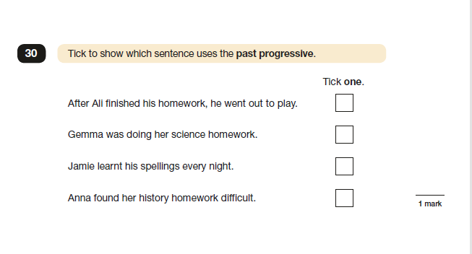
Sample GPS Questions
Notes:
Class teacher

Slide 32
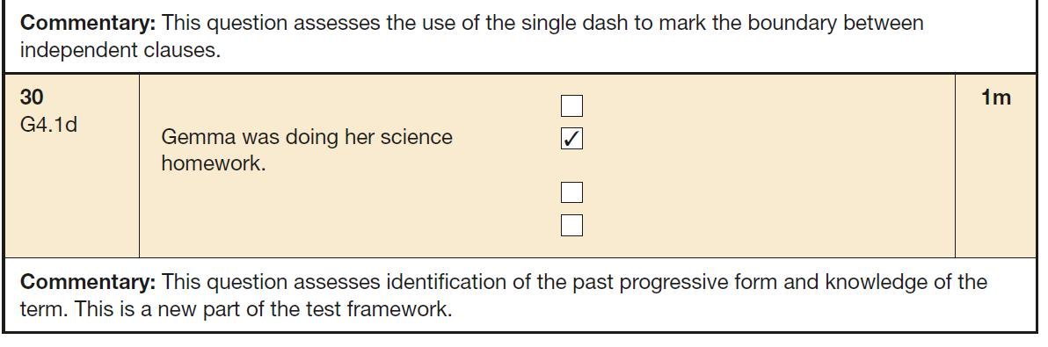
Sample GPS Questions
Notes:
Class teacher

Slide 33
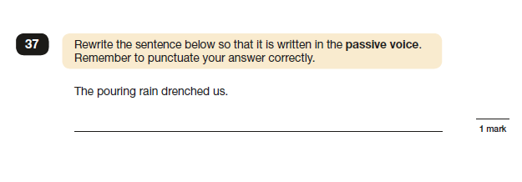
Sample GPS Questions
Notes:
Class teacher

Slide 34
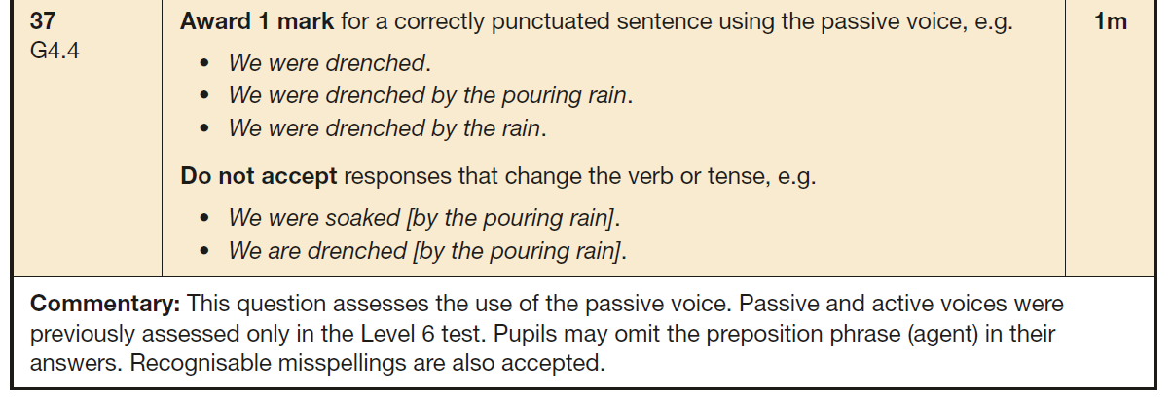
Sample GPS Questions
Notes:
Class teacher

Slide 35
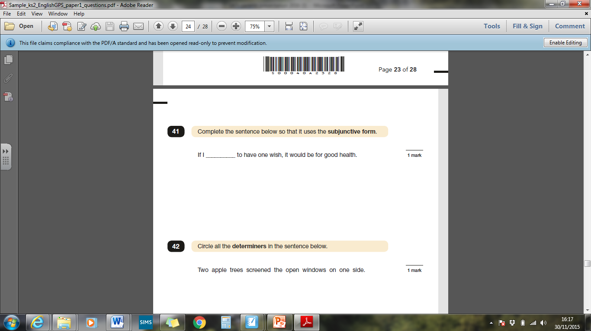
Sample GPS Questions
Notes:
Class teacher

Slide 36
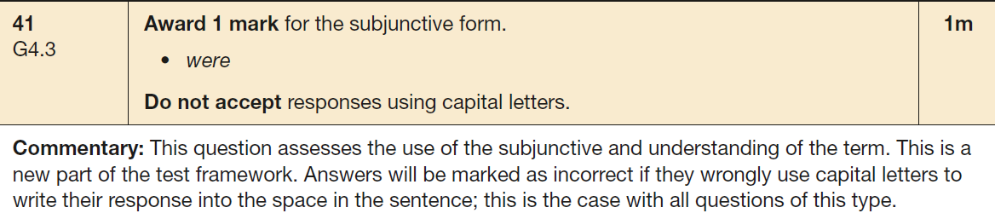
Sample GPS Questions
Notes:
Class teacher

Slide 37
Sample GPS Questions
Notes:
Class teacher

Slide 38
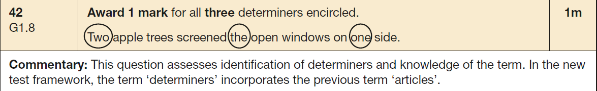
Sample GPS Questions
Notes:
Class teacher

Slide 39
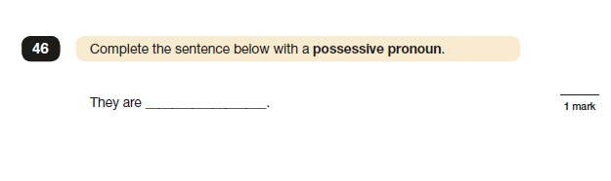
Sample GPS Questions
Notes:
Class teacher

Slide 40
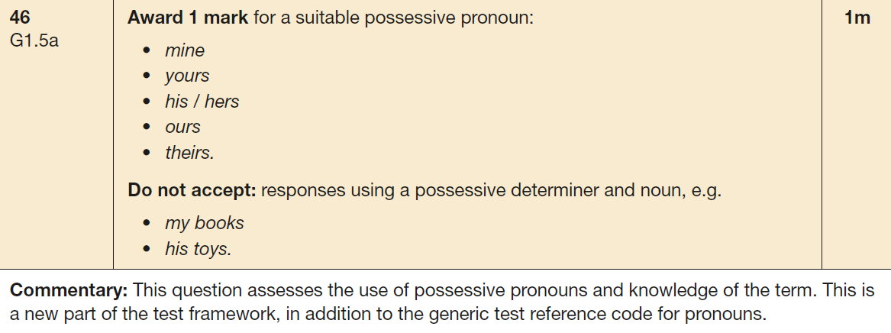
Sample GPS Questions
Notes:
Class teacher

Slide 41
Writing Assessments
There is no written ‘test’ as such.
Writing judgements are based on teacher assessment only but may be moderated by local authority representatives.
Throughout the year we have been, and will continue to, assess the children’s writing.
This continues until the end of the year.
Moderation of work is very likely this year.

Slide 42
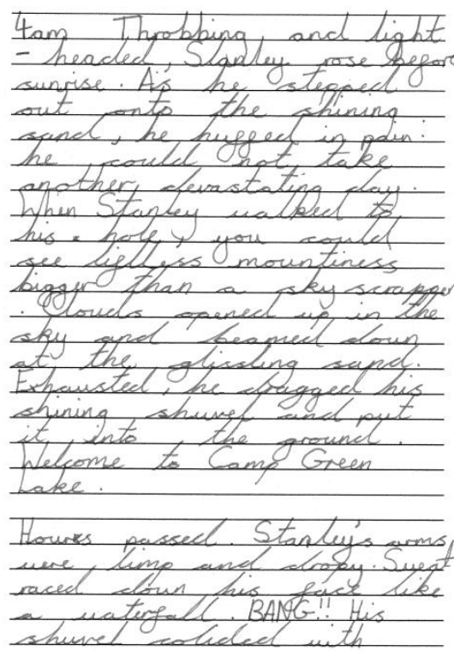

Slide 43
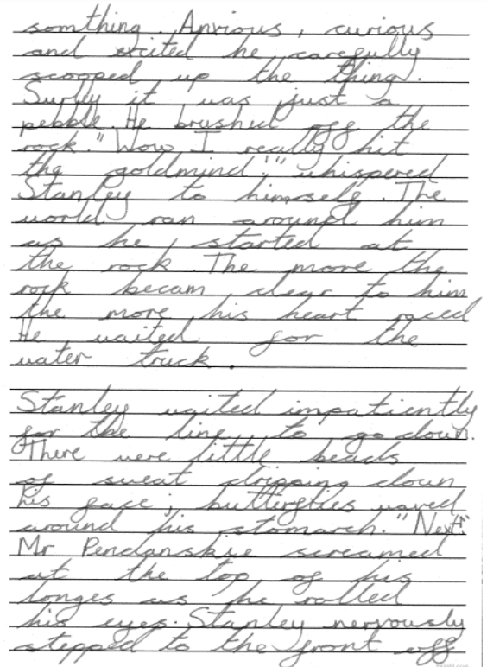

Slide 44
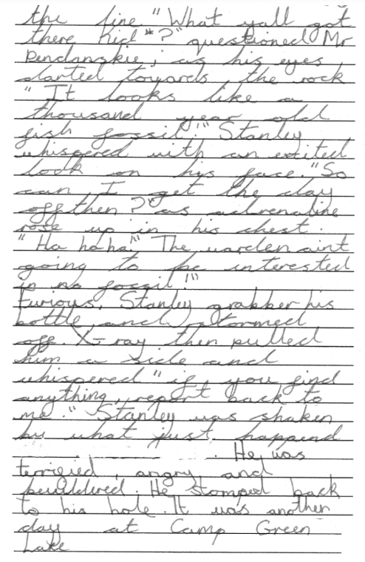

Slide 45
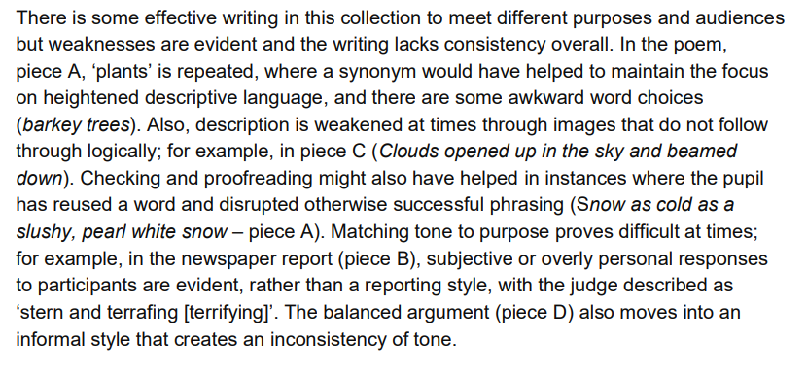



Slide 46
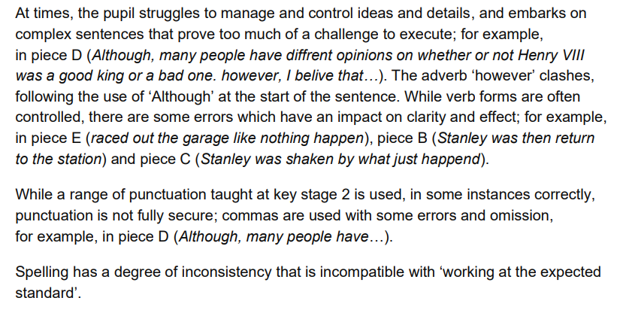

Slide 47
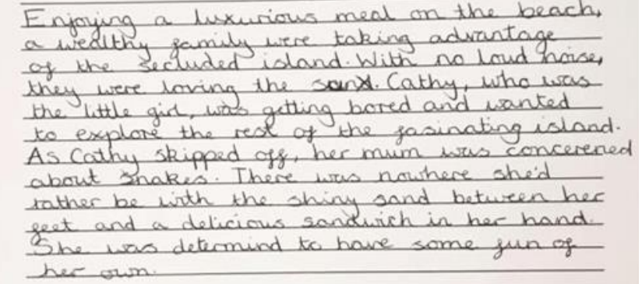

Slide 48
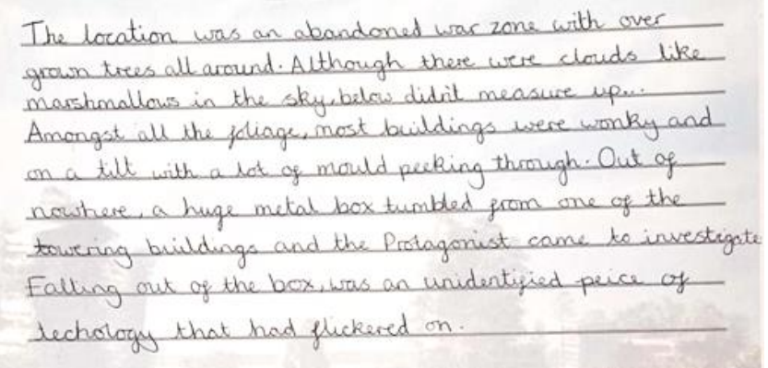

Slide 49
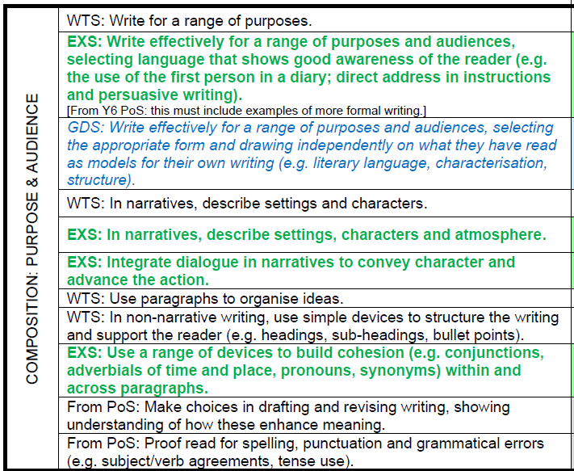

Slide 50
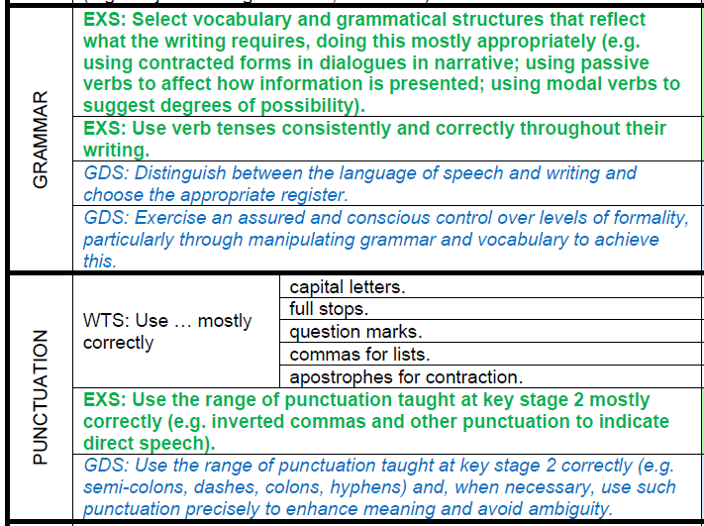

Slide 51
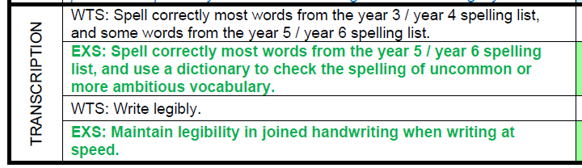

Slide 52
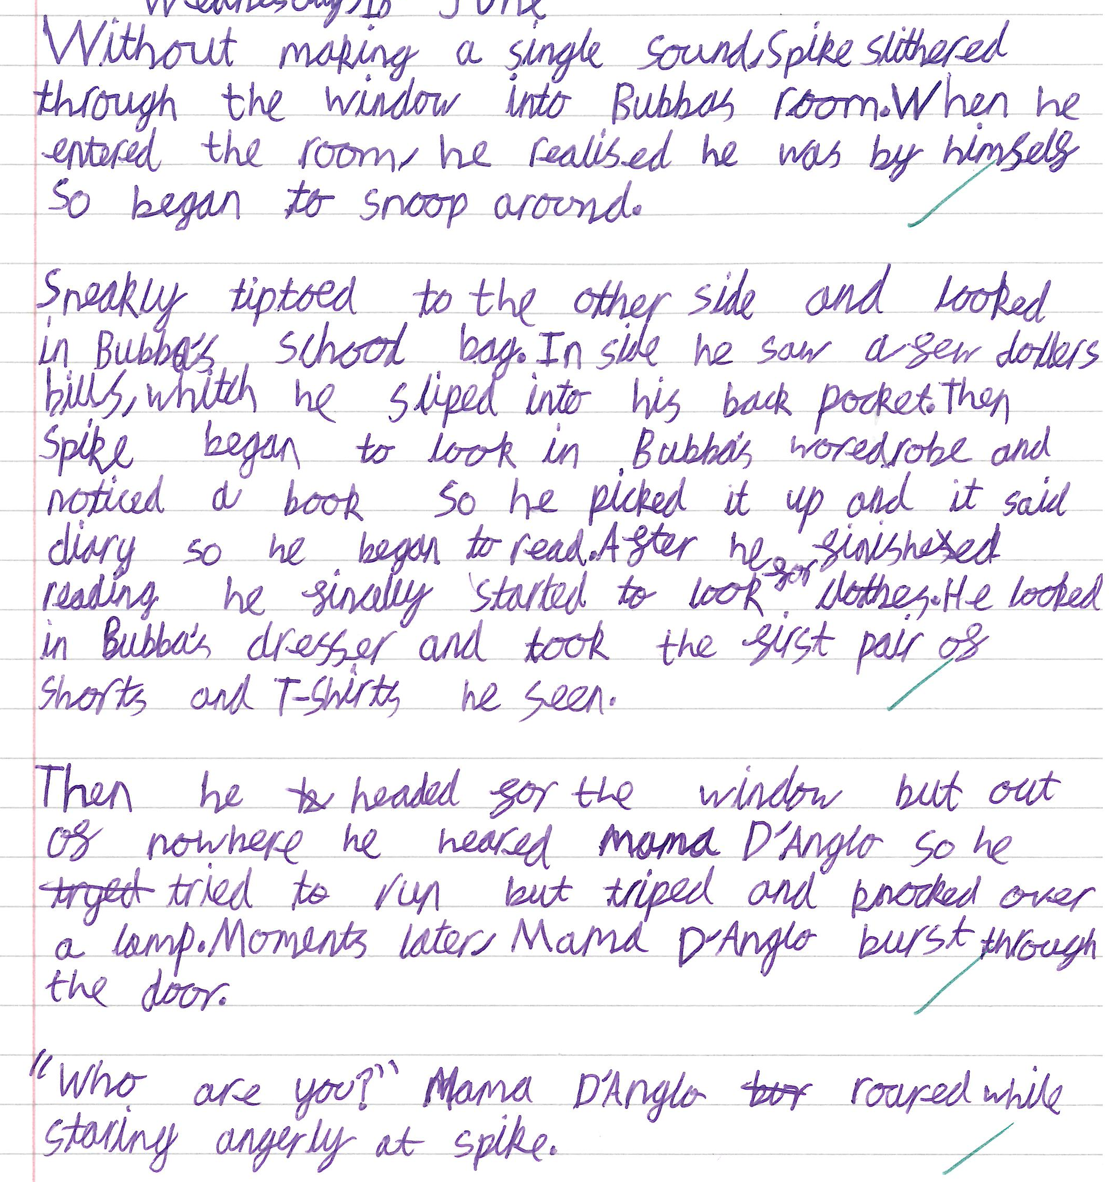

Slide 53
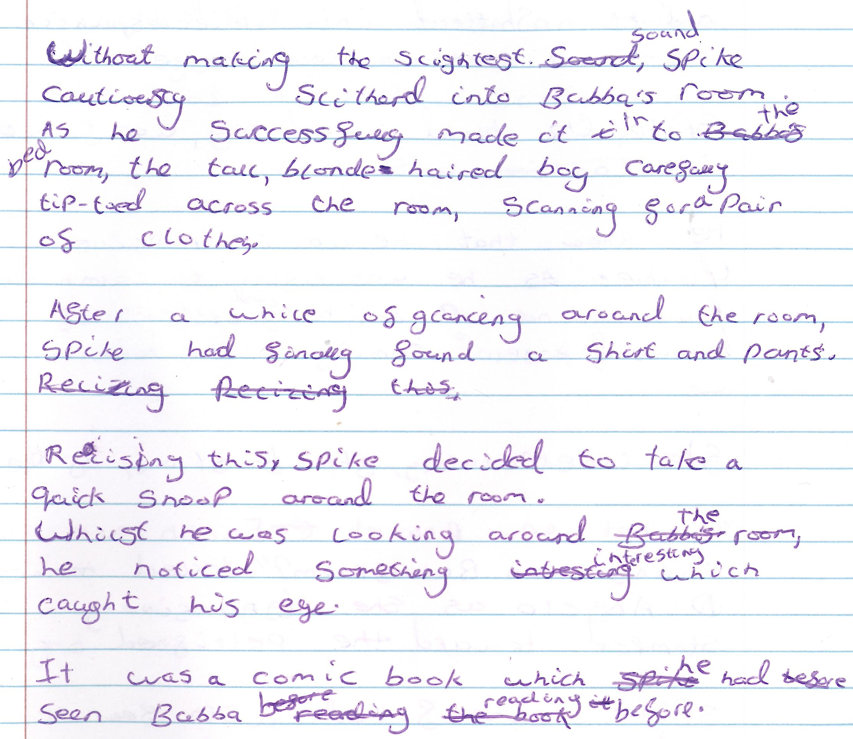

Slide 54
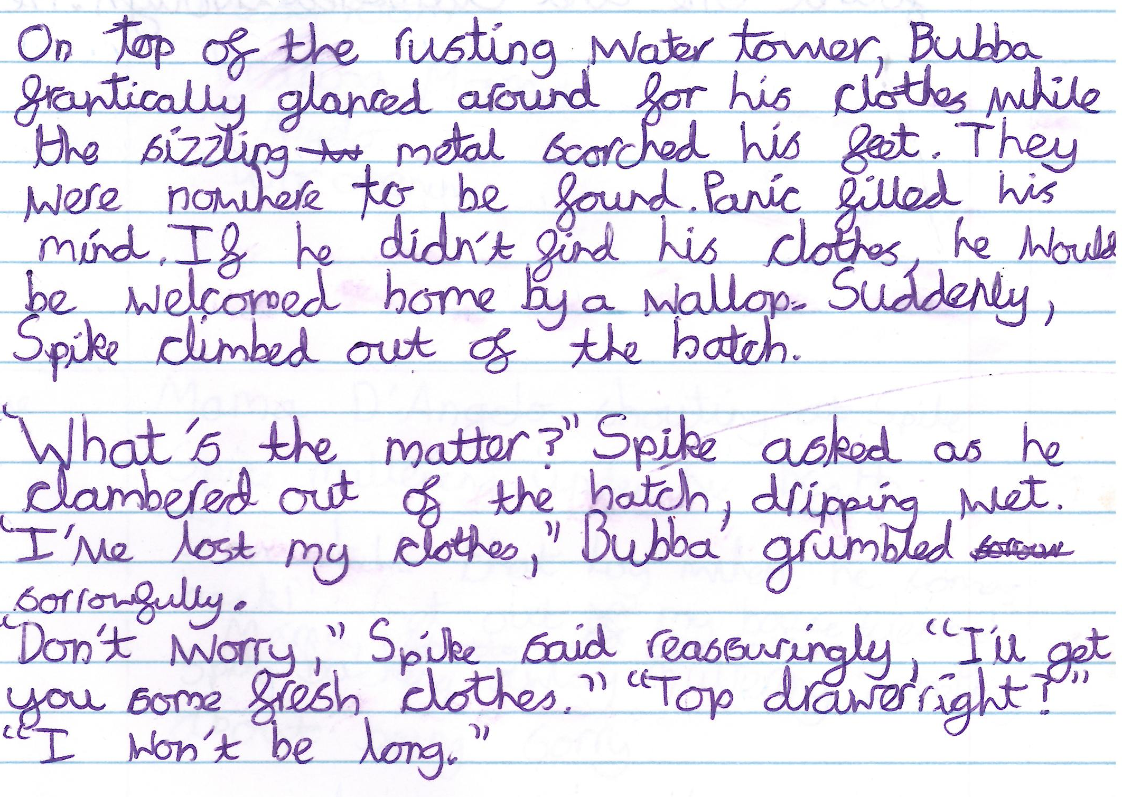

Slide 55
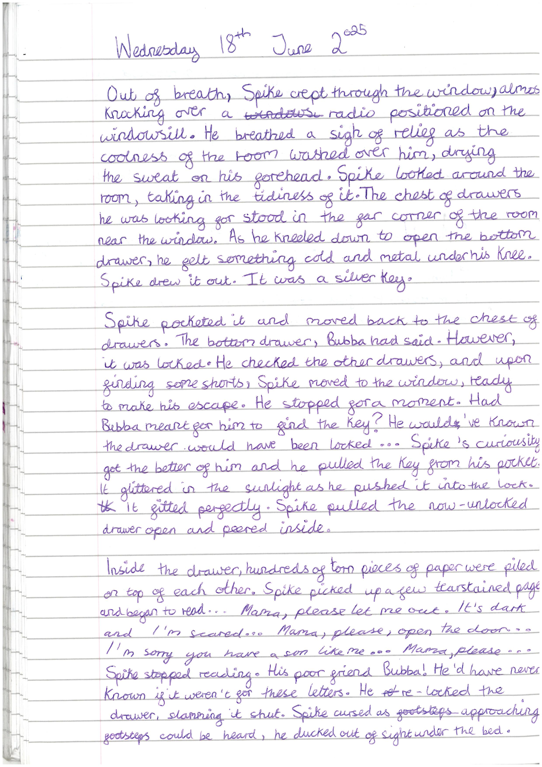

Slide 57
Receiving their results
For the Reading, GPS and Mathematics tests you will receive:
a scaled score
confirmation of whether or not they attained the national standard
For writing you will be told if your child is:
Expected - the expected range of attainment for his/her age
Greater Depth - working beyond the expected standard
Working towards – had some but not all elements of expected standard
Notes:
As well as the teacher assessment for the reading, writing and gps in the same language as writing

Slide 58
What Can You Do at Home to Help Your Child
http://www.lovelearnlaugh.org.uk/
Check downloadable documents available on Y5/6 class page
Maths – times tables, learning key facts
Reading – regular reading of varied texts and genres
Notes:
Class teacher

Slide 59
What Can You Do at Home to Help Your Child
During SATs week
They are well rested
Drink plenty of water
Make sure that they are relaxed and confident about the tests.
Encourage them to ask the adult in the room if they would like something read to them during the tests
Explain that the Tests are a way of showing what they know, not of catching them out.
Notes:
Class teacher

