Slide 1


Diary dates
PE days: Tuesday (inside) and Friday (outside)
Spelling test: Tuesday
Homework/reading diaries: Friday
3/4GG newsletter – Summer 1
Geography
We will answer the following questions during our geography lessons:
How can our food choices impact the environment?
What does it mean to trade responsibly?
How do we get our chocolate?
Where does our food come from?
Are our school dinners locally sourced?
Is it better to buy local or imported food?
English
Historical recount – Shackleton’s journey
Organisational features of recounts such as an instruction, chronological structure and clear sequencing.
Describing events clearly with detail drawn from historical sources.
Expanded noun phrases to describe.
Conjunctions to show cause, contrast and sequence.
Fronted adverbials followed by commas.
Paragraphs to organise content.
Innovated narrative – Weslandia
Range of sentence types within a narrative.
Describe settings and characters.
Use of consistent tense.
Create settings, characters and plot.
Use Standard English.
Speech punctuated with inverted commas.
Maths
During maths lessons, we will learn how to:
Convert fractions into decimals
Divide one-digit numbers by 10
Divide 2-digit numbers by 10
Show 100ths as fractions and decimals
Compare decimals
Round decimals to the nearest whole number
Write money using decimals
Compare, estimate and calculate with money
Convert between analogue and digital times
Convert to and from the 24 hour clock
This term’s times table focus: revision of all times tables in preparation for the Multiplication Check.
Science
Classification and changing habitats
Grouping living things: vertebrates and invertebrates
Grouping living things: plants
Classification keys
Habitats and seasonal change
Human impacts on habitats
Natural changes to habitats
PSHE
During PSHE lessons, we will focus on:
Setting goals
Describing key actions needed to achieve goals
Identifying any help needed to achieve goals
Staying safe outside the home
RE
We will answer these questions during RE this term:
What does a journey mean to us?
What is the significance of Baptism to Christians?
How do Jewish people mark becoming an adult?
Art
We will study the work of Bridget Riley. We will create patterns, develop use of colour, and create art work by weaving different materials.

Slide 2
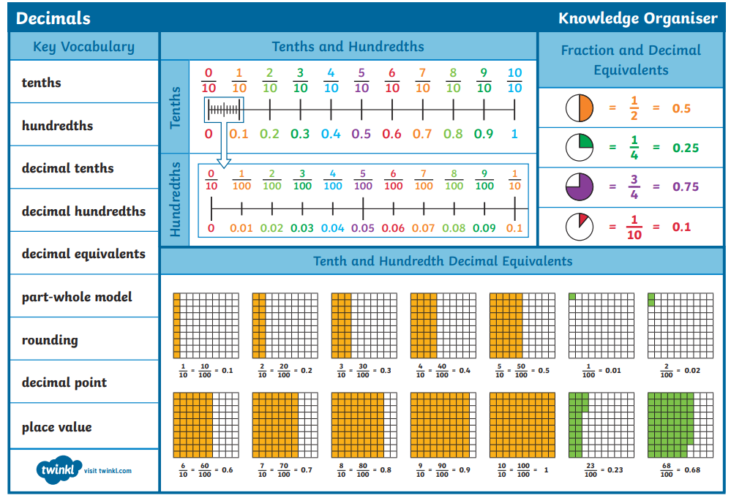
Maths knowledge organiser

Slide 3
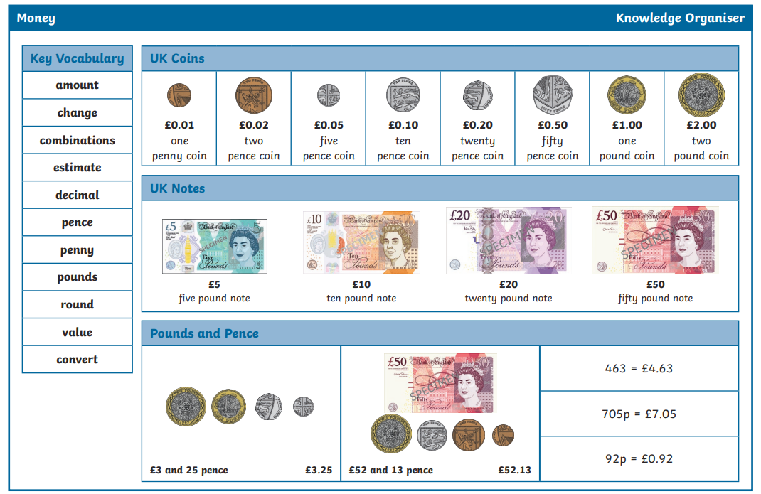

Slide 4
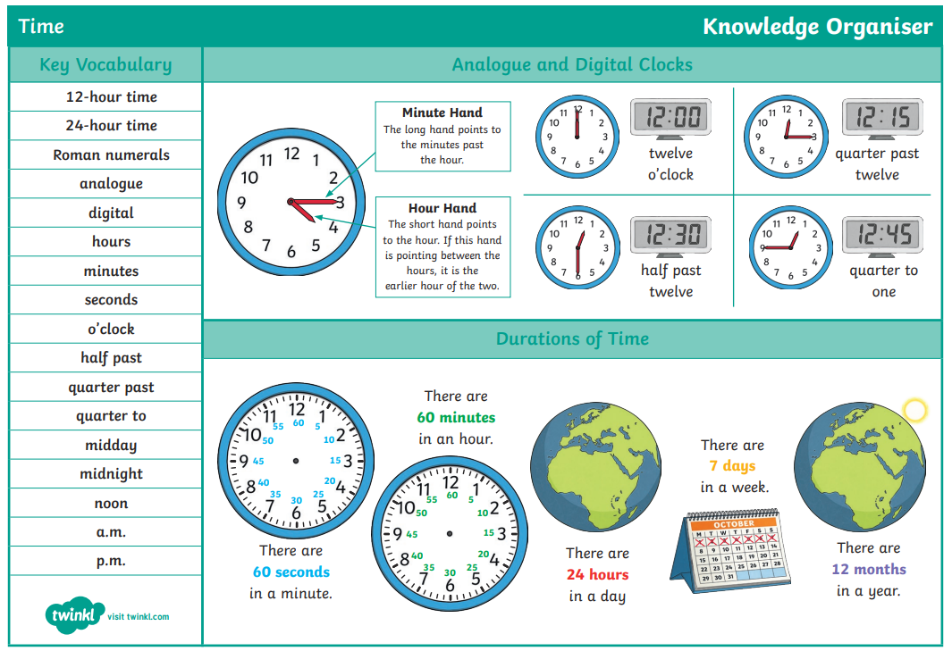

Slide 5
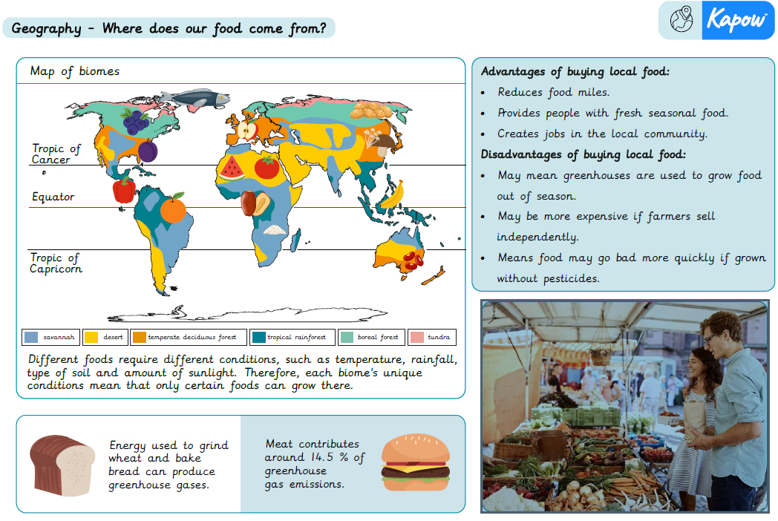

Slide 6
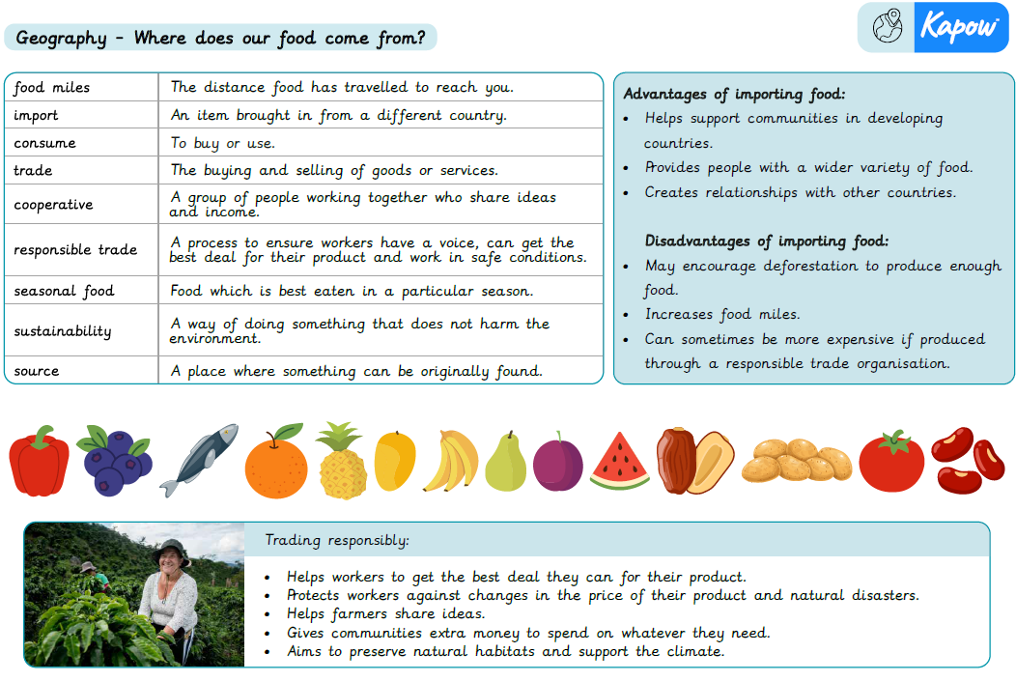

Slide 7
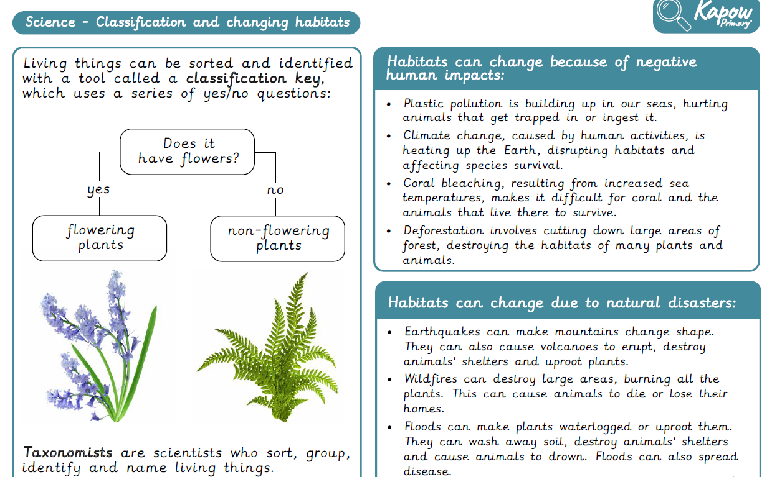

Slide 8
