Slide 1
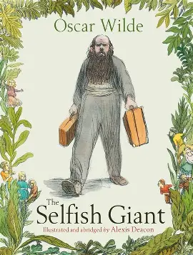
Diary dates
Forest School – Tuesday AM
PE days - Friday (outside)
Spelling test - Thursday
Homework and reading diaries – Friday
3/4GG newsletter – Spring 2
History
We will answer the following questions during history this term:
When and where did the Ancient Maya live?
What do we know about Ancient Maya cities?
What did the Ancient Maya believe and how did they worship?
How did the Ancient Maya feed their people?
How do we know that the Ancient Maya could read, write and do complex maths?
What happened to the Ancient Maya?
English
We will retell a story from a different perspective.
During lessons, we will focus on:
Punctuating direct speech accurately.
Using a range of reporting clauses.
Using paragraphs to create cohesion.
Creating developed settings, characters and plots in narratives.
Using fronted adverbials to vary sentence openings.
Maths
During maths lessons, we will learn how to:
Count in fractions beyond 1.
Partition mixed numbers.
Place mixed numbers on number lines.
Compare and order mixed numbers.
Understand improper fractions.
Convert mixed numbers to improper fractions/
Convert improper fractions into mixed numbers.
Add fractions.
Subtract fractions.
Convert fractions into decimals.
Divide one-digit numbers by 10.
Divide 2-digit numbers by 10.
Show 100ths as fractions and decimals.
This term’s times table focus: square numbers.
RE
We will answer these questions during RE this term:
Who did Jesus say he was? Why is he so important to Christians?
Why do Christians call the day Jesus died ‘Good Friday’ and the following Sunday his Resurrection day?
Is Jesus still important today? Why? Who to? How does it show?
What kind of image of Jesus for the 21st Century would pupils like to create? Might it be inspiring to others
Does being inspired by Jesus make a person stronger?
Who is inspiring for me? Who is inspiring for other children in my class?
Science – Sound and vibrations
Vibrations – describing how sounds are made.
Sound waves – describing how sounds are heard.
Volume – the relationship between vibration strength and volume.
Pitch – describing pitch and how to change it.
Sound insulation – explain how insulting materials can be used to muffle sound.
DT
We will explore products with different fastenings. We will develop our sewing skills. We will apply these skills to design and make a fabric book cover.
PSHE
We will be learning how to relate and get along well with others. We will focus on developing good relationships and celebrating differences.

Slide 2
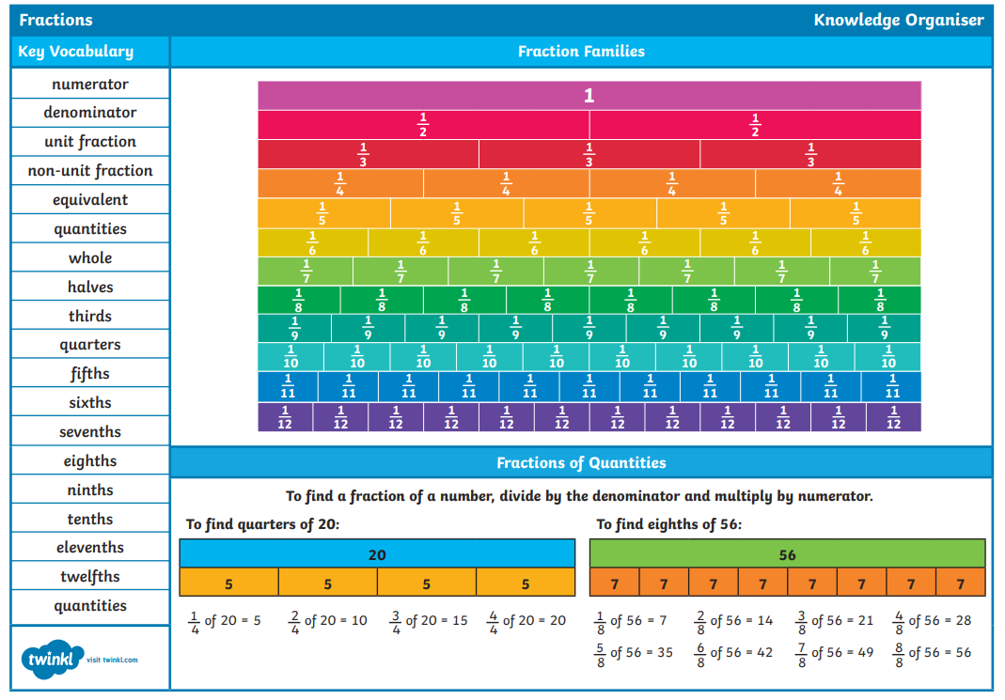
Maths knowledge organiser

Slide 3
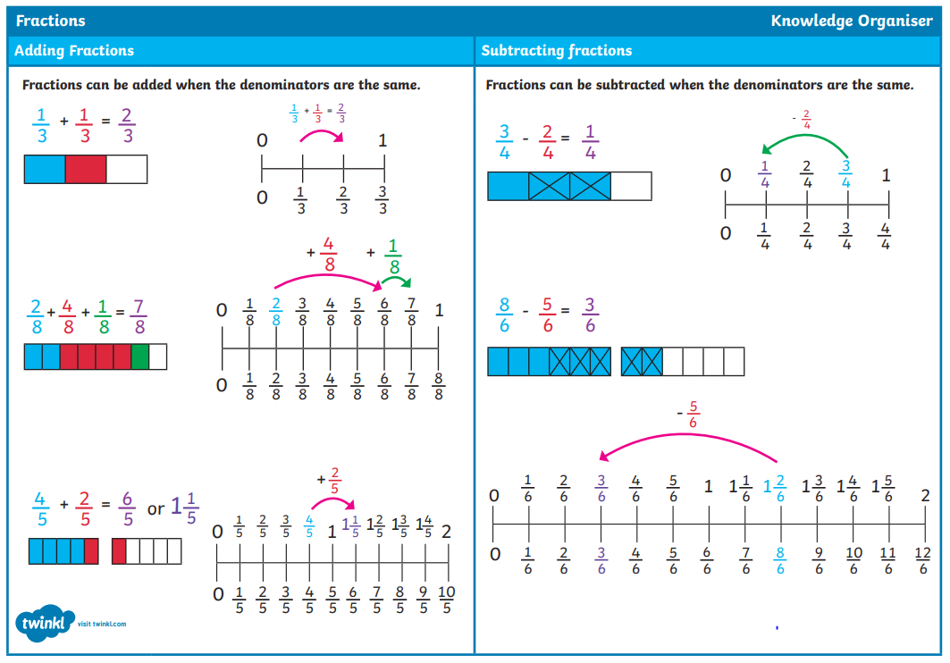

Slide 4
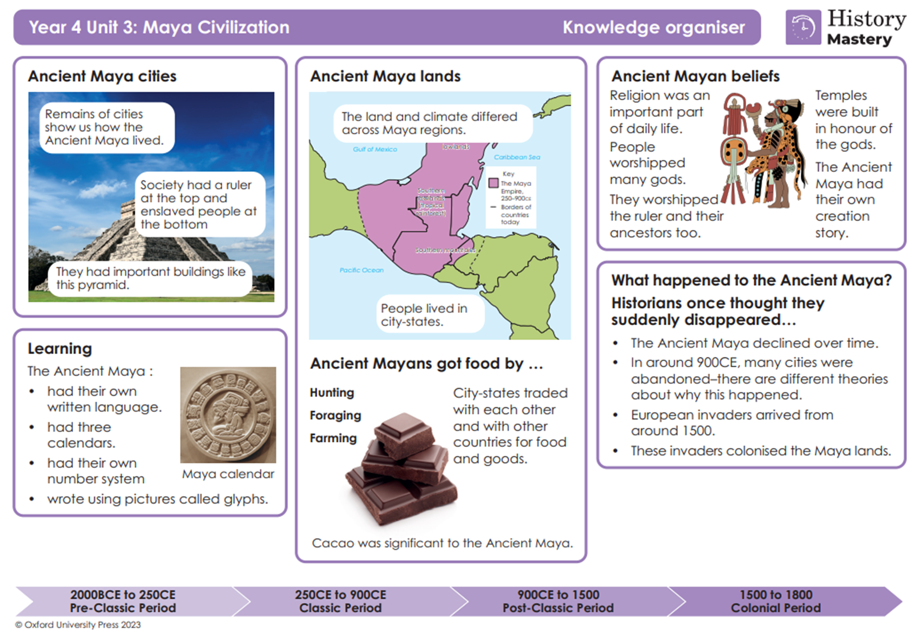

Slide 5
