Slide 1

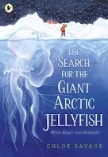
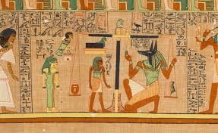

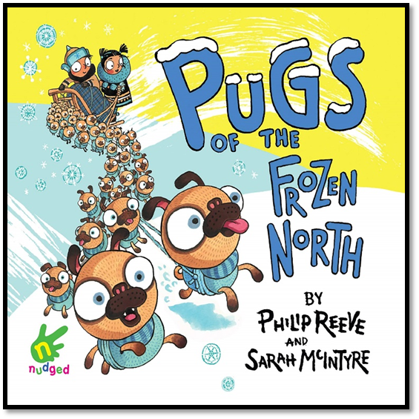
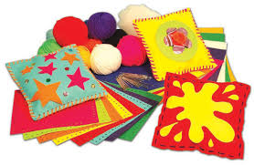
3CH Newsletter Spring 2 2025-2026
We hope you had a lovely rest over the half term holiday.
We have a busy half term finishing a couple of last half term’s lessons before beginning all the great learning we’ve got planned for this second spring term.
Spellings and homework will continue to be set on a Tuesday and tested / marked the following Tuesday.
All spellings will be set on Edshed where children can play games to help them practise (new passwords in reading diaries).
Please continue to read every day and use TTRS and Nessy (if your child has been given a password for this intervention).
PE will be on a Monday and forest school sessions on a Tuesday (all afternoon).
Our class assembly will be at 9:10am on Monday 16th March 2026.
Maths: Length and Perimeter Converting measurements (mm, cm and m), finding equivalent lengths (adding and subtracting), measuring and calculating perimeters.
Fractions A Identifying and representing unit and non‑unit fractions, compare and order them, and understand how the numerator and denominator describe parts of a whole. Fractions on number lines, counting in steps of fractions, and beginning to recognise simple equivalent fractions using bar models and diagrams.
English: We will continue our work using ‘The Last Garden’ text. We will be writing an alternative ending before moving onto ‘The Search for the Giant Artic Jellyfish’. We will be looking at and writing a non-chronological report based on an endangered species from the Amazon rainforest. Throughout these units, we will be using expanded noun phrases, fronted adverbials, conjunctions and organising our writing into paragraphs
History: Ancient Egypt
(See knowledge mat and lesson overview for coverage)
Science: Light and Shadows We will exploring the link between light and darkness, observing reflections and investigating different factors that affect shadows.
RE: What do different people believe about God?
(See knowledge mat for whole spring term)
Guided Comprehension:
(Whole spring term)
Computing: Children will develop their understanding of what a branching database is and how to create one. They will use yes/no questions to gain an understanding of what attributes are and how to use them to sort groups of objects. They will also create physical and on-screen branching databases. They will also consider real-world applications for branching databases.
PSHE/myHappymind: Relate Module
Friendships
Families and close positive relationships
DT: We will be looking at a variety of cushions to see how they are made. Then we will practise a running stitch and a cross stitch before designing, making and evaluating our own cushions.

Slide 2
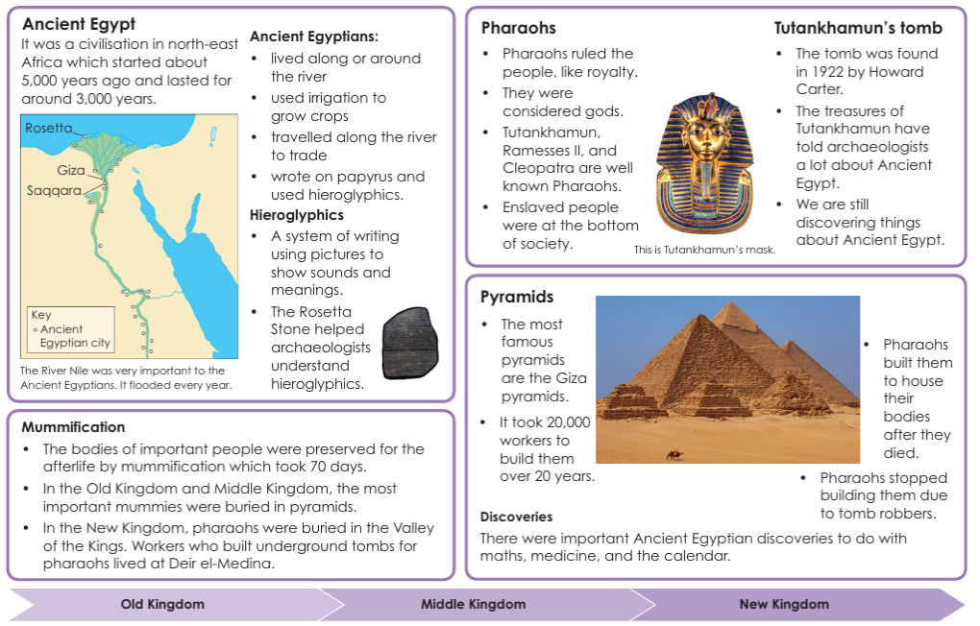


Slide 3
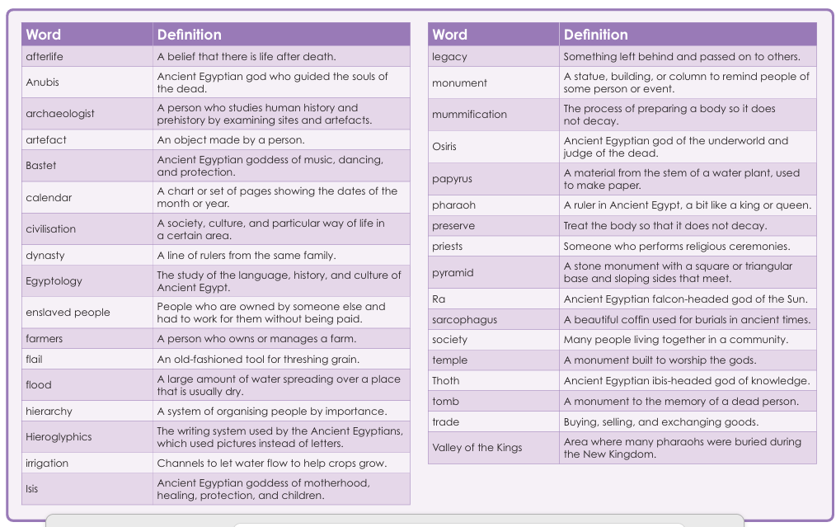

Slide 4
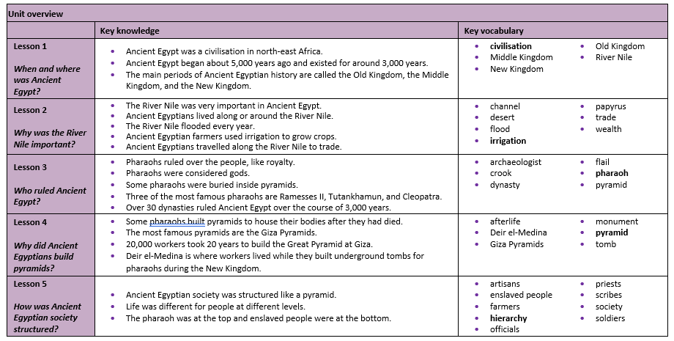

Slide 5
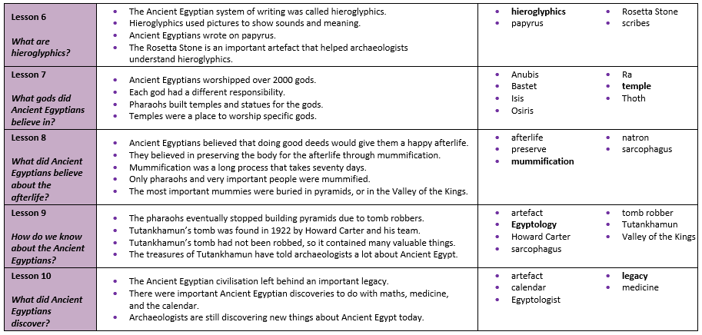

Slide 6
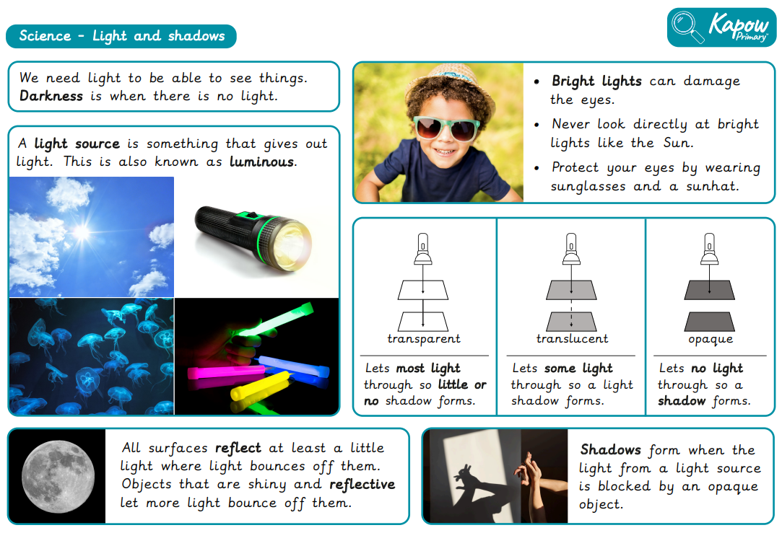

Slide 7
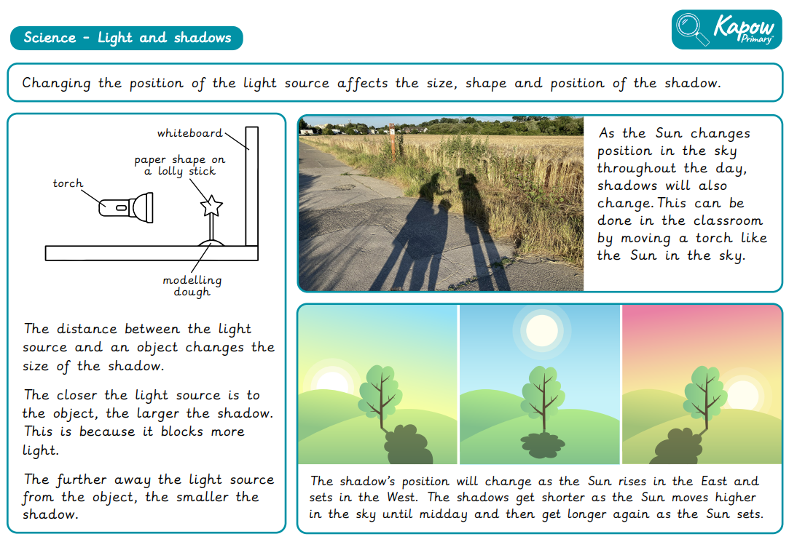

Slide 8
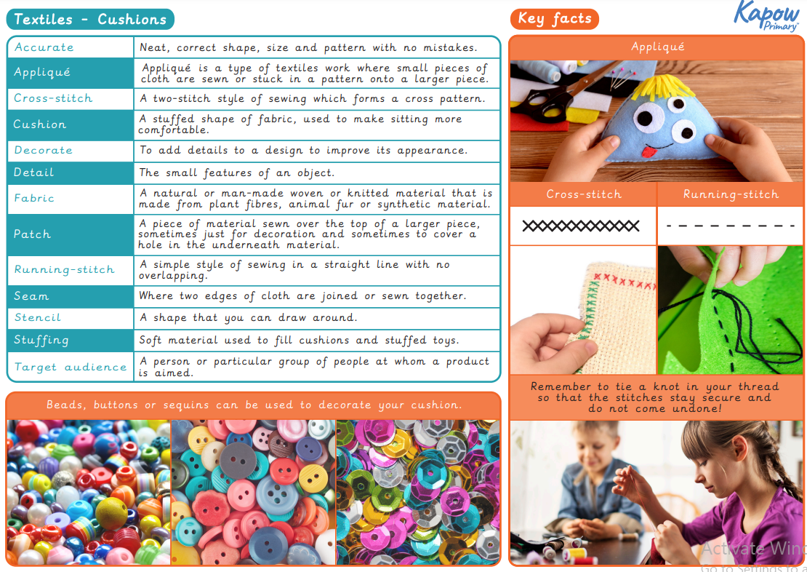

Slide 9
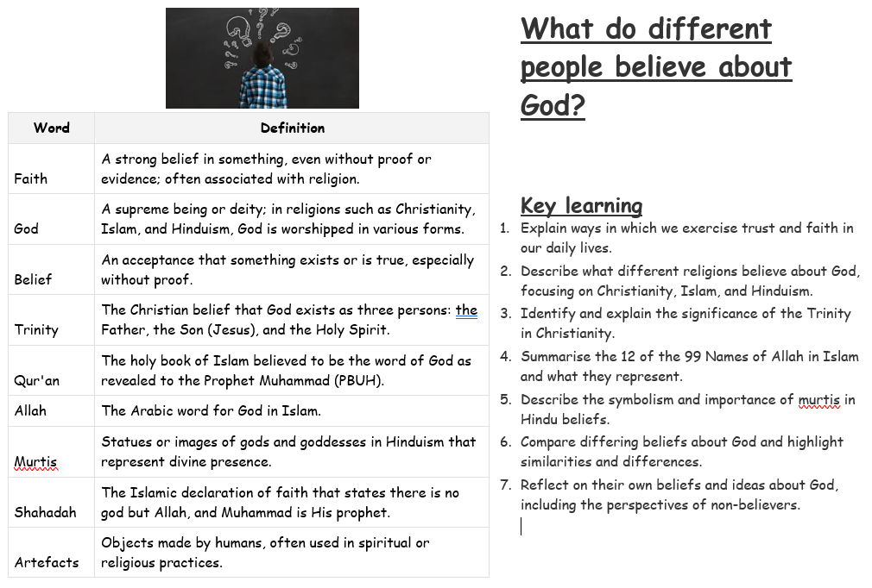

Slide 10
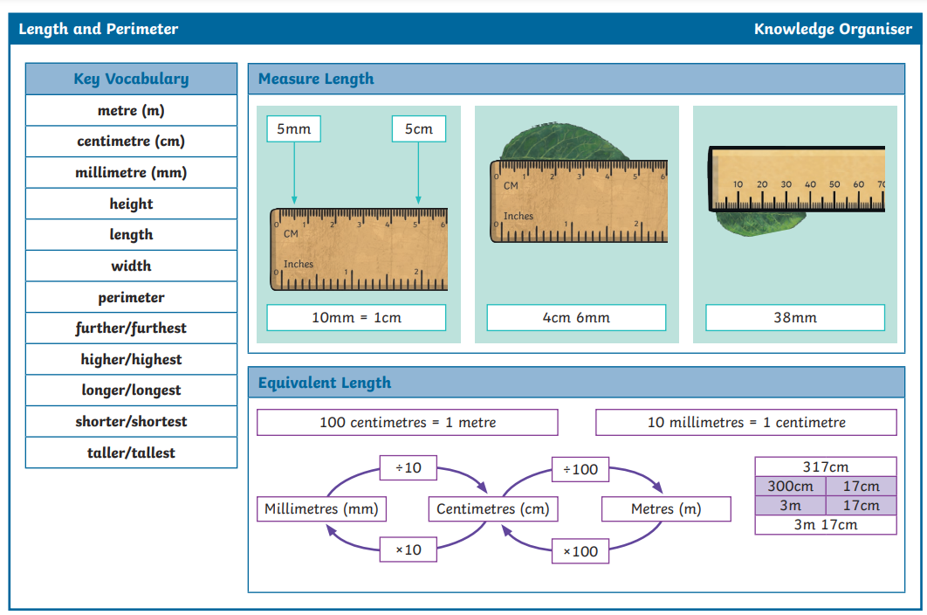

Slide 11
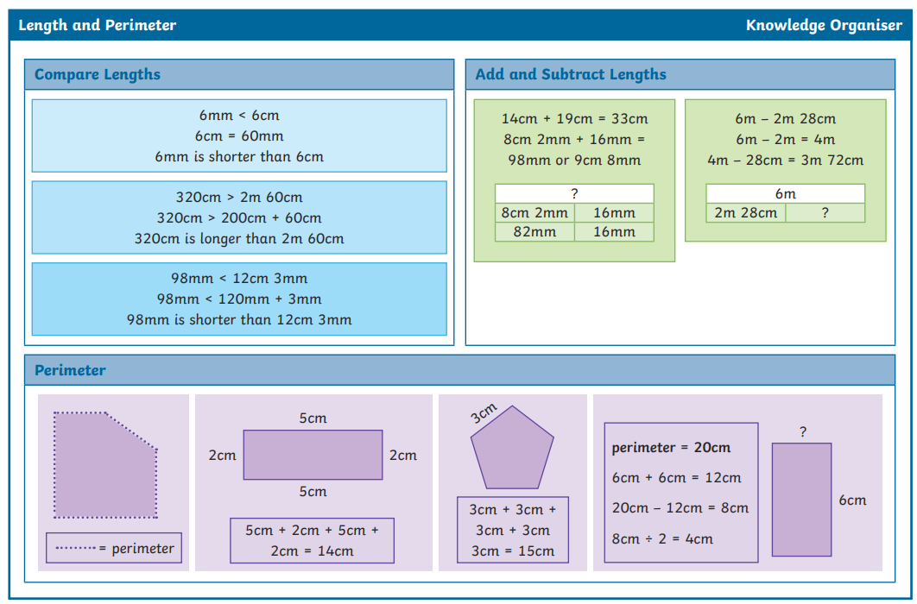

Slide 12
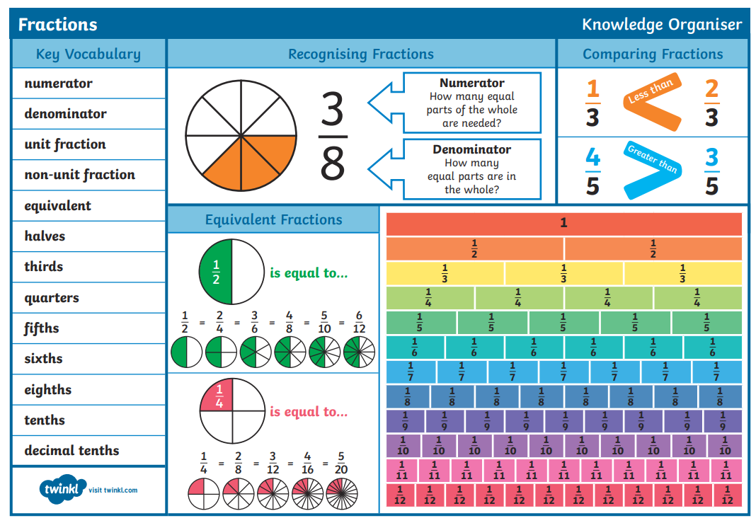

Slide 13
